Slide 1
Paging

Slide 2
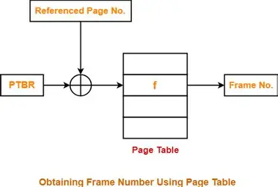

Slide 3
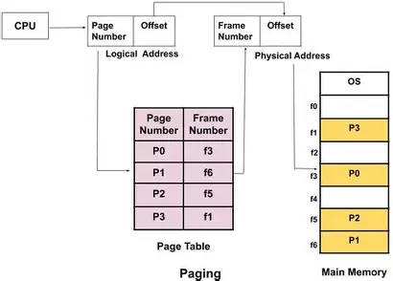

Slide 4
Main Memory
Physical Address Space = Size of main memory
Size of main memory = Total number of frames x Page size
Frame size = Page size
If number of frames in main memory = 2^{X}, then number of bits in frame number = X bits
If Page size = 2^{X} Bytes, then number of bits in page offset = X bits
If size of main memory = 2^{X} Bytes, then number of bits in physical address = X bits

Slide 5
Process
Virtual Address Space = Size of process
Number of pages the process is divided = Process size / Page size
If process size = 2^{X} bytes, then number of bits in virtual address space = X bits

Slide 6
Page Table
Size of page table = Number of entries in page table x Page table entry size
Number of entries in pages table = Number of pages the process is divided
Page table entry size = Number of bits in frame number + Number of bits used for optional fields if any

Slide 7
NOTE
In general, if the given address consists of ‘n’ bits, then using ‘n’ bits, 2^{n} locations are possible.
Then, size of memory = 2^{n} x Size of one location.
If the memory is byte-addressable, then size of one location = 1 byte.
Thus, size of memory = 2^{n} bytes.
If the memory is word-addressable where 1 word = m bytes, then size of one location = m bytes.
Thus, size of memory = 2^{n} x m bytes.

Slide 8
Problem-01
Calculate the size of memory if its address consists of 22 bits and the memory is 2-byte addressable.

Slide 9
Solution
Number of locations possible with 22 bits = 2²² locations
It is given that the size of one location = 2 bytes
Thus, Size of memory = 2²² x 2 bytes = 2²³ bytes = 8 MB

Slide 10
Problem-02:
Calculate the number of bits required in the address for memory having size of 16 GB. Assume the memory is 4-byte addressable.

Slide 11
Solution-
Let ‘n’ number of bits are required. Then, Size of memory = 2^{n} x 4 bytes.
Since, the given memory has size of 16 GB, so we have-
2^{n} x 4 bytes = 16 GB
2^{n} x 4 = 16 G
2^{n} x 2² = 2³⁴
2^{n} = 2³²
∴ n = 32 bits

Slide 12
Problem-03:
Consider a system with byte-addressable memory, 32 bit logical addresses, 4 kilobyte page size and page table entries of 4 bytes each. The size of the page table in the system in megabytes is _____.
2
4
8
16

Slide 13
Solution-
Given
Number of bits in logical address = 32 bits
Page size = 4KB
Page table entry size = 4 bytes
Process Size-
Number of bits in logical address = 32 bits
Thus,
Process size
= 2³² B
= 4 GB

Slide 14
Number of Entries in Page Table
Number of pages the process is divided
= Process size / Page size
= 4 GB / 4 KB
= 2²⁰ pages
Thus,
Number of entries in page table = 2²⁰ entries

Slide 15
Page Table Size
Page table size
= Number of entries in page table x Page table entry size
= 2²⁰ x 4 bytes
= 4 MB
Thus, Option (B) is correct.

Slide 16
Problem-04:
Consider a machine with 64 MB physical memory and a 32 bit virtual address space. If the page size is 4 KB, what is the approximate size of the page table?
16 MB
8 MB
2 MB
24 MB

Slide 17
Problem 05:
Consider a single level paging scheme. The virtual address space is 4 MB and page size is 4 KB. What is the maximum page table entry size possible such that the entire page table fits well in one page?

Slide 18
Solution
For page table, to fit well in one page, we must have-
Page table size <= Page size
Number of Pages of Process-
Number of pages = Process size / Page size
= 4 MB / 4 KB
= 2¹⁰ pages
Page Table Size-
Let page table entry size = B bytes -> Page table size = Number of pages x Page table entry
size
= 2¹⁰ x B bytes
According to the above condition, we must have-
2¹⁰ x B bytes <= 4 KB
2¹⁰ x B <= 2¹²
B <= 4
Thus, maximum page table entry size possible = 4 bytes.

Slide 19
Problem 06:
Consider a single level paging scheme. The virtual address space is 256 MB and page table entry size is 4 bytes. What is the minimum page size possible such that the entire page table fits well in one page?

Slide 20
Solution
For page table, to fit well in one page, we must have-
Page table size <= Page size
Let page size = B bytes.
Number of Pages of Process-
Number of pages = Process size / Page size
= 256 MB / B bytes
= 2²⁸ / B
Page Table Size-
Page table size = Number of pages x Page table entry size
= (2²⁸ / B) x 4 bytes
= (2³⁰ / B) bytes
Now,
According to the above condition, we must have-
(2³⁰ / B) bytes <= B bytes
B² >= 2³⁰
B >= 2¹⁵
Thus, minimum page size possible = 2¹⁵ bytes or 32 KB.

Slide 21
Segmented Paging Problem
A certain computer system has the segmented paging architecture for virtual memory. The memory is byte addressable. Both virtual and physical address spaces contain 2¹⁶ bytes each. The virtual address space is divided into 8 non-overlapping equal size segments. The memory management unit (MMU) has a hardware segment table, each entry of which contains the physical address of the page table for the segment. Page tables are stored in the main memory and consists of 2 byte page table entries. What is the minimum page size in bytes so that the page table for a segment requires at most one page to store it? Also
give the division of virtual address.

Slide 22
Solution
Virtual Address Space = Process size = 2¹⁶ bytes
Physical Address Space = Main Memory size = 2¹⁶ bytes
Process is divided into 8 equal size segments
Page table entry size = 2 bytes
Let page size = n bytes.
Now, since page table has to be stored into a single page, so we must have-
Size of page table <= Page size
Size of Each Segment
Size of each segment= Process size / Number of segments
2¹⁶ bytes / 8 = 2¹⁶ bytes / 2³ = 2¹³ bytes = 8 KB

Slide 23
Number of Pages Of Each Segment-
Number of pages in a segment = Size of segment / Page size = 8 KB / n bytes = (8K / n) pages
Size of Each Page Table
Size of each page table = Number of pages x 2 bytes = (8K / n) x 2 bytes = (16K / n) bytes
Page Size
Substituting values in the above condition, we get (16K / n) bytes <= n bytes
(16K / n) <= n
n² >= 16K
n² >= 2¹⁴
n >= 2⁷
Thus, minimum page size possible = 2⁷ bytes = 128 bytes.

Slide 24
Number of Bits Required For Segment Number-
Number of segments = 8 = 2³
Thus, Number of bits required to identify a particular segment in segment table = 3 bits.
Number of Bits Required For Page Number-
Number of pages in a segment = Segment size / Page size = 8KB / 128 bytes
= 2¹³ bytes / 2⁷ bytes = 2⁶ pages
Thus, Number of bits required to identify a particular page in table = 6 bits.
Number of Bits Required For Page Offset-
Page size = 128 bytes = 2⁷ bytes
Thus, Number of bits required for page offset = 7 bits.
Thus, virtual address is divided as-

Slide 25
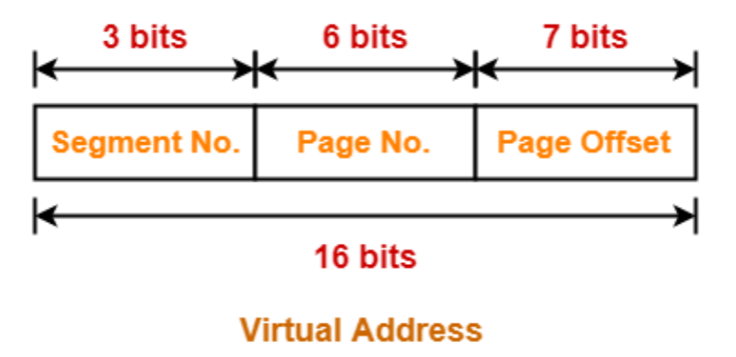

Slide 26
MultiLevel Paging
Need –
The need for multilevel paging arises when-
The size of page table is greater than the frame size.
As a result, the page table can not be stored in a single frame in main memory.
Working-
In multilevel paging,
The page table having size greater than the frame size is divided into several parts.
The size of each part is same as frame size except possibly the last part.
The pages of page table are then stored in different frames of the main memory.
To keep track of the frames storing the pages of the divided page table, another page table is maintained.
As a result, the hierarchy of page tables get generated.
Multilevel paging is done till the level is reached where the entire page table can be stored in a single frame.

Slide 27
Illustration of Multilevel Paging-
Consider a system using paging scheme where-
Logical Address Space = 4 GB
Physical Address Space = 16 TB
Page size = 4 KB
Now, let us find how many levels of page table will be required.
Number of Bits in Physical Address-
Size of main memory
= Physical Address Space
= 16 TB
= 2⁴⁴ B
Thus, Number of bits in physical address = 44 bits

Slide 28
Number of Frames in Main Memory-
Number of frames in main memory
= Size of main memory / Frame size
= 16 TB / 4 KB
= 2³² frames
Thus, Number of bits in frame number = 32 bits
Number of Bits in Page Offset-
We have,
Page size
= 4 KB
= 2¹² B
Thus, Number of bits in page offset = 12 bits

Slide 29
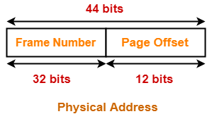
Alternatively,
Number of bits in page offset
= Number of bits in physical address – Number of bits in frame number
= 44 bits – 32 bits
= 12 bits
So, Physical address is-

Slide 30
Number of Pages of Process-
Number of pages the process is divided
= Process size / Page size
= 4 GB / 4 KB
= 2²⁰ pages
Inner Page Table Size-
Inner page table keeps track of the frames storing the pages of process.
Inner Page table size
= Number of entries in inner page table x Page table entry size
= Number of pages the process is divided x Number of bits in frame number
= 2²⁰ x 32 bits
= 2²⁰ x 4 bytes
= 4 MB

Slide 31
Now, we can observe-
The size of inner page table is greater than the frame size (4 KB).
Thus, inner page table can not be stored in a single frame.
So, inner page table has to be divided into pages.
Number of Pages of Inner Page Table-
Number of pages the inner page table is divided
= Inner page table size / Page size
= 4 MB / 4 KB
= 2¹⁰ pages
Now, these 2¹⁰ pages of inner page table are stored in different frames of the main memory.

Slide 32
Number of Page Table Entries in One Page of Inner Page Table-
Number of page table entries in one page of inner page table
= Page size / Page table entry size
= Page size / Number of bits in frame number
= 4 KB / 32 bits
= 4 KB / 4 B
= 2¹⁰
Number of Bits Required to Search an Entry in One Page of Inner Page Table-
One page of inner page table contains 2¹⁰ entries.
Thus,
Number of bits required to search a particular entry in one page of inner page table = 10 bits

Slide 34
Outer Page Table Size-
Outer page table is required to keep track of the frames storing the pages of inner page table.
Outer Page table size
= Number of entries in outer page table x Page table entry size
= Number of pages the inner page table is divided x Number of bits in frame number
= 2¹⁰ x 32 bits
= 2¹⁰ x 4 bytes
= 4 KB
Now, we can observe-
The size of outer page table is same as frame size (4 KB).
Thus, outer page table can be stored in a single frame.
So, for given system, we will have two levels of page table.
Page Table Base Register (PTBR) will store the base address of the outer page table.

Slide 35
Number of Bits Required to Search an Entry in Outer Page Table-
Outer page table contains 2¹⁰ entries.
Thus,
Number of bits required to search a particular entry in outer page table = 10 bits

Slide 36
