Slide 1
Disk Management

Slide 2
File Descriptor Table, System File Table, in-memory Inode Table

Slide 3
Contd..
The system file table, which is shared by all the processes in the system, has an entry for each active open.
Each system file table entry contains the file offset, an indication of the access mode (i.e., read, write or read-write) and a count of the number of file descriptor table entries pointing to it.
Several system file table entries may correspond to the same physical file. Each of these entries points to the same entry in the in-memory inode table.
The in-memory inode table contains an entry for each active file in the system.
When a program opens a particular physical file that is not currently open, the call creates an entry in this inode table for that file.

Slide 4
System File Table Shared Entry

Slide 5
Question?
Suppose a process opens a file for reading and then forks a child process. Both the parent and child can read from the file. How are reads by these two processes related? What about writes?

Slide 6
System File Table Different Entries

Slide 7
Structure of Typical UNIX File System

Slide 8
Unix File System

Slide 9
Directory Access
#include <dirent.h>
DIR *opendir(const char *dirname);
struct dirent *readdir(DIR *dirp);
int closedir(DIR *dirp);
void rewinddir(DIR *dirp);

Slide 10
#include <dirent.h>
#include <errno.h>
#include <stdio.h>
int main(int argc, char *argv[]) {
struct dirent *direntp;
DIR *dirp;
if (argc != 2) {
fprintf(stderr, "Usage: %s directory_name\n", argv[0]);
return 1;
}
if ((dirp = opendir(argv[1])) == NULL) {
perror ("Failed to open directory");
return 1;
}
while ((direntp = readdir(dirp)) != NULL)
printf("%s\n", direntp->d_name);
while ((closedir(dirp) == -1) && (errno == EINTR)) ;
return 0;
}

Slide 11
Accessing File Status Information
#include <sys/stat.h>
int lstat(const char *restrict path, struct stat *restrict buf);
int stat(const char *restrict path, struct stat *restrict buf);

Slide 12
Inode Structure

Slide 13
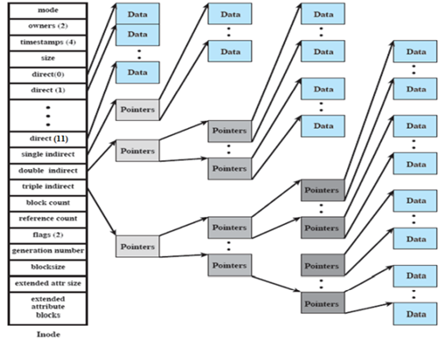

Slide 14
Exercise
Suppose that an inode is 128 bytes, pointers are 4 bytes long, and the status information takes
up 68 bytes. Assume a block size of 8K bytes and block pointers of 32 bits each. How much
room is there for pointers in the inode? How big a file can be represented with direct pointers?
Indirect? Double indirect? Triple indirect?

Slide 15
Solution
The single, double, and triple indirect pointers take 4 bytes each, so 128 - 68 - 12 = 48 bytes
are available for 12 direct pointers. The size of the inode and the block size depend on the
system. A file as large as 8192 x 12 = 98, 304 bytes can be represented solely with direct
pointers. If the block size is 8K bytes, the single indirect pointer addresses an 8K block that can
hold 8192 ÷ 4 = 2048 pointers to data blocks. Thus, the single indirect pointer provides the
capability of addressing an additional 2048 x 8192 = 16, 777, 216 bytes or 16 megabytes of
information. Double indirect addressing provide 2048 x 2048 pointers with the capability of
addressing an additional 32 gigabytes. Triple indirect addressing provides 2048 x 2048 x 2048
pointers with the capability of addressing an additional 64 terabytes. However, since 20483 =
233, pointers would need to be longer than 4 bytes to fully address this storage.

