Slide 1
Interprocess Communication in Linux
Unnamed Pipes, Named Pipes (FIFOs), and Redirection

Slide 2
What is IPC?
Communication between processes
Ensures data exchange & synchronization
Linux provides: Pipes, FIFOs, Shared Memory, Sockets

Slide 3
Pipes
Shell pipelines are a common way to move data between programs, e.g.:
cat filename | grep “search_string”
Linux provides pipe() system call to allow direct inter-process communication
Command above relies on shell “pipelines” which do not necessarily use pipe()

Slide 4
Unnamed Pipes
Temporary, parent-child only
Half-duplex, FIFO
Created with pipe(fd)
Exists only in memory

Slide 5
Linux pipes
The Linux pipe() system call:
Allows anonymous (un- named) communication
Is unidirectional
Produces / consumes data through file syscalls write() and read()
Data stored in kernel via pipefs in virtual filesystem
Process A
Write FD
Pipe Imp.
Read FD
Process B

Slide 6
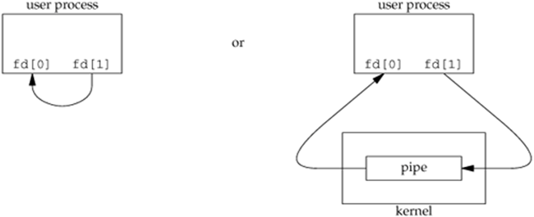
The pipe System Call
Syntax: int pipe(int fds[2])
Semantic
creates a pipe and returns two file descriptors fds[0] and fds[1]
a read from fds[0] accesses the data written to fds[1] (half-duplex, POSIX) and a read from fds[1] accesses the data written to fds[0] (full-duplex, non-standard, POSIX.1 allows).
pipe has limited size (64K in some systems) – write will block when pipe is full
Write to pipe with no reader (read end closed): broken pipe error
Read from a pipe with no writer (write end closed): end of file
man –s 2 pipe and man –s 7 pipe for more information

Slide 7
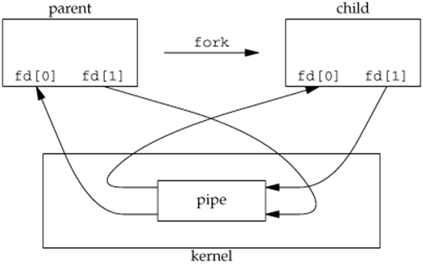
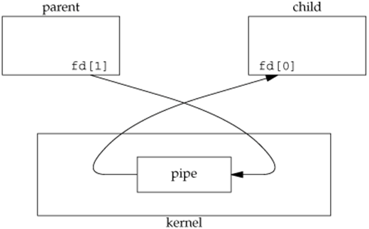
Pipe between Parent and Child Process
Half-duplex pipe after fork
Pipe from parent to child

Slide 8
Unnamed Pipe Example
int fd[2];
pipe(fd);
if(fork()==0){
close(fd[0]);
write(fd[1],"Hello",5);
}else{
close(fd[1]);
char buf[10];
read(fd[0],buf,10);
printf("%s\n",buf);
}

Slide 9
Named Pipes (FIFOs)
Special file in filesystem
Allows unrelated processes to communicate
Created with mkfifo

Slide 10

Named Pipes (FIFOs)
Named Pipes (also called FIFOs) are a special type of file used for process communication.
Unlike unnamed pipes, they have a name in the filesystem.
Allow unrelated processes (not sharing a parent-child relationship) to communicate.
Data is transmitted in a first-in, first-out (FIFO) manner.

Slide 11
Named Pipes (2)
Exist as special files (type: p when listed with ls -l).
Support half-duplex communication (data flows one way).
Data is buffered in kernel memory.
Can exist until deleted, unlike unnamed pipes that disappear when processes exit.
Access permissions and ownership are managed by the file system.

Slide 12
Redirection Basics
stdin (0), stdout (1), stderr (2)
Operators: >, <, >>, 2>, &>

Slide 13
Pipe and FIFO paradiagms
Linux pipes and FIFOs are useful to implement key design patterns and idioms:
Producer / Consumer
Client / Server
Active Object
Process A
Pipe
Process B
Process A
Process B
FIFO
Process D
Process C
Pipe
Process A
Process B
Pipe

Slide 14
Redirection Examples
ls > out.txt
sort < input.txt
ls | grep ".c" > cfiles.txt

Slide 15
Pipes vs Redirection
Pipe: process → process
Redirection: process → file

Slide 16
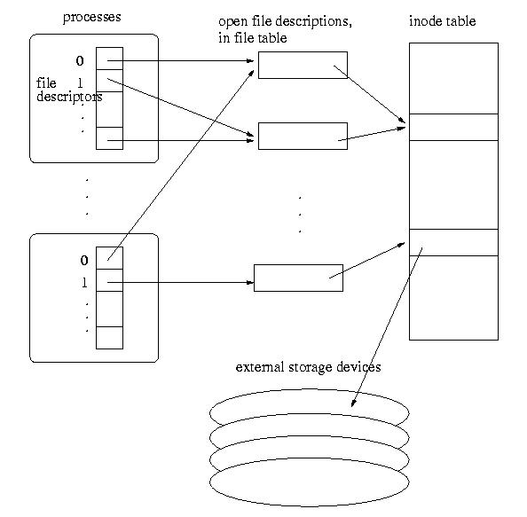
Data Structures for Open Files

Slide 17
Data Structures for Open Files
File descriptor table
Each process has a table.
nonnegative integer used to identify an entry in the open file table
The table size is limited, which limits the number of files that can be opened in a process
Open file table(System)
The whole system shares the table
The entries are called open file descriptions, which are records of how files are currently accessed.
File offset: the byte position in the open file description that decides where to access the file through the open file description.

Slide 18
I/O Redirection
All UNIX processes have three predefined files open: stdin, stdout, stderr. STDIN_FILENO (0), STDOUT_FILENO (1) and STDERR_FILENO (2).
Defined in <unistd.h>
We can redirect the I/O by manipulating these file descriptors.
Order enforcer: fflush();
Exercise: mycat.c
When happens when the end of file is reached in read?

Slide 19
The dup and dup2 System Calls
dup, dup2
Syntax
int dup(int oldfd)
int dup2(int oldfd, int newfd)
Duplicating the file descriptor in the process file descriptor table, sharing the same open file table
See example2.c
NOTE
Similarly, fork() will only duplicate file descriptor table, but not the system-wide open file table.

Slide 20
Redirection using Pipes
A program to execute the equivalent of ls -l | sort -n +4.
int main(void) {
pid_t childpid;
int fd[2];
if ((pipe(fd) == -1) || ((childpid = fork()) == -1)) {
perror("Failed to setup pipeline");
return 1;
}
if (childpid == 0) { /* ls is the child */
if (dup2(fd[1], STDOUT_FILENO) == -1)
perror("Failed to redirect stdout of ls");
else if ((close(fd[0]) == -1) || (close(fd[1]) == -1))
perror("Failed to close extra pipe descriptors on ls");
else {
execl("/bin/ls", "ls", "-l", NULL);
perror("Failed to exec ls");
}
return 1;
}
if (dup2(fd[0], STDIN_FILENO) == -1) /* sort is the parent */
perror("Failed to redirect stdin of sort");
else if ((close(fd[0]) == -1) || (close(fd[1]) == -1))
perror("Failed to close extra pipe file descriptors on sort");
else {
execl("/bin/sort", "sort", "-n", "+4", NULL);
perror("Failed to exec sort");
}
return 1;
}

Slide 21
Summary
Unnamed pipes → temporary IPC
Named pipes → persistent IPC via filesystem
Redirection → file-process connection

