Slide 1

Element of cost

Slide 2

Element of cost
Cost can be broadly classified into:
variable cost and
overhead cost.
Variable cost varies with the volume of production, while,
overhead cost is fixed, irrespective of the production volume.

Slide 3

Variable cost can be further classified into :
Direct material cost:
It is the cost of the raw materials and components used to create a product.
Direct labour cost:
It is the wages that are earned in order to produce specific goods or provide specific services to customers.
Direct expenses:
Expenses connected with purchases of goods are known as direct expenses. For example, freight, insurance of goods in transport, carriage, wages, import duty, etc.

Slide 4
Overhead cost
Overhead cost is the aggregate of indirect material costs, indirect labour costs and indirect expenses.
Administration overhead includes all the costs that are incurred in administering the business.Examples: legal fees, audit fees, stationery, office rent, etc.

Slide 5
Selling overhead is the total expense that is incurred in the promotional activities and the expenses relating to sales force. Examples: advertising, salesmen’s salaries, commission, showroom expenses, etc.
Distribution overhead is the total cost of shipping the items from the factory site to the customer sites. Examples: packing, transportation, warehouse rent, delivery van fuel, etc.

Slide 6
OTHER COSTS/REVENUES
Marginal cost
Marginal revenue
Sunk cost
Opportunity cost

Slide 7
Marginal Cost
Marginal cost is defined as rate of change in total cost. It is change in TC due to one additional unit of output produced.
MC = Change in TC/Change in output
Marginal Revenue
Marginal revenue is defined as rate of change in total revenue. It is change in TR due to one additional unit of output sold.
MR = Change in TR/Change in output

Slide 8
Sunk Cost
This is known as the past cost of an equipment/asset.
Let us assume that an equipment has been purchased for Rs. 1,00,000 about three years back. If it is considered for replacement, then its present value is not Rs. 1,00,000. Instead, its present market value should be taken as the present value of the equipment for further analysis. So, the purchase value of the equipment in the past is known as its sunk cost. The sunk cost should not be considered for any analysis done from now onwards.

Slide 9
Opportunity Cost
Opportunity cost play important role in decision making. We go for the choice whose opportunity cost is minimum. It is the cost of best alternative foregone.
For example the opportunity cost of the government spending nearly 10 billion on investment in National Health Service might be that 10 billion less is available for spending on education or the transport network.

Slide 10
Breakeven Analysis
The main objective of break-even analysis is to find the cut-off production

Slide 11
What is Breakeven?
The Point at which Revenues = Costs
Revenues above the breakeven point result in profit
Revenues below the breakeven point result in loss
volume from where a firm will make profit. Let
s = selling price per unit
v = variable cost per unit
FC = fixed cost per period
Q = volume of production
Notes:
Introduction:
What is breakeven?
What is its purpose? Why should we learn it?

Slide 12
The Breakeven Equation
Revenue – Costs = Profit
Notes:
Activity Step 3 Identify the key variables in the breakeven equation.
The breakeven equation is based on the income statement equation: Revenues – Operating Costs = Profit

Slide 13
The Breakeven Equation
Revenue –Costs = Profit
Revenue - Variable Cost - Fixed Cost = Profit
Notes:
Activity Step 3 Identify the key variables in the breakeven equation. (cont’d)
Operating costs can be divided into two components: Variable and Fixed

Slide 14
The Breakeven Equation
Revenue –Costs = Profit
Revenue - Variable Cost - Fixed Cost = Profit
Breakeven Point is where Profit = 0
Revenue - Variable Cost - Fixed Cost = 0
Revenue = Variable Cost + Fixed Cost
Notes:
Activity Step 3 Identify the key variables in the breakeven equation. (cont’d)
Breakeven point is where profit equals zero, or Revenue – VC – FC = Profit.
Memorization is not emphasized in this course, but if you want to memorize a formula, this is the one to memorize. All breakeven formulas used in accounting textbooks are derived from this one equation.
Breakeven Point is where Profit = 0 or Revenue – VC – FC = 0
Another way of stating this is that Revenue = VC + FC

Slide 15
The Breakeven Equation
Revenue –Costs = Profit
Revenue - Variable Cost - Fixed Cost = Profit
Breakeven Point is where Profit = 0
Revenue - Variable Cost - Fixed Cost = 0
Revenue = Variable Cost + Fixed Cost
Revenue = #Units Sold * Selling Price $/Unit
Notes:
Activity Step 3 Identify the key variables in the breakeven equation. (cont’d)

Slide 16
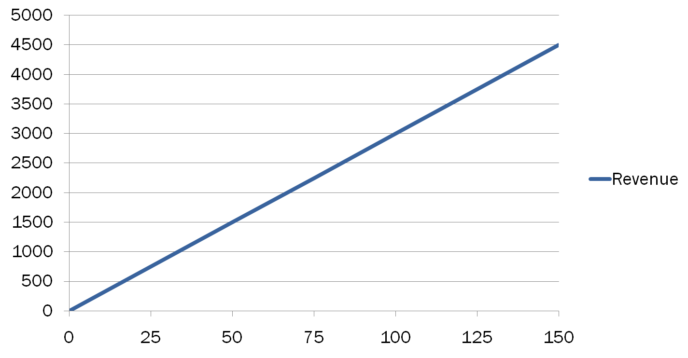
Graphic Depiction of Breakeven
$
Units Sold
Notes:
Activity Step 3 Identify key variables in the breakeven equation.
Identify the lines on the graph.
The purple line represents revenue. Revenue when zero units are sold is zero dollars.

Slide 17
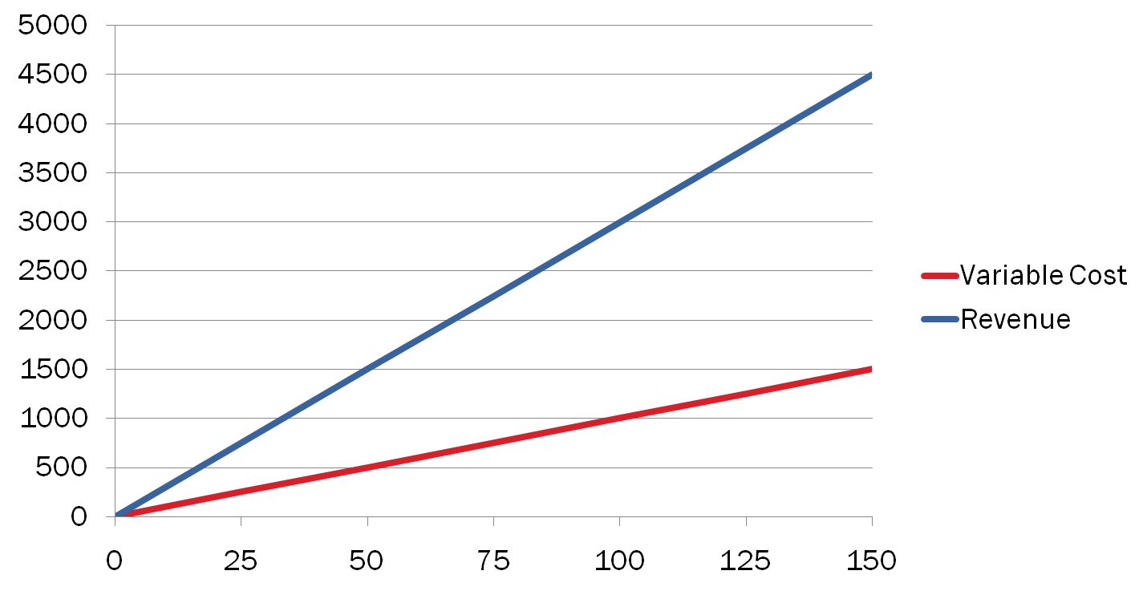
Graphic Depiction of Breakeven
$
Units Sold
Notes:
Activity Step 3 Identify key variables in the breakeven equation.
Identify the lines on the graph.
The red line represents variable cost. VC when zero units are sold is zero dollars.

Slide 18
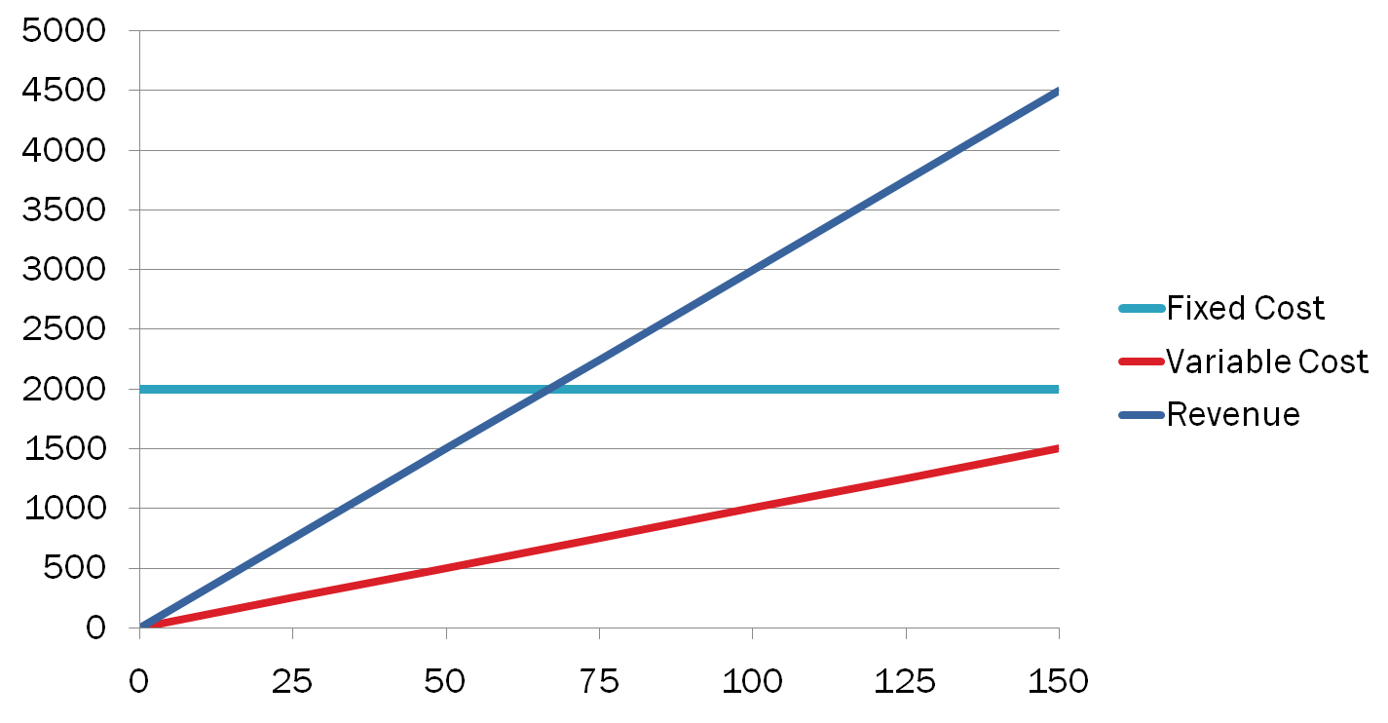
Graphic Depiction of Breakeven
$
Units Sold
Notes:
Activity Step 3 Identify key variables in the breakeven equation. (cont’d)
Identify the lines on the graph.
The blue line represents fixed cost. FC, by definition, remains the same regardless of number of units sold

Slide 19
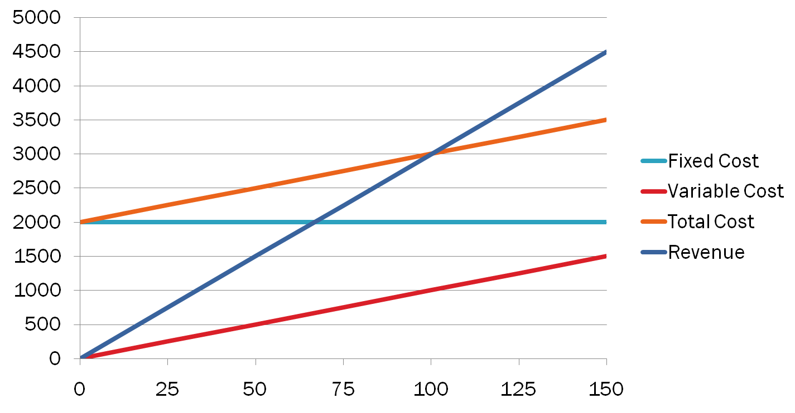
Graphic Depiction of Breakeven
$
Units Sold
Notes:
Activity Step 3 Identify key variables in the breakeven equation. (cont’d)
Identify the lines on the graph.
The green line represents total cost, which is the sum of VC and FC.

Slide 20
Graphic Depiction of Breakeven
$
Units Sold
Notes:
Activity Step 3 Identify key variables in the breakeven equation.
Identify the lines on the graph.
The Point at which Total Cost and Revenue intersect (are equal) is the point at which profit = zero

Slide 21
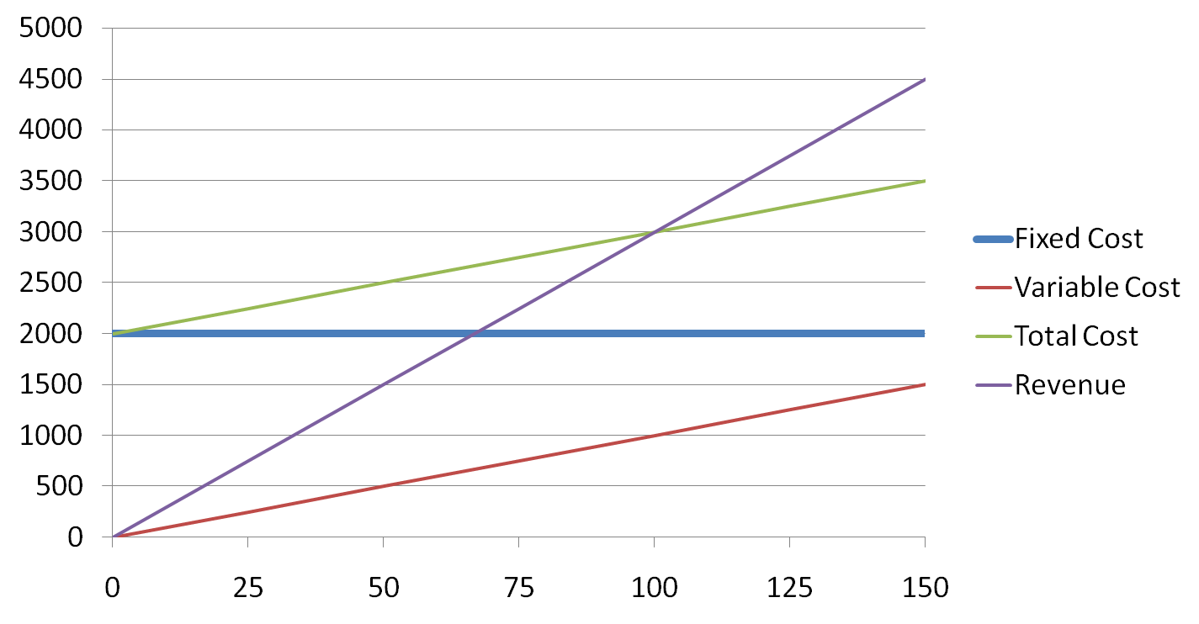
Graphic Depiction of Breakeven
$
Units Sold
Notes:
Activity Step 3 Identify key variables in the breakeven equation.
Identify the lines on the graph.
Revenue above the breakeven point results in profit (represented by the green shaded area)

Slide 22
Graphic Depiction of Breakeven
$
Units Sold
Notes:
Activity Step 3 Identify key variables in the breakeven equation.
Identify the lines on the graph.
Revenue below the breakeven point results in loss (represented by the red shaded area)

Slide 23
The total sales revenue (S) of the firm is given by the following formula:
S = s x Q
The total cost of the firm for a given production volume is given as
TC = Total variable cost + Fixed cost
TC= TVC+ TFC

Slide 24
For any production quantity which is more than the break-even quantity, the total revenue will be more than the total cost. Hence, the firm will be making profit.
Profit = Sales – (Fixed cost + Variable costs)
= s X Q – (FC + VC)

Slide 25
Find out the total cost and Sales of the firm and also find out the profit of the firm when the price of product is $50, and also describe it diagrammatically where break even point is? and also find out the MR and MC.
Output (Q) | Total Variable Cost (TVC) | Total Fixed Cost (TFC)
0 | 0 | 500
10 | 300 | 500
20 | 600 | 500
25 | 750 | 500
30 | 900 | 500
40 | 1200 | 500
50 | 1500 | 500

Slide 26
break-even quantity and break-even sales quantity
Break-even quantity refers to the number of units a Firm must sell to cover all its costs.
Break even sales a sales with no profit or loss, also called breakeven point. It is the sales volume, in units or in rupees, where total sales revenue equals total costs. Thus, zero profit results.

Slide 27
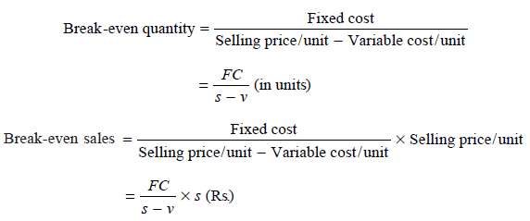
The formulae to find the break-even quantity and break-even sales quantity:

Slide 28
Contribution and margin of safety
The contribution is the difference between the sales and the variable costs. It is the amount of money a company has to cover its fixed costs after it pays all of its variable expenses
The margin of safety is how much output or sales level can fall before a business reaches its breakeven point. It is the sales over and above the break-even sales.

Slide 29
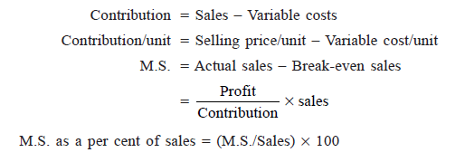
The formulae to compute these values are:

Slide 30
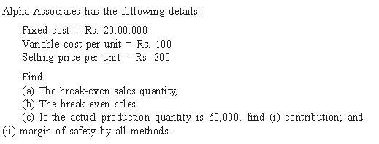
Example: 1

Slide 31
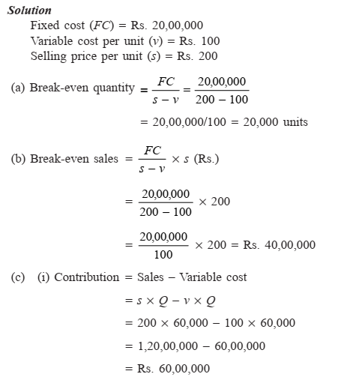

Slide 32
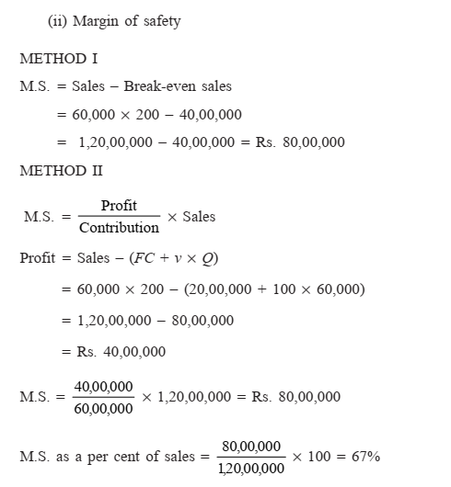

Slide 33
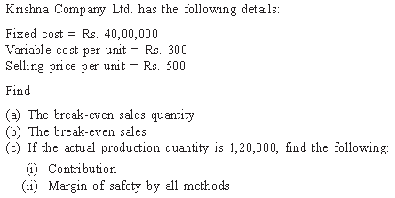
Example: 2

Slide 34
PROFIT/VOLUME RATIO (P/V RATIO)
P/V ratio is a valid ratio which is useful for further analysis. The ratio shows the amount of contribution per rupee of sales. Since, in the short-term, fixed cost does not change, the profit-volume ratio also measures the rate of change of profit due to change in the volume of sales.

Slide 35
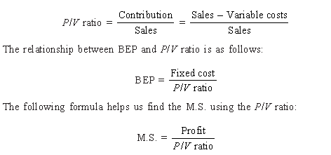
The different formulae for the P/V ratio are as follows:

Slide 36
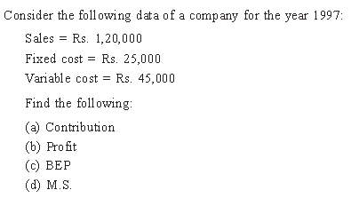
Example: 1

Slide 37
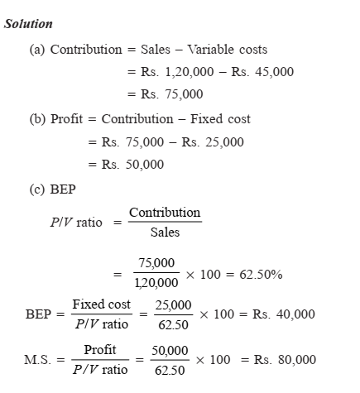

Slide 38
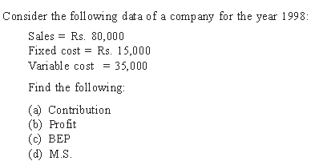
Example: 2

Slide 39
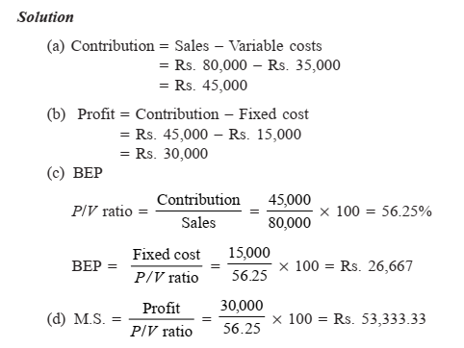

Slide 40
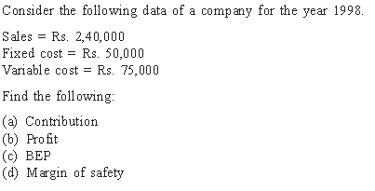
Example: 3

