Slide 1

CPE 324: Digital Signal Processing
Dr. Khurram Ali
Assistant Professor
Department of Electrical & Computer Engineering, COMSATS University Islamabad, Lahore Campus

Slide 2
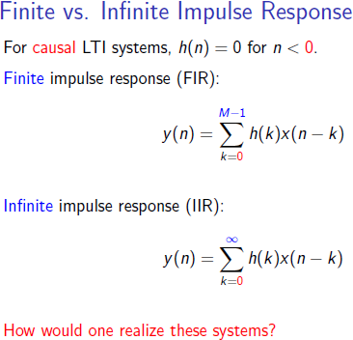
Discrete Time System Implementation

Slide 3
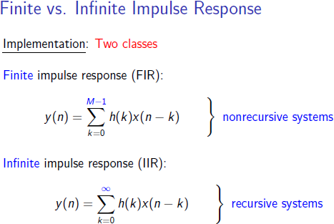
Discrete Time System Implementation

Slide 4
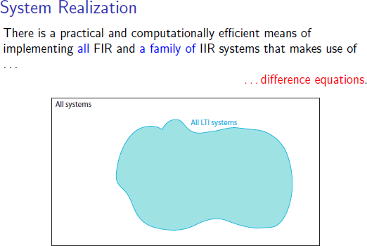
Discrete Time System Implementation

Slide 5
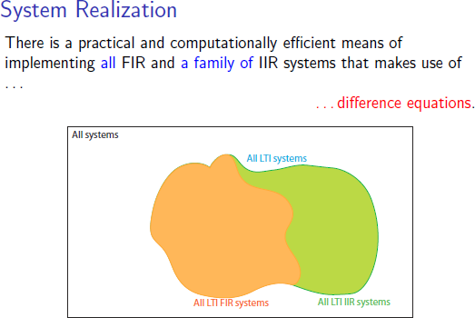
Discrete Time System Implementation

Slide 6
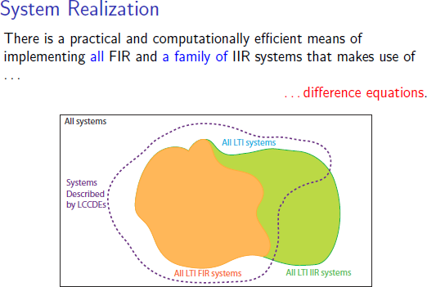
Discrete Time System Implementation

Slide 7
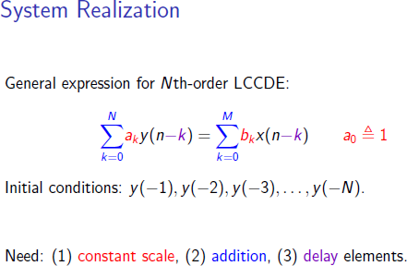
Discrete Time System Implementation

Slide 8

Discrete Time System Implementation
Our focus is to implement the above equation either on a hardware or on a software or on a programmable digital computer.
This equation can be implemented in many ways.
Why not just implement it directly?
3 main factors that influence our choice of a particular realization of the above equation:
Computational complexity: Number of arithmetic operations required to compute an output value y(n) for the system.
Memory requirements: Number of memory locations required to store the system parameters, past inputs, past outputs and any intermediate results.
Finite word length effect: Quantization effects that are inherent in any digital implementation of a system.

Slide 9
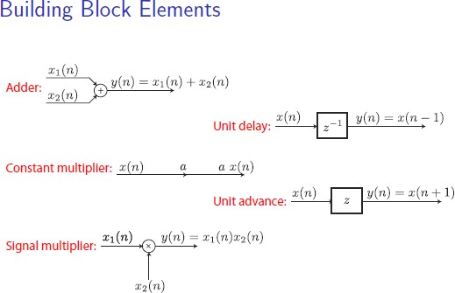
Discrete Time System Implementation

Slide 10
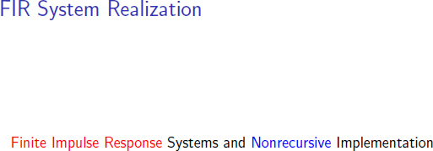
Discrete Time System Implementation

Slide 11
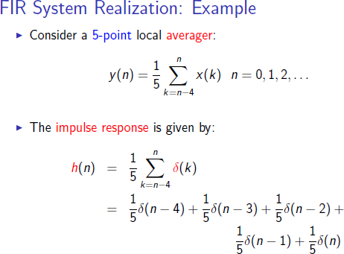
Discrete Time System Implementation

Slide 12
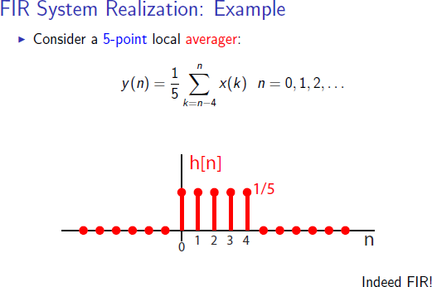
Discrete Time System Implementation

Slide 13
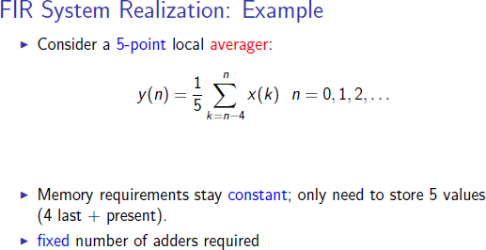
Discrete Time System Implementation

Slide 14
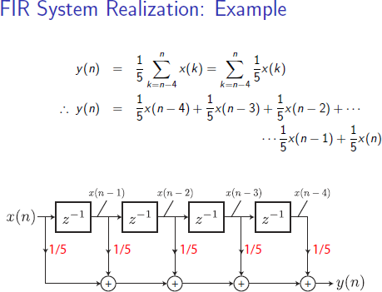
Discrete Time System Implementation

Slide 15
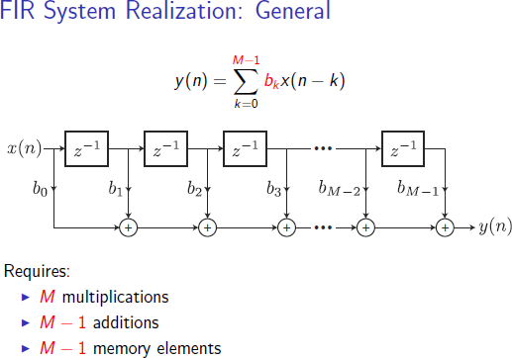
Discrete Time System Implementation

Slide 16
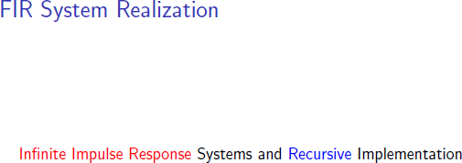
Discrete Time System Implementation

Slide 17
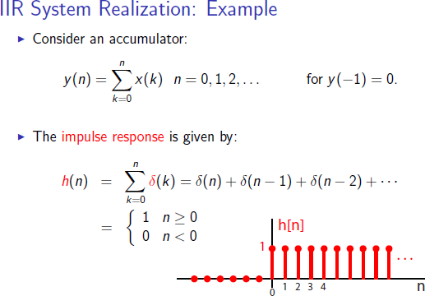
Discrete Time System Implementation

Slide 18
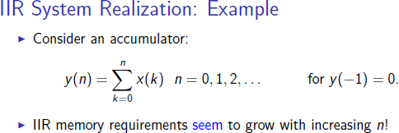
Discrete Time System Implementation

Slide 19
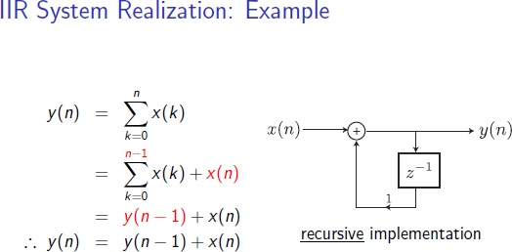
Discrete Time System Implementation

Slide 20
Discrete Time System Implementation
Structures for IIR Systems
Direct Form
Cascade Form
Parallel Form
Direct Form I Direct Form II
Transposed Direct Form II

Slide 21
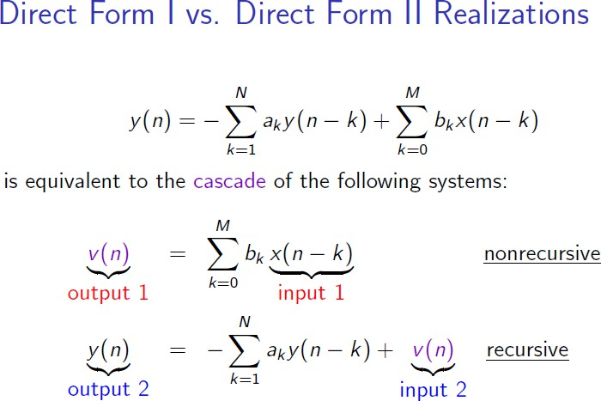
Discrete Time System Implementation

Slide 22
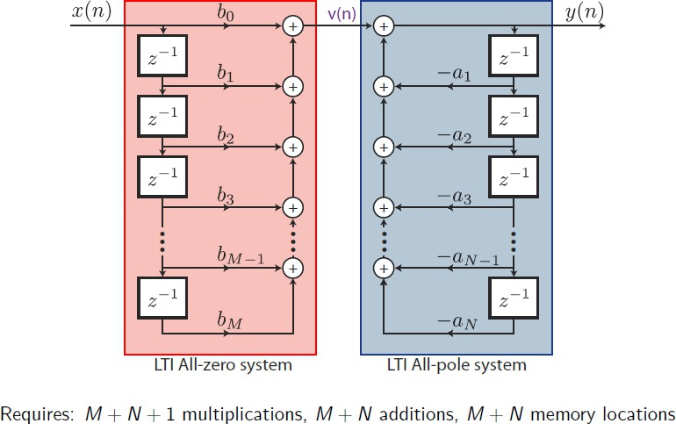
Discrete Time System Implementation
Observation: Two LTI systems in cascade. We can change their position without affecting the overall response

Slide 23
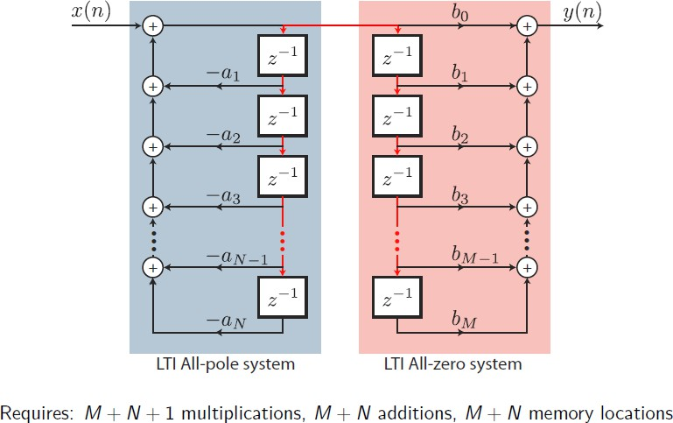
Discrete Time System Implementation
Observation: Delay elements can be combined

Slide 24
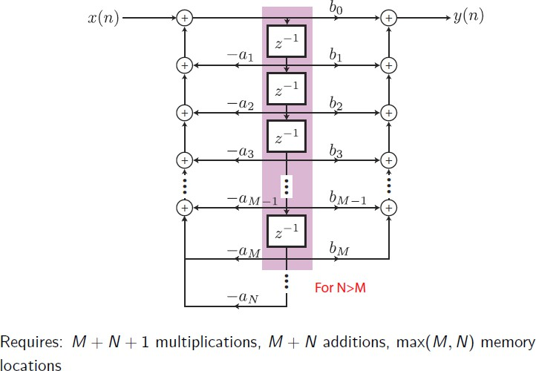
Discrete Time System Implementation

Slide 25
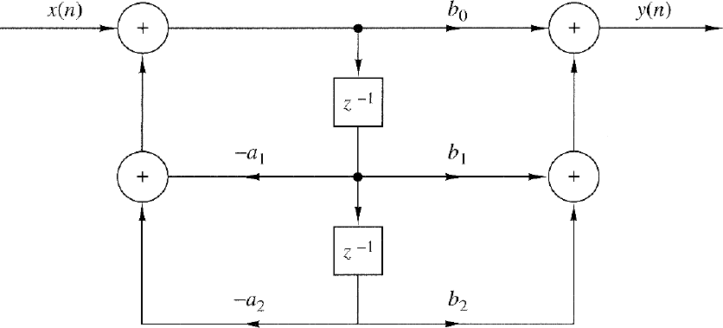

Discrete Time System Implementation
Transposed Direct Form II
Block Diagram Vs. Flow Graph representation
y ( n ) = b₀ x ( n ) + b₁ x ( n − 1 ) + b ₂ x ( n − 2 ) − a₁ y ( n − 1 ) − a ₂ y ( n − 2 )

Slide 26
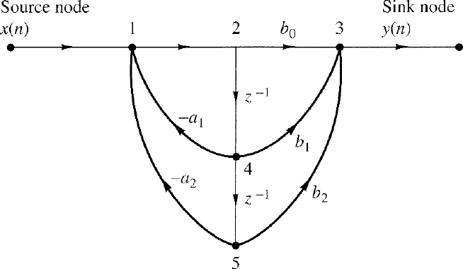
Discrete Time System Implementation
Transposed Direct Form II
Block Diagram Vs. Flow Graph representation
y ( n ) = b₀ x ( n ) + b₁ x ( n − 1 ) + b ₂ x ( n − 2 ) − a₁ y ( n − 1 ) − a ₂ y ( n − 2 )

Slide 27
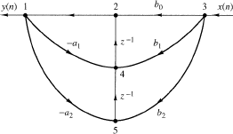
Discrete Time System Implementation
Transposed Direct Form II
Flow Graph reversal theorem: Reverse the direction of all branches and interchange the input and output in the flow graph, the system function remains unchanged.

Slide 28
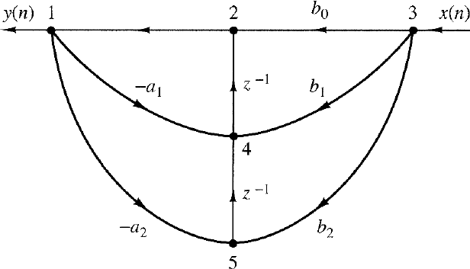
Discrete Time System Implementation
Transposed Direct Form II
Block Diagram ?

Slide 29
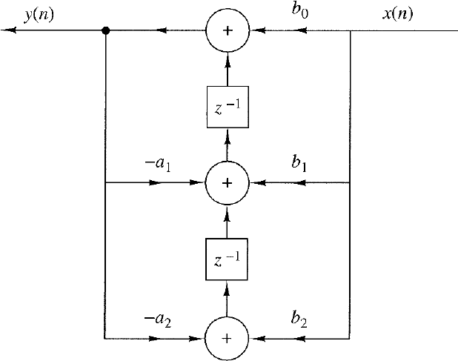
Discrete Time System Implementation
Transposed Direct Form II

