Slide 1
CPE 324 Digital signal processing
Dr. Arsla Khan

Slide 2
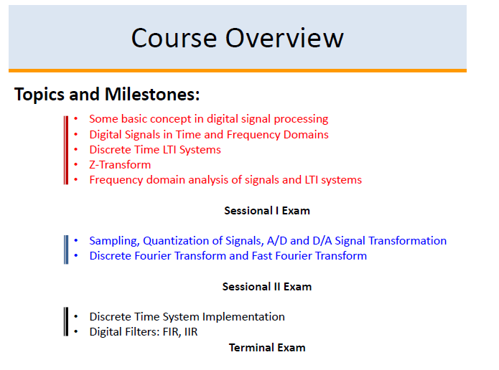

Slide 3
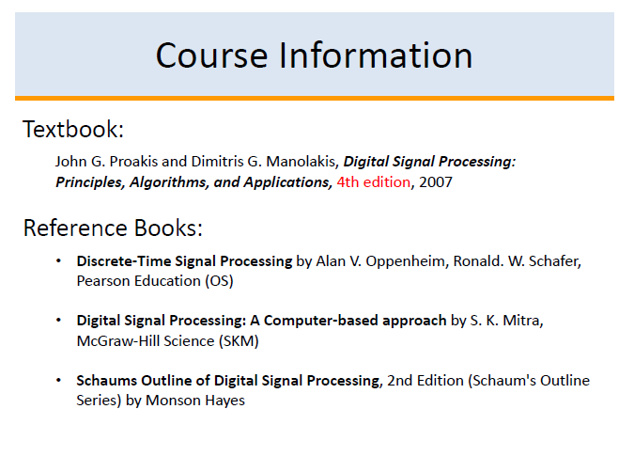

Slide 4
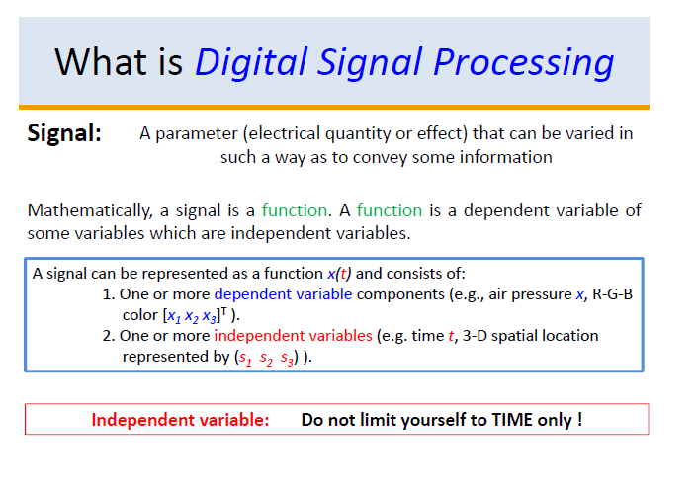

Slide 5
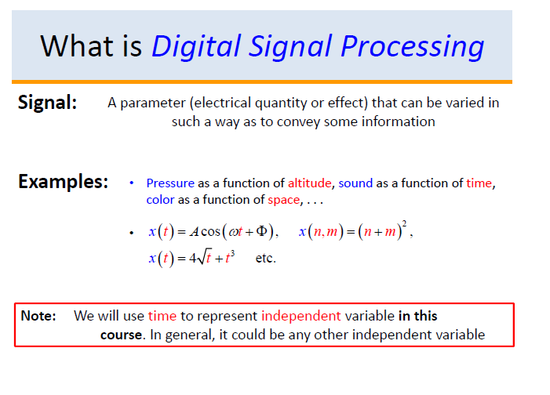

Slide 6
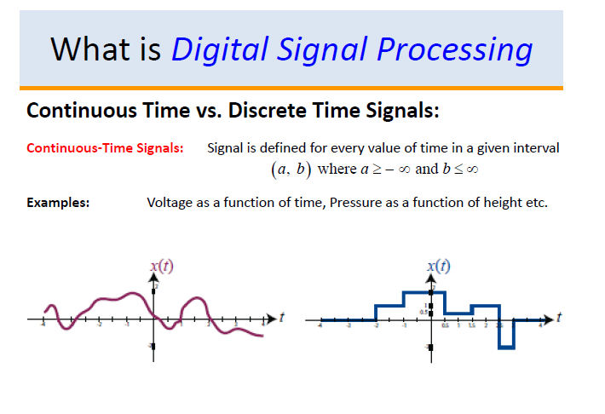

Slide 7
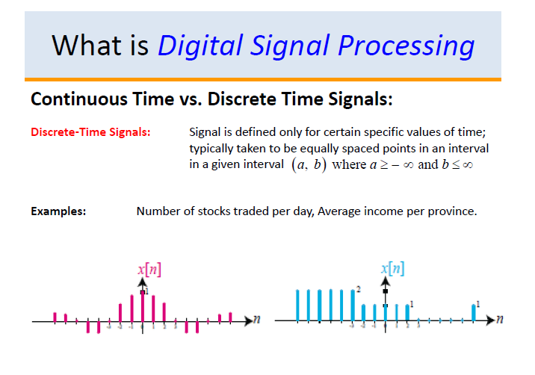

Slide 8
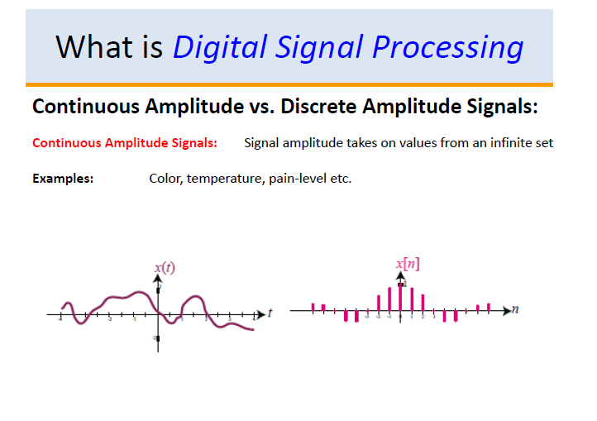

Slide 9
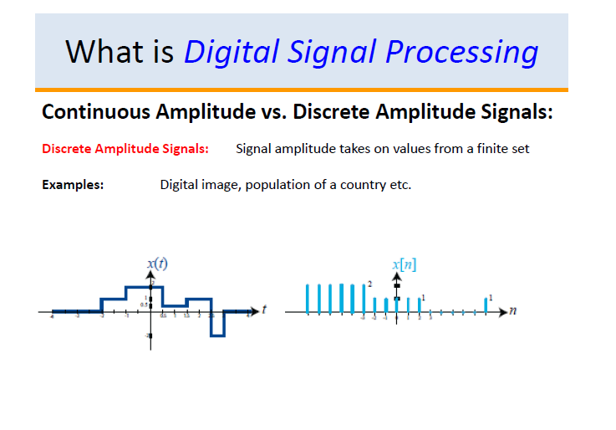

Slide 10
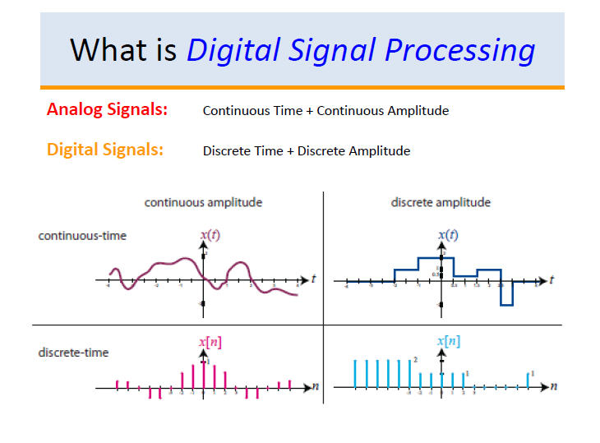

Slide 11
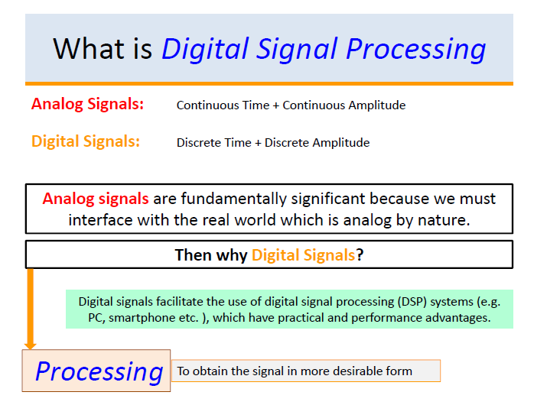

Slide 12
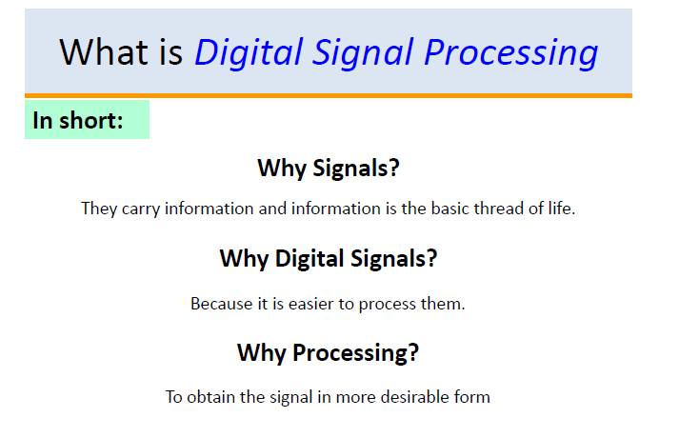
Thank You !!!

Slide 13
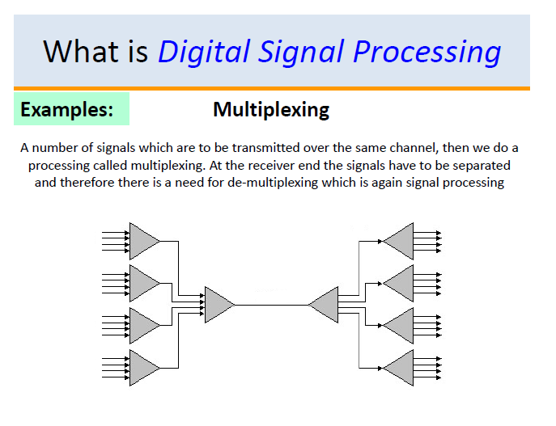

Slide 14
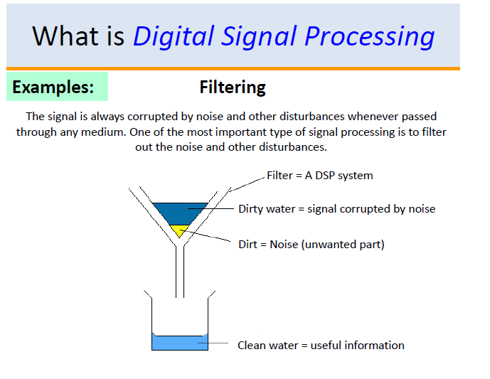

Slide 15
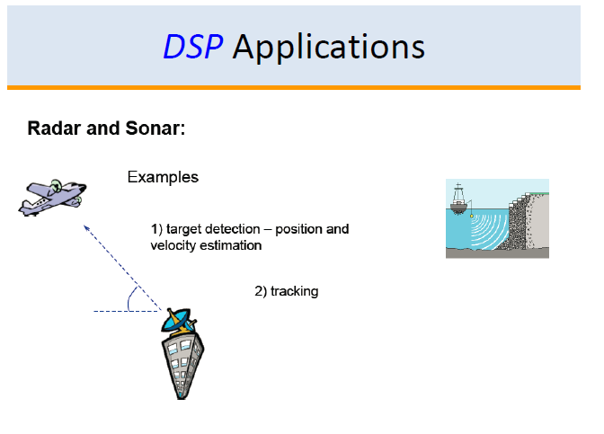

Slide 16


Slide 17
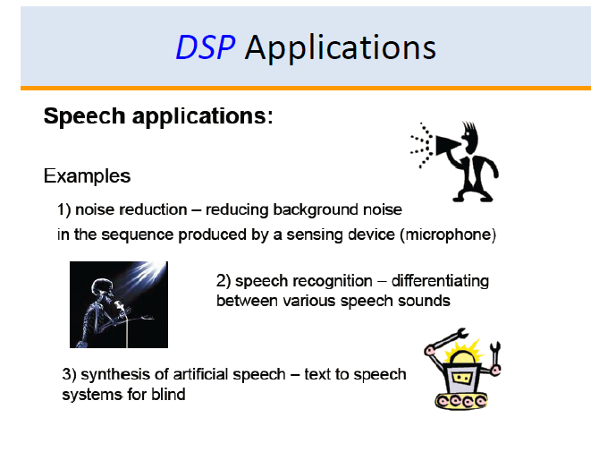

Slide 18
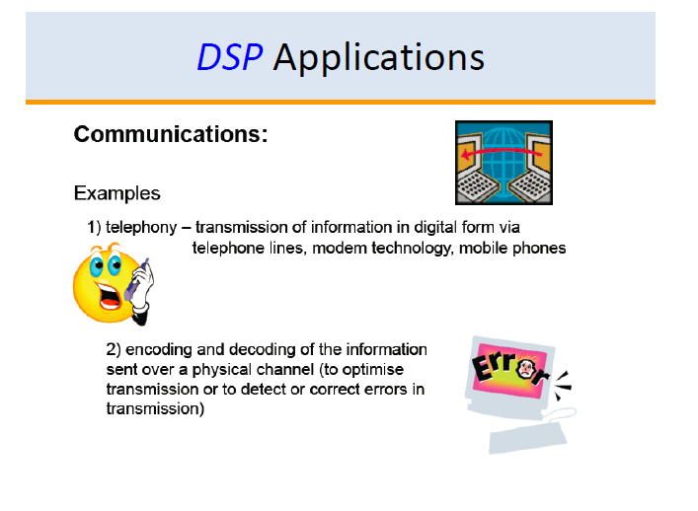

Slide 19
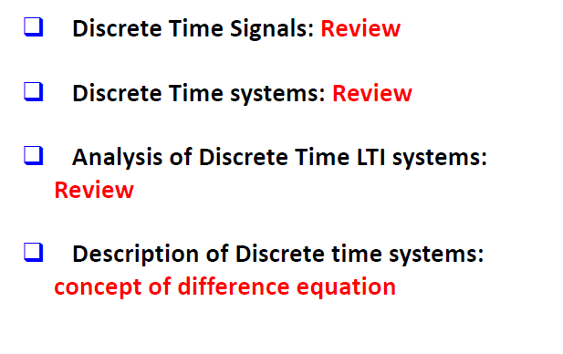
Chapter 2: Overview (Revision of SNS)

Slide 20
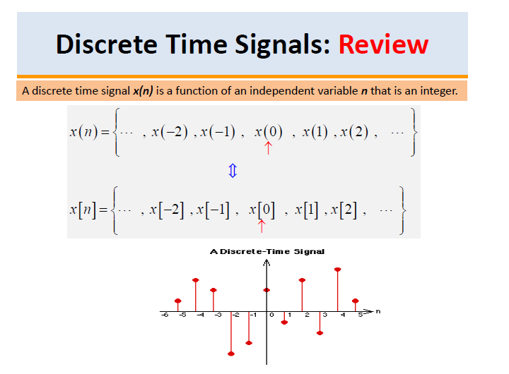

Slide 21
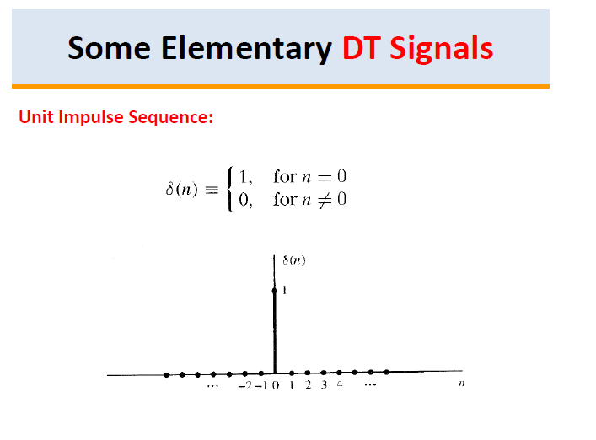

Slide 22
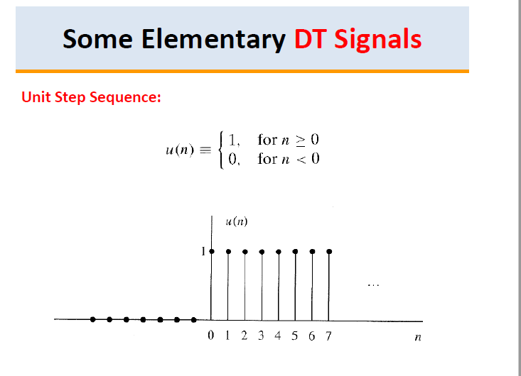

Slide 23
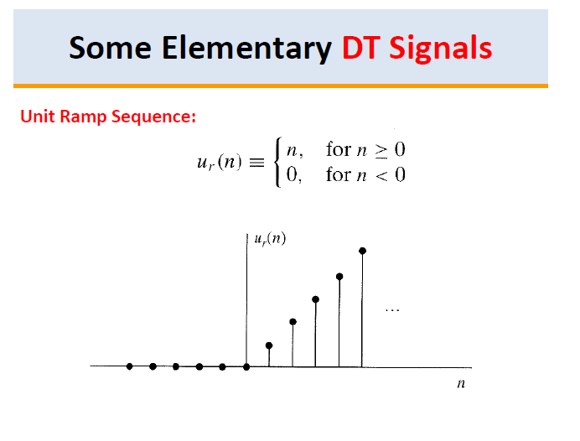

Slide 24
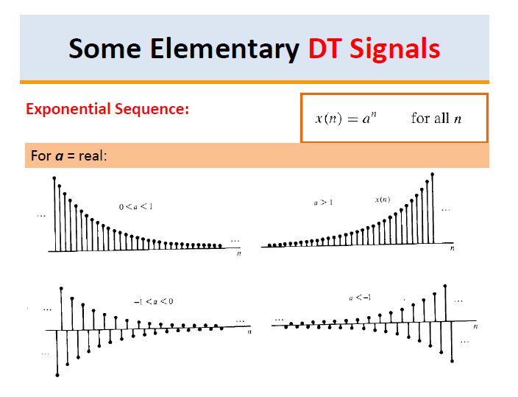

Slide 25
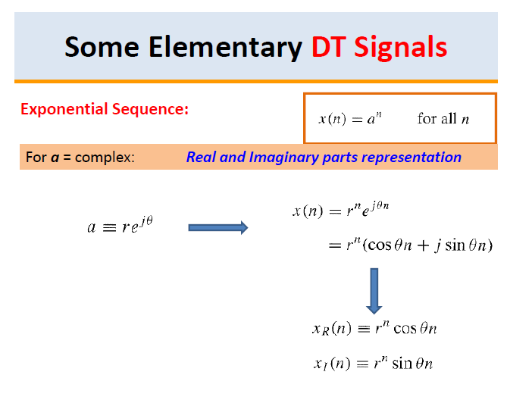

Slide 26
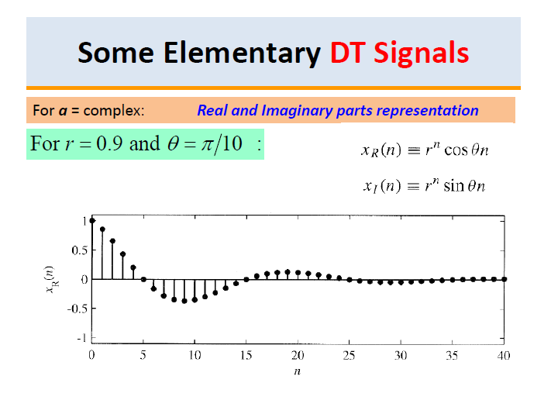

Slide 27
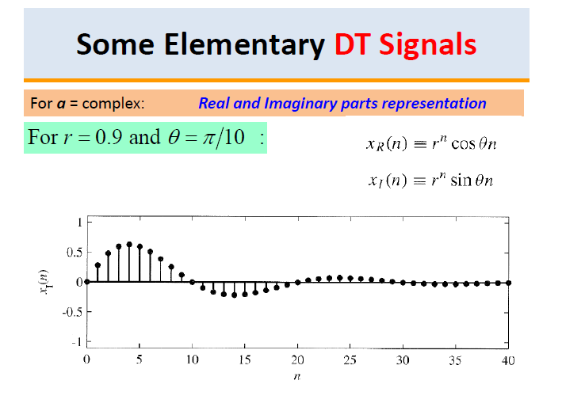

Slide 28
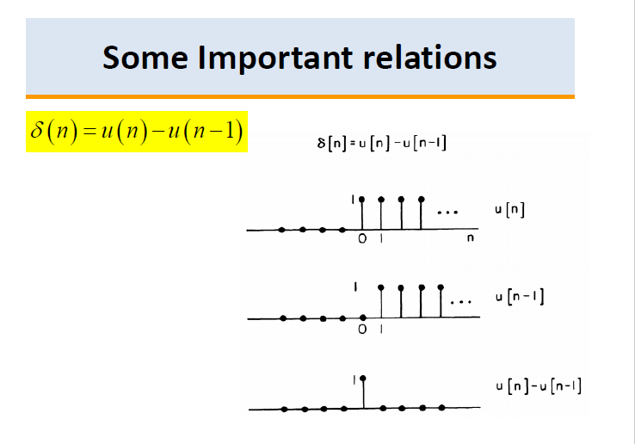

Slide 29
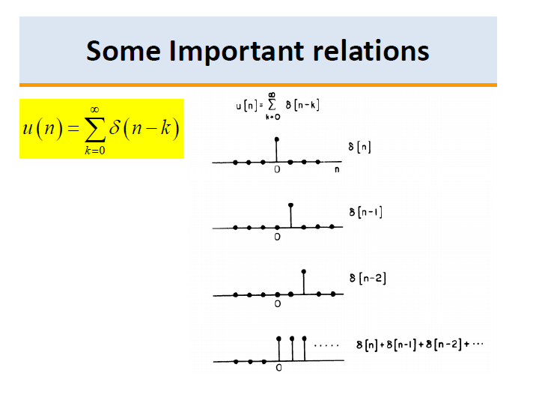

Slide 30
Classification of Signals
Based upon their characteristics and nature of availability, the signals can be classified
Continuous Time Signal
Discrete Time Signal
Even Signal
Odd Signal
Periodic Signal
Aperiodic Signal
Energy Signal
Power Signal
Deterministic Signal
Random Signal

Slide 31
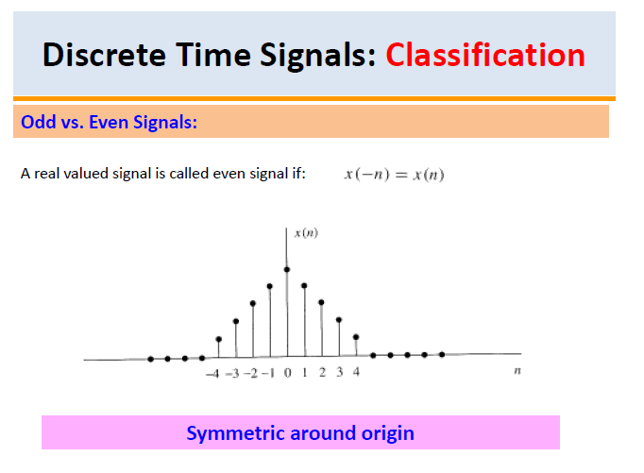

Slide 32
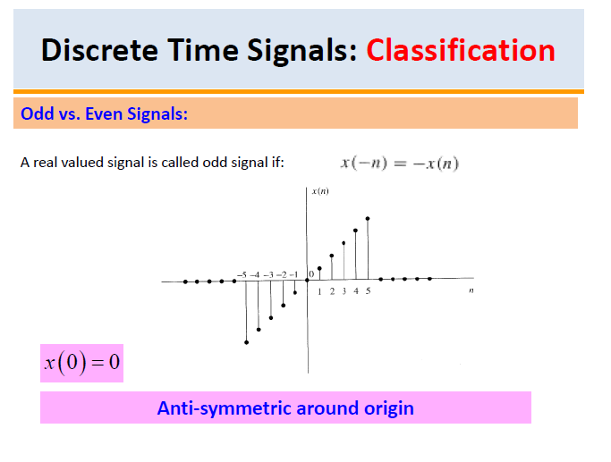

Slide 33
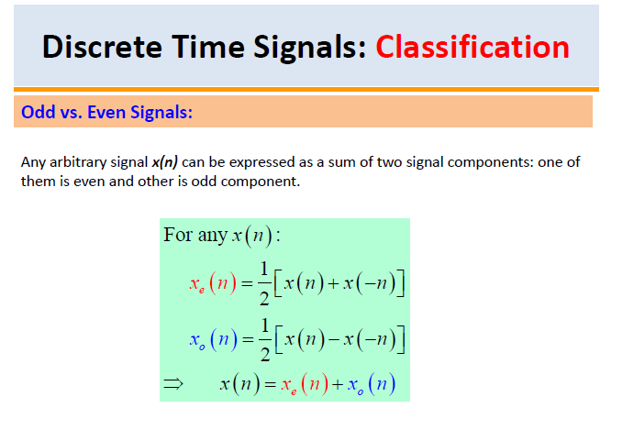

Slide 34
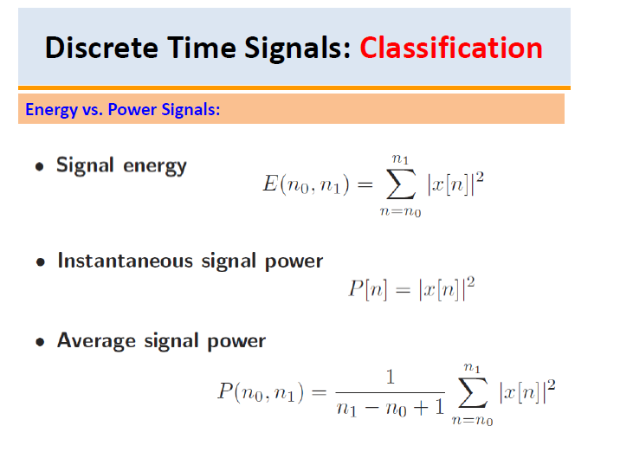

Slide 35
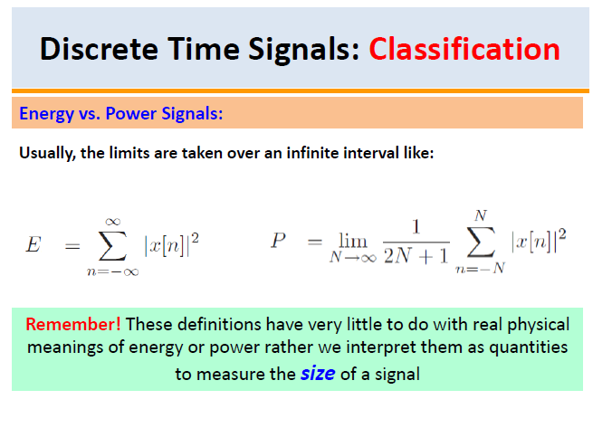

Slide 36
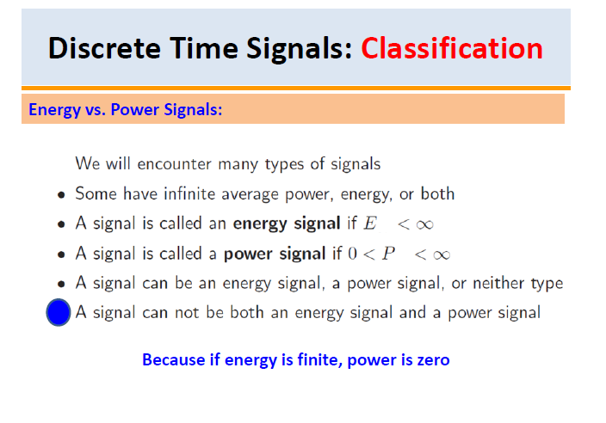

Slide 37
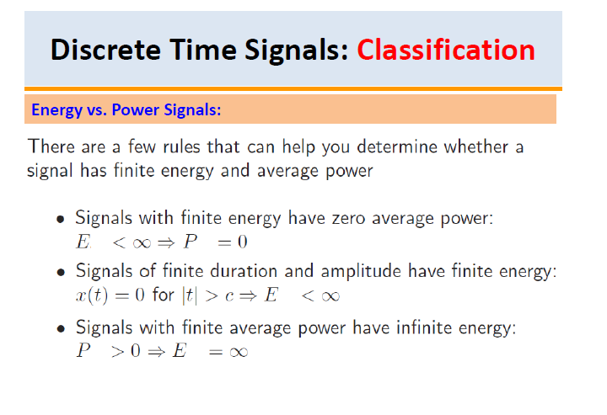

Slide 38
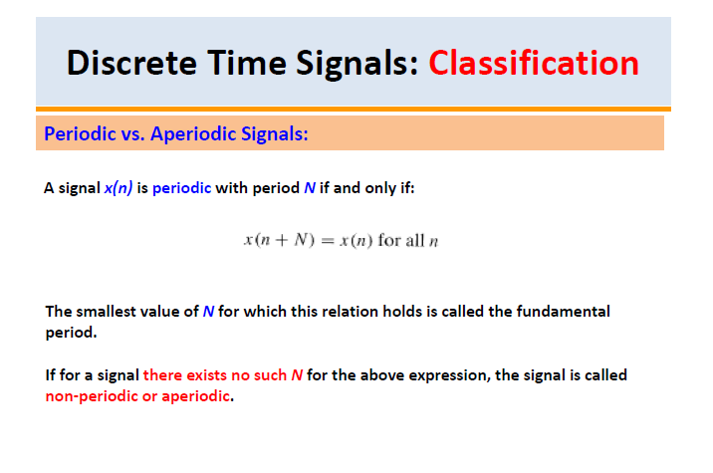

Slide 39
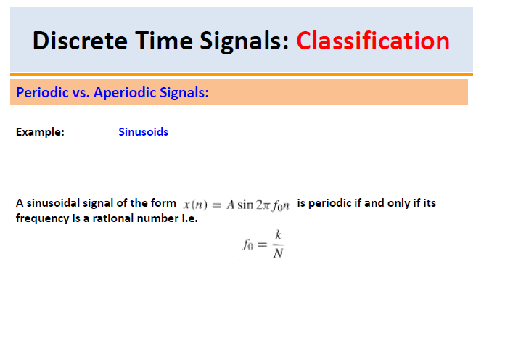

Slide 40
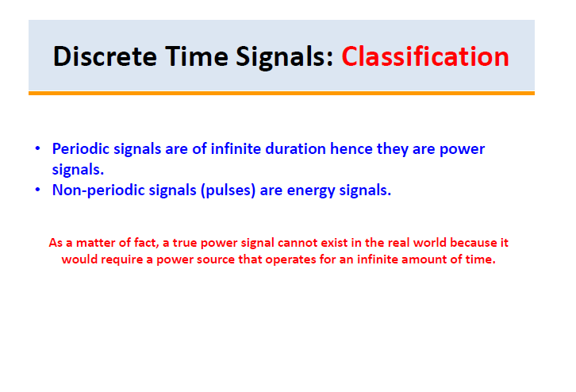

Slide 41
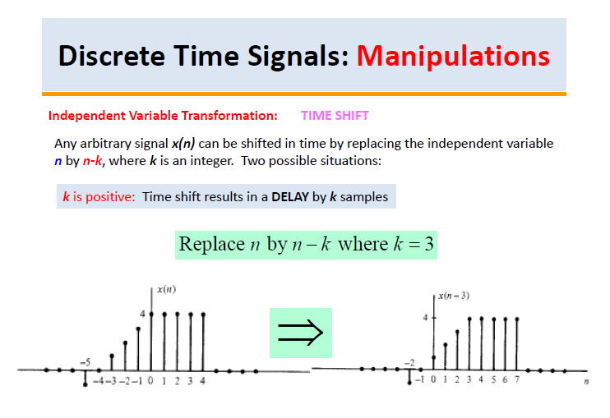

Slide 42
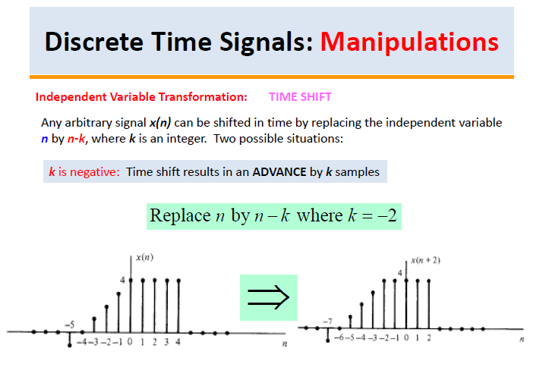

Slide 43
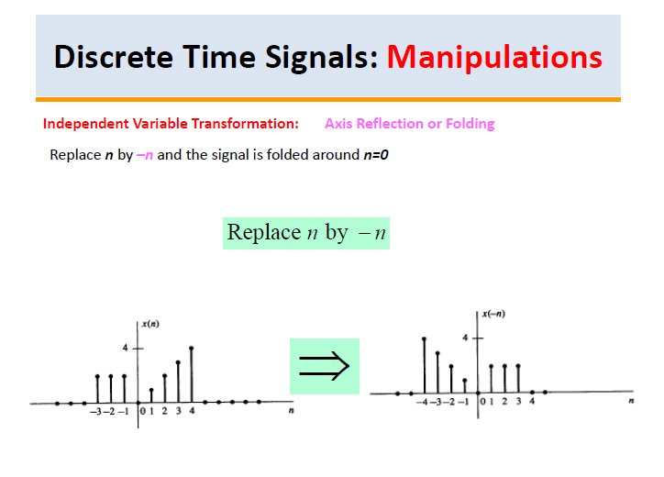

Slide 44
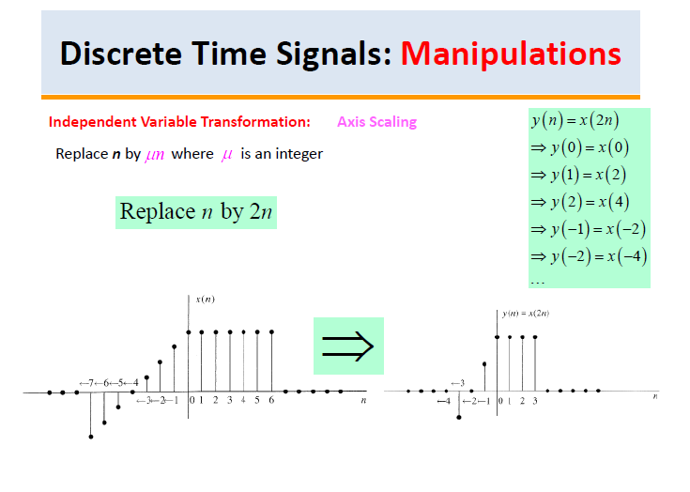

Slide 45
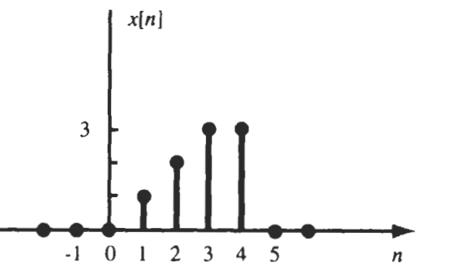
Exp : For the signal given, sketch x[2n] and x[n/2]

Slide 46
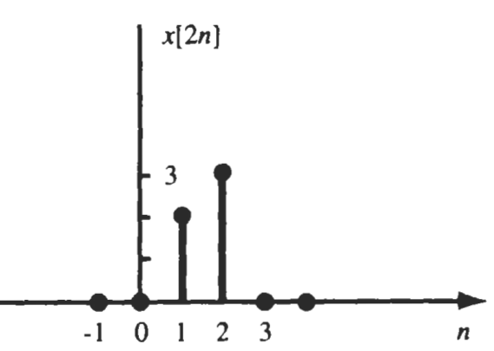






x[2n] → Down-sampling
2n = -2 → n=-1
2n = -1 → n=-1/5=-0.5
2n = 0 → n=0
2n = 1 → n=1/2=0.5
2n = 2 → n=2/2=1
2n = 3 → n=3/2=1.5
2n = 4 → n=4/2 = 2
Thus, for x[2n], pick every 2nd sample and discard other samples
Similarly for x[3n], pick every 3rd sample and discard other samples
$$\frac{−1}{2}$$
$$\frac{0}{2}$$
$$\frac{1}{2}$$
$$\frac{2}{2}$$
$$\frac{3}{2}$$
$$\frac{4}{2}$$

Slide 47
x[n/2] → Up-sampling
n/2 = -2 → n=-4
n/2 = -1 → n= -1 x 2= - 2
n/2 = 0 → n=0
n/2 = 1 → n=1 x 2= 2
n/2 = 2 → n=2 x2=4
n/2 = 3 → n=3 x 2=6
n/2 = 4 → n=4 x 2 = 8
Thus, x[n/2]→place samples at every 2nd place whereas zeros will be placed in between the samples
Thus, x[n/3]→place samples at every 3rd place whereas zeros will be placed in between the samples

Slide 48
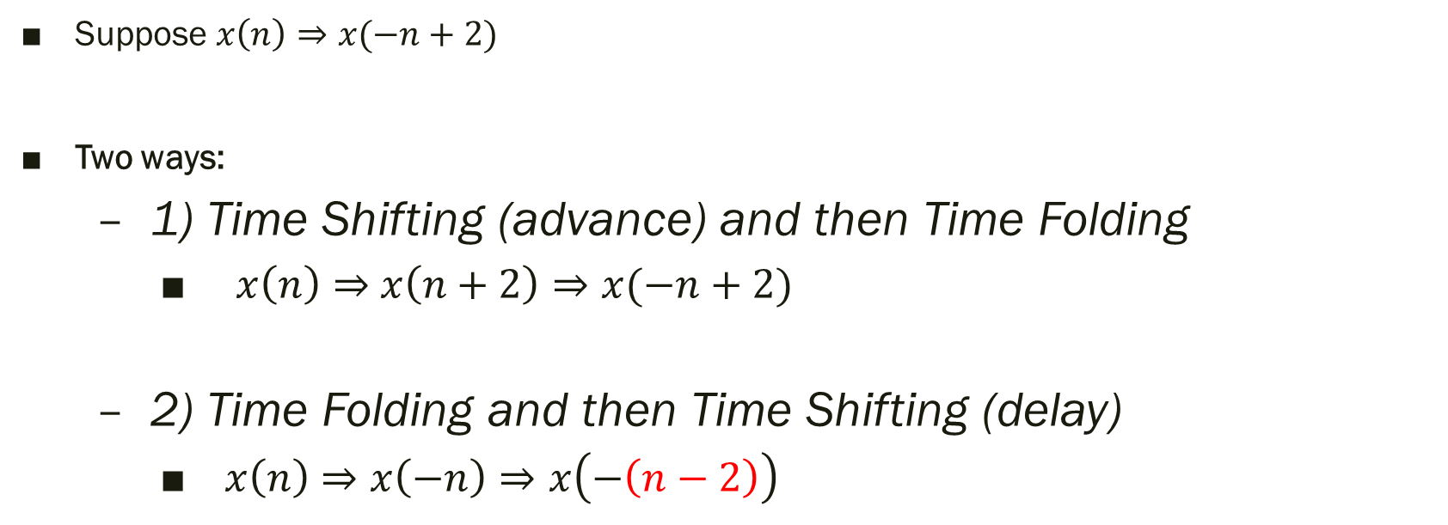
Combined Operations
Suppose $x\left(n\right)⇒x(−n+2)$
Two ways:
1) Time Shifting (advance) and then Time Folding
$x\left(n\right)⇒$ $x\left(n+2\right)⇒x(−n+2)$
2) Time Folding and then Time Shifting (delay)
$x\left(n\right)⇒$ $x\left(−n\right)⇒x\left(−\left(n−2\right)\right)$

Slide 49
General Rule for Combined Operations
First, do the time shifting operation
Then, do the time scaling operation
Then perform time folding

Slide 50
Exp : For the signal given, sketch x(-2t + 3)

Slide 51
x(t+3)
x(2t+3)
x(-2t+3)

Slide 52
Thank You !!!

