Slide 1
Lec 2: DT Systems Overview
Dr. Arsla Khan

Slide 2
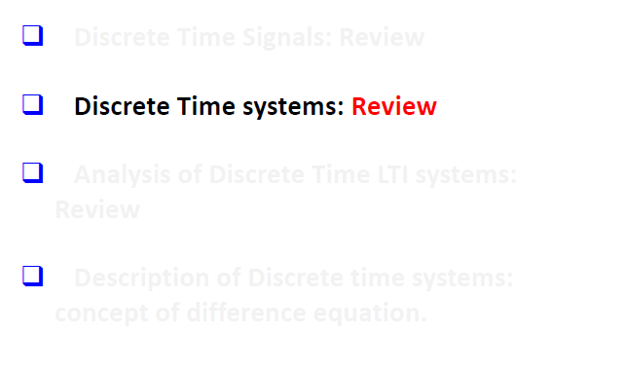
Chapter 2: Overview (SNS Revision)

Slide 3
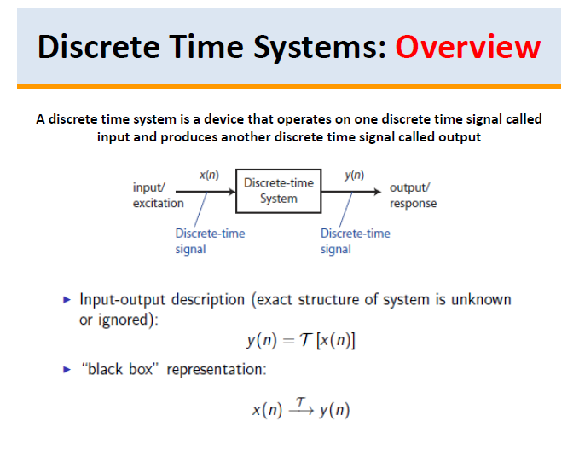

Slide 4
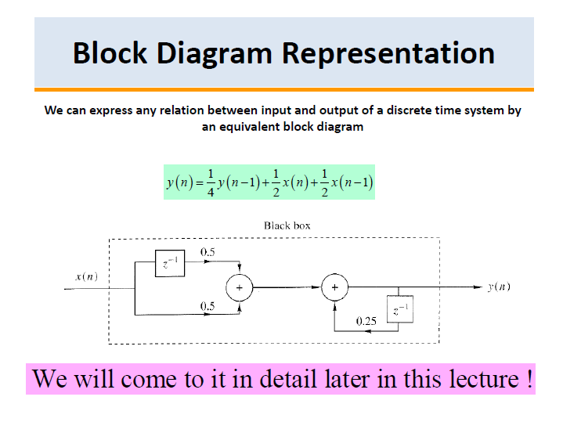

Slide 5
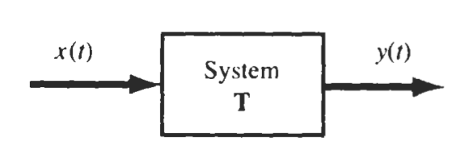
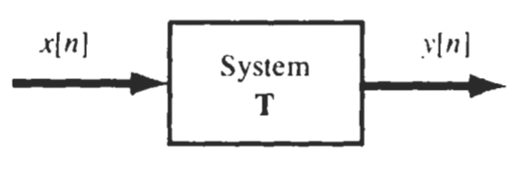
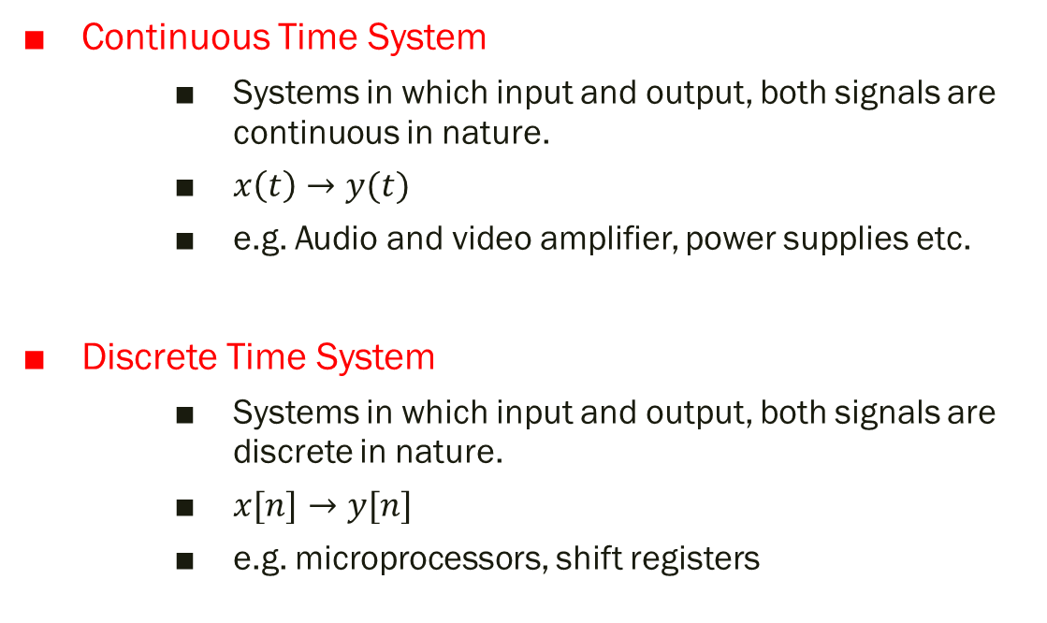
Types of Systems
Continuous Time System
Systems in which input and output, both signals are continuous in nature.
$x\left(t\right)→y(t)$
e.g. Audio and video amplifier, power supplies etc.
Discrete Time System
Systems in which input and output, both signals are discrete in nature.
$x[n]→y[n]$
e.g. microprocessors, shift registers

Slide 6
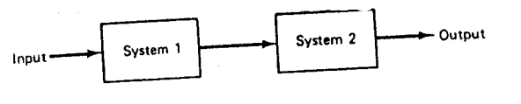
Interconnection of Systems
Systems can be interconnected in multiple ways
1) Series(Cascaded) Interconnection
Output of system 1 is input of other system
Overall impulse response is equal to convolution of individual impulse responses.

Slide 7
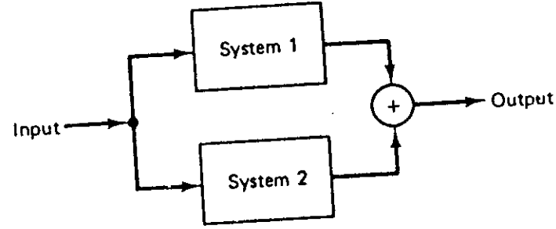
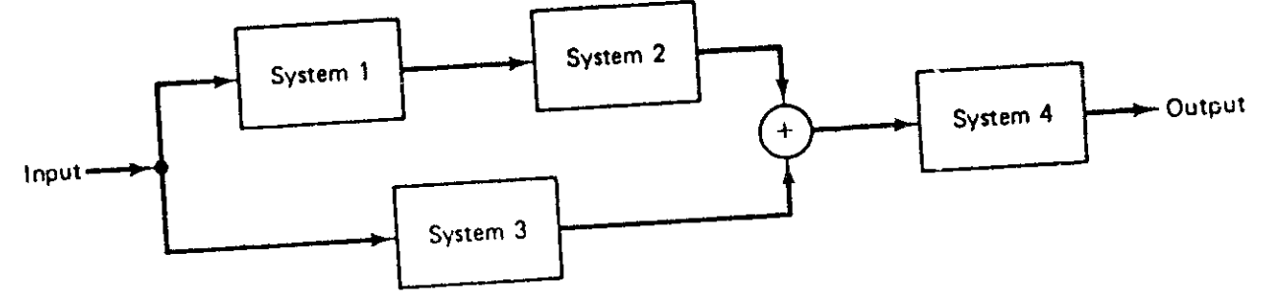
2) Parallel Interconnection
Same input is applied to all systems.
Overall impulse response is equal to addition of individual impulse responses
3) Series/Parallel Interconnection
Combination of series and parallel combination

Slide 8
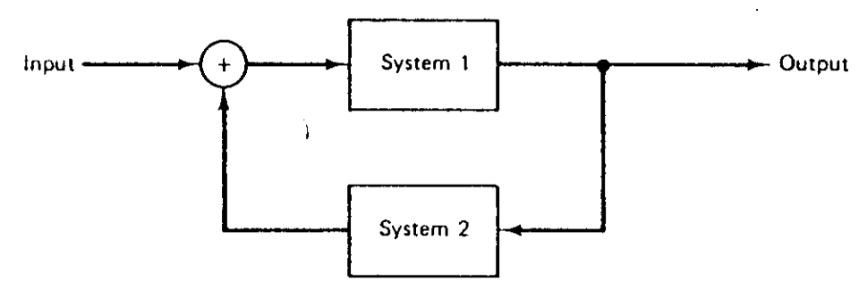
4) Feedback Interconnection
Output of system 1 is the input to system 2, while the output of system 2 is fed back and added to the external input to produce the actual input to system 1.

Slide 9
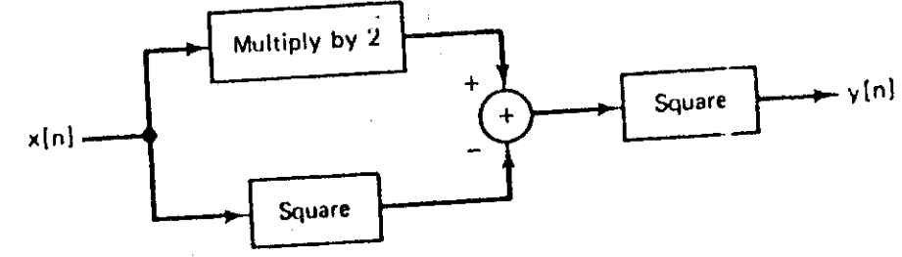

Exp 7.1: Write relationship between input and output signals
Multiple input $x[n]$ by 2 → $2x\left[n\right]$
Square of input $x[n]$ → ${x[n]}^{2}$
Relationship is: $y\left[n\right]= {(2x\left[n\right]−{x[n]}^{2})}^{2}$

Slide 10
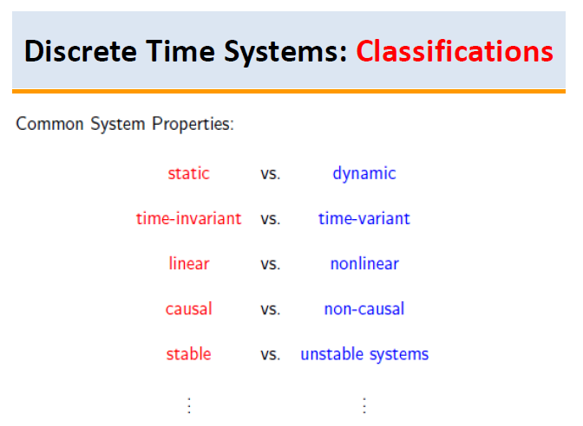

Slide 11
1) Causal and Non-Causal Systems
Response of the causal system to an input does not depend on future values of that input but depends only on the present and past values.

Slide 12
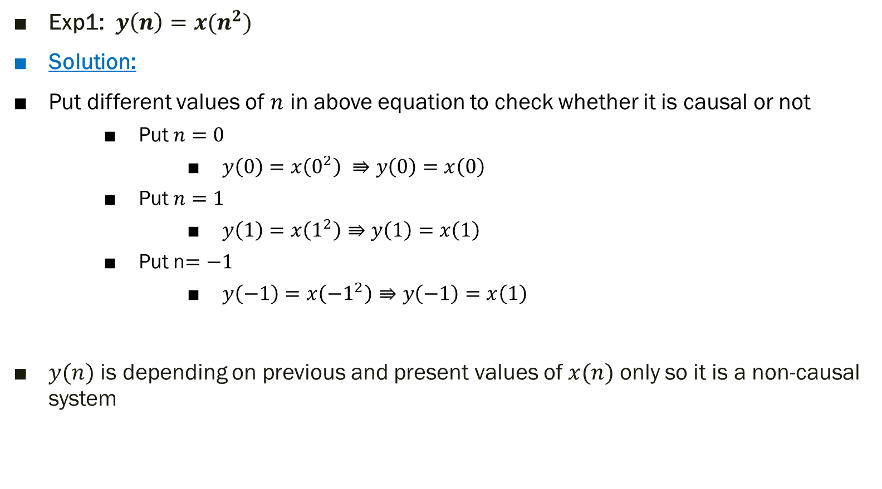
Exp1: $y\left(n\right)=x(n^{2})$
Solution:
Put different values of $n$ in above equation to check whether it is causal or not
Put $n=0$
$y\left(0\right)=x\left(0^{2}\right) ⇛y\left(0\right)=x\left(0\right)$
Put $n=1$
$y\left(1\right)=x\left(1^{2}\right)⇛y\left(1\right)=x\left(1\right)$
Put n$=−1$
$y\left(−1\right)=x\left({−1}^{2}\right)⇛y\left(−1\right)=x\left(1\right)$
$y(n)$ is depending on previous and present values of $x(n)$ only so it is a non-causal system

Slide 13
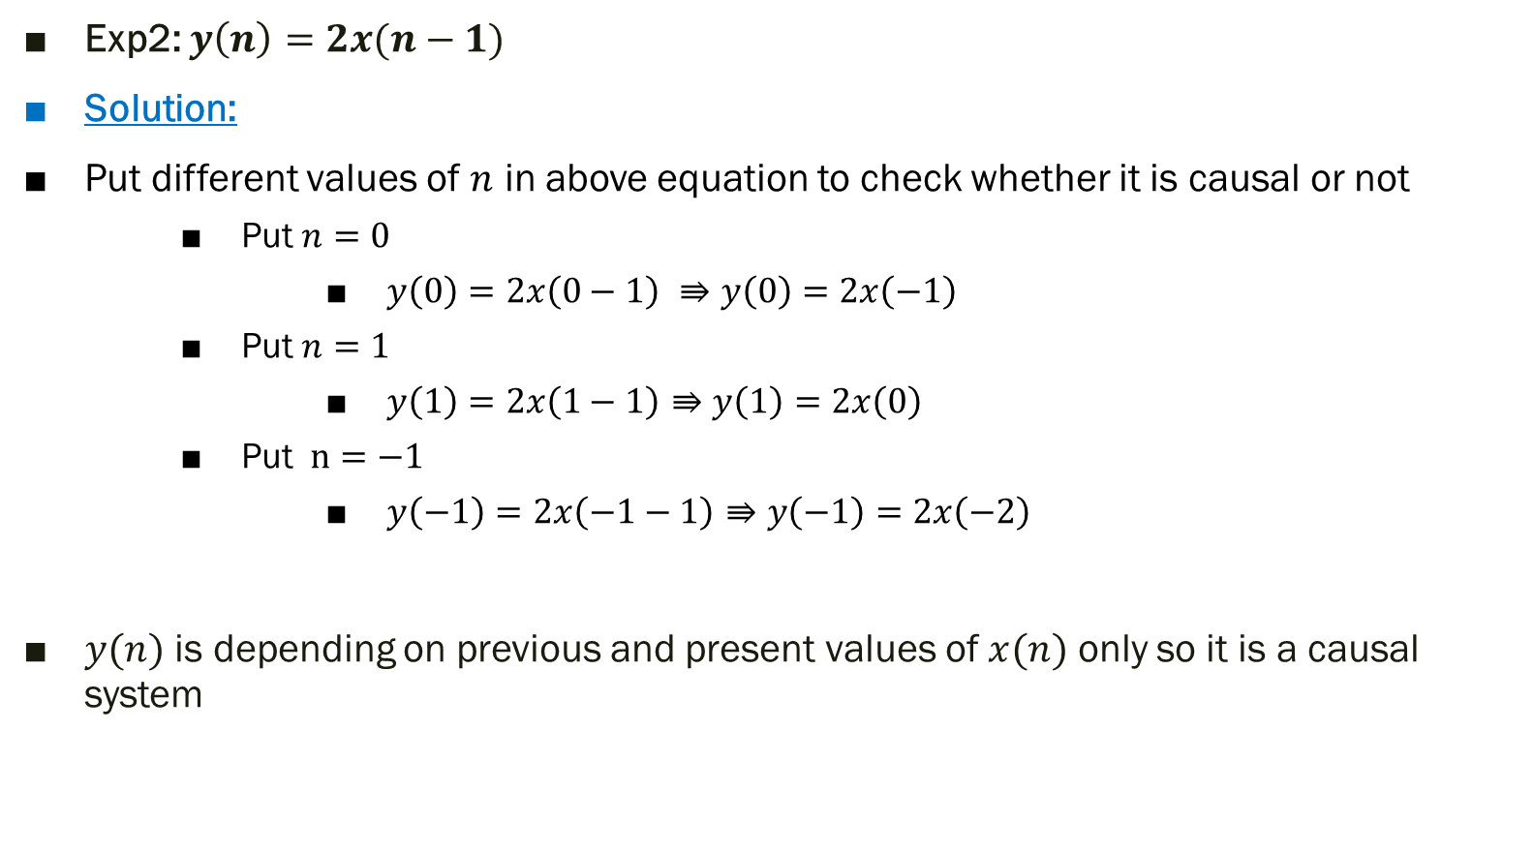
Exp2: $y\left(n\right)=2x(n−1)$
Solution:
Put different values of $n$ in above equation to check whether it is causal or not
Put $n=0$
$y\left(0\right)=2x\left(0−1\right) ⇛y\left(0\right)=2x\left(−1\right)$
Put $n=1$
$y\left(1\right)=2x\left(1−1\right)⇛y\left(1\right)=2x\left(0\right)$
Put $n=−1$
$y\left(−1\right)=2x\left(−1−1\right)⇛y\left(−1\right)=2x\left(−2\right)$
$y(n)$ is depending on previous and present values of $x(n)$ only so it is a causal system

Slide 14
2) Static (memoryless) and Dynamic (with memory) Systems
Static systems are also known as memoryless systems
Static systems contain no storage elements (thus, no integrals, derivatives or signal delays)
A static or memoryless system is a system with an output signal whose values depends upon the present value of the input signal only. Otherwise the system is dynamic or with memory.

Slide 15
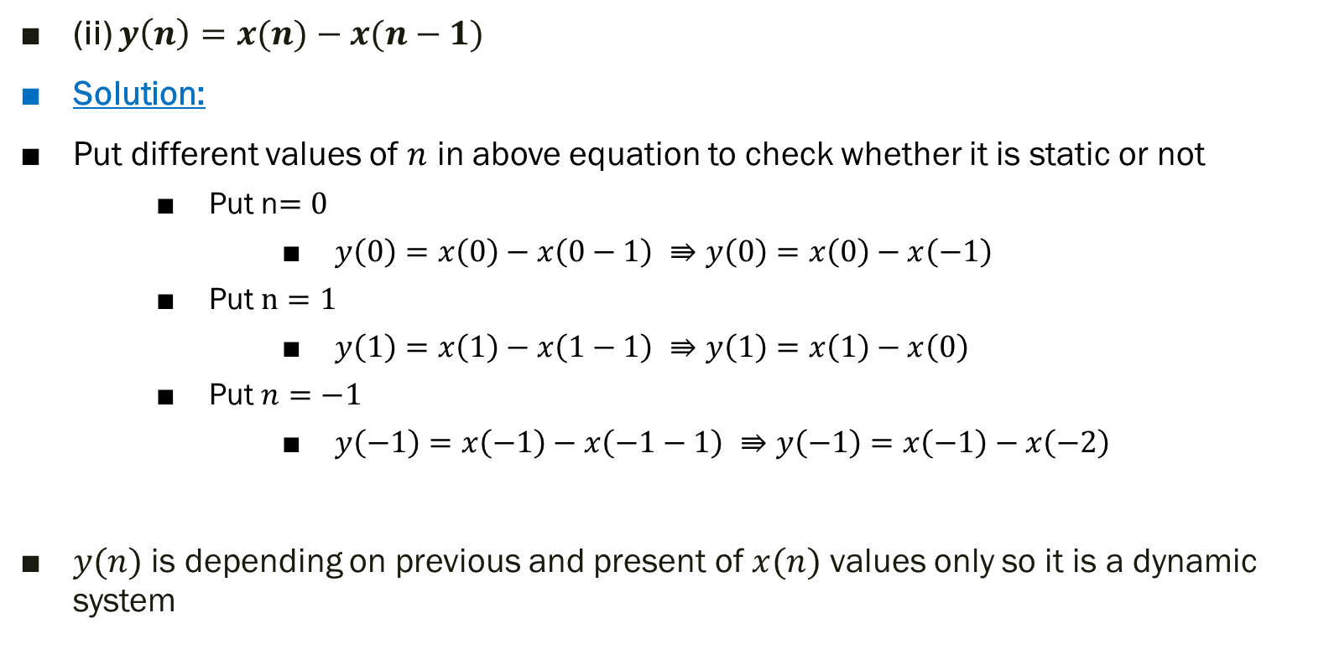
(ii) $y\left(n\right)=x(n)−x(n−1)$
Solution:
Put different values of $n$ in above equation to check whether it is static or not
Put n$=0$
$y\left(0\right)=x\left(0\right)−x\left(0−1\right) ⇛y\left(0\right)=x\left(0\right)−x\left(−1\right)$
Put $n=1$
$y\left(1\right)=x\left(1\right)−x\left(1−1\right) ⇛y\left(1\right)=x\left(1\right)−x\left(0\right)$
Put $n=−1$
$y\left(−1\right)=x\left(−1\right)−x\left(−1−1\right) ⇛y\left(−1\right)=x\left(−1\right)−x\left(−2\right)$
$y(n)$ is depending on previous and present of $x(n)$ values only so it is a dynamic system

Slide 16
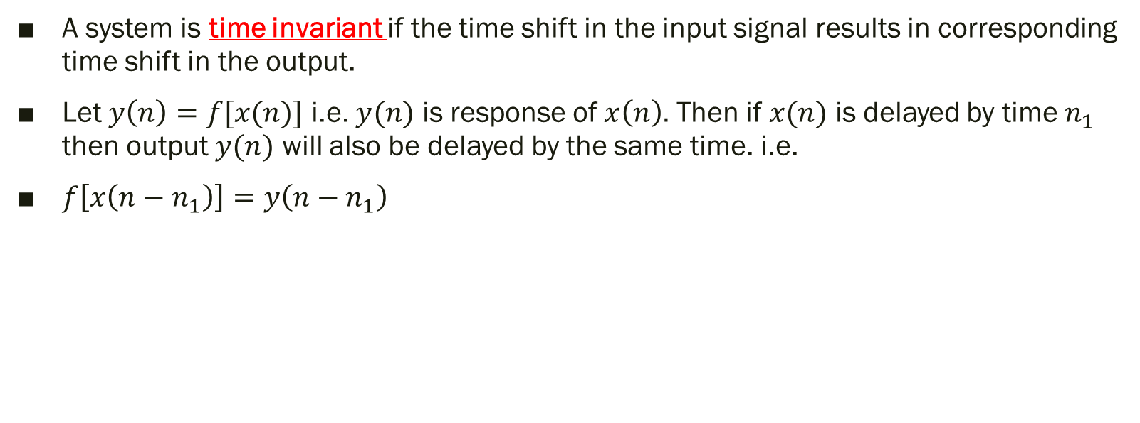
3) Time Invariant and Time Variant Systems
A system is time invariant if the time shift in the input signal results in corresponding time shift in the output.
Let $y\left(n\right)=f[x(n)]$ i.e. $y(n)$ is response of $x\left(n\right).$ Then if $x(n)$ is delayed by time $n_{1}$ then output $y(n)$ will also be delayed by the same time. i.e.
$f\left[x\left(n−n_{1}\right)\right]=y\left(n−n_{1}\right)$

Slide 17

Steps to test for time invariance property
Step 1: Determine the output of system for delayed input i.e. $x(n−n_{1})$
$y\left(n,n_{1}\right)=f[x(n−n_{1})]$
Step 2: Then delay the output itself by $n_{1}$ i.e. $y(n−n_{1})$
Step 3: If
$y\left(n,n_{1}\right)≠y(n−n_{1})$ → Time variant
$y\left(n,n_{1}\right)=y(n−n_{1})$ → Time invariant

Slide 18
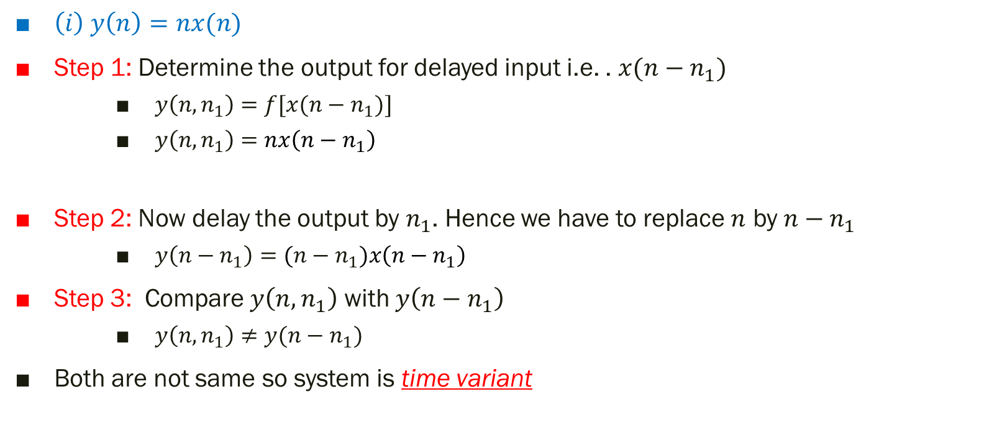
$\left(i\right) y\left(n\right)=nx(n)$
Step 1: Determine the output for delayed input i.e. . $x(n−n_{1})$
$y\left(n,n_{1}\right)=f[x(n−n_{1})]$
$y\left(n,n_{1}\right)=nx\left(n−n_{1}\right)$
Step 2: Now delay the output by $n_{1}$. Hence we have to replace $n$ by $n−n_{1}$
$y\left(n−n_{1}\right)=(n−n_{1})x\left(n−n_{1}\right)$
Step 3: Compare $y\left(n,n_{1}\right)$ with $y\left(n−n_{1}\right)$
$y\left(n,n_{1}\right)≠y(n−n_{1})$
Both are not same so system is time variant

Slide 19
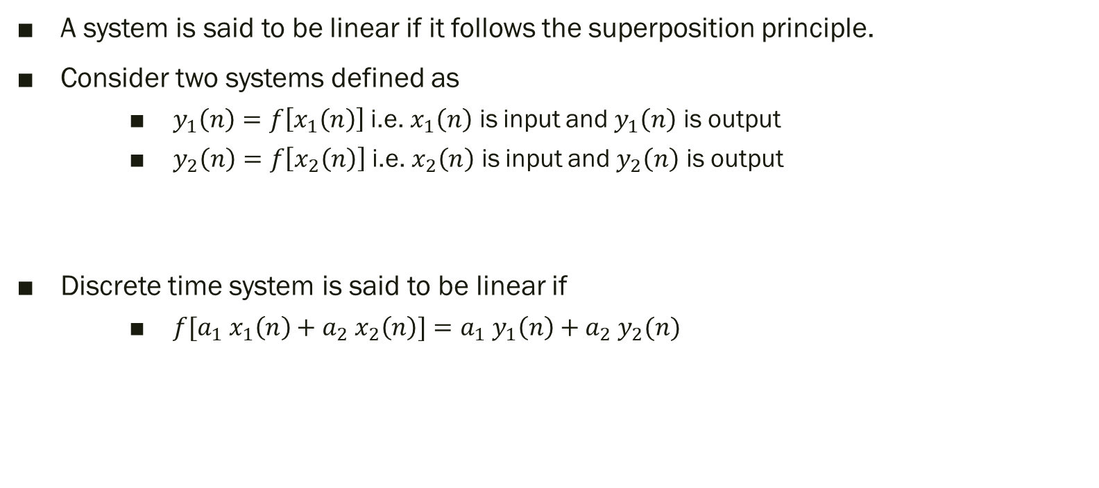
4) Linear and Non-Linear Systems
A system is said to be linear if it follows the superposition principle.
Consider two systems defined as
$y_{1}\left(n\right)=f\left[x_{1}\left(n\right)\right]$ i.e. $x_{1}\left(n\right)$ is input and $y_{1}\left(n\right)$ is output
$y_{2}\left(n\right)=f\left[x_{2}\left(n\right)\right]$ i.e. $x_{2}\left(n\right)$ is input and $y_{2}\left(n\right)$ is output
Discrete time system is said to be linear if
${f[a}_{1} x_{1}\left(n\right)+a_{2} x_{2}\left(n\right)]=a_{1} y_{1}\left(n\right)+a_{2} y_{2}(n)$

Slide 20
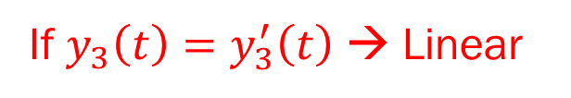
If $y_{3}\left(t\right)=y_{3}^{′}\left(t\right)$ → Linear

Slide 21
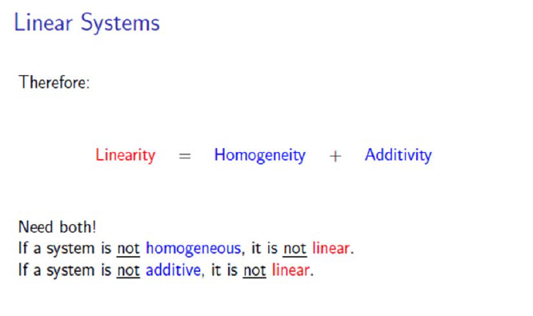

Slide 22

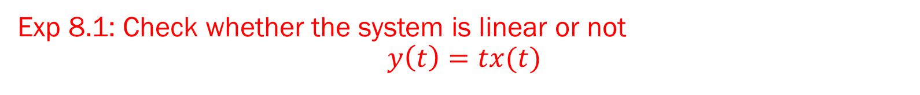

Exp 8.1: Check whether the system is linear or not $$y\left(t\right)=tx(t)$$
For RHS
Consider two systems
$y_{1}\left(t\right)=tx_{1}\left(t\right)$
$y_{2}\left(t\right)=tx_{2}\left(t\right)$
$y_{3}^{′}\left(t\right)=a_{1}y_{1}\left(t\right)+$ $a_{2}y_{2}\left(t\right)$
$y_{3}^{′}\left(t\right)=a_{1}tx_{1}\left(t\right)+$ $a_{2}tx_{2}\left(t\right)$
For LHS
$y_{3}\left(t\right)=f\left[{a_{1}x}_{1}\left(t\right)+{a_{2}x}_{2}\left(t\right)\right]$
$=t$ (${a_{1}x}_{1}\left(t\right)+{a_{2}x}_{2}\left(t\right))$
$=t$ ${a_{1}x}_{1}\left(t\right)+{{ta}_{2}x}_{2}\left(t\right)$
Since $y_{3}\left(t\right)=y_{3}^{′}\left(t\right)$ → Linear

Slide 23

5) Stable and Unstable Systems
When every bounded input produces bounded output. It is called Stable System.
Follows BIBO
If $\left|x(t)\right|≤M_{x}<∞$
$\left|x(n)\right|≤M_{x}<∞$
Then O/P is
$\left|y(t)\right|≤M_{x}<∞$
$\left|x(n)\right|≤M_{x}<∞$
Bounded Input
Bounded Output

Slide 24
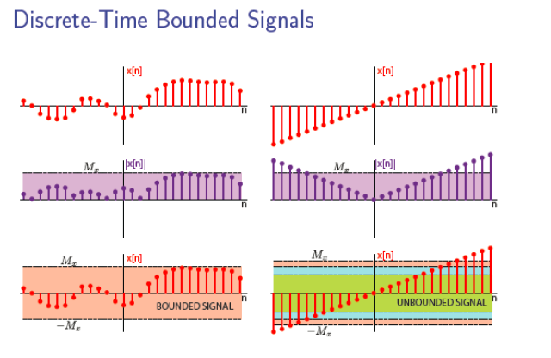

Slide 25
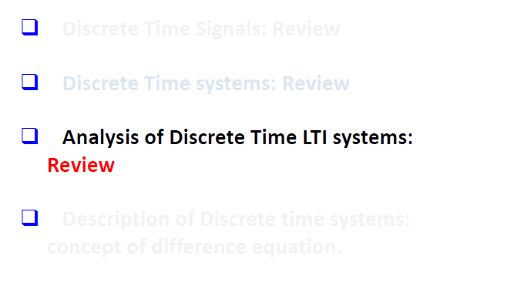

Slide 26
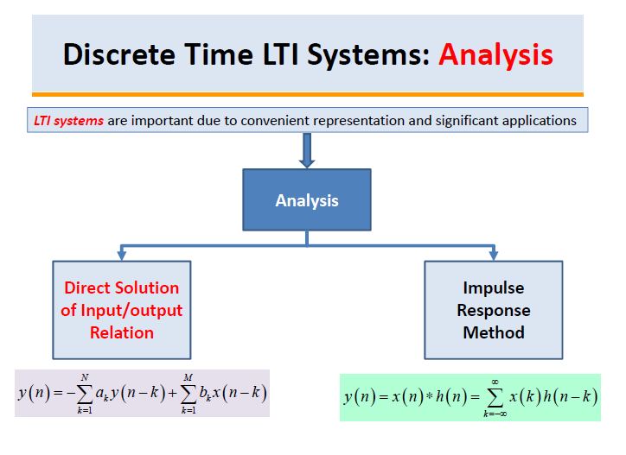

Slide 27
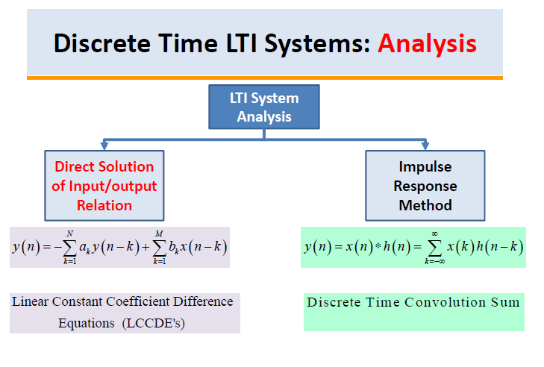

Slide 28
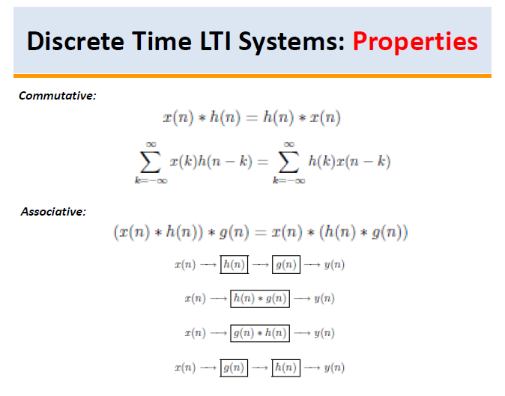

Slide 29
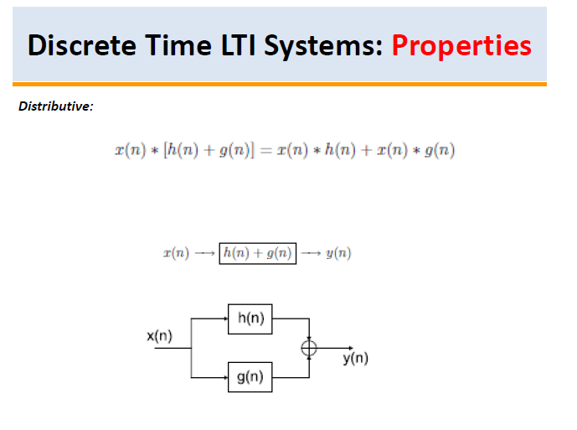

Slide 30
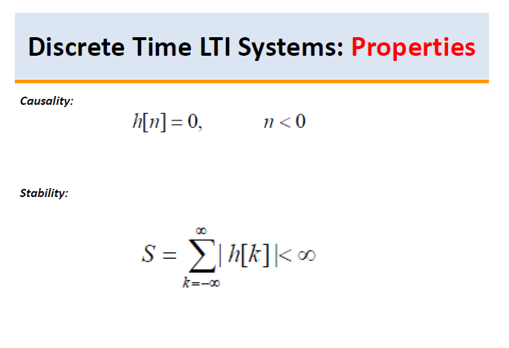

Slide 31
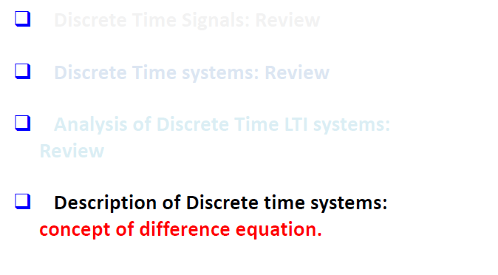

Slide 32
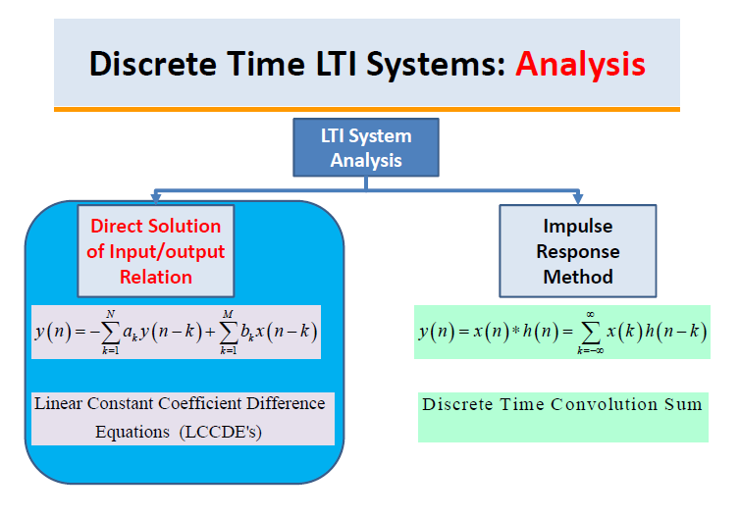

Slide 33
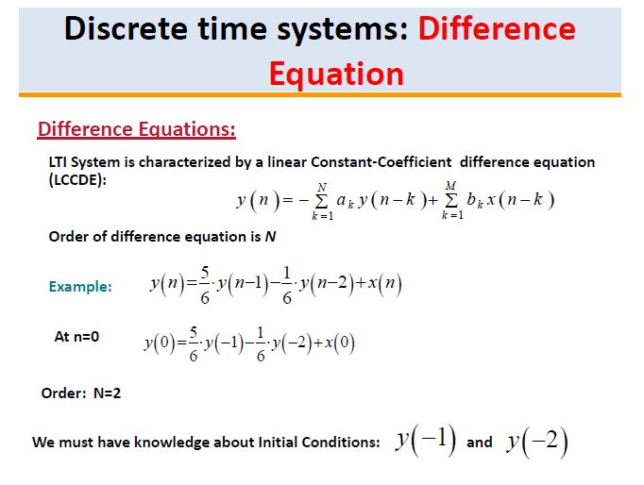

Slide 34
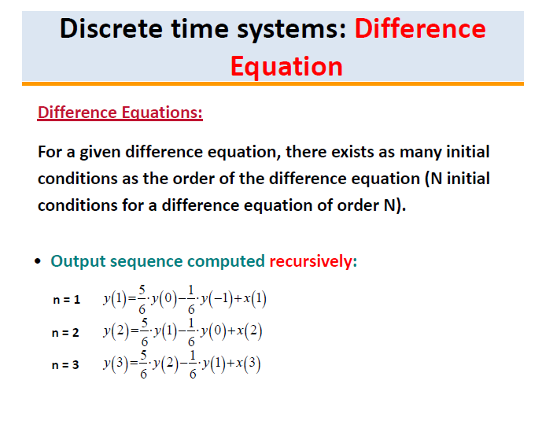

Slide 35
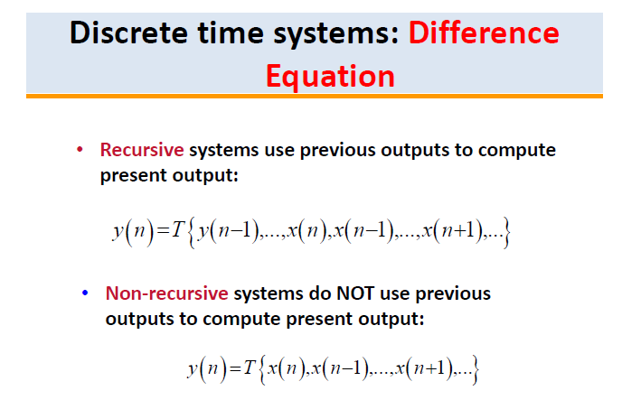

Slide 36
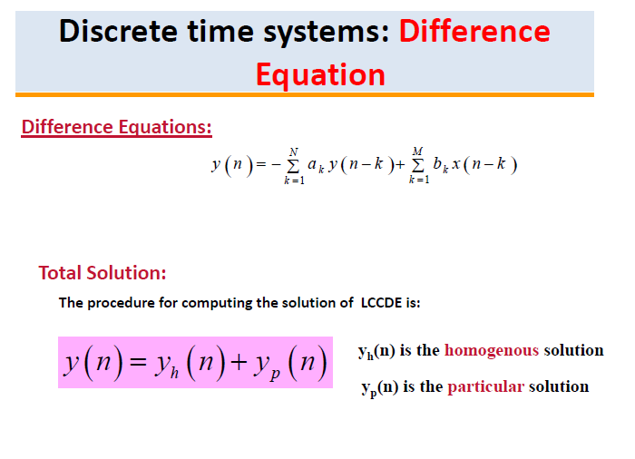

Slide 37
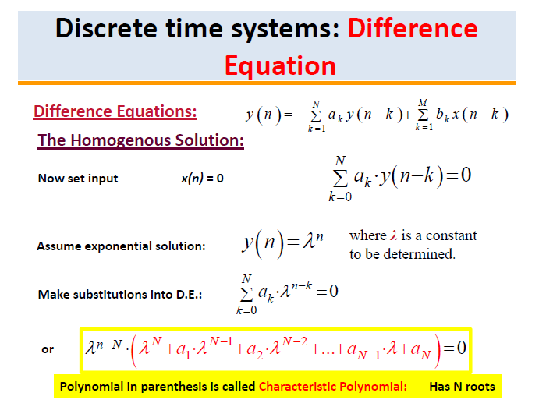

Slide 38
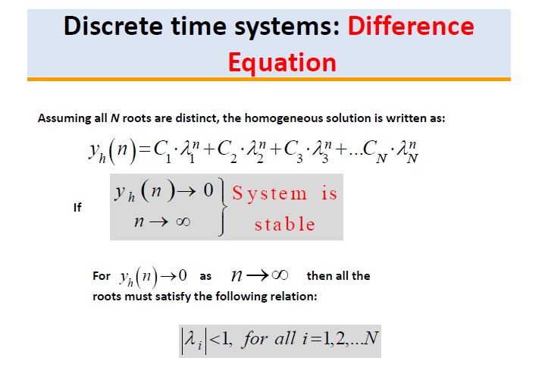

Slide 39
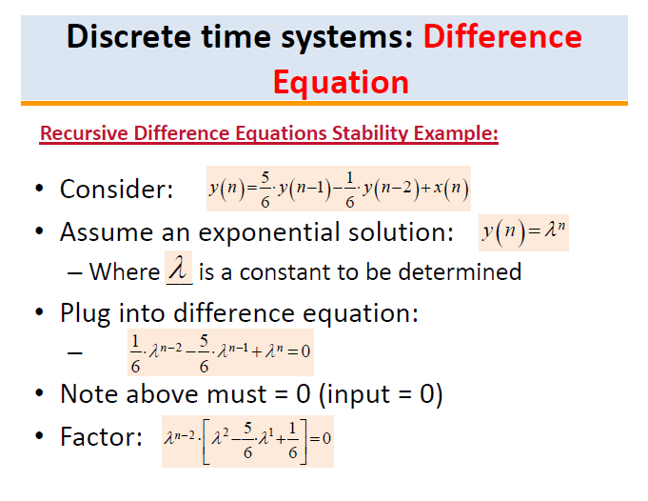

Slide 40
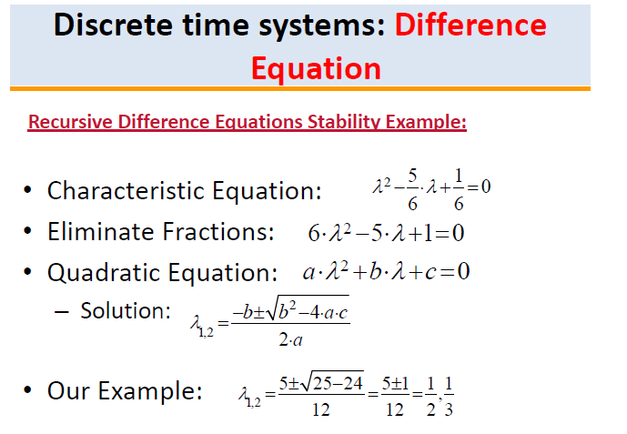

Slide 41
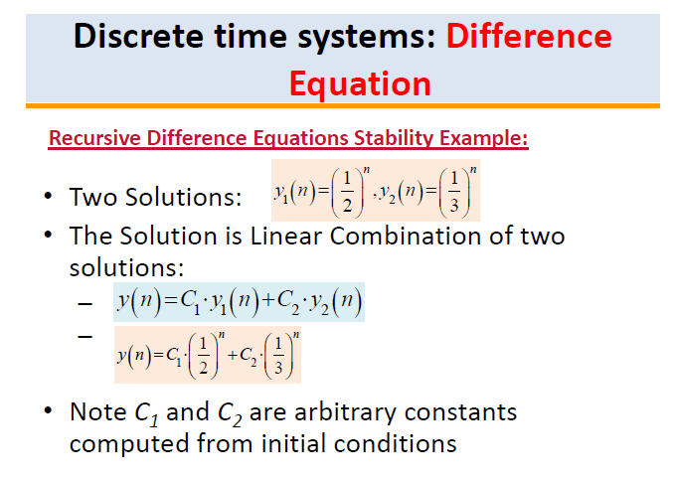

Slide 42
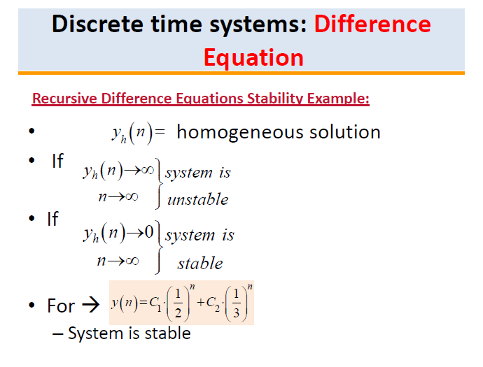

Slide 43
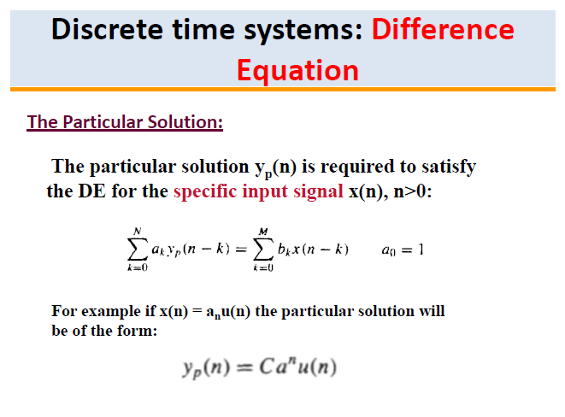

Slide 44
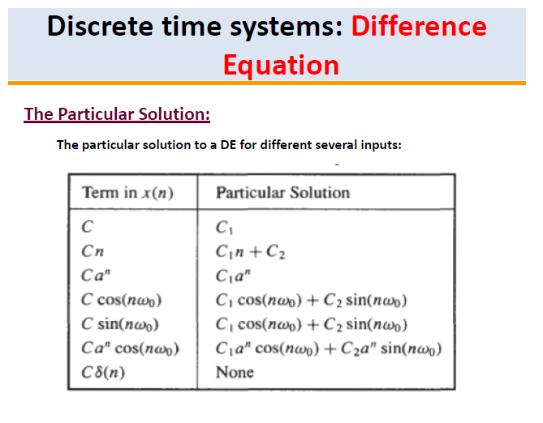

Slide 45
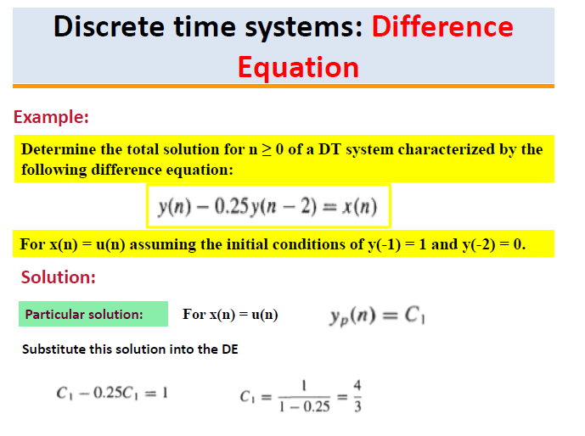

Slide 46
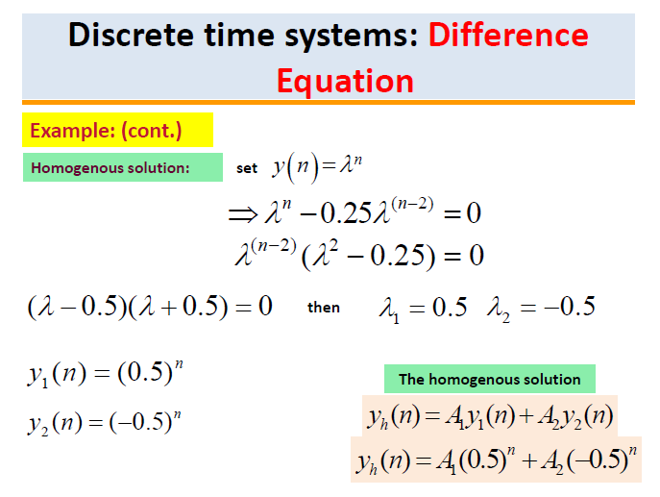

Slide 47
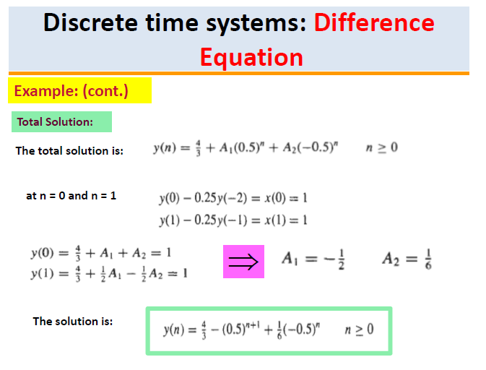

Slide 48
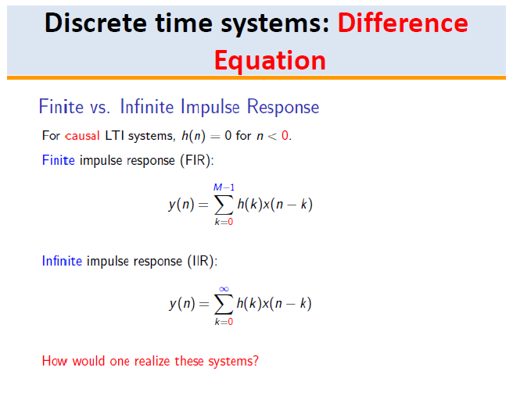

Slide 49


Slide 50


Slide 51


Slide 52


Slide 53


Slide 54


Slide 55


Slide 56


Slide 57


Slide 58


Slide 59


Slide 60


Slide 61


Slide 62
Thank You !!!

