Slide 1
Microprocessor Systems and Interfacing EEE 342
Nesruminallah
nesruminallah@cuilahore.edu.pk

Slide 2
Microprocessor 8088
CLO | Bloom Taxonomy | Specific Outcome
CLO1 | C2 | Comprehend the theoretical knowledge of computer architecture using hardware architectures
CLO2 | C5 | Integrate the RAM/ROM with 8088 microprocessors using NAND address decoding techniques.
Outline
Architecture of 8088
Pin layout of 8088
Pin Explanation of 8088
Type of Memories
Pin Configuration of Memory Chip
Interfacing with 8088

Slide 3
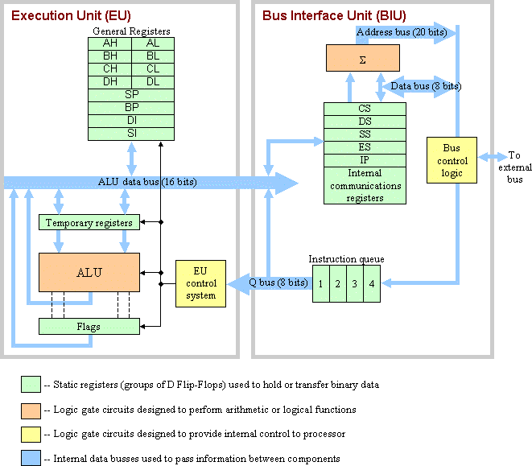
Architecture

Slide 4
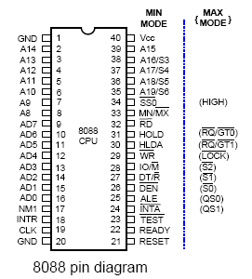
Pinout of 8088

Slide 5
Pinout of 8088
Pin Number | Description
1 | GND - Ground
2-8 | ADDR - Address Bus
9-16 | Data - Address Data Bus
17 | NMI - Non-Maskable Interrupt
18 | INTR - Interrupt Request
19 | CLK - Clock
20 | GND - Ground
21 | RESET - Reset
22 | READY - Ready
23 | TEST - Test (Active Low)
24 | INTA - Interrupt Acknowledge (Active Low)

Slide 6
Pinout of 8088
25 | ALE - Address Latch Enable
26 | DEN - Data Enable (Active Low)
27 | DT/R - Data Transmit/Receive
28 | IO/M - Status Line
29 | WR - Write (Active Low)
30 | HLDA - Hold A
31 | HOLD - Hold
32 | RD - Read (Active Low)
33 | MN/MX - Minimum or Maximum Mode
34 | SSO - Status Line (Active Low)
35-39 | ADDRESS/STATUS - Address/Status Information
40 | Vcc - Positive Power Supply

Slide 7
Pin Explanation
AD7-AD0 : address/data bus(multiplexed)
memory address or I/O port no : whenever ALE = 1
data : whenever ALE = 0
high-impedance state : during a hold acknowledge
AD15-AD8 : address/data bus(multiplexed)
memory address bits A15-A8 : whenever ALE = 1
data bits D15-D8 : whenever ALE = 0
high-impedance state : during a hold acknowledge
A19/S6-A16/S3 : address/status bus(multiplexed)
memory address A19-A16, status bits S6-S3
S6 : always remain a logic 0
S5 : indicate condition of IF flag bits
S4, S3 : show which segment is accessed during current bus cycle
S4, S3 : can used to address four separate 1M byte memory banks by decoding them as A21, A20

Slide 8
Pin Explanation
RD(bar) : read signal
data bus receive data from memory or I/O device :RD’=0
READY :
µ enter into wait states and remain idle : READY = 0
INTR : interrupt request
used to request a hardware interrupt
if INTR is held high when IF = 1 : µ enter interrupt acknowledge cycle(INTA’ become active) after current instruction has complete execution
TEST(bar)(BUSY(bar)) : tested by the WAIT instruction
WAIT instruction function as a NOP : if TEST’= 0
WAIT instruction wait for TEST’ to become 0:if TEST’=1
NMI : non-maskable interrupt
similar to INTR except that no check IF flag bit
if NMI is activated : use interrupt vector 2
RESET :
µ : reset if RESET held high for a minimum of four clock

Slide 9
Pin Explanation
CLK(CLOCK) : provide basic timing to µ duty cycle of 33%
VCC(power supply) : +5.0V, ±10%
GND(Ground) : two pins labeled GND
MN/MX(bar) : select either minimum or maximum mode (HIGH for minimum mode)
BHE(bar)/S7 : bus high enable
status of S7 : always a logic 1
BHE=0 at least one byte of current transfer is to be made AD15-AD8 ( HIGHER ORDER BYTE)
IO/M(bar)(8088) or M/IO(bar)(8086) : select memory or I/O
address bus : whether memory or I/O port address
WR(bar) : write signal(high impedance state during hold ack).
strobe that indicate that output data to memory or I/O
during WR(bar)=0 : data bus contains valid data for M or I/O

Slide 10
Pin Explanation
S6 : always remain a logic 0
S5 : indicate condition of IF flag bits
S4, S3 : show which segment is accessed during current bus cycle
S4, S3 : can used to address four separate 1M byte memory banks by decoding them as A21, A20
S4 | S3 | Function
0 | 0 | Extra Segment
0 | 1 | Stack Segment
1 | 0 | Code or no Segment
1 | 1 | Data Segment

Slide 11
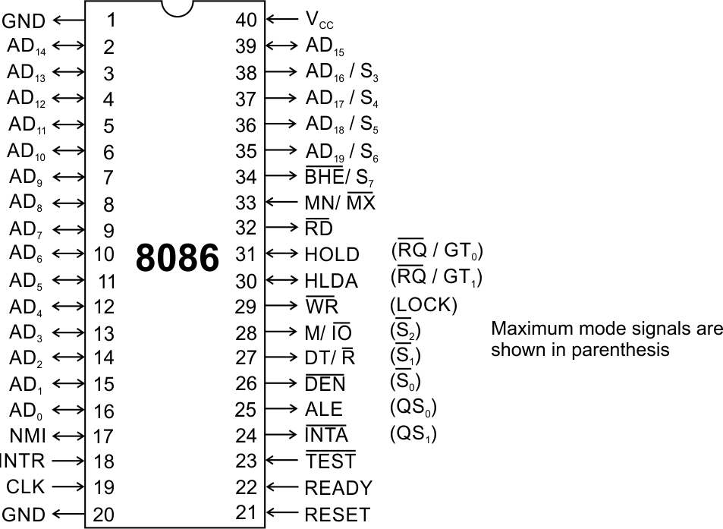
Pins and Signals
Common signals
AD₀-AD₁₅ (Bidirectional)
Address/Data bus
Low order address bus; these are multiplexed with data.
When AD lines are used to transmit memory address the symbol A is used instead of AD, for example A₀-A₁₅.
When data are transmitted over AD lines the symbol D is used in place of AD, for example D₀-D₇, D₈-D₁₅ or D₀-D₁₅.
A₁₆/S₃, A₁₇/S₄, A₁₈/S₅, A₁₉/S₆
High order address bus. These are multiplexed with status signals

Slide 12
Pins and Signals
Common signals
BHE (Active Low)/S₇ (Output)
Bus High Enable/Status
It is used to enable data onto the most significant half of data bus, D₈-D₁₅. 8-bit device connected to upper half of the data bus use BHE (Active Low) signal. It is multiplexed with status signal S₇.
MN/ MX
MINIMUM / MAXIMUM
This pin signal indicates what mode the processor is to operate in.
RD (Read) (Active Low)
The signal is used for read operation.
It is an output signal.
It is active when low.

Slide 13
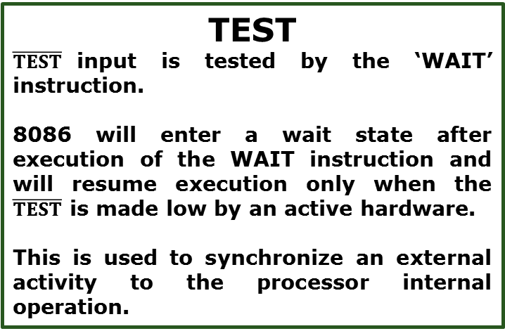
Pins and Signals
Common signals
TEST
$\overline{TEST}$input is tested by the ‘WAIT’ instruction.
8086 will enter a wait state after execution of the WAIT instruction and will resume execution only when the $\overline{TEST}$ is made low by an active hardware.
This is used to synchronize an external activity to the processor internal operation.
READY
This is the acknowledgement from the slow device or memory that they have completed the data transfer.
The signal made available by the devices is synchronized by the 8284A clock generator to provide ready input to the 8086.
The signal is active high.

Slide 14
Pins and Signals
Common signals
RESET (Input)
Causes the processor to immediately terminate its present activity.
The signal must be active HIGH for at least four clock cycles.
CLK
The clock input provides the basic timing for processor operation and bus control activity. Its an asymmetric square wave with 33% duty cycle.
INTR Interrupt Request
This is a triggered input. This is sampled during the last clock cycles of each instruction to determine the availability of the request. If any interrupt request is pending, the processor enters the interrupt acknowledge cycle.
This signal is active high and internally synchronized.

Slide 15
Pins and Signals
Min/ Max Pins
The 8086 microprocessor can work in two modes of operations : Minimum mode and Maximum mode.
In the minimum mode of operation the microprocessor do not associate with any co-processors and can not be used for multiprocessor systems.
In the maximum mode the 8086 can work in multi-processor or co-processor configuration.
Minimum or maximum mode operations are decided by the pin MN/ MX(Active low).
When this pin is high 8086 operates in minimum mode otherwise it operates in Maximum mode.

Slide 16
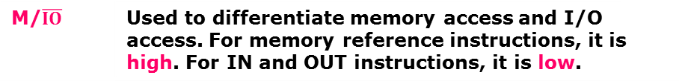

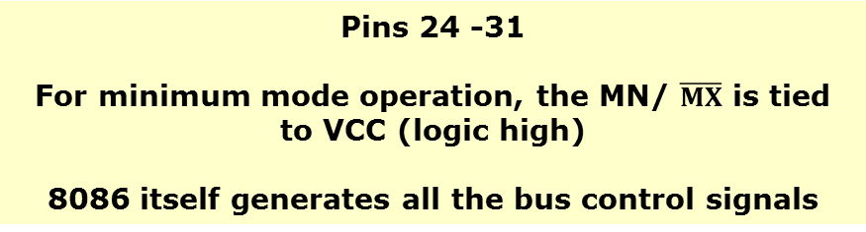

Pins and Signals
Minimum mode signals
Pins 24 -31
For minimum mode operation, the MN/ $\overline{MX}$ is tied to VCC (logic high)
8086 itself generates all the bus control signals
DT/$\overline{R}$ | (Data Transmit/ Receive) Output signal from the processor to control the direction of data flow through the data transceivers
$$\overline{DEN}$$ | (Data Enable) Output signal from the processor used as out put enable for the transceivers
ALE | (Address Latch Enable) Used to demultiplex the address and data lines using external latches
M/$\overline{IO}$ | Used to differentiate memory access and I/O access. For memory reference instructions, it is high. For IN and OUT instructions, it is low.
$$\overline{WR}$$ | Write control signal; asserted low Whenever processor writes data to memory or I/O port
$$\overline{INTA}$$ | (Interrupt Acknowledge) When the interrupt request is accepted by the processor, the output is low on this line.

Slide 17
Pins and Signals
Minimum mode signals
Pins 24 -31
For minimum mode operation, the MN/ $\overline{MX}$ is tied to VCC (logic high)
8086 itself generates all the bus control signals
HOLD | Input signal to the processor form the bus masters as a request to grant the control of the bus. Usually used by the DMA controller to get the control of the bus.
HLDA | (Hold Acknowledge) Acknowledge signal by the processor to the bus master requesting the control of the bus through HOLD. The acknowledge is asserted high, when the processor accepts HOLD.

Slide 18
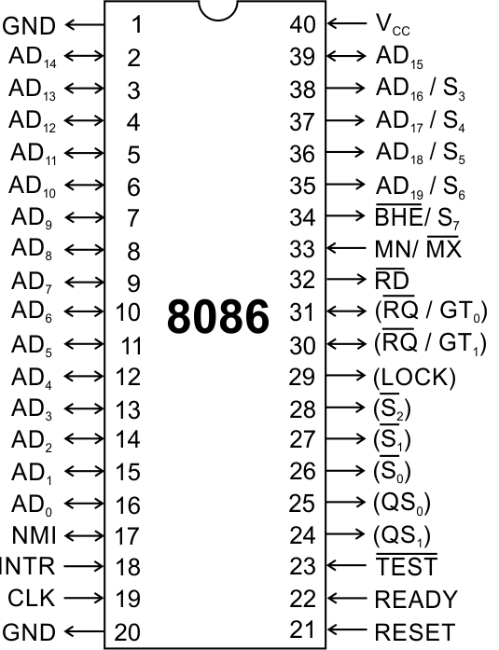
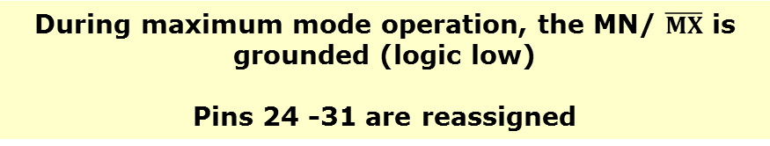
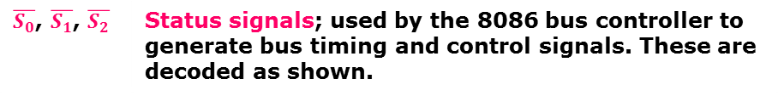
Pins and Signals
Maximum mode signals
During maximum mode operation, the MN/ $\overline{MX}$ is grounded (logic low)
Pins 24 -31 are reassigned
$\overline{S_{0}}$, $\overline{S_{1}}$, $\overline{S_{2}}$ | Status signals; used by the 8086 bus controller to generate bus timing and control signals. These are decoded as shown.

Slide 19
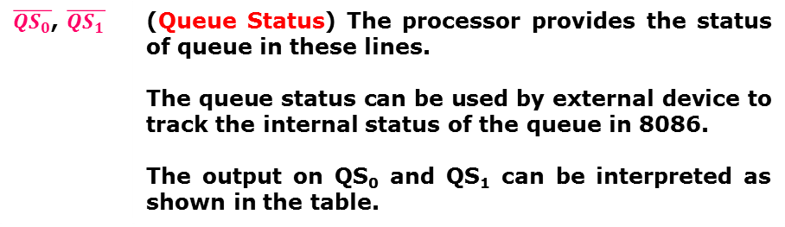
Pins and Signals
Maximum mode signals
During maximum mode operation, the MN/ $\overline{MX}$ is grounded (logic low)
Pins 24 -31 are reassigned
$\overline{{QS}_{0}}$, $\overline{QS_{1}}$ | (Queue Status) The processor provides the status of queue in these lines. The queue status can be used by external device to track the internal status of the queue in 8086. The output on QS₀ and QS₁ can be interpreted as shown in the table.

Slide 20
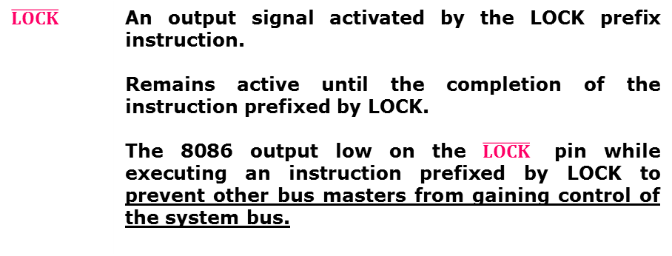
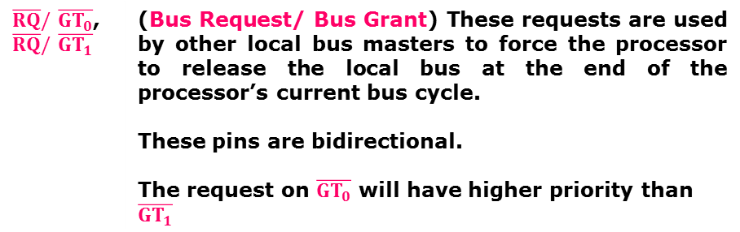
Pins and Signals
Maximum mode signals
During maximum mode operation, the MN/ $\overline{MX}$ is grounded (logic low)
Pins 24 -31 are reassigned
$\overline{RQ}/\overline{GT_{0}}$, $\overline{RQ}/\overline{GT_{1}}$ | (Bus Request/ Bus Grant) These requests are used by other local bus masters to force the processor to release the local bus at the end of the processor’s current bus cycle. These pins are bidirectional. The request on$\overline{GT_{0}}$ will have higher priority than$\overline{GT_{1}}$
$$\overline{LOCK}$$ | An output signal activated by the LOCK prefix instruction. Remains active until the completion of the instruction prefixed by LOCK. The 8086 output low on the $\overline{LOCK}$ pin while executing an instruction prefixed by LOCK to prevent other bus masters from gaining control of the system bus.

Slide 21
Memories
Every microprocessor-based system has memories
Semiconductor memories are used as primary storage of data and code
These memories are directly connected to CPU
Two main type of memories
RAM (Random Access Memory)
ROM (Read Only Memory)
Memory Capacity
The number of bits a memory chip can store

Slide 22
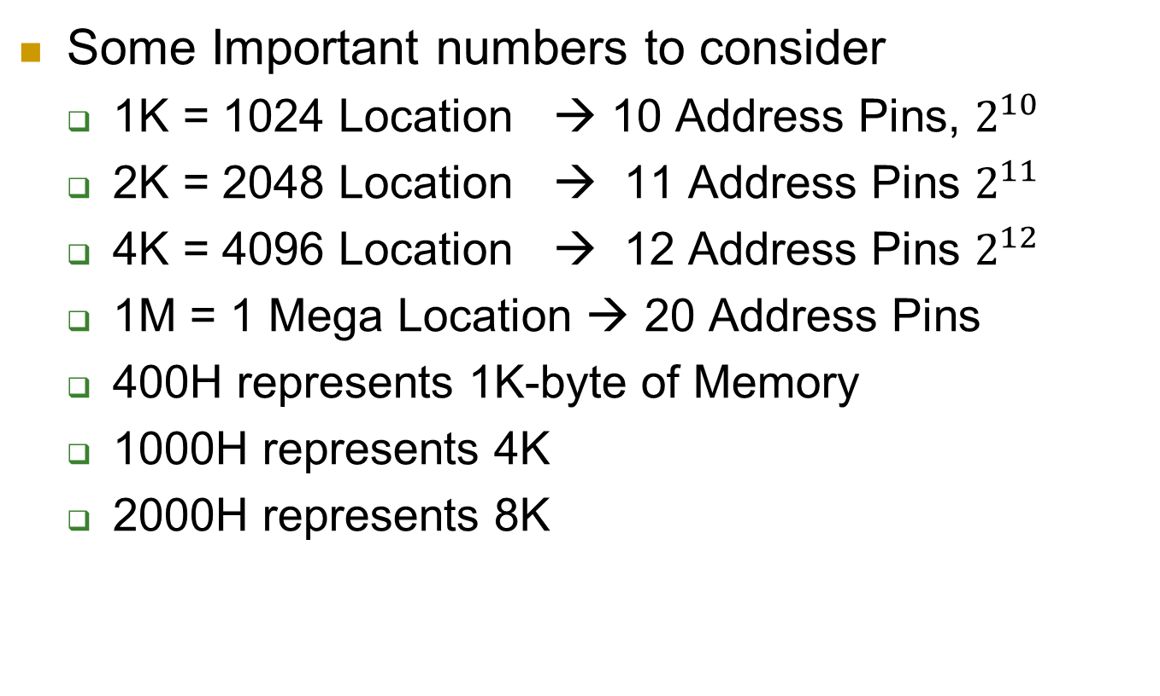
Memories
Some Important numbers to consider
1K = 1024 Location → 10 Address Pins, $2^{10}$
2K = 2048 Location → 11 Address Pins $2^{11}$
4K = 4096 Location → 12 Address Pins $2^{12}$
1M = 1 Mega Location → 20 Address Pins
400H represents 1K-byte of Memory
1000H represents 4K
2000H represents 8K

Slide 23
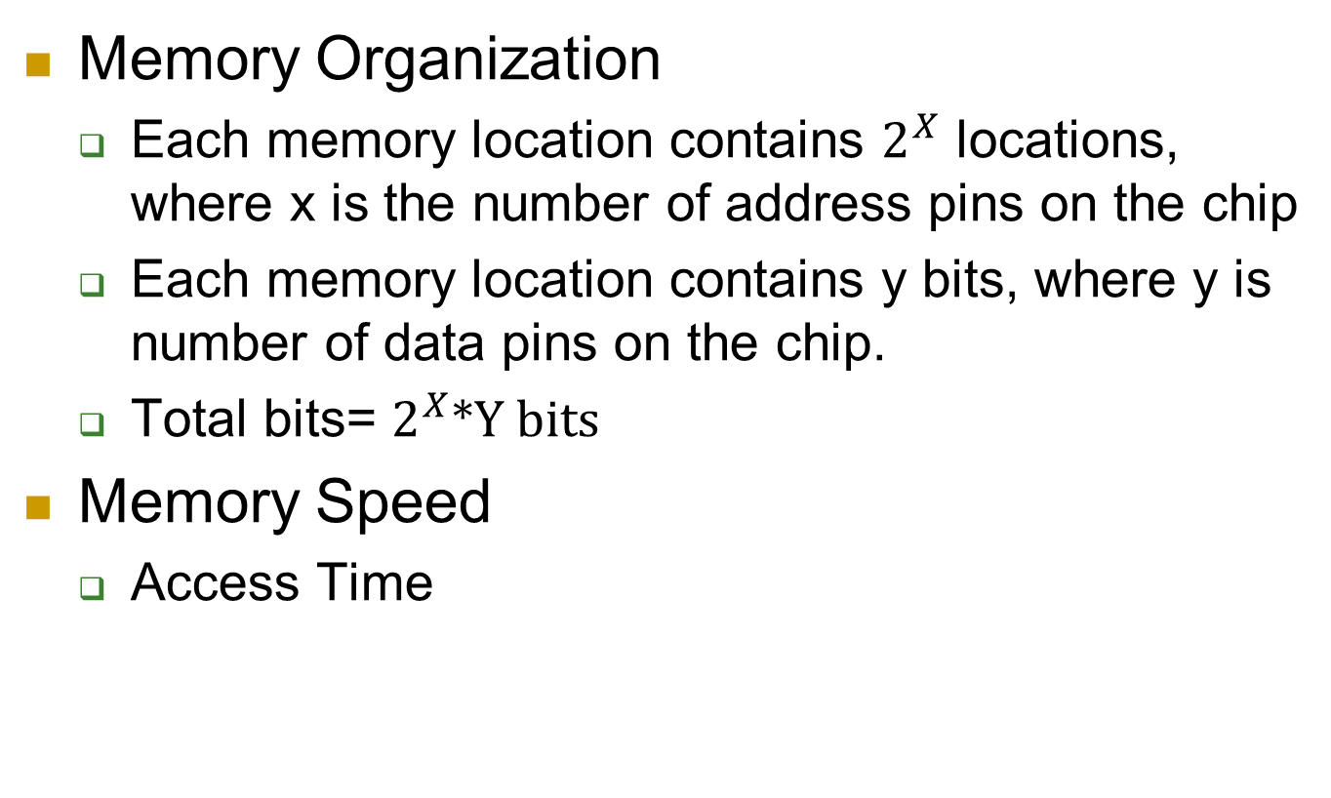
Memories
Memory Organization
Each memory location contains $2^{X}$ locations, where x is the number of address pins on the chip
Each memory location contains y bits, where y is number of data pins on the chip.
Total bits= $2^{X}∗Y bits$
Memory Speed
Access Time

Slide 24
Pin configuration of Memory Chips
Pin connections common to all memory devices.
The address inputs
Data outputs or input
Some type of selection input
At least one control input used to select a read or write operation.
Memory device has one chip select, chip enable or select
Memory device has control pin

Slide 25
Pin configuration of Memory Chips

Slide 26
Address Connections
Memory devices have address inputs to select a memory location within the device.
The number of address pins on a memory device is determined by the number of memory locations found within it.
A 1K memory device has 10 address pins. therefore, 10 address inputs are required to select any of its 1024 memory locations.
It takes a 10-bit binary number to select any single location

Slide 27
Data Connections
All memory devices have a set of data outputs or input/outputs.
An 8-bit-wide memory device is often called a byte-wide memory.
Catalog listings of memory devices often refer to memory locations times bits per location.
A memory device with 1K memory locations and 8 bits in each location is often listed as a 1K x 8 by the manufacturer
Memory devices are often classified according to total bit capacity.

Slide 28
Select Connections
Each memory device has an input that selects or enables the memory device.
This type of input is most often called a chip select (G2A) chip enable (CE) or simply select (S) input.
RAM memory generally has at least one or input, and ROM has at least one
If more than one CE connection is present, all must be activated to read or write data.

Slide 29
Control Connections
All memory devices have some form of control input or inputs.
ROM usually has one control input, while RAM often has one or two control inputs
Control input often found on ROM is the output enable or gate connection, which allows data flow from output data pins.
RAM has either one or two control inputs.
if one control input, it is often called R/W

Slide 30
Control Connections
If the RAM has two control inputs, they are usually labeled WE (or W ), and OE (or G ).
write enable must be active to perform memory write, and OE active to perform a memory read
when the two controls are present, they must never both be active at the same time
If both inputs are inactive, data are neither written nor read.

Slide 31

Memory Hierarchy
Address |  | Actual Memory Location
000F
000E
000D
000C
000B
000A
0009
0008
0007
0006
0005
0004
0003
0002
0001
0000
Assume a memory 16 X 8
Address Pins required $2^{4}=16$
So 4 Address pins are required i-e: A0 to A3
Data pins, always D0 to D7

Slide 32
ROM Memory
Read-only memory (ROM) permanently stores programs/data resident to the system.
must not change when power disconnected
Often called nonvolatile memory, because its contents do not change even if power is disconnected.
programmed during fabrication at the factory
The EPROM (erasable programmable read-only memory) is commonly used when software must be changed often.
An EPROM is programmed in the field

Slide 33
ROM Memory
Type of EPROM
PROM memory devices are also available, although they are not as common today.
The PROM (programmable read-only memory) is also programmed in the field
Once it is programmed, it cannot be erased.
A newer type of read-mostly memory (RMM) is called the flash memory.
also often called an EEPROM (electrically erasable programmable ROM), EAROM (electrically alterable ROM) or NOVRAM (nonvolatile RAM)

Slide 34
ROM Memory
Electrically erasable in the system, but they require more time to erase than normal RAM.
The flash memory device is used to store setup information for systems such as the video card in the computer.
Flash has all but replaced the EPROM in most computer systems for the BIOS.
some systems contain a password stored in the flash memory device

Slide 35
Interfacing with 8088

Slide 36
Why Decode Memory?
The 8088 has 20 address connections and the RAM/ROM has X connections.
The 8088 sends out a 20-bit memory address whenever it reads or writes data.
– because the RAM/ROM has only X address pins, there is a mismatch that must be corrected
The decoder corrects the mismatch by decoding address pins that do not connect to the memory component.
Types of Decoder
NAND Gate Decoder
3-8 Line Decoder

Slide 37
NAND Gate Decoder
When the 2K x 8 SRAM is used:
2K X 8 EPROM, 2¹¹ = 2K
Address connections A₁₀-A₀
Remaining 9-pins (A₁₉-A₁₁) are used for Decoding
Example
A 2K EPROM is decoded at memory address locations FF800H
Starting Address = 1111 1111 1000 0000 0000 = FF800H
Ending Address = FF800H + 2K -1 = FFFFFH
1111 1111 1111 1111 1111 = FFFFFH
1111 1111 1XXX XXXX XXXX

Slide 38
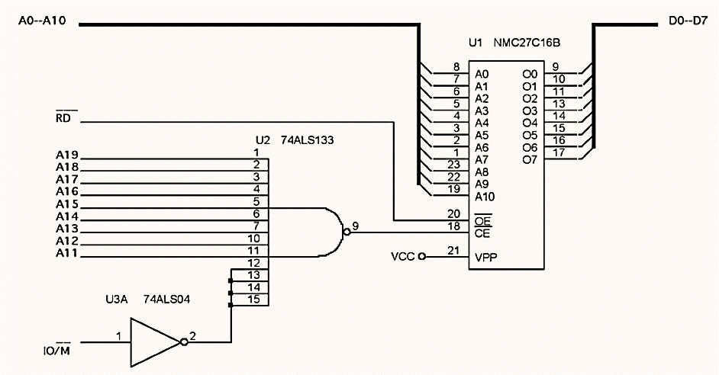
NAND Gate Decoder
Address FF800H to FFFFFH.

Slide 39
NAND Gate Decoder
When the 64K x 8 SRAM is used:
Address connections A15–A0 of 8088 are connected to address inputs A15–A0 of the SRAM.
The remaining four address pins (A19–A16) are connected to a NAND gate decoder

Slide 40
NAND Gate Decoder
In this circuit a NAND gate decodes the memory address, as seen in the above figure.
The memory will be enabled only when A19-A16 = 1110.
The 64K SRAM is mapped to the address range E0000H to EFFFFH.

Slide 41
NAND Gate Decoder
In this circuit a NAND gate decodes the memory address, as seen in the above figure.
The memory will be enabled only when A19-A16 = 1100.
The 64K SRAM is mapped to the address range C0000H to CFFFFH.

Slide 42
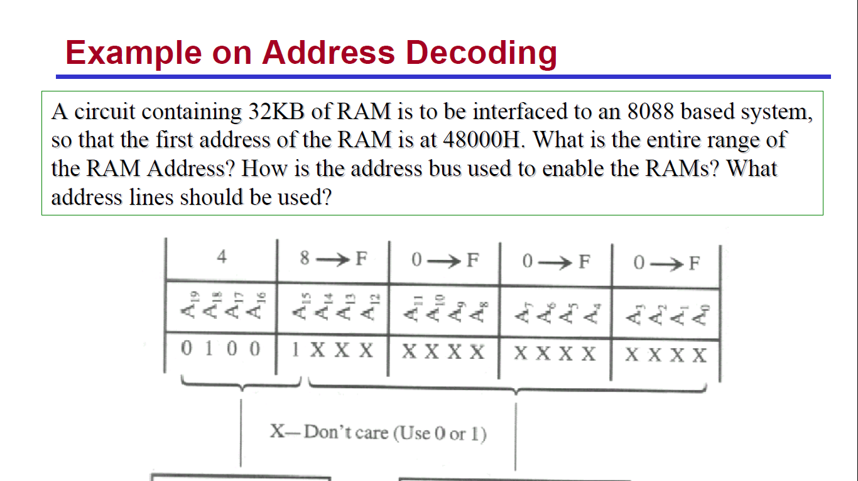
NAND Gate Decoder

Slide 43
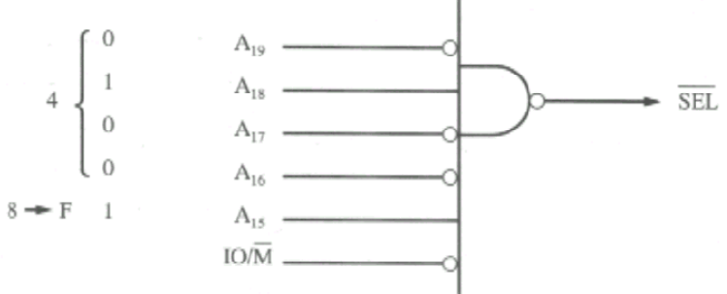
NAND Gate Decoder
Address 48000H to 4FFFFH.

