Slide 1
Microprocessor Systems and Interfacing
EEE 342
Nesruminallah
nesruminallah@cuilahore.edu.pk

Slide 2
Introduction to 8086 & Programming Model
CLO | Bloom Taxonomy | Specific Outcome
CLO1 | C2 | Comprehend the theoretical knowledge of microprocessor and microcontroller using hardware architecture
Outline
  Introduction to MPU System
  History of Microprocessors
  Basic Concepts of Microprocessor Architecture
  Registers and Flags

Slide 3
Introduction
MICROCOMPUTERS AND MICROPROCESSORS
There are three major parts of a Computer System.
  Central Processing Unit (CPU): Also simply called as the microprocessor acts as the brain coordinating all activities within a computer.
  The Memory: The program instructions and data are primarily stored.
  The Input/output (I/O) Devices: Allow the computer to input information for processing and then output the results. I/O Devices are also known as computer peripherals.
The integrated Circuit (IC) chip containing the CPU is called the microprocessor and the entire computer including the microprocessor, memory and I/O is called a microcomputer.

Slide 4
Introduction
The CPU is connected to memory and I/O devices through a strip of wires called a bus. The bus inside a computer carries information from place to place. In every computer there are three types of busses:
  Address Bus: The address bus is used to identify the memory location or I/O device the processor intends to communicate with
  Data Bus: Data bus is used by the CPU to get data from / to send data to the memory or the I/O devices.
  Control Bus: Each time the processor outputs an address it also activates one of the four control bus signals: Memory Read, Memory Write, I/O Read and I/O Write.

Slide 5
Introduction
The address and control bus contains output lines only, therefore it is unidirectional, but the data bus is bidirectional.
There two types of memory used in microcomputers:
  RAM (Random Access Memory/ Read-Write memory) is used by the computer for the temporary storage of the programs that is running. Data is lost when the computer is turned off. So known as volatile memory.
  ROM (Read Only Memory) the information in ROM is permanent and not lost when the power is turned off. Therefore, it is called nonvolatile memory.
Note that RAM is sometimes referred as primary storage, where magnetic /optical disks are called secondary storage.

Slide 6
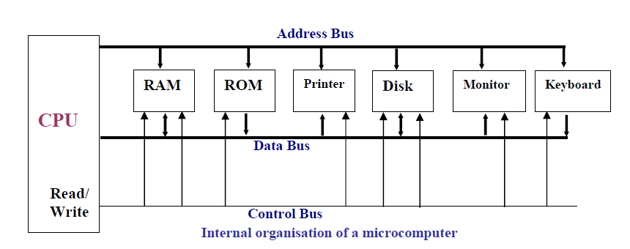
Introduction

Slide 7
Introduction
Inside the CPU:
A program stored in the memory provides instructions to the CPU to perform a specific action. This action can be a simple addition. It is function of the CPU to fetch the program instructions from the memory and execute them.
1. The CPU contains a number of registers to store information inside the CPU temporarily.
  Registers inside the CPU can be 8-bit, 16-bit, 32-bit or even 64-bit depending on the CPU.
2. The CPU also contains Arithmetic and Logic Unit (ALU). The ALU performs arithmetic (add, subtract, multiply, divide) and logic (AND, OR, NOT) functions.

Slide 8
Introduction
3. The CPU contains a program counter also known as the Instruction Pointer to point the address of the next instruction to be executed.
4. Instruction Decoder is a kind of dictionary which is used to interpret the meaning of the instruction fetched into the CPU. Appropriate control signals are generated according to the meaning of the instruction.

Slide 9
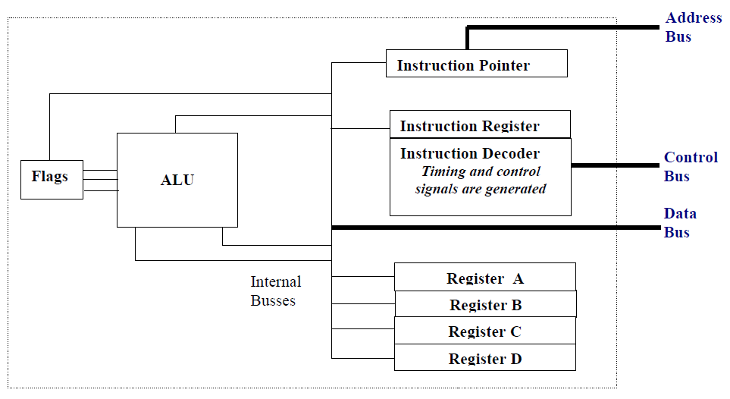
Introduction

Slide 10
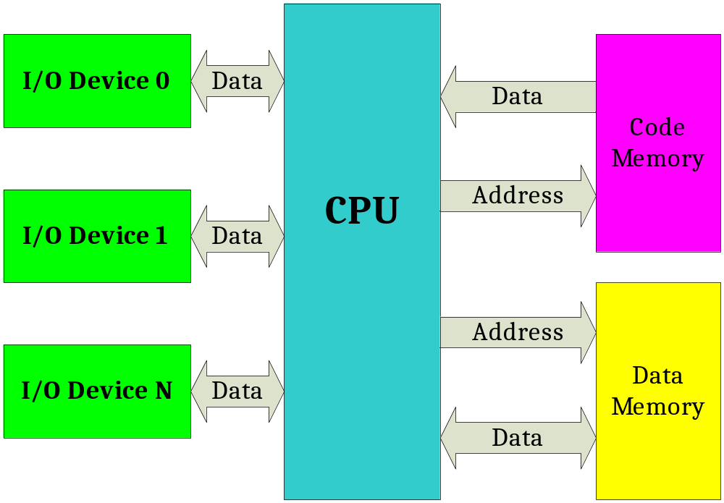
Introduction

Slide 11
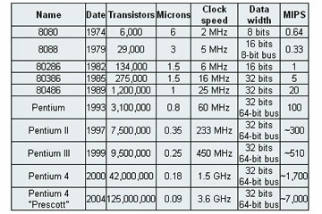
History

Slide 12
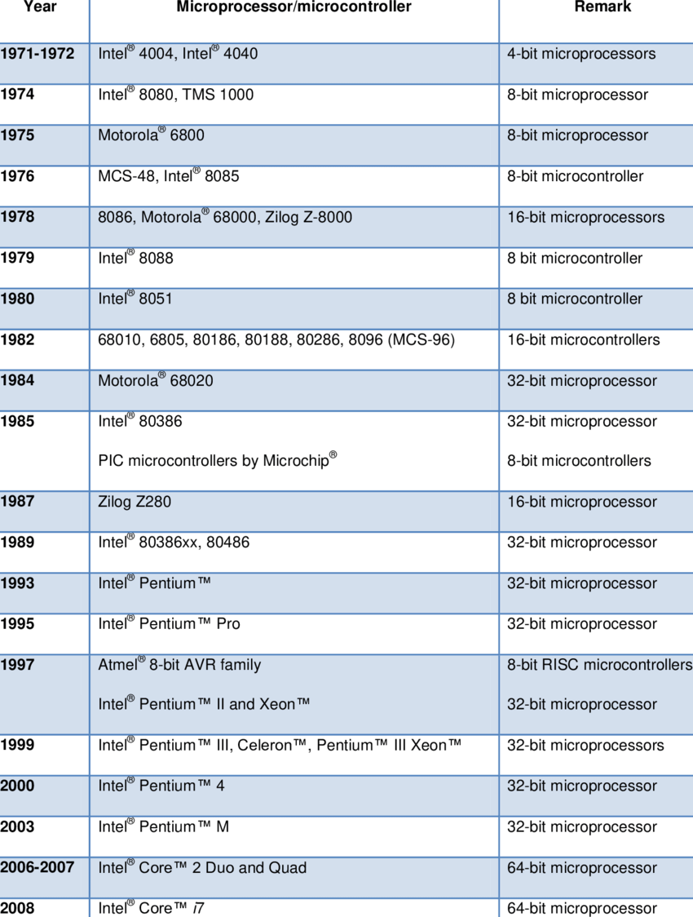
History

Slide 13
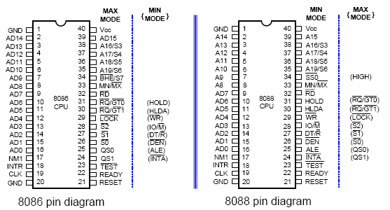
Pinout of 8086 & 8088

Slide 14
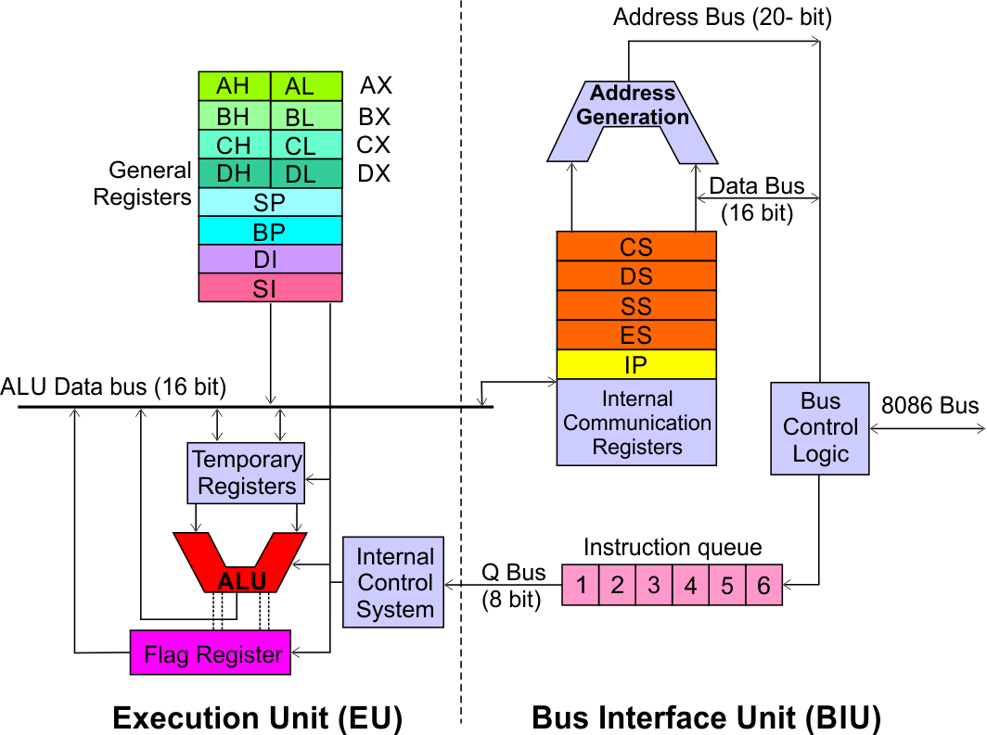
Architecture
Execution Unit (EU)
EU executes instructions that have already been fetched by the BIU.
BIU and EU functions separately.
Bus Interface Unit (BIU)
BIU fetches instructions, reads data from memory and I/O ports, writes data to memory and I/ O ports.

Slide 15
Architecture
Bus Interface Unit (BIU)
Dedicated Adder to generate 20 bit address
Four 16-bit segment registers
Code Segment (CS)
Data Segment (DS)
Stack Segment (SS)
Extra Segment (ES)
Segment Registers >>

Slide 16
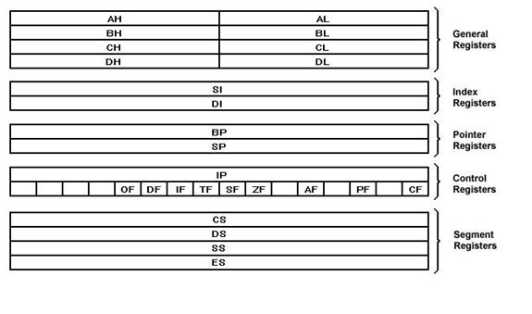
Microprocessor Architecture

Slide 17
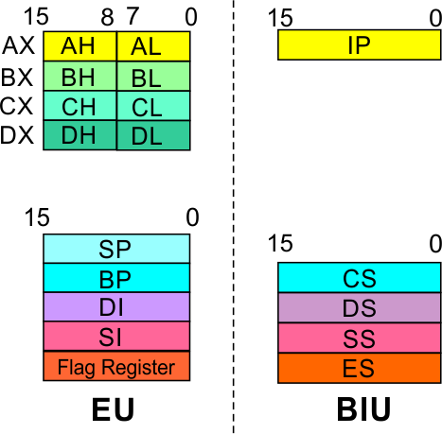
Architecture
Bus Interface Unit (BIU)
Segment
Registers
Data Segment Register
16-bit
Points to the current data segment; operands for most instructions are fetched from this segment.
The 16-bit contents of the Source Index (SI) or Destination Index (DI) or a 16-bit displacement are used as offset for computing the 20-bit physical address.

Slide 18
Architecture
Bus Interface Unit (BIU)
Segment
Registers
Stack Segment Register
16-bit
Points to the current stack.
The 20-bit physical stack address is calculated from the Stack Segment (SS) and the Stack Pointer (SP) for stack instructions such as PUSH and POP.
In based addressing mode, the 20-bit physical stack address is calculated from the Stack segment (SS) and the Base Pointer (BP).

Slide 19
Architecture
Bus Interface Unit (BIU)
Segment
Registers
Extra Segment Register
16-bit
Points to the extra segment in which data (in excess of 64K pointed to by the DS) is stored.
String instructions use the ES and DI to determine the 20-bit physical address for the destination.

Slide 20
Architecture
Bus Interface Unit (BIU)
Segment
Registers
Instruction Pointer
16-bit
Always points to the next instruction to be executed within the currently executing code segment.
So, this register contains the 16-bit offset address pointing to the next instruction code within the 64Kb of the code segment area.
Its content is automatically incremented as the execution of the next instruction takes place.

Slide 21
Multipurpose Registers
AX (accumulator) 16-bit register
  The accumulator is used for instructions such as multiplication, division, and some of the adjustment instructions. For these instructions, the accumulator has a special purpose, but is generally considered to be a multipurpose register.
BX (base index) register
  Sometimes holds the offset address of a location in the memory system in all versions of the microprocessor.
CX, CH, or CL, is a (count) register
  General-purpose register that also holds the count for various instructions.

Slide 22
Multipurpose Registers
CX, CH, or CL, is a (count) register
  General-purpose register that also holds the count for various instructions.
DX , DH, or DL, is a (data) register
  It holds a part of the result from a multiplication or part of the dividend before a division.
DI (destination index)
  It often addresses string destination data for the string instructions.
SI (source index)
  The source index register often addresses source string data for the string instructions.

Slide 23
Special-Purpose Registers.
The special-purpose registers include IP, SP, FLAGS and the segment registers include CS, DS, ES, SS, FS, and GS.
IP (instruction pointer)
  It addresses the next instruction in a section of memory defined as a code segment
SP (stack pointer)
  The stack memory stores data through this pointer.

Slide 24
Architecture
Execution Unit (EU)
EU
Registers
Accumulator Register (AX)
Consists of two 8-bit registers AL and AH, which can be combined together and used as a 16-bit register AX.
AL in this case contains the low order byte of the word, and AH contains the high-order byte.
The I/O instructions use the AX or AL for inputting / outputting 16 or 8 bit data to or from an I/O port.
Multiplication and Division instructions also use the AX or AL.

Slide 25
Architecture
Execution Unit (EU)
EU
Registers
Base Register (BX)
Consists of two 8-bit registers BL and BH, which can be combined together and used as a 16-bit register BX.
BL in this case contains the low-order byte of the word, and BH contains the high-order byte.
This is the only general purpose register whose contents can be used for addressing the 8086 memory.
All memory references utilizing this register content for addressing use DS as the default segment register.

Slide 26
Architecture
Execution Unit (EU)
EU
Registers
Counter Register (CX)
Consists of two 8-bit registers CL and CH, which can be combined together and used as a 16-bit register CX.
When combined, CL register contains the low order byte of the word, and CH contains the high-order byte.
Instructions such as SHIFT, ROTATE and LOOP use the contents of CX as a counter.
Example:
The instruction LOOP START automatically decrements CX by 1 without affecting flags and will check if [CX] = 0.
If it is zero, 8086 executes the next instruction; otherwise the 8086 branches to the label START.

Slide 27
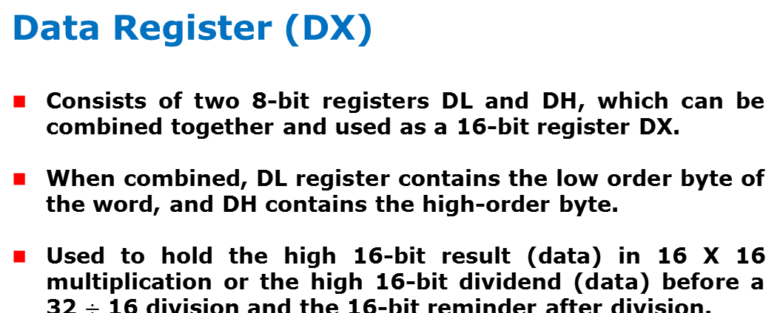
Architecture
Execution Unit (EU)
EU
Registers

Slide 28
Architecture
Execution Unit (EU)
EU
Registers
Stack Pointer (SP) and Base Pointer (BP)
SP and BP are used to access data in the stack segment.
SP is used as an offset from the current SS during execution of instructions that involve the stack segment in the external memory.
SP contents are automatically updated (incremented/ decremented) due to execution of a POP or PUSH instruction.
BP contains an offset address in the current SS, which is used by instructions utilizing the based addressing mode.

Slide 29
Architecture
Execution Unit (EU)
EU
Registers
Source Index (SI) and Destination Index (DI)
Used in indexed addressing.
Instructions that process data strings use the SI and DI registers together with DS and ES respectively in order to distinguish between the source and destination addresses.

Slide 30
Architecture
Execution Unit (EU)
EU
Registers
Source Index (SI) and Destination Index (DI)
Used in indexed addressing.
Instructions that process data strings use the SI and DI registers together with DS and ES respectively in order to distinguish between the source and destination addresses.

Slide 31
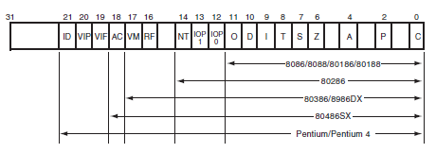
Flags
It indicate the condition of the microprocessor and control its operation.

Slide 32
Flags
It indicate the condition of the microprocessor and control its operation.
C (carry)
  Carry holds the carry after addition or the borrow after subtraction. The carry flag also indicates error conditions, as dictated by some programs and procedures.
P (parity)
  Parity is a logic 0 for odd parity and a logic 1 for even parity. Parity is the count of ones in a number expressed as even or odd.

Slide 33
Flags
A (auxiliary carry)
  The auxiliary carry holds the carry (half-carry) after addition or the borrow after subtraction between bit positions 3 and 4 of the result
Z (zero)
  The zero flag shows that the result of an arithmetic or logic operation is zero.
S (sign)
  The sign flag holds the arithmetic sign of the result after an arithmetic or logic instruction executes.

Slide 34
Flags
T (trap)
  The trap flag enables trapping through an on-chip debugging feature.
I (interrupt)
  The interrupt flag controls the operation of the INTR (interrupt request) input pin.
D (direction)
  The direction flag selects either the increment or decrement mode for the DI and/or SI registers during string instructions.

Slide 35
Flags
(overflow)
  Overflows occur when signed numbers are added or subtracted. An overflow indicates that the result has exceeded the capacity of the machine
NT (nested task)
  The nested task flag indicates that the current task is nested within another task in protected mode operation. This flag is set when the task is nested by software.
RF (resume)
  The resume flag is used with debugging to control the resumption of execution after the next instruction.

Slide 36
Architecture
Execution Unit (EU)
Auxiliary Carry Flag
This is set, if there is a carry from the lowest nibble, i.e, bit three during addition, or borrow for the lowest nibble, i.e, bit three, during subtraction.
Carry Flag
This flag is set, when there is a carry out of MSB in case of addition or a borrow in case of subtraction.
Flag Register
Sign Flag
This flag is set, when the result of any computation is negative
Zero Flag
This flag is set, if the result of the computation or comparison performed by an instruction is zero
Parity Flag
This flag is set to 1, if the lower byte of the result contains even number of 1’s ; for odd number of 1’s set to zero.
15 | 14 | 13 | 12 | 11 | 10 | 9 | 8 | 7 | 6 | 5 | 4 | 3 | 2 | 1 | 0
 |  |  |  | OF | DF | IF | TF | SF | ZF |  | AF |  | PF |  | CF
Over flow Flag
This flag is set, if an overflow occurs, i.e, if the result of a signed operation is large enough to accommodate in a destination register. The result is of more than 7-bits in size in case of 8-bit signed operation and more than 15-bits in size in case of 16-bit sign operations, then the overflow will be set.
Tarp Flag
If this flag is set, the processor enters the single step execution mode by generating internal interrupts after the execution of each instruction
Direction Flag
This is used by string manipulation instructions. If this flag bit is ‘0’, the string is processed beginning from the lowest address to the highest address, i.e., auto incrementing mode. Otherwise, the string is processed from the highest address towards the lowest address, i.e., auto incrementing mode.
Interrupt Flag
Causes the 8086 to recognize external mask interrupts; clearing IF disables these interrupts.

Slide 37
Segment Register
Additional registers, called segment registers, generate memory addresses when combined with other registers in the microprocessor.
CS (code)
  The code segment is a section of memory that holds the code (programs and procedures) used by the microprocessor.
DS (data)
  The data segment is a section of memory that contains most data used by a program.

Slide 38
Segment Register
ES (extra)
  The extra segment is an additional data segment that is used by some of the string instructions to hold destination data.
SS (stack)
  The stack segment defines the area of memory used for the stack.

Slide 39
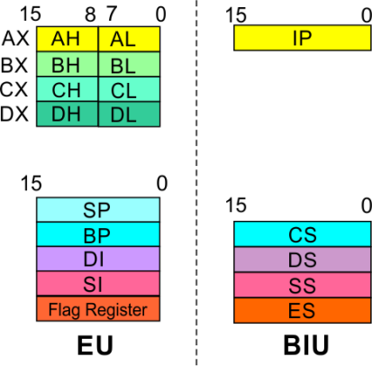
Architecture
8086 registers categorized into 4 groups
15 | 14 | 13 | 12 | 11 | 10 | 9 | 8 | 7 | 6 | 5 | 4 | 3 | 2 | 1 | 0
 |  |  |  | OF | DF | IF | TF | SF | ZF |  | AF |  | PF |  | CF
Sl.No. | Type | Register width | Name of register
1 | General purpose register | 16 bit | AX, BX, CX, DX
 |  | 8 bit | AL, AH, BL, BH, CL, CH, DL, DH
2 | Pointer register | 16 bit | SP, BP
3 | Index register | 16 bit | SI, DI
4 | Instruction Pointer | 16 bit | IP
5 | Segment register | 16 bit | CS, DS, SS, ES
6 | Flag (PSW) | 16 bit | Flag register

Slide 40
Architecture
Registers and Special Functions
Register | Name of the Register | Special Function
AX | 16-bit Accumulator | Stores the 16-bit results of arithmetic and logic operations
AL | 8-bit Accumulator | Stores the 8-bit results of arithmetic and logic operations
BX | Base register | Used to hold base value in base addressing mode to access memory data
CX | Count Register | Used to hold the count value in SHIFT, ROTATE and LOOP instructions
DX | Data Register | Used to hold data for multiplication and division operations
SP | Stack Pointer | Used to hold the offset address of top stack memory
BP | Base Pointer | Used to hold the base value in base addressing using SS register to access data from stack memory
SI | Source Index | Used to hold index value of source operand (data) for string instructions
DI | Data Index | Used to hold the index value of destination operand (data) for string operations

