Slide 1
Microprocessor Systems and Interfacing EEE 342
Nesruminallah
nesruminallah@cuilahore.edu.pk

Slide 2
Stack
CLO | Bloom Taxonomy | Specific Outcome
CLO1 | C4 | Analyze and construct the stack memory map using the knowledge of stack programming concepts
Outline
Stack
Stack Programming in assembly language

Slide 3
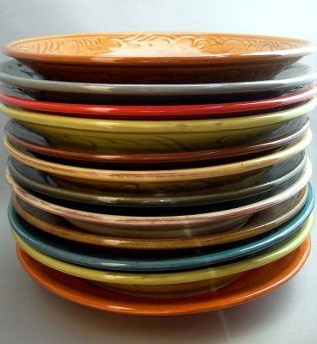
Stack
Stack
Access is allowed only at one point of the structure, normally termed the top of the stack
access to the most recently added item only
Operations are limited:
push (add item to stack)
pop (remove top item from stack)
Described as a "Last In First Out" (LIFO) data structure

Slide 4
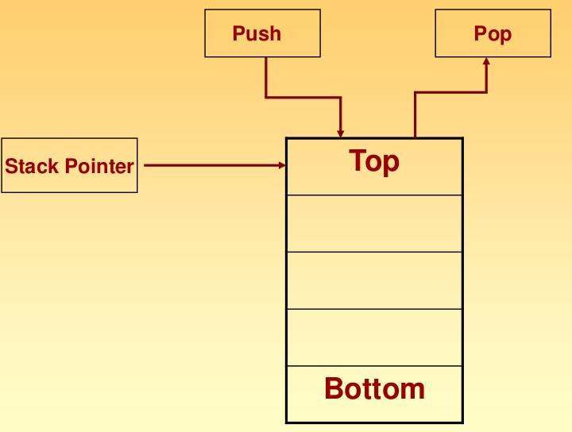
Stack

Slide 5
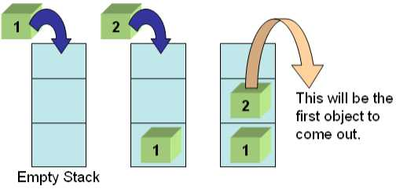
Stack

Slide 6
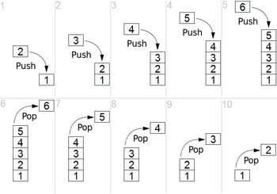
Stack

Slide 7
CPU’s stack grows downward
Stack
FFFF
stack
contents
top-of-stack
0000

Slide 8
A Software Implementation
Data items don't move in memory, just our idea about there the TOP of the stack is.
/ / / / / /
/ / / / / /
#12
TOP
#12
/ / / / / /
/ / / / / /
#5
#5
/ / / / / /
/ / / / / /
#31
#31
TOP
/ / / / / /
#18
TOP
#18
#18
/ / / / / /
TOP
/ / / / / /
/ / / / / /
/ / / / / /
x4000
x3FFF
x3FFC
x3FFE
Initial State
After
One Push
After Three
More Pushes
After
Two Pops

Slide 9
Stack Pointer
It is a 16-bit register, contains the address of the data item currently on top of the stack.
Stack operation includes pushing (providing) data on to the stack and popping (taking)data from the stack.
Pushing operation decrements stack pointer and Popping operation increments stack pointer. i.e there is a last in first out (LIFO) operation.

Slide 10
Push
Source can be register, segment register or memory.
This instruction pushes the contents of specified source on to the stack.
In this stack pointer is decremented by 2.
The higher byte data is pushed first (SP-1).
Then lower byte data is pushed (SP-2).
E.g.:
(1). PUSH AX;
(2). PUSH DS;
(3). PUSH [5000H];

Slide 11
Push
INITIAL POSITION
(1) STACK POINTER
DECREMENTS SP & STORES HIGHER BYTE
HIGHER BYTE
(2) STACK
POINTER
DECREMENTS SP & STORES LOWER BYTE
LOWER BYTE
HIGHER BYTE
(3) STACK POINTER

Slide 12
Push
BEFORE EXECUTION
SP | 2002H
2000H
BH |  | BL
CH | 10 | CL | 50
DH |  | DL
2001H
2002H
PUSH CX
AFTER EXECUTION
SP | 2000H
50
10
2000H
BH |  | BL
CH | 10 | CL | 50
DH |  | DL
2001H
2002H

Slide 13
Pop
Destination can be register, segment register or memory.
This instruction pops (takes) the contents of specified destination.
In this stack pointer is incremented by 2.
The lower byte data is popped first (SP+1).
Then higher byte data is popped (SP+2).
E.g.
(1). POP AX;
(2). POP DS;
(3). POP [5000H];

Slide 14
Pop
INITIAL POSITION AND READS LOWER BYTE
LOWER BYTE
HIGHER BYTE
(1) STACK
POINTER
INCREMENTS SP & READS HIGHER BYTE
LOWER BYTE
HIGHER BYTE
(2) STACK
POINTER
INCREMENTS SP
LOWER BYTE
HIGHER BYTE
(3) STACK POINTER

Slide 15
Pop
BEFORE EXECUTION
2000H
50
10
SP | 2000H
2001H
BH |  | BL
2002H
POP BX
AFTER EXECUTION
2000H
50
10
SP | 2002H
2001H
BH | 10 | BL | 50
2002H

Slide 16
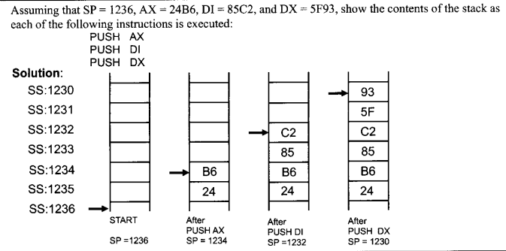
PUSH Example

Slide 17
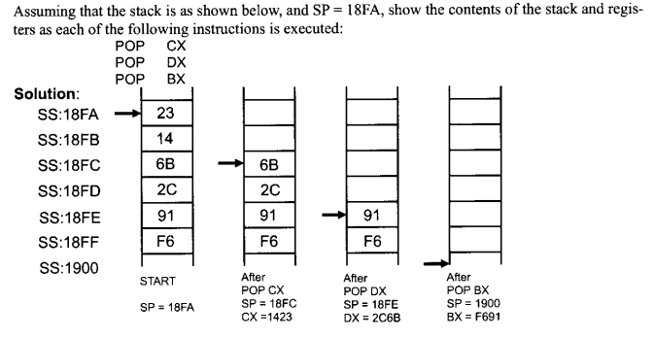
POP Example

Slide 18
Stack Example
MOV DX, 0FFFEH
MOV SP,DX
MOV DX,0A000H
MOV SS,DX
MOV AX,0ACADH
MOV BX,1000H
PUSH AX
PUSH BX
ADD AX,BX
PUSH AX
POP CX
POP DX
HLT

