Slide 1

Digital Design
Chapter 2:
Combinational Logic Design
Slides to accompany the textbook Digital Design, First Edition,
by Frank Vahid, John Wiley and Sons Publishers, 2007.
http://www.ddvahid.com
Copyright © 2007 Frank Vahid
Instructors of courses requiring Vahid's Digital Design textbook (published by John Wiley and Sons) have permission to modify and use these slides for customary course-related activities, subject to keeping this copyright notice in place and unmodified. These slides may be posted as unanimated pdf versions on publicly-accessible course websites.. PowerPoint source (or pdf with animations) may not be posted to publicly-accessible websites, but may be posted for students on internal protected sites or distributed directly to students by other electronic means. Instructors may make printouts of the slides available to students for a reasonable photocopying charge, without incurring royalties. Any other use requires explicit permission. Instructors may obtain PowerPoint source or obtain special use permissions from Wiley – see http://www.ddvahid.com for information.

Slide 2
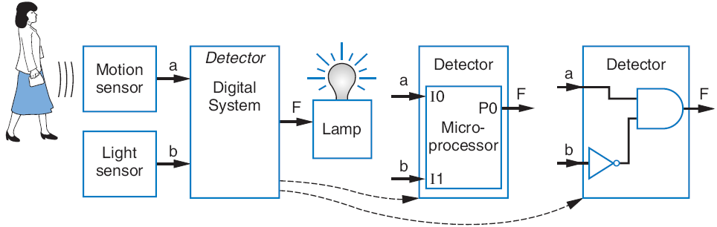
Introduction
2.1
Digital circuit
Let’s learn to design digital circuits
We’ll start with a simple form of circuit:
  Combinational circuit
    A digital circuit whose outputs depend solely on the present combination of the circuit inputs’ values
1
a
Combinational
1
0
F
b
digital circuit
1
a
Sequential
?
0
F
b
digital circuit
Note: Slides with animation are denoted with a small red "a" near the animated items

Slide 3
Switches
2.2
Electronic switches are the basis of binary digital circuits
  Electrical terminology
    Voltage: Difference in electric potential between two points
      Analogous to water pressure
    Current: Flow of charged particles
      Analogous to water flow
    Resistance: Tendency of wire to resist current flow
      Analogous to water pipe diameter
    V = I * R (Ohm’s Law)
4.5 A
–
9V
+
4.5 A
2 ohms
0
V
9
V
4.5 A

Slide 4
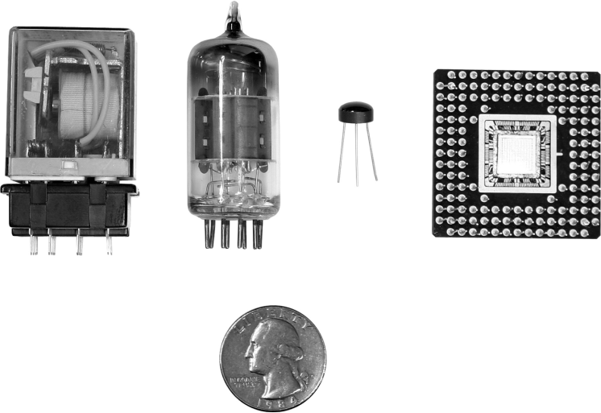
Switches
A switch has three parts
  Source input, and output
    Current wants to flow from source input to output
  Control input
    Voltage that controls whether that current can flow
The amazing shrinking switch
  1930s: Relays
  1940s: Vacuum tubes
  1950s: Discrete transistor
  1960s: Integrated circuits (ICs)
    Initially just a few transistors on IC
    Then tens, hundreds, thousands...
control
input
“off”
source
output
input
a
control
input
“on”
source
output
input
(
b
)
discrete
transistor
relay
vacuum tube
IC
quarter
(to see the relative size)

Slide 5

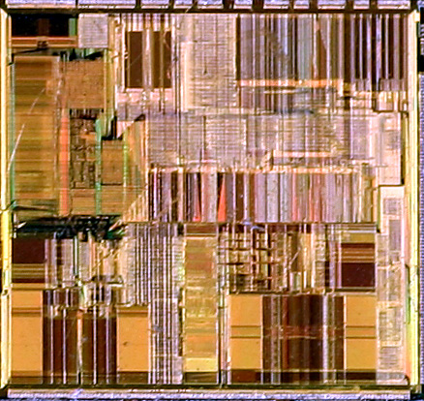
Moore’s Law
IC capacity doubling about every 18 months for several decades
  Known as “Moore’s Law” after Gordon Moore, co-founder of Intel
    Predicted in 1965 predicted that components per IC would double roughly every year or so
  Book cover depicts related phenomena
    For a particular number of transistors, the IC shrinks by half every 18 months
      Notice how much shrinking occurs in just about 10 years
      Enables incredibly powerful computation in incredibly tiny devices
  Today’s ICs hold billions of transistors
    The first Pentium processor (early 1990s) needed only 3 million
An Intel Pentium processor IC
having millions of transistors

Slide 6
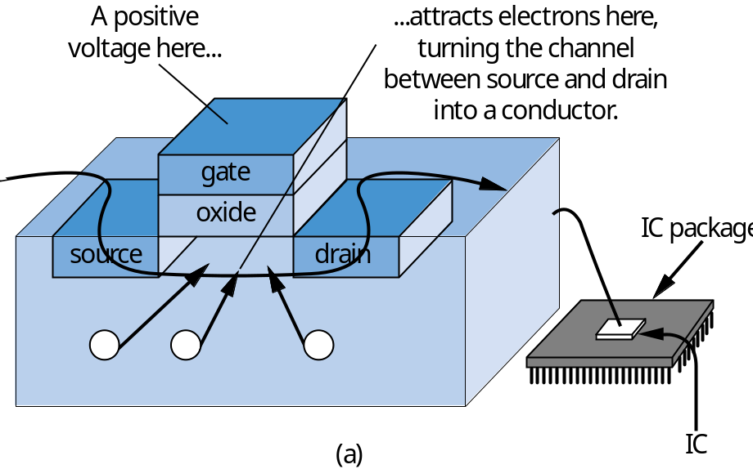
The CMOS Transistor
2.3
CMOS transistor
  Basic switch in modern ICs
a
nMOS
gate
1
0
conducts
does not
conduct
pMOS
gate
1
0
Silicon -- not quite a conductor or insulator:
Semiconductor
does not
conducts
conduct

Slide 7
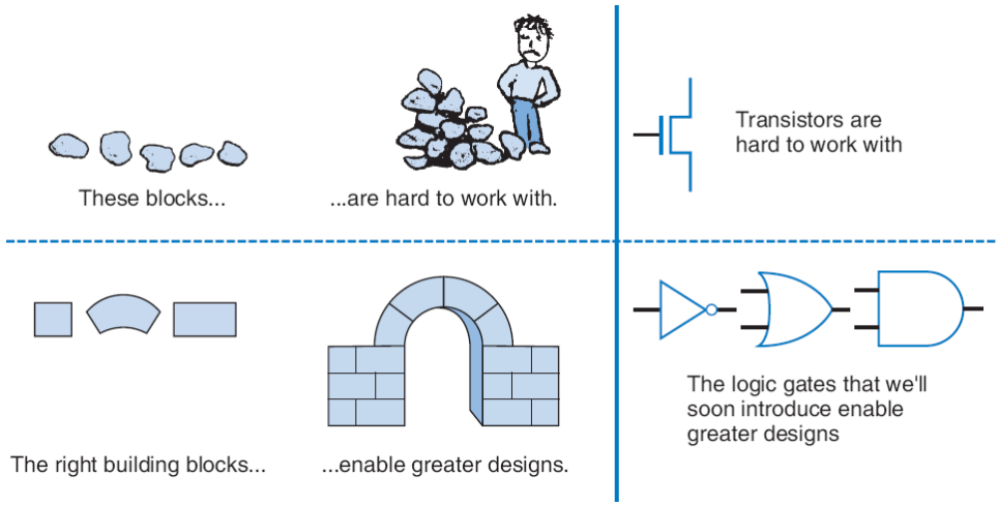
Boolean Logic Gates
Building Blocks for Digital Circuits
(Because Switches are Hard to Work With)
2.4
“Logic gates” are better digital circuit building blocks than switches (transistors)
  Why?...

Slide 8
Relating Boolean Algebra to Digital Design
N
O
T
OR
AND
Symbol
x
F
x
x
y
F
y
F
x
F
x
y
F
x
y
F
Truth table
0
1
0
0
0
0
0
0
1
0
0
1
1
0
1
0
1
0
1
1
0
0
1
1
1
1
1
1
1
0
0
y
y
x
Transistor
circuit
x
F
x
F
F
y
x
y
0
x
1
1
Implement Boolean operators using transistors
  Call those implementations logic gates.

Slide 9


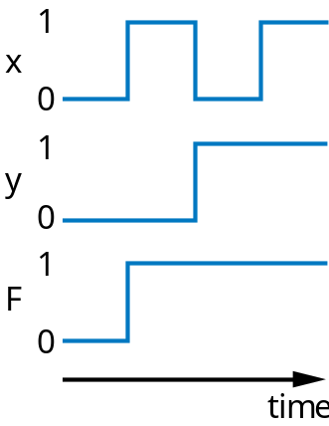
NOT/OR/AND Logic Gate Timing Diagrams
1
1
x
x
0
0
1
1
y
0
F
1
0
F
time
0
time

Slide 10
Boolean Algebra and its Relation to Digital Circuits
Boolean Algebra
  Variables represent 0 or 1 only
  Operators return 0 or 1 only
  Basic operators
    AND: a AND b returns 1 only when both a=1 and b=1
    OR: a OR b returns 1 if either (or both) a=1 or b=1
    NOT: NOT a returns the opposite of a (1 if a=0, 0 if a=1)
a
b
AND
a
b
OR
a
NOT
0
0
0
0
0
0
0
1
0
1
0
0
1
1
1
0
1
0
0
1
0
1
1
1
1
1
1
1

Slide 11
Evaluating Boolean Equations
Evaluate the Boolean equation F = (a AND b) OR (c AND d) for the given values of variables a, b, c, and d:
  Q1: a=1, b=1, c=1, d=0.
    Answer: F = (1 AND 1) OR (1 AND 0) = 1 OR 0 = 1.
a
a
b
AND
0
0
0
0
1
0
1
0
0
1
1
1
a
b
OR
0
0
0
0
1
1
1
0
1
1
1
1
a
NOT
0
1
1
0

Slide 12
Converting to Boolean Equations
Convert the following English statements to a Boolean equation
  Q1. a is 1 and b is 1.
    Answer: F = a AND b
  Q2. either of a or b is 1.
    Answer: F = a OR b
  Q3. both a and b are not 0.
    Answer:
      (a) Option 1: F = NOT(a) AND NOT(b)
      (b) Option 2: F = a OR b
  Q4. a is 1 and b is 0.
    Answer: F = a AND NOT(b)
a

Slide 13
Example: Converting a Boolean Equation to a Circuit of Logic Gates
Q: Convert the following equation to logic gates: F = a AND NOT( b OR NOT(c) )
a
F
(
a
)
a
a
b
F
c
(
b
)

Slide 14
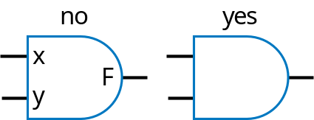
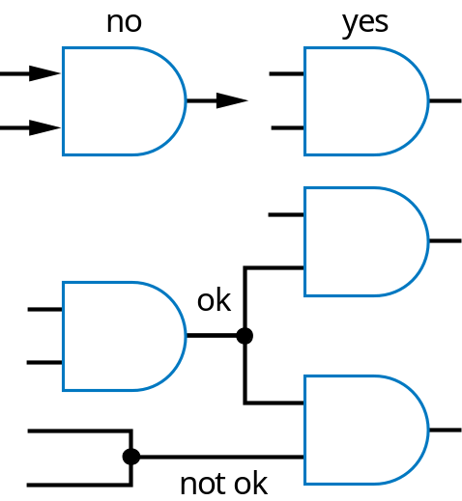
Some Circuit Drawing Conventions

Slide 15
Boolean Algebra Terminology
Example equation: F(a,b,c) = a’bc + abc’ + ab + c
Variable
  Represents a value (0 or 1)
  Three variables: a, b, and c
Literal
  Appearance of a variable, in true or complemented form
  Nine literals: a’, b, c, a, b, c’, a, b, and c
Product term
  Product of literals
  Four product terms: a’bc, abc’, ab, c
Sum-of-products
  Equation written as OR of product terms only
  Above equation is in sum-of-products form. “F = (a+b)c + d” is not.

Slide 16
Boolean Algebra Properties
Commutative
  a + b = b + a
  a * b = b * a
Distributive
  a * (b + c) = a * b + a * c
  a + (b * c) = (a + b) * (a + c)
    (this one is tricky!)
Associative
  (a + b) + c = a + (b + c)
  (a * b) * c = a * (b * c)
Identity
  0 + a = a + 0 = a
  1 * a = a * 1 = a
Complement
  a + a’ = 1
  a * a’ = 0
To prove, just evaluate all possibilities
Example uses of the properties
Show abc’ equivalent to c’ba.
  Use commutative property:
    a*b*c’ = a*c’*b = c’*a*b = c’*b*a = c’ba.
Show abc + abc’ = ab.
  Use first distributive property
    abc + abc’ = ab(c+c’).
  Complement property
    Replace c+c’ by 1: ab(c+c’) = ab(1).
  Identity property
    ab(1) = ab*1 = ab.
Show x + x’z equivalent to x + z.
  Second distributive property
    Replace x+x’z by (x+x’)*(x+z).
  Complement property
    Replace (x+x’) by 1,
  Identity property
    replace 1*(x+z) by x+z.

Slide 17
Example that Applies Boolean Algebra Properties
Found inexpensive chip that computes:
    f = c’hp + c’hp’ + c’h’p
  Can we use it?
    Is it the same as f = c’(p+h)?
Use Boolean algebra:
h
DoorOpener
c
f
p
f = c’hp + c’hp’ + c’h’p
f = c’h(p + p’) + c’h’p (by the distributive property)
f = c’h(1) + c’h’p (by the complement property)
f = c’h + c’h’p (by the identity property)
f = hc’ + h’pc’ (by the commutative property)
Same!

Slide 18
Boolean Algebra: Additional Properties
Aircraft lavatory sign example
Null elements
  a + 1 = 1
  a * 0 = 0
Idempotent Law
  a + a = a
  a * a = a
Involution Law
  (a’)’ = a
DeMorgan’s Law
  (a + b)’ = a’b’
  (ab)’ = a’ + b’
  Very useful!
To prove, just evaluate all possibilities
Equation and circuit
  S = a’ + b’ + c’
Transform
  (abc)’ = a’+b’+c’ (by DeMorgan’s Law)
  S = (abc)’
New equation and circuit
Circuit
Circuit
a
a
S
S
b
b
c
c

Slide 19
Representations of Boolean Functions
2.6
English 1: F outputs 1 when a is 0 and b is 0, or when a is 0 and b is 1.
English 2: F outputs 1 when a is 0, regardless of b’s value
(
a
)
a
a
b
F
b
0
0
1
Equation 1: F(a,b) = a’b’ + a’b
F
0
1
1
Equation 2: F(a,b) = a’
1
0
0
(
b
)
(
c
)
1
1
0
Circuit 1
Truth table
a
F
(
d
)
Circuit 2
T
he function F
A function can be represented in different ways
  Above shows seven representations of the same functions F(a,b), using four different methods: English, Equation, Circuit, and Truth Table

Slide 20
Truth Table Representation of Boolean Functions
Define value of F for each possible combination of input values
  2-input function: 4 rows
  3-input function: 8 rows
  4-input function: 16 rows
Q: Use truth table to define function F(a,b,c) that is 1 when abc is 5 or greater in binary
a
b
F
a
b
c
F
a
b
c
d
F
0
0
0
0
0
0
0
0
0
0
1
0
0
1
0
0
0
1
1
0
0
1
0
0
0
1
0
1
1
0
1
1
0
0
1
1
(
a
)
1
0
0
0
1
0
0
1
0
1
0
1
0
1
1
1
0
0
1
1
0
1
1
1
0
1
1
1
(
b
)
1
0
0
0
1
0
0
1
a
b
c
F
1
0
1
0
0
0
0
0
1
0
1
1
0
0
1
0
1
1
0
0
a
0
1
0
0
1
1
0
1
0
1
1
0
1
1
1
0
1
0
0
0
1
1
1
1
1
0
1
1
(
c
)
1
1
0
1
1
1
1
1

Slide 21
Converting among Representations
Can convert from any representation to any other
Common conversions
  Equation to circuit
  Truth table to equation
  Equation to truth table
    Easy -- just evaluate equation for each input combination (row)
    Creating intermediate columns helps
Inputs
Outputs
Term
a
b
F
F = sum of
0
0
1
a’b’
0
1
1
a’b
1
0
0
1
1
0
F = a’b’ + a’b
Q: Convert to equation
a
b
c
F
0
0
0
0
0
0
1
0
0
1
0
0
0
1
1
0
Q: Convert to truth table: F = a’b’ + a’b
1
0
0
0
1
0
1
1
ab’c
Inputs
Output
1
abc’
a
b
a
'
b
'
a
' b
F
1
1
0
1
1
1
1
abc
a
0
0
1
0
1
a
0
1
0
1
1
F = ab’c + abc’ + abc
1
0
0
0
0
1
1
0
0
0

Slide 22
Standard Representation: Truth Table
How can we determine if two functions are the same?
    Use algebraic methods
    But if we failed, does that prove not equal? No.
Solution: Convert to truth tables
  Only ONE truth table representation of a given function
    Standard representation -- for given function, only one version in standard form exists
f = c’hp + c’hp’ + c’h’
f = c’h(p + p’) + c’h’p
f = c’h(1) + c’h’p
f = c’h + c’h’p
(what if we stopped here?)
f = hc’ + h’pc’
F = ab + a
'
F = a’b’ +
a’b + ab
a
b
F
a
b
F
0
0
1
0
0
1
0
1
Same
1
0
1
1
1
0
0
1
0
0
1
1
1
1
1
1
a

Slide 23
Canonical Form -- Sum of Minterms
Truth tables too big for numerous inputs
Use standard form of equation instead
  Known as canonical form
  Regular algebra: group terms of polynomial by power
    ax² + bx + c (3x² + 4x + 2x² + 3 + 1 --> 5x² + 4x + 4)
  Boolean algebra: create sum of minterms
    Minterm: product term with every function literal appearing exactly once, in true or complemented form
    Just multiply-out equation until sum of product terms
    Then expand each term until all terms are minterms
Q: Determine if F(a,b)=ab+a’ is same function as F(a,b)=a’b’+a’b+ab, by converting first equation to canonical form (second already in canonical form)
F = ab+a’ (already sum of products)
F = ab + a’(b+b’) (expanding term)
F = ab + a’b + a’b’ (SAME -- same three terms as other equation)
a

Slide 24
Multiple-Output Circuits
Many circuits have more than one output
Can give each a separate circuit, or can share gates
Ex: F = ab + c’, G = ab + bc
a
a
b
b
F
F
c
c
G
G
(
a
)
(
b
)
Option 1: Separate circuits
Option 2: Shared gates

Slide 25
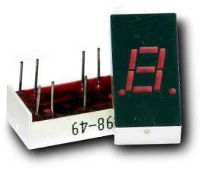
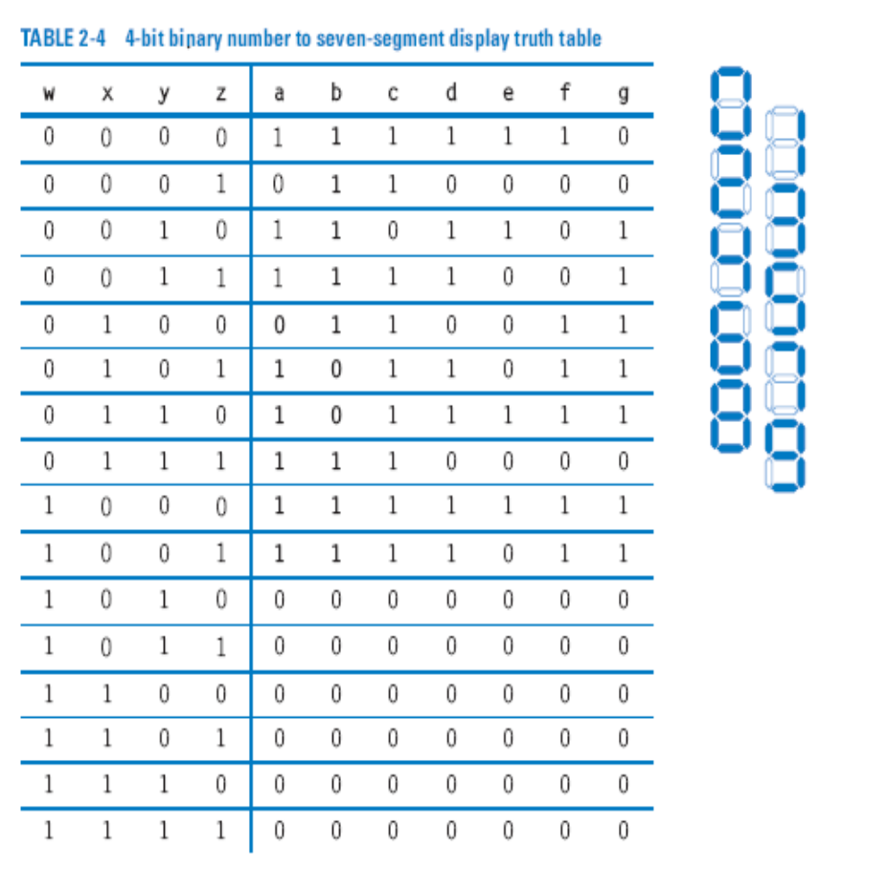
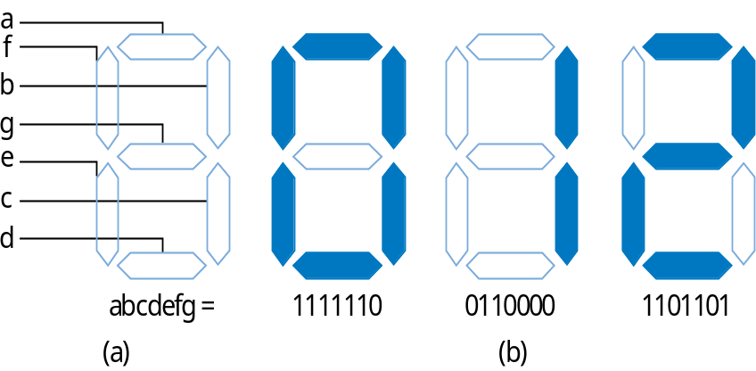
Multiple-Output Example:
BCD to 7-Segment Converter
a = w’x’y’z’ + w’x’yz’ + w’x’yz + w’xy’z + w’xyz’ + w’xyz + wx’y’z’ + wx’y’z
b = w’x’y’z’ + w’x’y’z + w’x’yz’ + w’x’yz + w’xy’z’ + w’xyz + wx’y’z’ + wx’y’z

Slide 26
Combinational Logic Design Process
2.7
Step
Description
Step 1
Capture the function
Create a truth table or equations, whichever is most natural for the given problem, to describe the desired behavior of the combinational logic.
Step 2
Convert to equations
This step is only necessary if you captured the function using a truth table instead of equations. Create an equation for each output by ORing all the minterms for that output. Simplify the equations if desired.
Step 3
Implement as a gate-based circuit
For each output, create a circuit corresponding to the output’s equation. (Sharing gates among multiple outputs is OK optionally.)

Slide 27
Example: Three 1s Detector
Problem: Detect three consecutive 1s in 8-bit input: abcdefgh
    00011101 → 1 10101011 → 0 11110000 → 1
  Step 1: Capture the function
    Truth table or equation?
      Truth table too big: 2^8=256 rows
      Equation: create terms for each possible case of three consecutive 1s
    y = abc + bcd + cde + def + efg + fgh
  Step 2: Convert to equation -- already done
  Step 3: Implement as a gate-based circuit
a
a
a
abc
b
c
bcd
d
cde
e
y
def
f
efg
g
fgh
h

Slide 28
More Gates
2.8
1
NAND
1
NOR
NAND
NOR
XOR
XNOR
x
x
x
F
F
x
y
y
y
F
y
x
y
F
x
y
F
x
y
F
x
y
F
x
F
0
0
1
0
0
1
0
0
0
0
0
1
0
1
1
0
1
0
0
1
1
0
1
0
x
y
1
0
1
1
0
0
1
0
1
1
0
0
y
1
1
0
1
1
0
1
1
0
1
1
1
0
0
NAND: Opposite of AND (“NOT AND”)
NOR: Opposite of OR (“NOT OR”)
XOR: Exactly 1 input is 1, for 2-input XOR. (For more inputs -- odd number of 1s)
XNOR: Opposite of XOR (“NOT XOR”)
NAND same as AND with power & ground switched
  Why? nMOS conducts 0s well, but not 1s (reasons beyond our scope) -- so NAND more efficient
Likewise, NOR same as OR with power/ground switched
AND in CMOS: NAND with NOT
OR in CMOS: NOR with NOT
So NAND/NOR more common

Slide 29
More Gates: Example Uses
Aircraft lavatory sign example
  S = (abc)’
Detecting all 0s
  Use NOR
Detecting equality
  Use XNOR
Detecting odd # of 1s
  Use XOR
  Useful for generating “parity” bit common for detecting errors
Circuit
a
b
S
c
0
0
1
a0
0
b0
a1
A=B
b1
a2
b2

Slide 30
Completeness of NAND
Any Boolean function can be implemented using just NAND gates. Why?
  Need AND, OR, and NOT
  NOT: 1-input NAND (or 2-input NAND with inputs tied together)
  AND: NAND followed by NOT
  OR: NAND preceded by NOTs
Likewise for NOR

Slide 31
Decoders and Muxes
2.9
Decoder: Popular combinational logic building block, in addition to logic gates
  Converts input binary number to one high output
2-input decoder: four possible input binary numbers
  So has four outputs, one for each possible input binary number
Internal design
  AND gate for each output to detect input combination
Decoder with enable e
  Outputs all 0 if e=0
  Regular behavior if e=1
n-input decoder: 2^{n} outputs
d0
1
d0
0
d0
0
d0
0
0
i0
d1
0
1
i0
d1
1
0
i0
d1
0
1
i0
d1
0
0
i1
d2
0
0
i1
d2
0
1
i1
d2
1
1
i1
d2
0
d3
0
d3
0
d3
0
d3
1
i1’i0’
d0
d0
0
1
i0
d1
0
i1’i0
d1
1
i1
d2
0
e
d3
1
i1i0’
d2
1
i1i0
d3
d0
0
1
i0
d1
0
1
i1
d2
0
e
d3
0
i1
i0
0

Slide 32
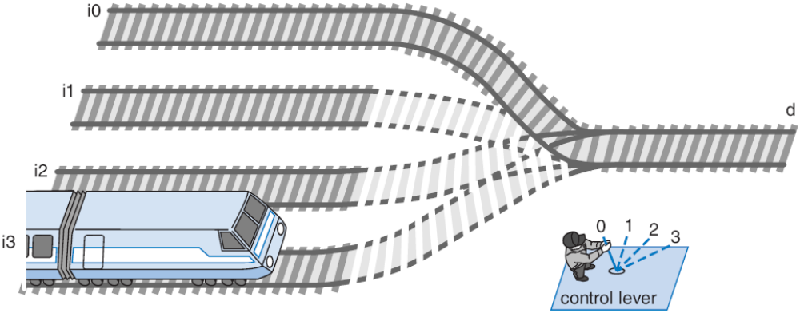
Multiplexor (Mux)
Mux: Another popular combinational building block
  Routes one of its N data inputs to its one output, based on binary value of select inputs
    4 input mux → needs 2 select inputs to indicate which input to route through
    8 input mux → 3 select inputs
    N inputs → log₂(N) selects
  Like a railyard switch

Slide 33
Mux Internal Design
i0
i0 (1*i0=i0)
2
×
1
2
×
1
2
×
1
1
d
i0
(0+i0=i0)
i0
i0
i0
i1
i1
d
i1
d
i1
d
0
0
s0
s0
s0
a
0
1
2x1 mux
0
s0
i0
4
⋅
1
i0
i1
i1
d
i2
d
i2
i3
s1
s0
i3
4x1 mux
s1
s0

Slide 34
Mux Example
City mayor can set four switches up or down, representing his/her vote on each of four proposals, numbered 0, 1, 2, 3
City manager can display any such vote on large green/red LED (light) by setting two switches to represent binary 0, 1, 2, or 3
Use 4x1 mux
Mayor’s switches
1
4x1
on/off
i0
2
i1
i2
d
r
3
i3
Green/
Red
LED
P
s1
s0
4
manager's
switches

Slide 35
Muxes Commonly Together -- N-bit Mux
a3
i0
2
⋅
1
Simplifying
notation:
b3
i1
d
s0
4-bit
4
a2
i0
2
⋅
1
4
2x1
C
i1
d
A
I
0
4
b2
s0
4
D
C
is short
B
I
1
f
or
a1
i0
2
⋅
1
s0
b1
i1
d
c3
s0
2
⋅
1
s0
c2
a0
i0
d
b0
i1
c1
s0
s0
c0
Ex: Two 4-bit inputs, A (a3 a2 a1 a0), and B (b3 b2 b1 b0)
  4-bit 2x1 mux (just four 2x1 muxes sharing a select line) can select between A or B

Slide 36
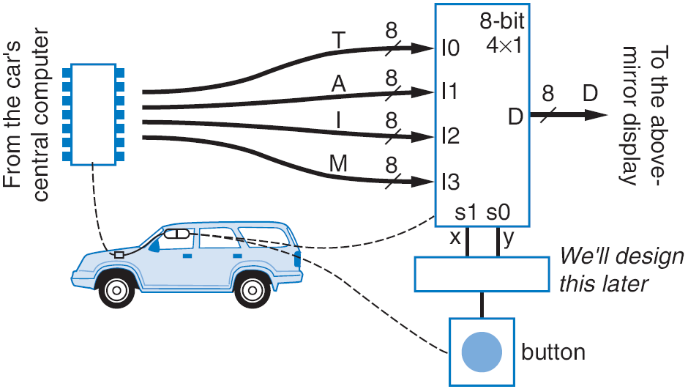
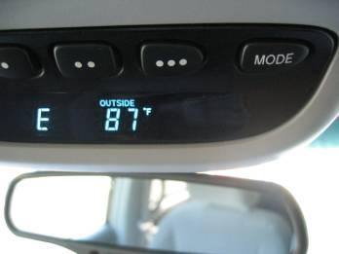
N-bit Mux Example
Four possible display items
  Temperature (T), Average miles-per-gallon (A), Instantaneous mpg (I), and Miles remaining (M) -- each is 8-bits wide
  Choose which to display using two inputs x and y
  Use 8-bit 4x1 mux

Slide 37
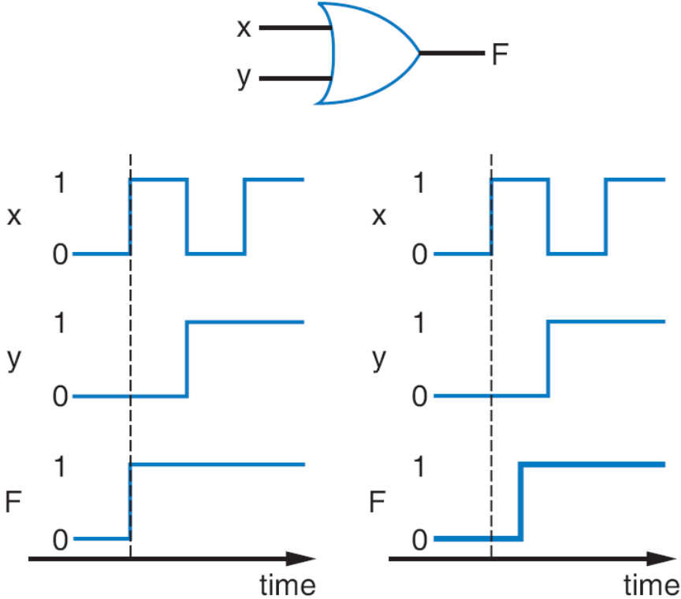
Additional Considerations
Non-Ideal Gate Behavior -- Delay
Real gates have some delay
  Outputs don’t change immediately after inputs change

Slide 38
Chapter Summary
Combinational circuits
  Circuit whose outputs are function of present inputs
    No “state”
Switches: Basic component in digital circuits
Boolean logic gates: AND, OR, NOT -- Better building block than switches
  Enables use of Boolean algebra to design circuits
Boolean algebra: uses true/false variables/operators
Representations of Boolean functions: Can translate among
Combinational design process: Translate from equation (or table) to circuit through well-defined steps
More gates: NAND, NOR, XOR, XNOR also useful
Muxes and decoders: Additional useful combinational building blocks

