Slide 1
AI & Machine Learning
AI Introduction & Python Foundations
Dr. Tariq Sadad

Slide 2
MATHEMATICS FOR MACHINE LEARNING
DATA = NUMBERS
Images → pixel values
Text → vectors
Users → features
Math begins when data becomes numbers.
Understand how models think, learn, and improve
  “ML is not magic. It is math with feedback.”

Slide 3
WHY MATH MATTERS
WHY MATH?
Data becomes numbers
Models are functions
Learning = optimization
📌 Math explains what the model is doing

Slide 4
WHY MATH MATTERS FOR ML
WHY MATH?
Machines don’t understand words or images
Machines understand numbers & shapes
Math gives rules to:
  Compare
  Optimize
  Improve
Math is the engine — tools are the steering wheel.

Slide 5
DESCRIPTIVE STATISTICS (LISTEN TO DATA)
Concept | Meaning | ML Use
Mean | Typical value | Baseline prediction
Median | Robust center | Outlier resistance
Std | Spread | Risk & noise

Slide 6
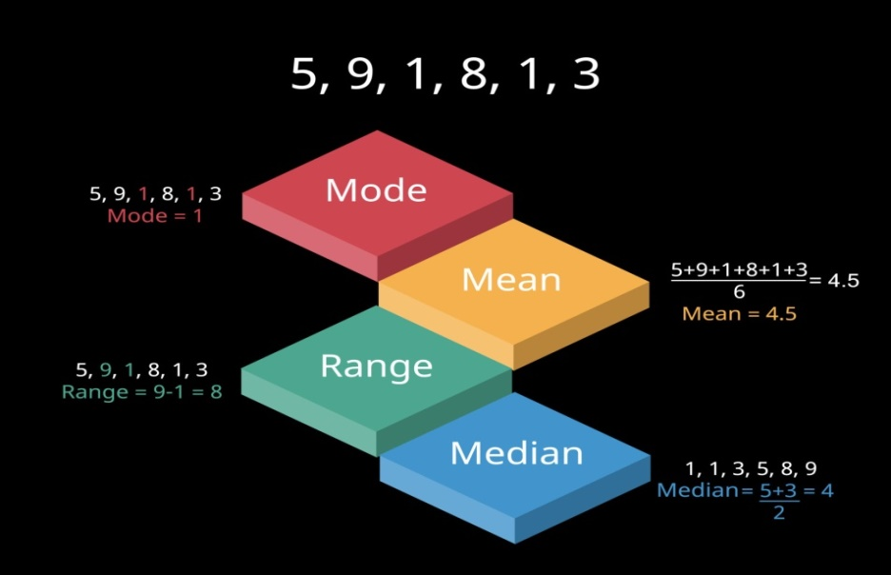
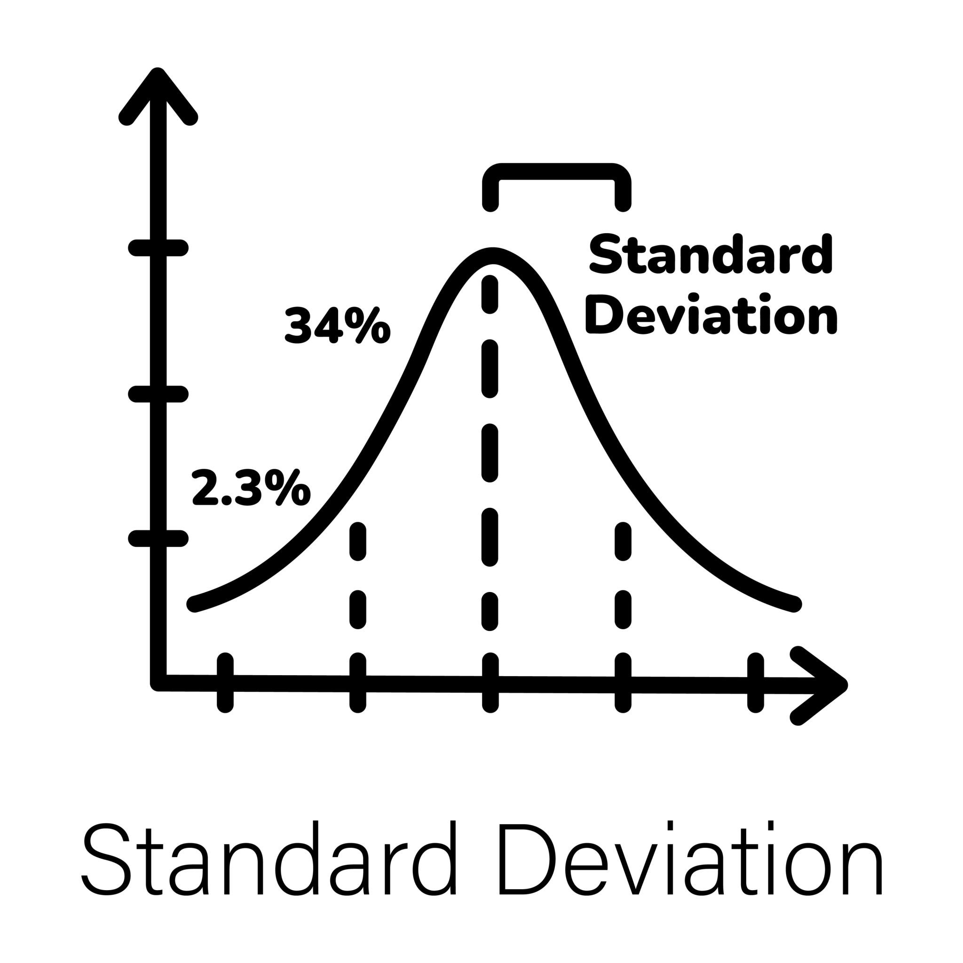
DESCRIPTIVE STATISTICS (MEAN, MEDIAN, STD)
WHY STATS FIRST
  Mean → typical value
  Median → robust center
  Std → spread / uncertainty
“Before ML, you must listen to your data.”

Slide 7
DATA BEHAVIOR
import numpy as np
data = [60, 65, 70, 72, 90]
print("Mean:", np.mean(data))
print("Median:", np.median(data))
print("Std:", np.std(data))
Same data, different stories.

Slide 8
CORRELATION (FEATURE RELATIONSHIPS)
FEATURE RELATIONSHIP
Correlation → strength
Covariance → direction
📌 Used for feature selection

Slide 9
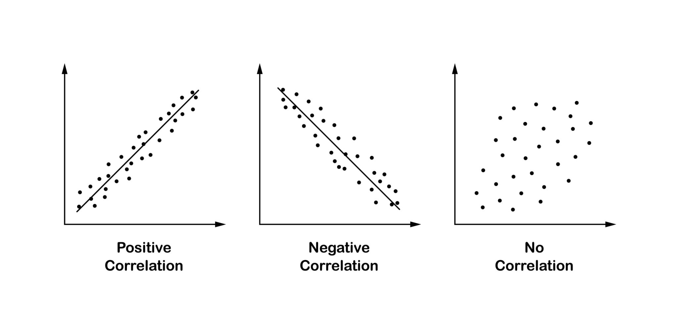
CORRELATION vs COVARIANCE
HOW FEATURES MOVE TOGETHER
  Covariance → direction (same / opposite)
  Correlation → strength (-1 to +1)
In practice → correlation is king.

Slide 10
import numpy as np
x = [1,2,3,4,5]
y = [2,4,6,8,10]
print("Correlation:", np.corrcoef(x, y))

Slide 11
In Machine Learning, every data point is a vector.
  A vector is just a list of numbers
  Those numbers represent features
  ML models never see names, words, or images
They only see vectors
“Each row in your dataset is converted into a vector.
The model learns from these vectors.”
📌 Pandas row → NumPy vector → Model input

Slide 12
WHY VECTORS MATTER
Vectors allow:
  Comparison
  Distance calculation
  Similarity measurement
“Once data becomes vectors, math can compare them.”
If two vectors point in the same direction → similar
If they point in different directions → less similar
Dot product measures alignment, not equality

Slide 13
import numpy as np
# Two students / users / documents
v1 = np.array([2, 3, 4])
v2 = np.array([4, 6, 8])
v3 = np.array([5, 1, 0])
print("Similarity v1 & v2:", np.dot(v1, v2))
print("Similarity v1 & v3:", np.dot(v1, v3))

Slide 14
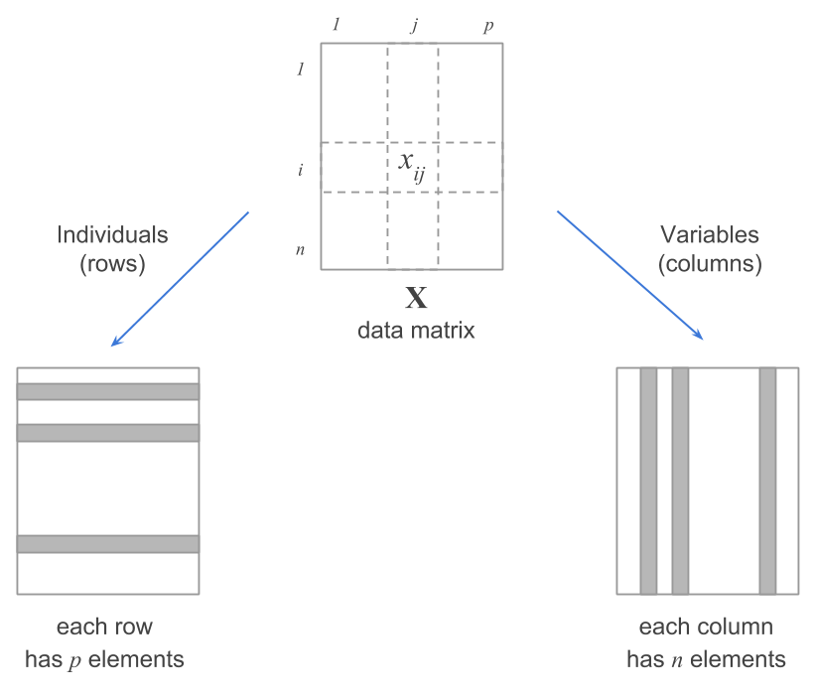
MATRICES (DATASETS)
MATRIX = DATASET
Rows → samples
Columns → features
📌 Every CSV = matrix

Slide 15
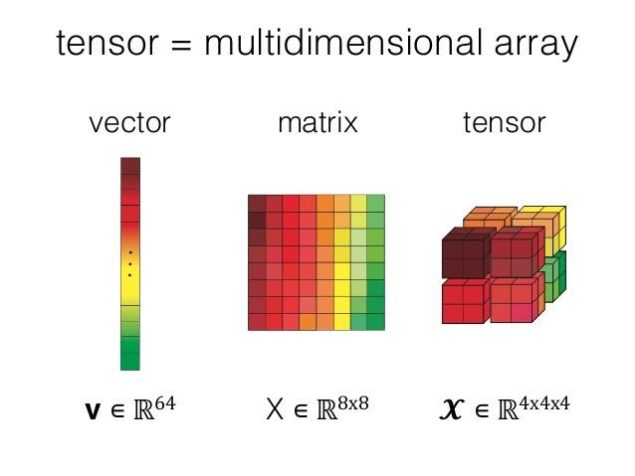
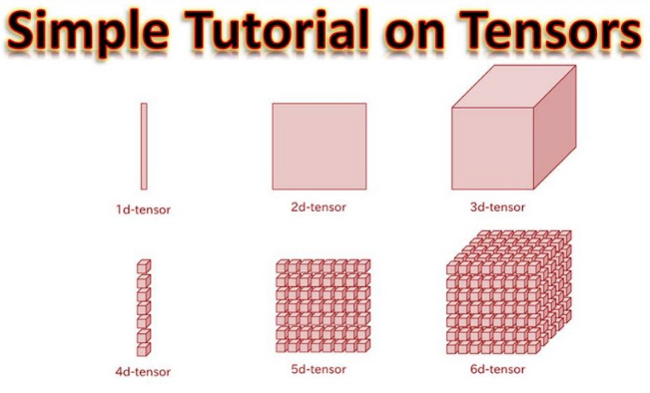
TENSORS (DEEP LEARNING)
WHY TENSORS?
Image = Height × Width × Color
  Grayscale image → C = 1
  RGB image → C = 3 (Red, Green, Blue)
Video = Time × Image
📌 Deep learning runs on tensors

Slide 16
Image: 224 × 224 RGB
  Shape: (224, 224, 3)
  “An image is just a stack of color layers.”
  Video: 30 frames, 224×224 RGB
    Shape: (30, 224, 224, 3)
  “A video is a sequence of images over time.”

Slide 17
BATCH SIZE (VERY IMPORTANT)
In real ML models, we process multiple samples at once.
  (B, H, W, C)
  Example: (32, 224, 224, 3)
(B, T, H, W, C)
Example: (8, 30, 224, 224, 3)
“Batch size means how many samples the GPU sees at one time.”

Slide 18
PROBABILITY FUNDAMENTALS
How ML handles uncertainty in the real world
  ML is not about being perfect.
  ML is about being confident enough to act.

Slide 19
RANDOM VARIABLE (NO THEORY)
RANDOM VARIABLE
  A number you don’t know in advance
  Output of an uncertain process
Examples
  Email → Spam (1) / Not spam (0)
  Customer → Churn (1) / Stay (0)
In ML, your target (y) is always a random variable

Slide 20
DISCRETE vs CONTINUOUS (USE-CASE VIEW)
DISCRETE (CHOICES)
  Yes / No
  Click / No click
  Pass / Fail
➡ Used in classification
CONTINUOUS (VALUES)
  Price
  Time
  Revenue
➡ Used in regression

Slide 21
CONDITIONAL PROBABILITY
CONDITIONAL PROBABILITY
  “What’s the chance of A, given B?”
Real Life
  Rain, given clouds
  Disease, given symptoms
ML always predicts based on conditions

Slide 22
CONDITIONAL PROBABILITY = ML CORE
WHERE YOU USE IT
  Spam detection
  Fraud detection
  Churn prediction
  Medical screening
Every serious ML system is conditional.

Slide 23
INDEPENDENCE (PRACTICAL MEANING)
INDEPENDENCE
  One thing does NOT affect another
Examples
  Coin tosses
  Shoe size & exam score
Assumed in Naive Bayes
Fast, simple, widely used

Slide 24
BAYES’ RULE (NO FORMULA)
BAYES’ THINKING
  Start with a belief
  New data arrives
  Update the belief
Example
  Email looks spam
  New word appears → confidence changes
ML is belief updating

Slide 25
EXPECTATION (AVERAGE BEHAVIOR)
EXPECTATION
  Long-run average outcome
Used For
  Average error
  Average loss
  Average performance
ML optimizes expected results, not single cases.

Slide 26
WHY YOU NEED PROBABILITY
WHY PROBABILITY MATTERS
  Real data is messy
  Real decisions are risky
  ML works with uncertainty, not guarantees
Real Outputs
  Spam → 92%
  Churn → 0.78
  Fraud → high risk
Probability = confidence score

Slide 27
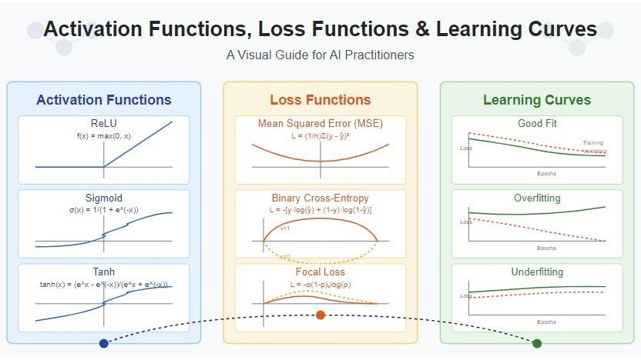
Loss Function
LOSS = HOW WRONG WE ARE
High loss → bad model
Low loss → improving
📌 Models learn by reducing loss

Slide 28
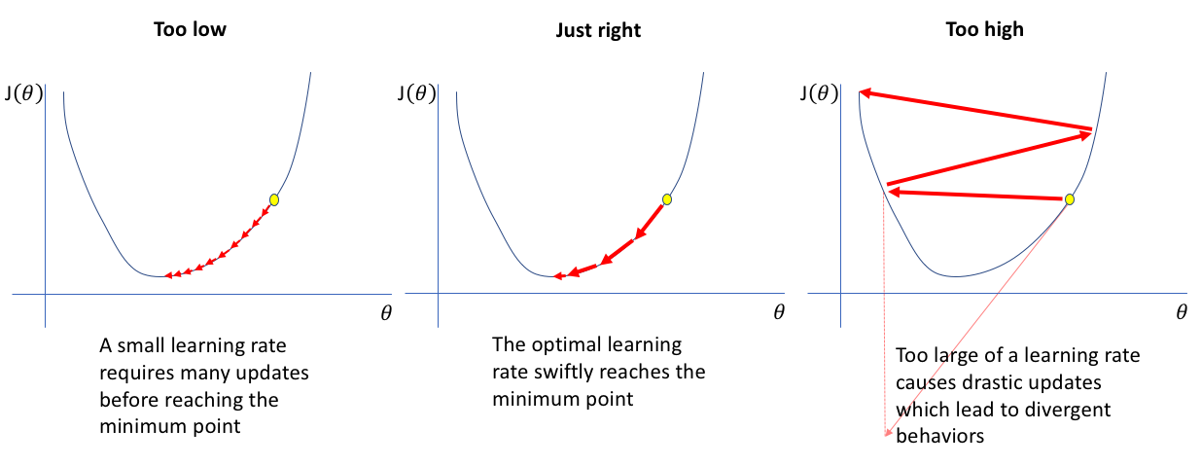
GRADIENT & LEARNING RATE
GRADIENT DESCENT
Gradient → direction
Learning rate → step size
📌 Too fast = unstable
Too slow = stuck

