Slide 1
AI & Machine Learning
SUPERVISED MACHINE LEARNING
Dr. Tariq Sadad

Slide 2
Regression Algorithms
Linear, Ridge & Lasso Regression
  Predicting continuous values from data
“Today, we teach machines to predict numbers — like prices, scores, demand, and risk.”

Slide 3
WHAT IS SUPERVISED LEARNING?
SUPERVISED LEARNING
  Data with inputs (X) and known outputs (y)
  Model learns the relationship
  We guide the model using examples
Examples
  House features → price
  Hours studied → marks
  Ads budget → sales
Supervised = learning with answers

Slide 4
REGRESSION vs CLASSIFICATION
What Are We Predicting?
Today = numbers only
“If the answer is a number, think regression.”
Regression | Number
Task | Output

Slide 5
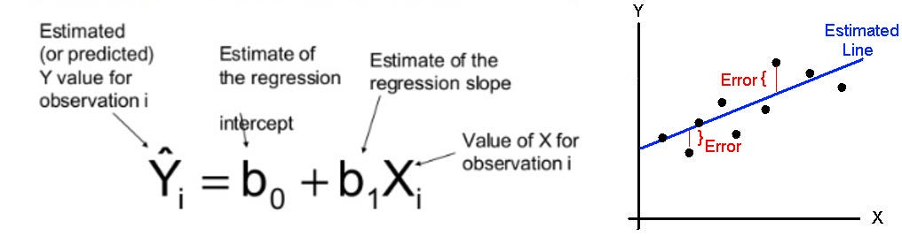
LINEAR REGRESSION
“Draw the best straight line through the data.”
Line minimizes total error
Simple & fast baseline
“This is the first model every ML engineer tries.”

Slide 6
THINK BEFORE CODE
Before Coding — Understand Data
  House Size (sqft) → Price (lakhs)
  500 → 50
  800 → 80
  1000 → 100
  If size increases, what should happen to price?”

Slide 7
DEMO 2: LINEAR REGRESSION (CODE)
import numpy as np
from sklearn.linear_model import LinearRegression
X = np.array([[500],[800],[1000],[1200]])
y = np.array([50, 80, 100, 120])
model = LinearRegression()
model.fit(X, y)
print("Prediction for 900 sqft:", model.predict([[900]]))
Conclusion
  Model learned relationship
  Prediction is interpolation (predicting values within the range of the observed training data.)

Slide 8
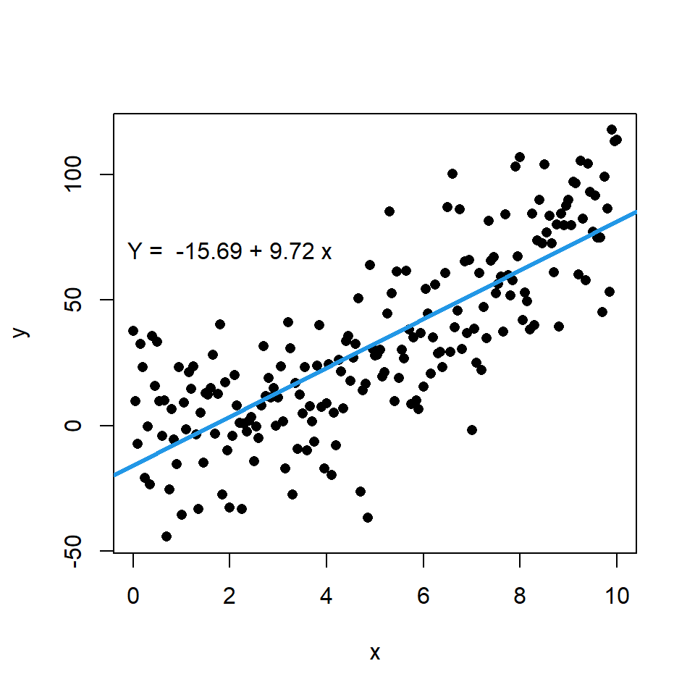
VISUALIZE THE MODEL
import matplotlib.pyplot as plt
plt.scatter(X, y)
plt.plot(X, model.predict(X))
plt.xlabel("Area")
plt.ylabel("Price")
plt.show()
“If you can’t visualize it, you don’t understand it.”

Slide 9
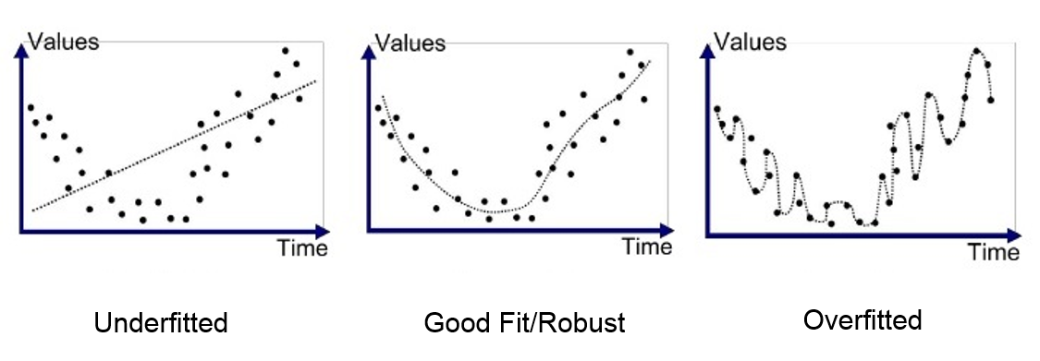
WHY LINEAR REGRESSION FAILS
Problems
  Sensitive to noise
  Overfitting with many features
We need control → regularization

Slide 10
REGULARIZATION
Regularization = Discipline
  Too free ❌ → Controlled ✅
Penalize large weights
Improve generalization
“Regularization tells the model: don’t overreact.”

Slide 11
RIDGE REGRESSION (L2)
Shrinks all weights
Keeps all features
Stable model
Best when features are correlated

Slide 12
DEMO: RIDGE REGRESSION
from sklearn.linear_model import Ridge
ridge = Ridge(alpha=1.0)
ridge.fit(X, y)
print("Ridge prediction:", ridge.predict([[900]]))
Explain
  Alpha controls strictness
  Higher alpha = more control

Slide 13
LASSO REGRESSION
Lasso Regression (L1)
Can force weights to zero
Automatic feature selection
📌 Lasso = simplify the model
from sklearn.linear_model import Lasso
lasso = Lasso(alpha=0.1)
lasso.fit(X, y)
print("Lasso coefficients:", lasso.coef_)
  “Zero weight = useless feature.”

Slide 14
MODEL COMPARISON
Which One to Use?
No single best model
Model | When
Linear | Simple baseline
Ridge | Stable predictions
Lasso | Feature selection

Slide 15
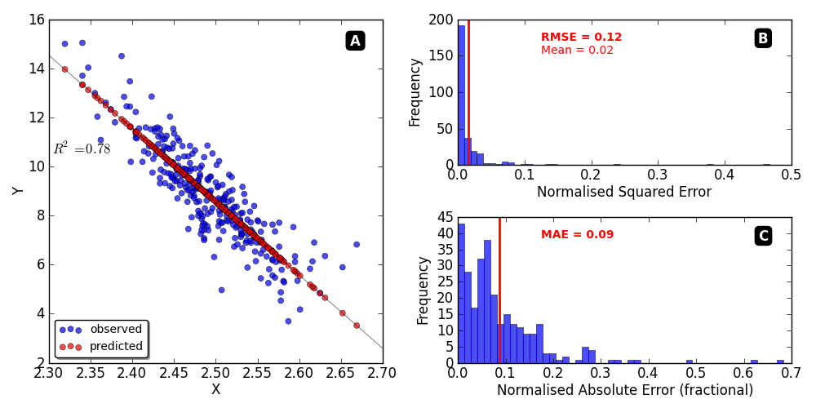
EVALUATION
How Good Is the Model?
  MAE → average mistake
  MSE → big mistakes count much more than small mistakes because the error is squared.
  R² → explained variance

Slide 16
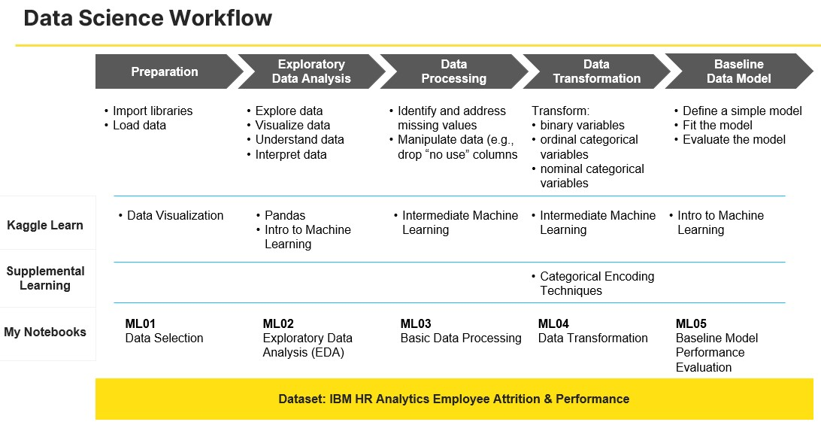
REAL KAGGLE PIPELINE

Slide 17
STUDENT LAB (REAL WORLD)
Lab: Business Price Predictor
You are hired by a shop owner.
Task
Load CSV
Clean missing values
Train Linear, Ridge, Lasso
Compare MAE
Recommend best model
📌 Explain your choice

Slide 18
Mini Project
Build a Price Prediction Tool
Input features
Predict price
Explain confidence

