Slide 1

Augmented Reality App for COMSATS Attock Campus
Group Members:
Muhammad Ali (FA20-BCS-070)
Sadiqa Khursheed (FA20-BCS-078)
Supervised by:
Mr. Muhammad Jamal Ahmed
Department of Computer Science
COMSATS University Islamabad, Attock Campus.

Slide 2









Outlines
Introduction
Literature Review
Comparison Table
Methodology
Objectives of Proposed System
Modules
Proposed Work Plan
Expected Outcomes
Tools & Technologies
Conclusion

Slide 3
Introduction
Project Title: Augmented Reality App for COMSATS Attock Campus
Supervisor: Mr. Muhammad Jamal Ahmed
Tagline: Navigating large campuses like COMSATS can be challenging for students, faculty, and visitors.
By implementing augmented reality technology, our project aims to revolutionize campus navigation, providing users with a more immersive and accurate indoor and outdoor navigation experience.

Slide 4
Problem Statement & Solution
Problem Statement:
Navigating large campuses like COMSATS can be daunting and inefficient for students, faculty, and visitors due to the lack of clear directional guidance, especially indoors where traditional maps are ineffective.
Solution:
Our project proposes the development of an Augmented Reality (AR) navigation system tailored for COMSATS University Attock Campus. By leveraging AR technology, our solution aims to provide real-time, immersive navigation experiences both indoors and outdoors, offering users clear and interactive guidance through a mobile application.

Slide 5
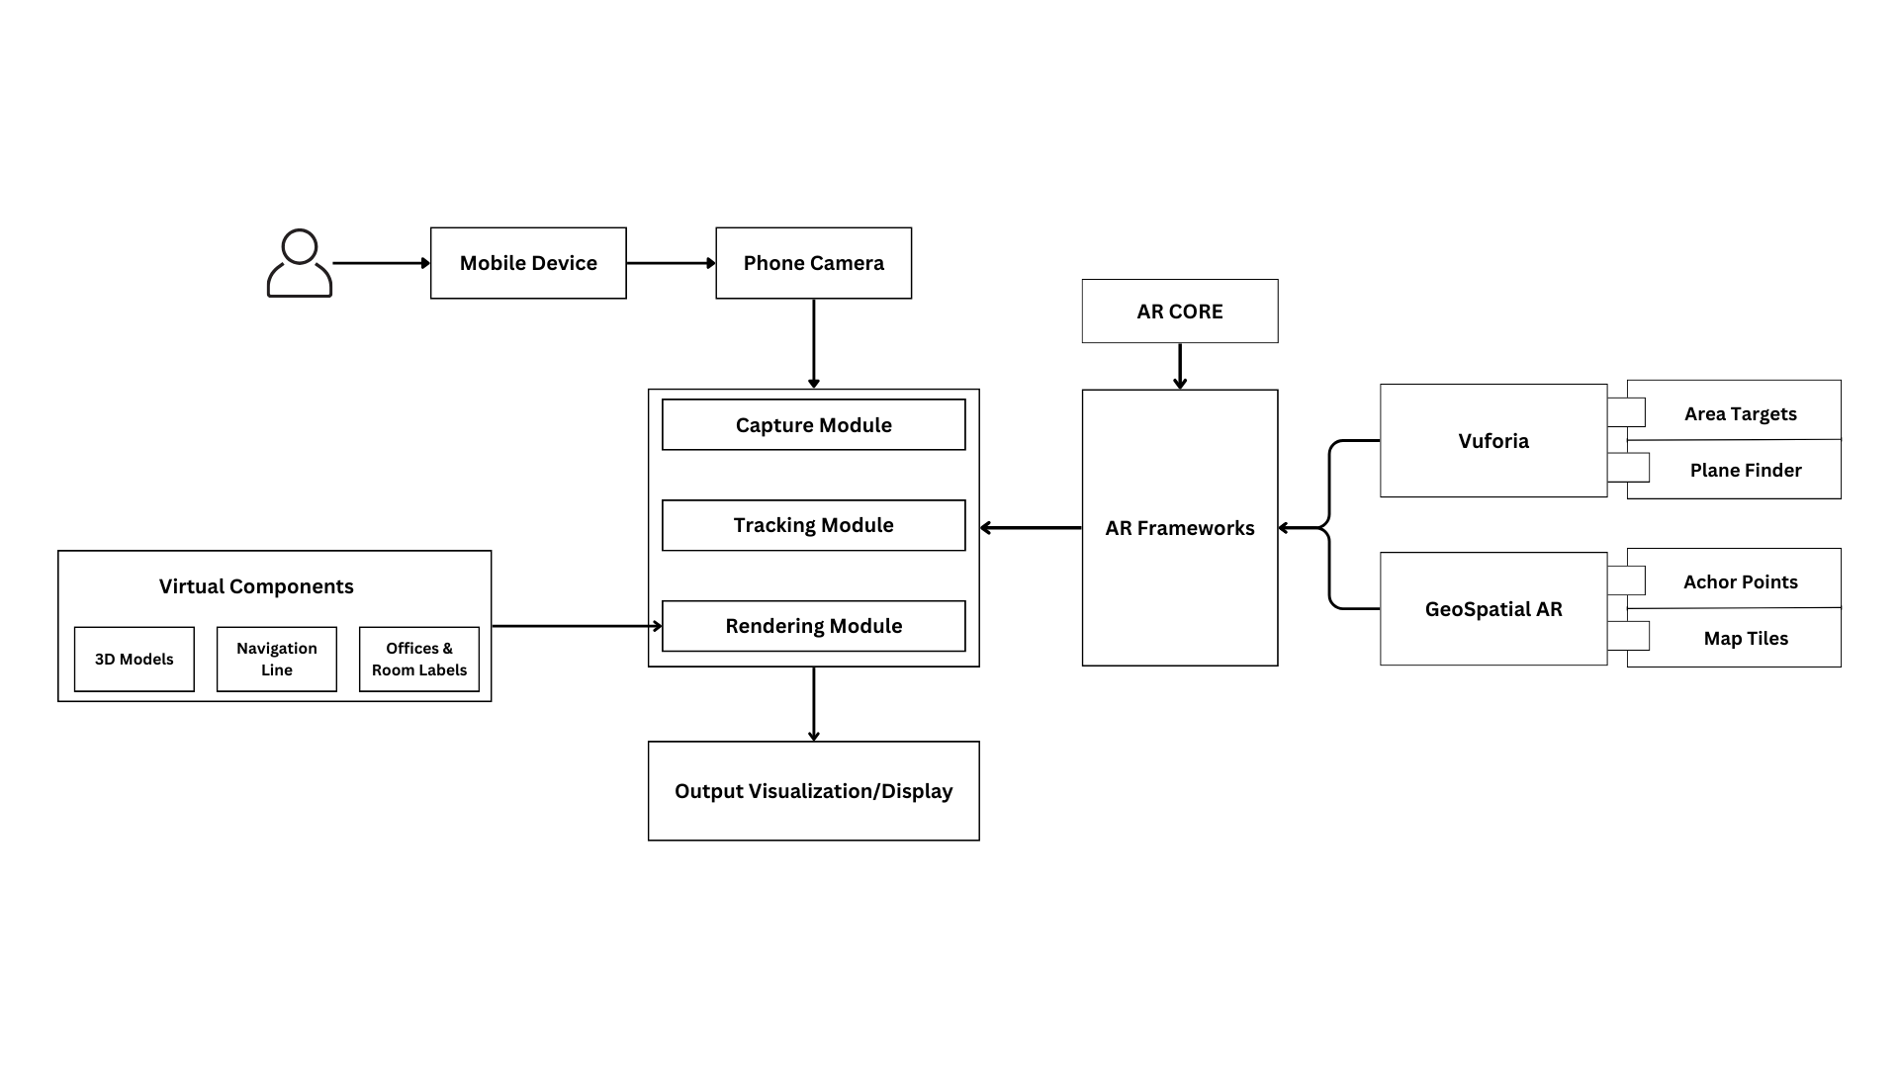
Architectural Diagram

Slide 6
Literature Review
Application Name | Weakness | Proposed Project Solution
COMSATS Attock Virtual Tour | Slow. Is Only Image Based. Does not Provide Indoor Tour. No AR Capability. | More Interactive and Fast. Is 3D Based. Will Provide Indoor Tour. Built with Augmented Reality.
Campus Navigation COMSATS Islamabad | No 3D AR Model of full Campus Does Not provide Indoor Tour. | Provide 3D AR Model of complete Campus Provide user the Indoor Tour

Slide 7
Objectives
To utilize a combination of GPS, indoor positioning technologies, and 3-Dimensional mapping to accurately locate users and guide them to their desired destination.
Giving Users the 3D map of Entire Campus Complete with interactive sites and points that offer relevant information
To provide users with real-time guidance and information about the location of buildings, facilities, and events on campus, making the walkthrough of the campus more efficient and less confusing.
1.
2.
3.

Slide 8
Modules
3D AR Model of Complete Campus
Augmented Reality Display
Search Functionality
Indoor AR Mapping of All Departments (CS, EE,BBA)
Outdoor AR Tour of Entire Campus
AR App for COMSATS Attock

Slide 9
Methodology
Indoor Navigation
Utilizing the Vuforia Creator App, scan the indoor location and import it into Unity. Align area targets for accuracy and establish destination points. Next, create a Navmesh surface for navigation and apply a navigation script to enable seamless indoor navigation.
Outdoor Navigation
We begin by creating a Google Maps API Key and setting up the Unity scene. Import AR Core Extensions and place anchor points at designated outdoor locations using latitude and longitude coordinates. Finally, connect these points through a Line Renderer to facilitate outdoor navigation.
AR Tabletop
Start by importing the Vuforia SDK and employing the Plane Finder Object to detect surfaces. Then, create 3D models in Blender and import them into Unity. Place and label these models accordingly to provide an interactive AR tabletop experience.

Slide 10
Proposed Work Plan
The proposed project aims to develop an Augmented Reality (AR) system for COMSATS University Attock Campus, with the goal of enhancing the experience of students, faculty, and visitors by providing real-time guidance and information through a mobile AR application.
The Application will feature
A Comprehensive 3D model of the entire campus
Outdoor Augmented Reality Tour
Indoor Tour of All Departments
Interactive Sites such as Buildings, Café, Mosque etc.

Slide 11
Expected Outcomes
Deliverables
Implementation of accurate indoor and outdoor positioning technologies.
Creation of detailed indoor mapping of campus departments.
Integration of real-time guidance and personalized information features.
Testing and validation of the application for usability, accuracy, and reliability.
Documentation of user manuals and technical specifications.
Presentation of final project report and demonstration of the application.

Slide 12
Tools and Technologies
Tools And Technologies | Tools | Version | Rationale
 | MS Visual Studio | 2022 | IDE
 | Unity 3D | 3.8.0 | Development Engine
 | Blender | 4.1 | Designing Models
 | Area Target Generator | 10.22.1 | Generating Area Target Unity Packages
 | Vuforia Creator App | 10.22 | Scanning & Creating Area Targets
 | Technology | Version | Rationale
 | Vuforia | 10.22.3 | AR Framework
 | AR Core Extensions | 1.37.0 | Geospatial AR Dependencies
 | Cesium | 1.22 | Loading Maps tiles in Unity
 | C Sharp (C#) | - | Back-end Development for Unity

Slide 13
Conclusion
Our project, COMSATS NAV AR, revolutionizes campus navigation through augmented reality.
By leveraging AR technology, we provide real-time guidance and information for seamless exploration.
Significance: Enhancing visitor experience, showcasing AR's potential in transforming interactions with physical environments.

Slide 14

Q&A Session

Slide 15
Thank You

