Slide 1
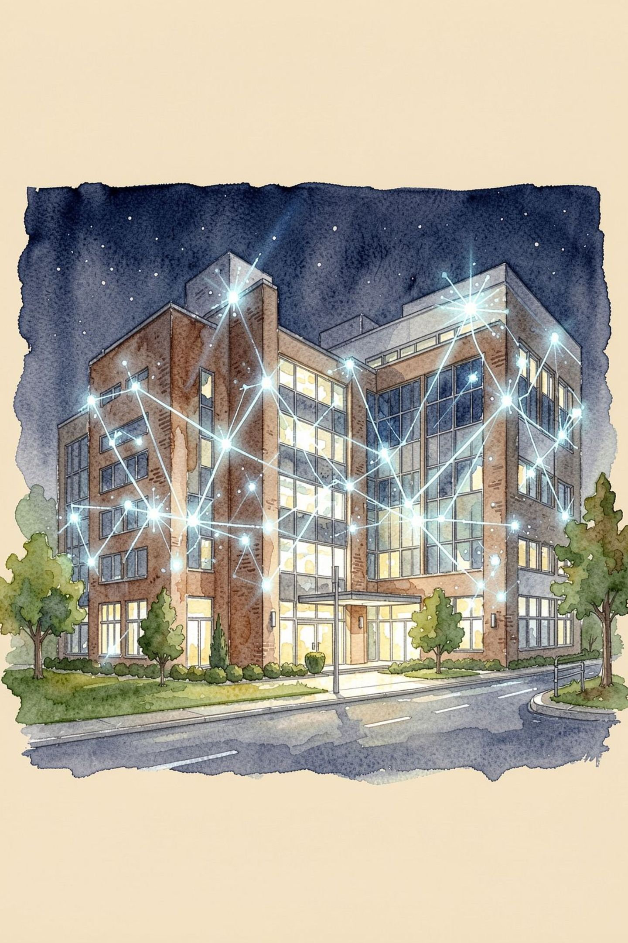
Renovia Hospital OS
AI-Powered Operating System for Modern Healthcare
Muhammad Umar · Muhammad Ali Hadi · Raghib Rizwan Rabbani

Slide 2


Healthcare Is Fragmented
40%+ Time Lost
Doctors spend the majority of their day on paperwork instead of patient care
Siloed Systems
EHR, billing, pharmacy, and lab operate in isolation — none talking to each other
Communication Breakdowns
Gaps between departments lead to medical errors, delays, and poor outcomes
Tool Overload
Hospital staff juggle 4–5 different software tools daily with no unified view

Slide 3
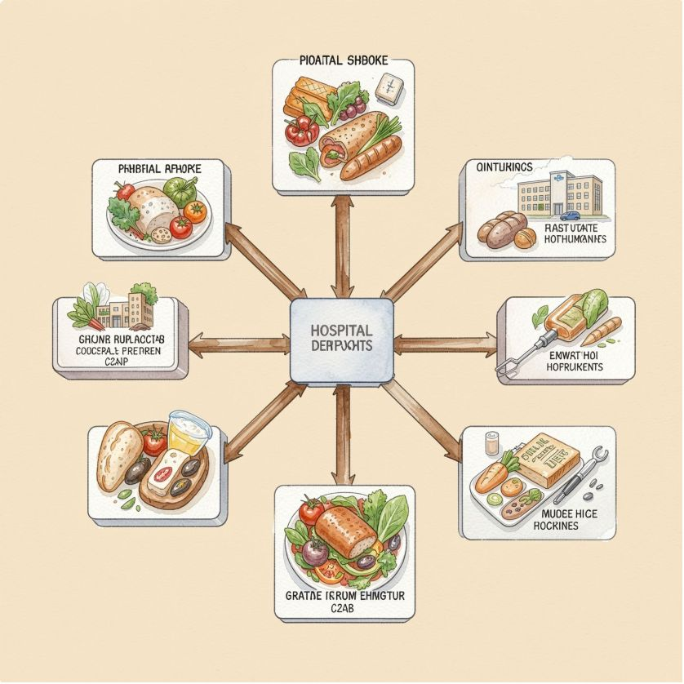
One Hospital. One Operating System.
Renovia unifies every hospital department into a single, real-time workflow.
25 Operational Domains
Centralized Patient Data
Real-Time Coordination
Connected seamlessly across every department
Clinical information unified in one source of truth
Live sync across Patients · Doctors · Nursing · Lab · Pharmacy · Billing
AI at Every Step
Integrated intelligence embedded throughout the workflow

Slide 4

From Registration to Discharge
The complete patient journey — in one platform:
Registration
Doctor Consult
Smart intake with AI triage
AI-assisted notes & diagnosis
Vitals & Queue
Labs & Pharmacy
Real-time prioritization
Automated orders and fulfillment

Slide 5

Rizocare AI — Intelligence Inside the Workflow
AI Capabilities
Clinical AI Assistant — Diagnostic suggestions & drug interactions
Voice Clinical Notes — Hands-free dictation for doctors
AI Receptionist & Triage — Automated patient intake
Lab Report Interpreter — Complex results in plain language
Discharge Summarizer — Complete discharge papers in one click
Prescription Draft Assistance — Smart dosage and precaution suggestions
RAG Knowledge Assistant — Hospital guidelines and medical references
User Input
Speech-to-Text
LLM Reasoning
Vector Retrieval

Slide 6



Everything the Hospital Needs — In One Platform
25 operational domains across clinical, operations, and administration
Clinical
Operations
Administration
Patient Management
Doctor & Consultation
Electronic Health Records
AI Triage
Departments & Beds
Appointments & Queues
Laboratory
Pharmacy & Inventory
Billing & Claims
Staff & HR
Notifications
Reports & Analytics
24 professional dashboard screens tailored to each hospital role

Slide 7

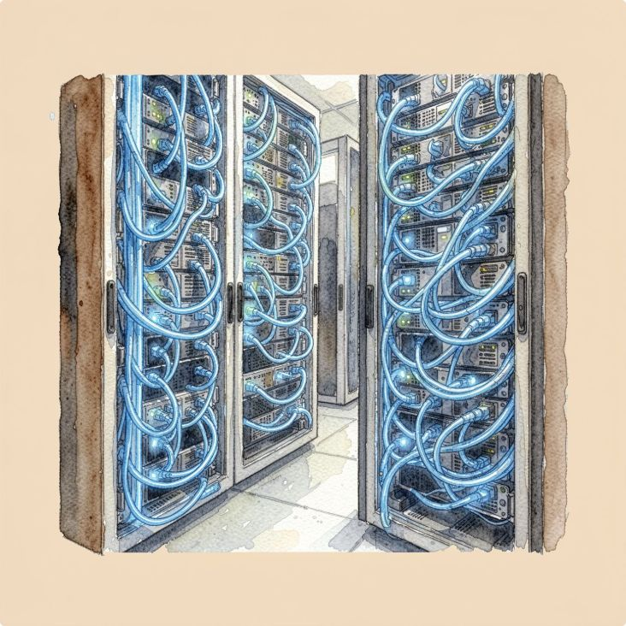
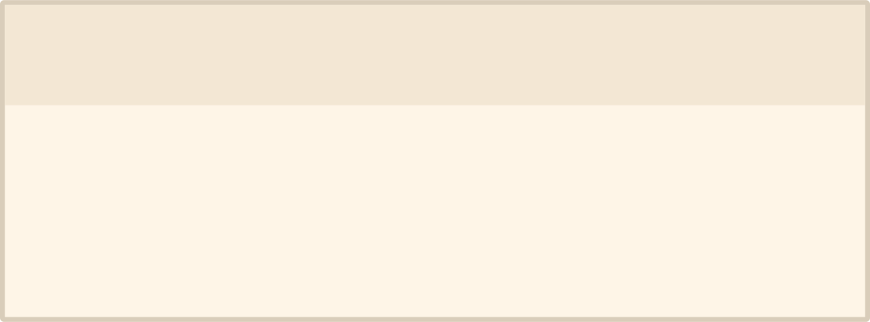
Built for Scale and Real-Time Operations
1
2
Frontend
Backend API
React 18 · TypeScript · Vite · Tailwind CSS
Node.js 20 · Express 5 · Prisma ORM · PostgreSQL
3
4
Real-Time Layer
AI Services
Socket.IO — live bed tracking, queue updates, emergency alerts
Groq (LLM & Speech) · Google Gemini (Embeddings) · Qdrant (Vector DB)
185
52
REST Endpoints
Data Models
16
AI Endpoints

Slide 8





Enterprise-Ready Security
Multi-Tenant Isolation
Strict hospital-level data separation via JWT-enforced queries
9 RBAC Roles
Admin · Doctor · Nurse · Receptionist · Pharmacist · Lab Tech · Accountant · Patient · Super Admin
JWT Authentication
Secure token refresh with single-flight concurrent request handling
Audit Logging
Immutable tracking of all sensitive medical record access
Bank-Grade Encryption
All data encrypted in transit and at rest

Slide 9
From Fragmented Workflows to Intelligent Healthcare
The scale and sophistication of Renovia at a glance:
185
25
REST Endpoints
Operational Domains
16
52
AI Endpoints
Data Models
24
9
Dashboard Screens
RBAC Roles
Unified Workflows
Real-Time Operations
AI Assistance
Secure Multi-Tenancy
A complete hospital operating system built for the modern healthcare era.

Slide 10
The Future of Hospital Intelligence
Now
1
Complete Hospital OS · 16 AI capabilities · Real-time operations across all departments
2
Next
Mobile application · FHIR / HL7 interoperability standards for cross-system integration
Future
3
Fine-tuned medical models · Predictive ICU deterioration alerts · Autonomous clinical workflows
Thank You
Questions?

