Slide 1


Slide 2


Slide 3


Slide 4


Slide 5


Slide 6


Slide 7
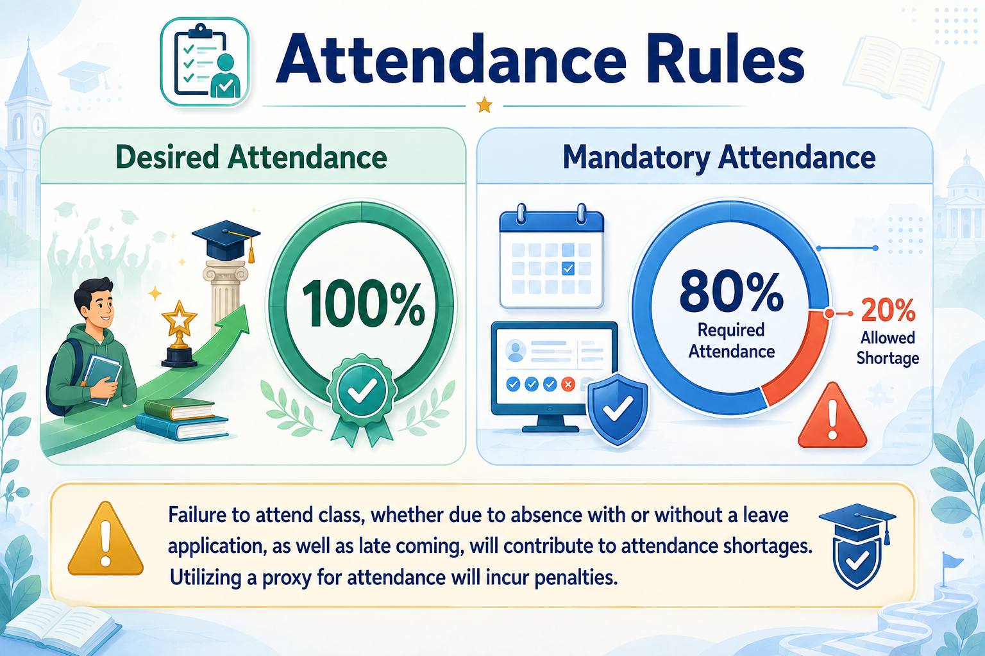

Slide 8
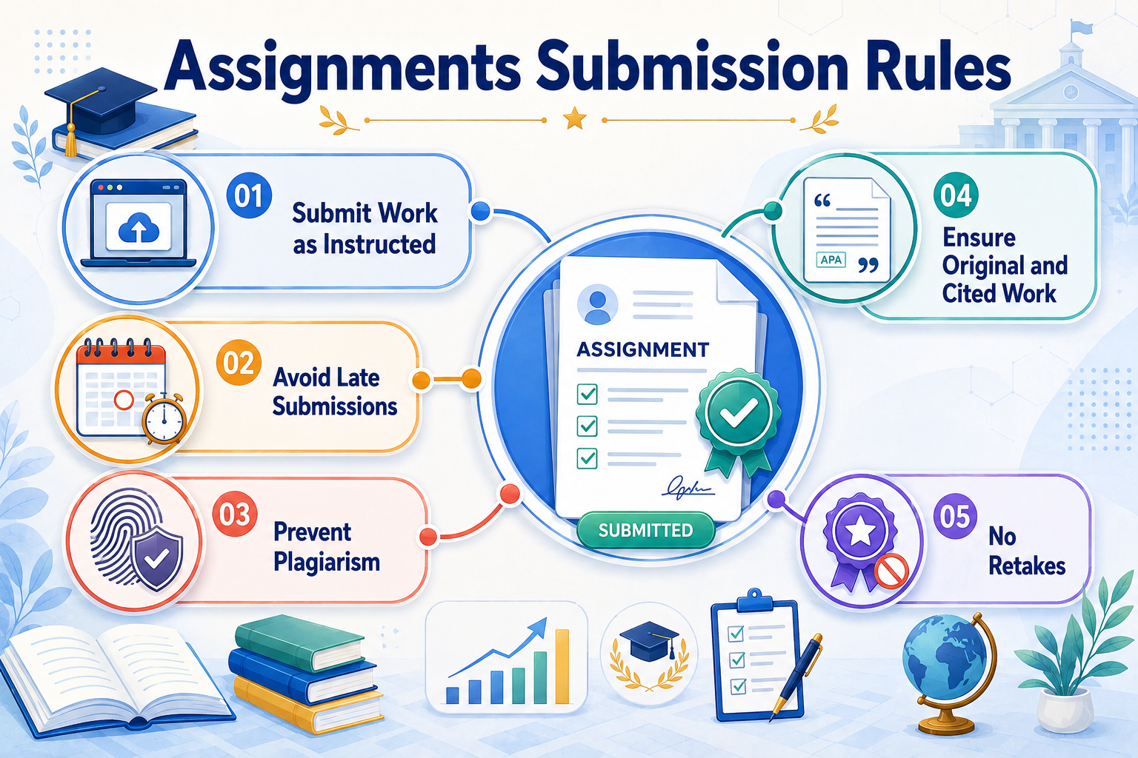

Slide 9


Slide 10
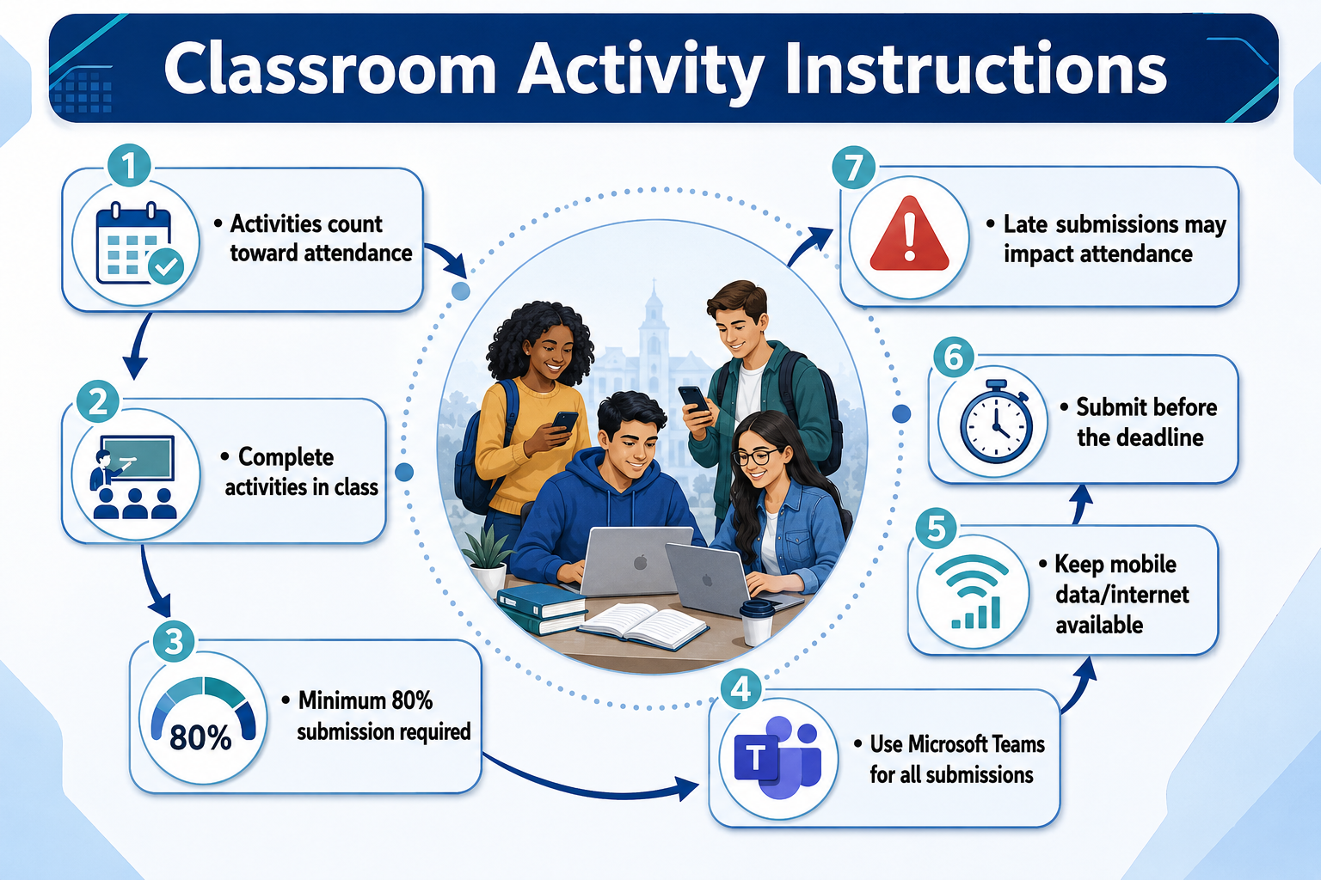

Slide 11


Slide 12


Slide 13


Slide 14
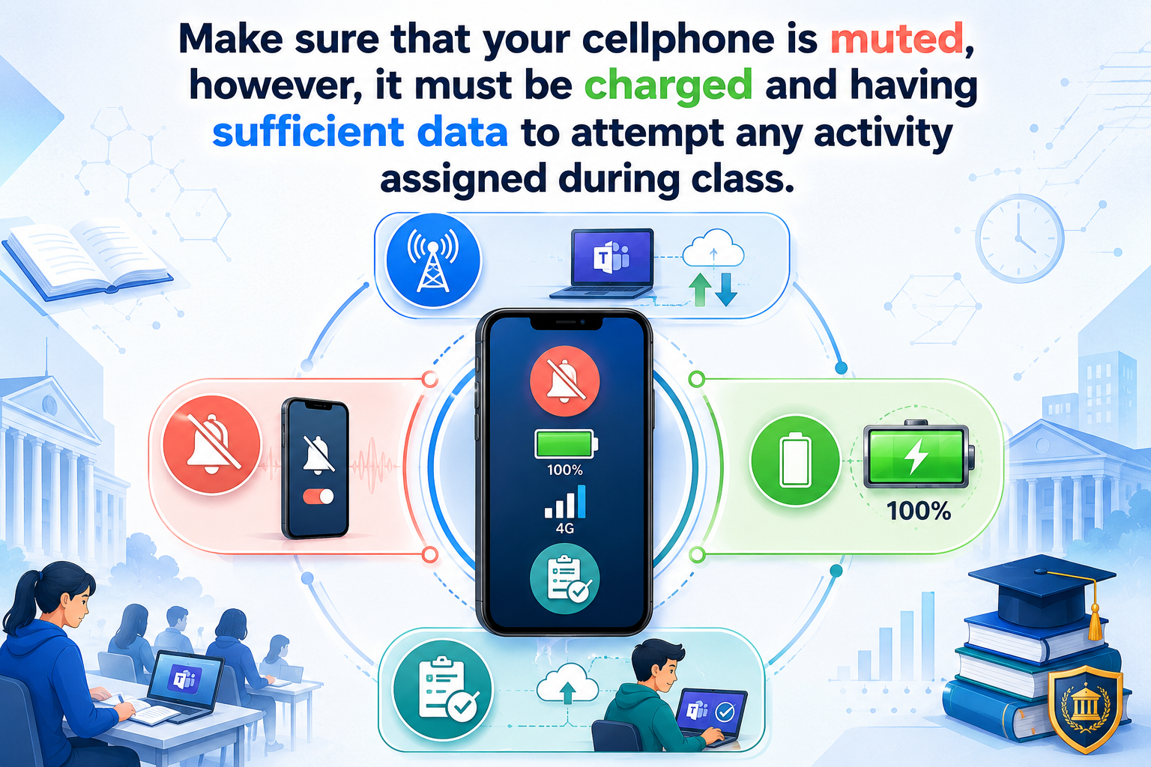

Slide 15


Slide 16

Notes:
To sign in Use
ID: uyourregno@giki.edu.pk
Password: write your date of birth:
year month day
20010813

Slide 17


Slide 18
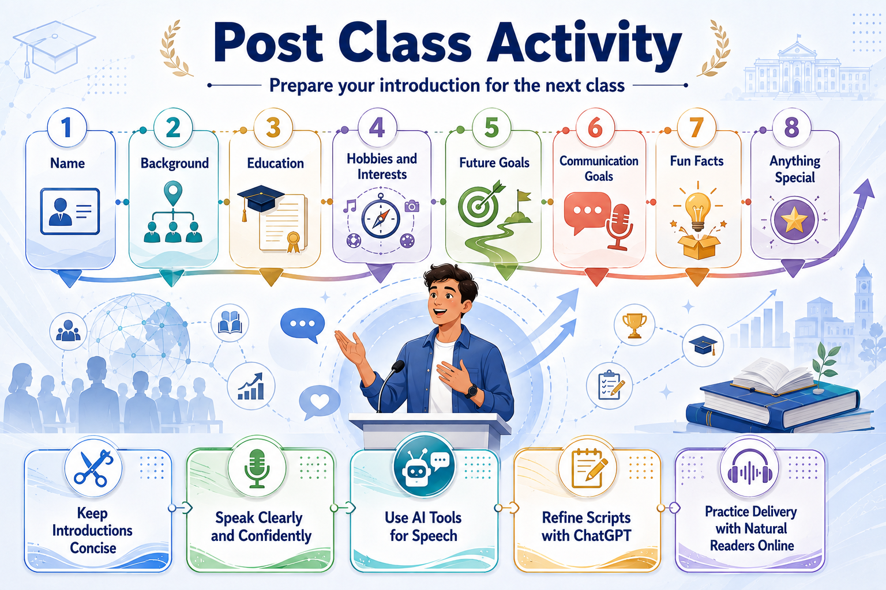

Slide 19

Notes:
Name
Start with your full name, and if you have a preferred nickname, you can mention that as well.
Background
Share a bit about where you are from, such as your hometown.
Education
Mention your current level of education, major or field of study, and any academic achievements or goals.
Hobbies and Interests
Talk about your interests and hobbies outside of academics or work.
Future Goals
Discuss your aspirations and what you hope to achieve in your academic or professional life.
Communication Goals
What you hope to improve or achieve in terms of communication skills during the course.
Fun Facts
Share a couple of interesting or unique facts about you that can make your introduction memorable.
Anything Special
Anything unique or special about your background, experiences, or talents that you'd like to share.

Slide 20


Slide 21


