Slide 1
Deep Learning with Tensorflow
Part II

Slide 2
Material
Hands-On Machine-Learning with Scikit-Learn, Keras, and Tensorflow. Aurelion Geron. Book 2nd Edition, Code 3rd Edition
https://github.com/ageron/handson-ml3.git
Andrew Ng via Coursera/Deeplearning.
https://www.coursera.org/specializations/deep-learning
Lawrence Moroney
https://www.tensorflow.org/tutorials (Basic Computer Vision with ML)
https://www.tensorflow.org/tutorials/images/classification
http://introtodeeplearning.com/

Slide 3
Caution
This material is intended to provide some familiarity with the Tensorflow framework.
It is not intended to replace conceptual understanding provided in other units (e.g Intro AI)
Thus, some concepts will only briefly be introduced so that we can concentrate on code.
Access to GPU very helpful for training CNNs!!!

Slide 4

Session's Content
Very brief Introduction to CNNs
CNN for image classification
CNN for image classification (skin cancer)
CNN for residual networks
CNN using pretrained layers

Slide 5
The Issue with Images
n_c^{[1]}
?
Task: Image Classification
n_h
n_w
Typical Dense Layers
Fixed input
Image Input
Take raw image as input, how to do this?
Could also perform manual feature extraction
Connecting every pixel/color value to dense layer?
1024x1024 RGB image to 1024 Dense layer - parameter explosion!

Slide 6
Approaches
Naïve approach rescale images
Introduces distortion, translation invariant
Same feature learned in different positions (no sharing)
Use “filters” (aka kernels), e.g. vertical edge detector
Have to specify weights, lots of filters (parameters) to specify!!!
Convolutional Neural Networks (CNNs)
Use learned filters, allows (some) image translation
Feature sharing (greatly reduces number of parameters)
Accept different sized images

Slide 7
Filter/Kernel Approach
Slide filter across image to produce new image
3x3 Vertical Edge Detector across 3 channels total of 27 weights
If stride is > 1 then output will be smaller than input
Can add padding so result is same size as input image
-1 0 +1
-1 0 +1
-1 0 +1
-1 0 +1
-1 0 +1
-1 0 +1
-1 0 +1
-1 0 +1
-1 0 +1
Filter overlap helps with translation invariance
Output
Height = ((h – f + 1) / stride) + 1
Width = ((h – f + 1) / stride) + 1
Input
Height x Width x Channels

Slide 8
Multiple (Manual) Filters
Generally height/width same or smaller
Generally will have same or more channels
3x3 Vertical Edge
-1 0 +1
-1 0 +1
-1 0 +1
Output depth (channels) is number of filters applied
-1 0 +1
-1 0 +1
-1 0 +1
-1 0 +1
-1 0 +1
-1 0 +1
3x3 Horizontal Edge
-1 -1 -1
0 0 0
+1 +1 +1
-1 -1 -1
0 0 0
+1 +1 +1
-1 -1 -1
0 0 0
+1 +1 +1
Output
Height = ((h – f + 1) / stride) + 1
Width = ((h – f + 1) / stride) + 1
Input
Height x Width x Channels

Slide 9
Convolutional Layer
Each layer has filters (that are learned), filter learns a feature
Slide across multiplying/adding with the input (convolve)
Parameters = (f x f x n_c^{[L-1]} x n_c^{[L]}) + n_c^{[L]}
n_c^{[1]}
n_c^{[2]}
n_h
f
n_c^{[1]}
n_w
f
Input
Height x Width x Channels
n_h x n_w x n_c^{[1]}
f x f x n_c
Filters aka
Feature Detectors
Output
Height x Width x Channels
n_h x n_w x n_c^{[2]}
Conv2D Layer

Slide 10
General Convolutional Layer
Each layer has filters, aka channels or features, that are learned
Slide across multiplying/adding with the input (convolve)
n_c^{[L-1]}
n_c^{[L]}
n_c^{[L]}
n_h^{[L-1]}
f
n_h^{[L]}
n_c^{[L-1]}
f
f = filter size
n_c^{[L]} = # of filters
stride, padding
Filters aka Feature Detectors
n_w^{[L]}
n_w^{[L=1]}
Input
Height x Width x Channels
Output
Height x Width x Channels
Conv2D Layer

Slide 11
More Layers – what does this mean?
Height/width decrease, channels increase
Early layers have “low level features”
Later layers have “high level features”
Flatten
to 1D
f
k x k
Conv
f
k x k
Conv
f
k x k
Conv
Low level
Features
(e.g. lines)
Mid level
Features
(e.g. eyes)
High level
Features
(e.g. faces)
Fully
Connected

Slide 12
Sequential Conv2D Layers
Better to have one Conv2D or 2 x Conv2D?
Stacking Conv2D can result in fewer parameters
n_c^{[L-1]}
n_c^{[L-1]}
n_h^{[L-1]}
n_h^{[L-1]}
n_w^{[L=1]}
n_w^{[L=1]}
7x7 filter size
Parameters = 7 x 7 x n_c^{[L-1]}
3x3 filter size
Parameters = 3 x 3 x n_c^{[L-1]}
3x3 filter size
Parameters = 3 x 3 x n_c^{[L-1]}

Slide 13
Feature Learning – Deep Learning
Deep Learning is about learning (useful) features
DNN later layers automatically learn useful features
Versus previously “manually” specifying features
f
k x k
Conv
f
k x k
Conv
f
k x k
Conv
Low level
Features
(e.g. lines)
Mid level
Features
(e.g. eyes)
High level
Features
(e.g. faces)
Fully
Connected
Feature Learning Layers
Top Layers

Slide 14
Pooling Layer Example
Reduce computational burden, ignore noise
Provides (some) translation invariance
Typical to reduce by 2, max or average
Intuition is to select most prominent value, ignore “noise”
2 | 7
1 | 3
7 | … | … | …
… | … | … | …
… | … | … | …
2x2
(not a volume)
stride = 2
No parameters to learn!
Output
Height = h /stride
Width = w/stride
Channel number not changed
Input
Height x Width x Channels

Slide 15
Pooling Layer
Difference with Conv2D
No learned parameters
Operation per channel, not convolved across channels
n_c^{[L-1]}
n_c^{[L-1]}
Max/Avg
Pool size
h x w
Stride
n_h^{[L-1]}
n_h^{[L]}
n_w^{[L]}
Pooling Layer
n_w^{[L=1]}
Input
Height x Width x Channels
Output
Height x Width x Channels

Slide 16
Session's Content
Very brief Introduction to CNNs
CNN for image classification
CNN for image classification (skin cancer)
CNN for residual networks
CNN using pretrained layers

Slide 17
LeNet 5 (AlexNet and VGG)
1
2
3
4
5
6
7
8
9
10
11
model = Sequential([
layers.Input(shape=(img_height, img_width, 3)),
layers.Conv2D( 6, 5, padding="valid", stride=1, activation="tanh"),
layers.AveragePooling2D( 2 ),
layers.Conv2D(16, 5, padding="valid", stride=1, activation="tanh"),
layers.AveragePooling2D( 2 ),
layers.Flatten(),
layers.Dense(120, activation="tanh"),
layers.Dense( 84, activation="tanh"),
layers.Dense( 10, activation=”softmax")
])
How many parameters?
1
32
32
6
5x5
Conv
Avg
Pool
2x2
16
5x5
Conv
Avg
Pool
2x2
16
8
8
10
num_classes
120
84

Slide 18
Simple CNN Example https://www.tensorflow.org/api_docs/python/tf/keras/layers/Conv2D
1
2
3
4
5
6
7
8
9
10
11
12
model = Sequential([
layers.Rescaling(1./255, input_shape=(img_height, img_width, 3)),
layers.Conv2D(16, 3, padding="same", activation="relu"),
layers.MaxPooling2D(),
layers.Conv2D(32, 3, padding="same", activation="relu"),
layers.MaxPooling2D(),
layers.Conv2D(64, 3, padding="same", activation="relu"),
layers.MaxPooling2D(),
layers.Flatten(),
layers.Dense(128, activation="relu"),
layers.Dense(num_classes)
])
How many parameters?
3
224
224
16
3x3
Conv
Max
Pool
2x2
32
3x3
Conv
Max
Pool
2x2
64
3x3
Conv
Max
Pool
2x2
64
28
28
num_classes = 4
128

Slide 19
Session's Content
Very brief Introduction to CNNs
CNN for image classification
CNN for image classification (skin cancer)
CNN for residual networks
CNN using pretrained layers

Slide 20




Custom Example – Skin Cancer
https://www.kaggle.com/datasets/farjanakabirsamanta/skin-cancer-dataset
10015 instances with 7 classes, also additional data (e.g. gender, location, age)
Need to reorganize folder structure for the tf.keras.utils.image_dataset_from_directory
ISIC_0024331.jpg
ISIC_0024332.jpg
ISIC_0024345.jpg
akiec
ISIC_0024345.jpg
bcc
ISIC_0024331.jpg
bkl
df
filename | type (dx)
ISIC_0024331.jpg | bcc
ISIC_0024332.jpg | mel
ISIC_0024345.jpg | akiec
mel
ISIC_0024332.jpg
nv
vasc
HAM10000_metadata.csv file with filename -> type mapping

Slide 21
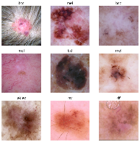
Custom Example – Skin Cancer
Load data
1
2
3
4
5
6
7
8
9
10
11
12
13
14
# Images are originally 600x450, either scale or crop
data_dir = "./health_small/"
batch_size = 32
img_height = 224
img_width = 224
train_ds = tf.keras.utils.image_dataset_from_directory(
data_dir,
validation_split=0.2, crop_to_aspect_ratio=True,
color_mode="rgb",
subset="training",
seed= 123,
image_size=(img_height, img_width),
batch_size=batch_size,
shuffle = True)
See: https://www.tensorflow.org/api_docs/python/tf/keras/utils/image_dataset_from_directory

Slide 22
Simple CNN Example https://www.tensorflow.org/api_docs/python/tf/keras/layers/Conv2D
1
2
3
4
5
6
7
8
9
10
11
12
13
14
15
16
model = tf.keras.Sequential([
tf.keras.layers.Rescaling(1./255, input_shape=[img_height, img_width, 3]),
tf.keras.layers.Conv2D(32, 5, strides=2, padding="same", activation="relu"),
tf.keras.layers.MaxPooling2D(),
tf.keras.layers.Conv2D(64, 3, padding="same", activation="relu"),
tf.keras.layers.MaxPooling2D(),
tf.keras.layers.Conv2D(128, 3, padding="same", activation="relu"),
tf.keras.layers.MaxPooling2D(),
tf.keras.layers.Flatten(),
tf.keras.layers.Dropout(0.5),
tf.keras.layers.Dense(128, activation='relu’),
tf.keras.layers.Dropout(0.5),
tf.keras.layers.Dense(64, activation='relu’),
tf.keras.layers.Dropout(0.5),
tf.keras.layers.Dense(num_classes, activation="softmax")
])
Model: "sequential_12"
_________________________________________________________________
Layer (type) Output Shape Param #
=================================================================
rescaling_8 (Rescaling) (None, 224, 224, 3) 0
conv2d_211 (Conv2D) (None, 112, 112, 32) 2432
max_pooling2d_28 (MaxPoolin (None, 56, 56, 32) 0
conv2d_212 (Conv2D) (None, 56, 56, 64) 18496
max_pooling2d_29 (MaxPoolin (None, 28, 28, 64) 0
conv2d_213 (Conv2D) (None, 28, 28, 128) 73856
max_pooling2d_30 (MaxPoolin (None, 14, 14, 128) 0
flatten_12 (Flatten) (None, 25088) 0
dropout_21 (Dropout) (None, 25088) 0
dense_27 (Dense) (None, 128) 3211392
dropout_22 (Dropout) (None, 128) 0
dense_28 (Dense) (None, 64) 8256
dropout_23 (Dropout) (None, 64) 0
dense_29 (Dense) (None, 7) 455
=================================================================
Total params: 3,314,887
Trainable params: 3,314,887
Non-trainable params: 0
How many parameters?

Slide 23
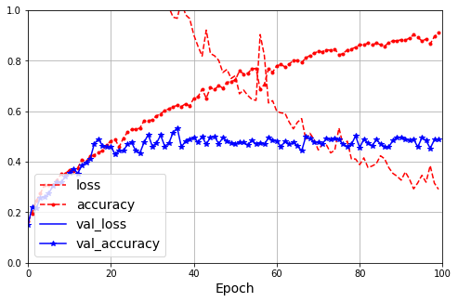
Results – Skin Cancer

Slide 24
Session's Content
Very brief Introduction to CNNs
CNN for image classification
CNN for image classification (skin cancer)
CNN for residual networks
CNN using pretrained layers

Slide 25
What is a residual network
Layer splits input onto two paths
Deep path, next layer as usual
Skip connection, subsequent layer (two or more layers)
f/s
3x3
Conv
Identity path
features
height
width
f/s
3x3
Conv
f
3x3
Conv
f
height/s
width/s
+
Deep path
Acts as single layer
With f features, s stride
3x3 kernel

Slide 26
Residual Layer
1
2
3
4
5
6
7
8
9
10
11
12
13
14
15
16
17
18
19
20
21
22
23
24
25
26
27
class ResidualLayer(tf.keras.layers.Layer):
def __init__(self, filters, strides=1, activation="relu", **kwargs):
super().__init__(**kwargs)
self.activation = tf.keras.activations.get(activation)
self.main_layers = [
DefaultConv2D(filters, strides=strides),
tf.keras.layers.BatchNormalization(),
self.activation,
DefaultConv2D(filters),
tf.keras.layers.BatchNormalization()
]
self.skip_layers = []
if strides > 1:
self.skip_layers = [
DefaultConv2D(filters, kernel_size=1, strides=strides),
tf.keras.layers.BatchNormalization()
]
def call(self, inputs):
Z = inputs
for layer in self.main_layers:
Z = layer(Z)
skip_Z = inputs
for layer in self.skip_layers:
skip_Z = layer(skip_Z)
return self.activation(Z + skip_Z)
How many parameters?

Slide 27
Residual Network Example
1
2
3
4
5
6
7
8
9
10
11
12
13
model = tf.keras.Sequential([
tf.keras.layers.Rescaling(1./255, input_shape=[img_height, img_width, 3]),
ResidualLayer( 64, strides=1),
ResidualLayer( 64, strides=1),
ResidualLayer(128, strides=2),
ResidualLayer(128, strides=1),
tf.keras.layers.MaxPooling2D(),
tf.keras.layers.Flatten(),
tf.keras.layers.Dropout(0.5),
tf.keras.layers.Dense(64, activation="relu"),
tf.keras.layers.Dropout(0.5),
tf.keras.layers.Dense(num_classes)
])
How many parameters?
3
224
224
64
3x3
Resnet
64
3x3
Resnet
128/2
3x3
Resnet
128
3x3
Resnet
Max
Pool
2x2
64
128
56
56
num_classes

Slide 28
Resnet 34 (Resnet 50, 101, 152)
1
2
3
4
5
6
7
8
9
10
11
12
13
14
15
model = tf.keras.Sequential([
DefaultConv2D(64, kernel_size=7, strides=2, input_shape=[img_height, img_width, 3]),
tf.keras.layers.BatchNormalization(),
tf.keras.layers.Activation("relu"),
tf.keras.layers.MaxPool2D(pool_size=3, strides=2, padding="same"),
])
prev_filters = 64
for filters in [64] * 3 + [128] * 4 + [256] * 6 + [512] * 3:
strides = 1 if filters == prev_filters else 2
model.add(ResidualLayer(filters, strides=strides))
prev_filters = filters
model.add(tf.keras.layers.GlobalAvgPool2D())
model.add(tf.keras.layers.Flatten())
model.add(tf.keras.layers.Dense(num_classes, activation="softmax"))
num
classes
f
w
h
64
7x7
Conv
Max
Pool
3x3,2
64
3x3
Res
64
3x3
Res
64
3x3
Res
128/2
3x3
Res
128
3x3
Res
128
3x3
Res
128
3x3
Res
256/2
3x3
Res
256
3x3
Res
256
3x3
Res
256
3x3
Res
256
3x3
Res
256
3x3
Res
512/2
3x3
Res
512
3x3
Res
512
3x3
Res
Avg
Pool
2x2
f’
w’
h’

Slide 29
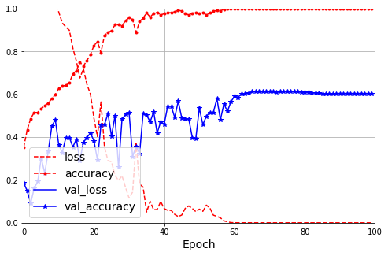
Results – Skin Cancer Resnet34

Slide 30
Session's Content
Very brief Introduction to CNNs
CNN for image classification
CNN for image classification (skin cancer)
CNN for residual networks
CNN using pretrained layers

Slide 31


Can we leverage existing models?
Can view a model as consisting of the following
Dataset D_{A} model was trained
Weights W_{AX} (a.k.a. features) learned from dataset on Task T_{X}
Task T_{X} indirectly represented by top layers with the softmax activation
Dataset D_{A}
Model W_{AX} (learned features)
Task T_{X} (top layers)
Layer
1
W¹_{AX}
Layer
2
W²_{AX}
Layer
3
W³_{AX}
Layer
4
softmax
Low Middle High
Dataset D_{B}
Model W_{BY} (learned features)
Task T_{Y} (top layers)
Layer
1
W¹_{BY}
Layer
2
W²_{BY}
Layer
3
W³_{BY}
Layer
4
softmax
Low Middle High

Slide 32
Transfer Learning
Freeze Layer means not trainable. Weights cannot be modified during training.
layer.trainable = True
Unfreeze Layer means trainable. Weights can be modified during training.
layer.trainable = False
Dataset D_{A}
Model W_{AX} (learned features)
Task T_{X} (top layers)
Layer
1
W¹_{AX}
Layer
2
W²_{AX}
Layer
3
W³_{AX}
Layer
4
ImageNet
~2M images
1000 classes
softmax
Low Middle High
Dataset D_{B}
Copied
Copied then modified
Task T_{Y} (top layers)
Skin Cancer
~10K images
Layer
1
W¹_{AX}
Layer
2
W²_{AX}
Layer
3
W³_{AX-BY}
Layer
4
7 classes
softmax
Freeze
Unfreeze

Slide 33
Transfer Learning Summary
Two potential benefits
Reduce computation, copied weights start in better state than random weights. May require fewer epochs to reach same accuracy.
Improve accuracy. Features learned from base model’s dataset can improve model that could not be learned on the new dataset.
Common to freeze base model, train, unfreeze higher layers, train, reduce learning rate, etc. until no improvement.
Not guaranteed
Do not know what/if base layers are useful for new task
Ideally base dataset and new dataset should have similarities

Slide 34
Inception Module
Multiple parallel kernel sizes (receptive field)
”1x1 Skip connection”, Concatenation, cross-channel patterns
64
1x1
Conv
64
28
28
96
1x1
Conv
128
3x3
Conv
128
28
28
32
28
28
192
28
28
128
28
28
Channel
Concat
32
28
28
256
28
28
16
1x1
Conv
32
5x5
Conv
32
28
28
Max
Pool
s=1
32
1x1
Conv
32
28
28
Acts as single layer

Slide 35
Inception Network (GoogLeNet)
Provided by Keras, nine inception modules
1
2
3
4
5
6
7
8
9
tf.keras.applications.inception_v3.InceptionV3(
include_top=True,
weights='imagenet’,
input_tensor=None,
input_shape=None,
pooling=None,
classes=1000,
classifier_activation='softmax'
)
num
classes
f
w
h
64
7x7
Conv
Max
Pool
3x3,2
Local
Norm
64
1x1
Conv
192
3x3
Conv
Local
Norm
Max
Pool
3x3,2
Max
Pool
3x3,2
Max
Pool
3x3,2
Glob
Avg
Drop
Out

Slide 36
Pretrained Models Provided Keras
Class name | Size (MB) | Top-1 acc | Top-5 acc | Params | CPU (ms) | GPU (ms)
MobileNetV2 | 14 | 71.3% | 90.1% | 3.5M | 25.9 | 3.8
MobileNet | 16 | 70.4% | 89.5% | 4.3M | 22.6 | 3.4
NASNetMobile | 23 | 74.4% | 91.9% | 5.3M | 27.0 | 6.7
EfficientNetB0 | 29 | 77.1% | 93.3% | 5.3M | 46.0 | 4.9
EfficientNetB1 | 31 | 79.1% | 94.4% | 7.9M | 60.2 | 5.6
EfficientNetB2 | 36 | 80.1% | 94.9% | 9.2M | 80.8 | 6.5
EfficientNetB3 | 48 | 81.6% | 95.7% | 12.3M | 140.0 | 8.8
EfficientNetB4 | 75 | 82.9% | 96.4% | 19.5M | 308.3 | 15.1
InceptionV3 | 92 | 77.9% | 93.7% | 23.9M | 42.2 | 6.9
ResNet50V2 | 98 | 76.0% | 93.0% | 25.6M | 45.6 | 4.4
EfficientNetB5 | 118 | 83.6% | 96.7% | 30.6M | 579.2 | 25.3
EfficientNetB6 | 166 | 84.0% | 96.8% | 43.3M | 958.1 | 40.4
ResNet101V2 | 171 | 77.2% | 93.8% | 44.7M | 72.7 | 5.4
InceptionResNetV2 | 215 | 80.3% | 95.3% | 55.9M | 130.2 | 10.0
EfficientNetB7 | 256 | 84.3% | 97.0% | 66.7M | 1578.9 | 61.6
Hands-On Machine-Learning: Table 14-3. Pretrained models available in Keras

Slide 37
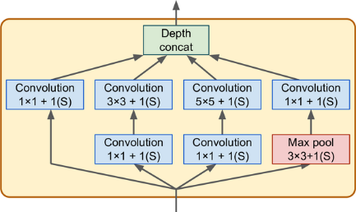
Inception Module
Multiple parallel kernel sizes (receptive field)
”1x1 Skip connection”
Concatenation
Hands-On Machine-Learning: Figure 14-14

Slide 38
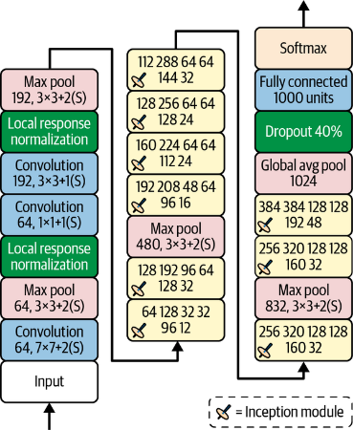
Inception Network
Repeated Inception Module
You must always compile your model after you freeze or unfreeze layers.
Hands-On Machine-Learning: Figure 14-15

Slide 39
Pre-trained Weights – Trainable
1
2
3
4
5
6
7
8
9
10
11
12
13
14
15
tf.random.set_seed(42) # extra code – ensures reproducibility
base_model = tf.keras.applications.xception.Xception(weights="imagenet",
include_top=False) # currently, only trained on imagenet
avg = tf.keras.layers.GlobalAveragePooling2D()(base_model.output)
output = tf.keras.layers.Dense(n_classes, activation="softmax")(avg)
model = tf.keras.Model(inputs=base_model.input, outputs=output)
# "unfreeze" base model layers (i.e. weights can be modified during training)
for layer in base_model.layers:
layer.trainable = True
optimizer = tf.keras.optimizers.SGD(learning_rate=0.1, momentum=0.9)
model.compile(loss="sparse_categorical_crossentropy", optimizer=optimizer,
metrics=["accuracy"])
history = model.fit(train_set, validation_data=valid_set, epochs=3)
Copy base layers without top layers
Connects Base Model with new Top Layers
Unfreeze all base model layers
Train on new dataset and task

Slide 40
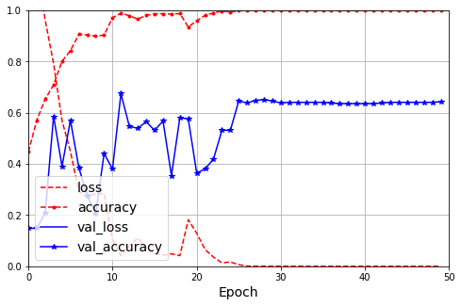
Results – ResNet50V2 Trainable

Slide 41
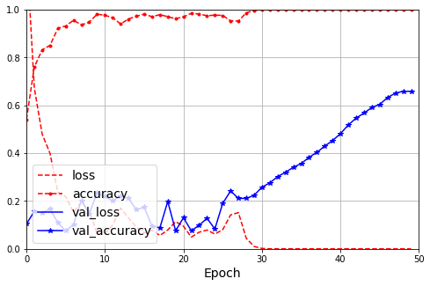
Results – MobileNetV2 Trainable

Slide 42
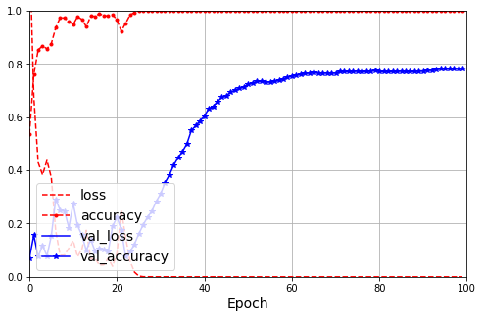
Results – MobileNetV2 Trainable

Slide 43
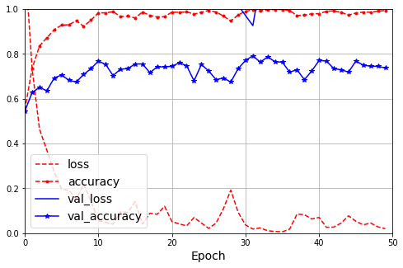
Results – EfficientNetV2B3 Trainable

Slide 44
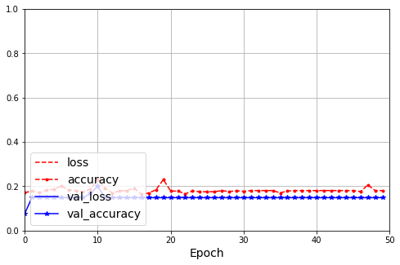
Results – VGG19 Trainable

Slide 45
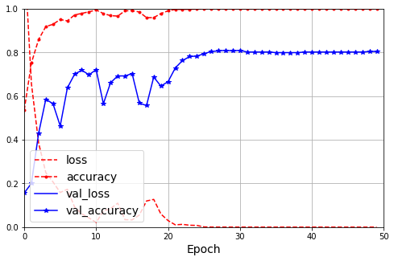
Results – Xception Trainable

Slide 46
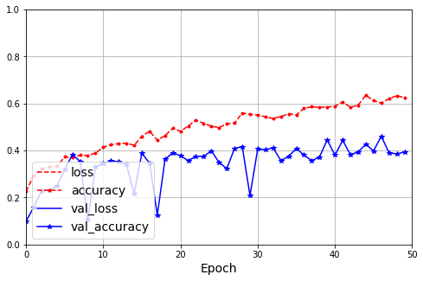
Results – Xception Not Trainable

