Slide 1
SPRING BOOT

Slide 2
Agenda
Why using Spring Boot?
Spring Architecture?
Spring Boot Features.
Running Applications with Spring Boot:
Rest APIs
Data JPA
Spring Security
Exception Handling
Logging

Slide 3
Why using Spring Boot?
Easy to create stand alone application.
Less Configuration
Running as micro service.
Providing Many features
Thymeleaf
Spring Data JPA
Spring Security
Exception Handling
Logging
Testing

Slide 4
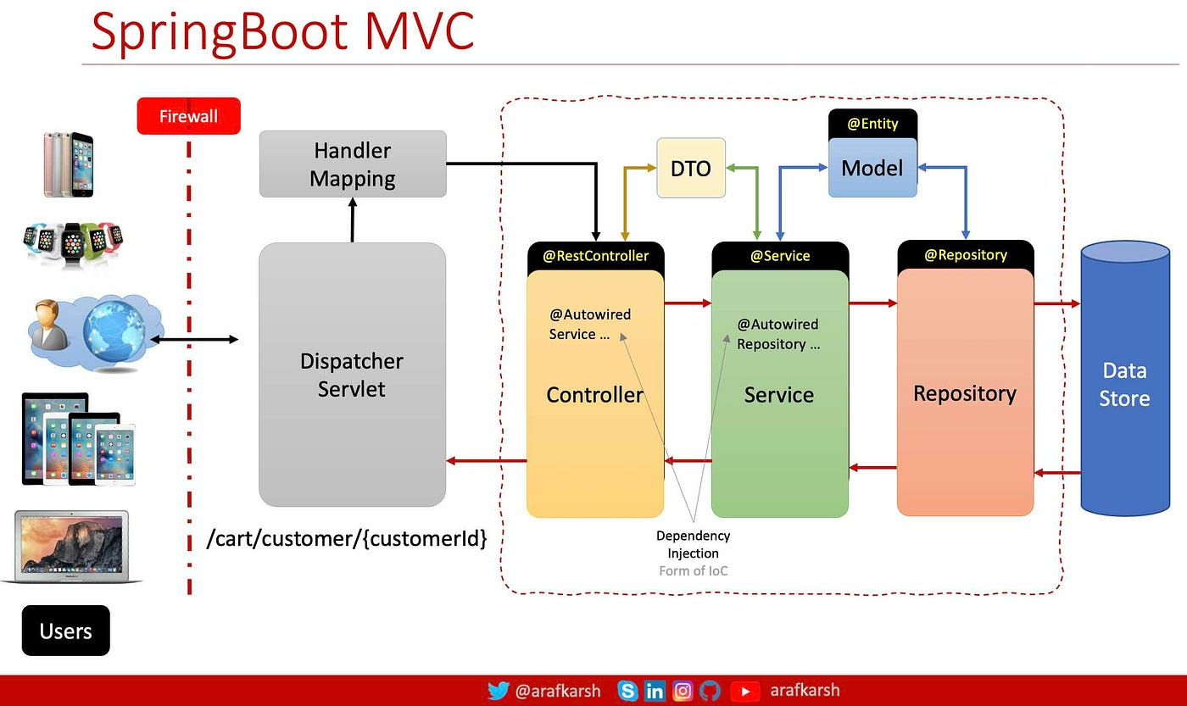

Slide 5
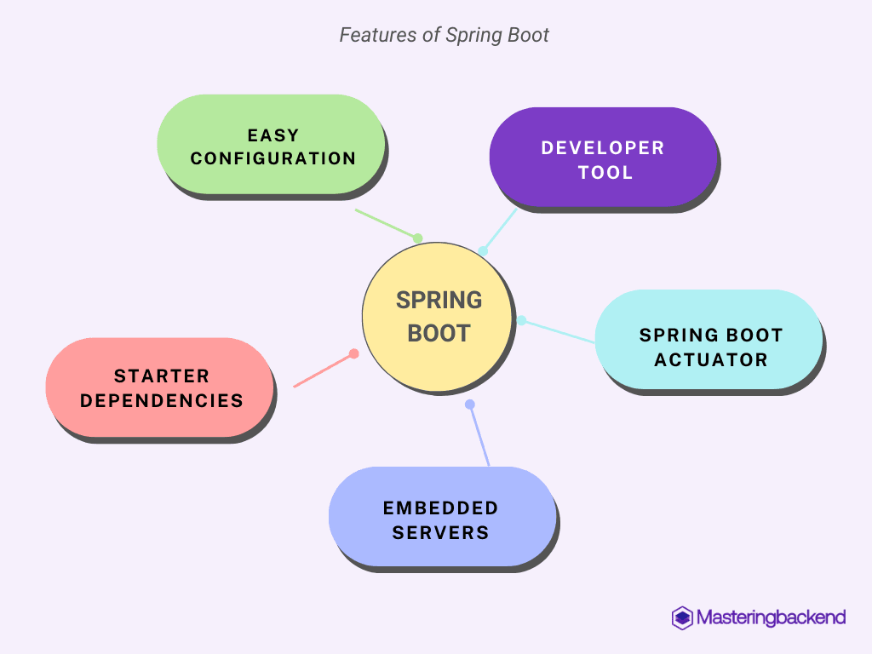
Spring Boot Features

Slide 6
Lab 1 – Hello World
- Create Rest Controller
Calling Rest with postman

Slide 7
Lab 2 – Using Spring Data JPA
Adding Config on Maven:
Spring Boot Starter Data JPA
<dependency>
<groupId>org.springframework.boot</groupId>
<artifactId>spring-boot-starter-data-jpa</artifactId>
</dependency>
Adding Annotation - @EnableJpaRepositories

Slide 8
Lab 3 – Using Spring Security & Authenticate With Database
Adding Config on Maven:
Spring Boot Starter Data JPA
<dependency>
<groupId>org.springframework.boot</groupId>
<artifactId>spring-boot-starter-Security</artifactId>
</dependency>
Adding Annotation - @EnableWebSecurity

Slide 9
Lab 4 – Handling Exceptions:
Adding Annotation - @ControllerAdvice

Slide 10
Lab 5 – Enable Logging
Adding Annotation - @Aspect, @Before, @After, @Around

Slide 11
Lab 6 – JWT Tokens
Adding Config on Maven:
Spring Boot Starter Data JPA
<dependency>
<groupId>io.jsonwebtoken</groupId>
<artifactId>jjwt-api</artifactId>
<version>0.11.1</version>
</dependency>
<dependency>
<groupId>io.jsonwebtoken</groupId>
<artifactId>jjwt-impl</artifactId>
<version>0.11.1</version>
</dependency>
<dependency>
<groupId>io.jsonwebtoken</groupId>
<artifactId>jjwt-jackson</artifactId>
<version>0.11.1</version>
</dependency>

