Slide 1

FIR Audio Noise Removal Studio
Signals and Systems Project Overview
Objective: Develop a MATLAB GUI for real-time FIR filtering and noise suppression in audio recordings.
Platform: Built entirely in MATLAB using GUI components and DSP toolkits.
Functionality: Supports loading, recording, filtering, and playback with dynamic visualization.
Signal Domain Visualization: Displays time and frequency domain plots, magnitude and phase responses.
Photo by Rostyslav Savchyn on Unsplash
Notes:
Welcome to the FIR Audio Noise Removal Studio—an interactive MATLAB-based tool designed for advanced signal processing tasks. This project offers a user-friendly interface for experimenting with FIR filtering to remove noise from audio recordings.
Users can seamlessly load or record audio, select appropriate filter parameters, and instantly see the results both audibly and visually. The application displays time-domain, frequency-domain, magnitude, and phase response plots, making it a powerful educational tool for signals and systems analysis.
With real-time interaction and highly customizable options, this GUI serves both as a robust DSP demonstration platform and a versatile development utility for audio signal enhancement.

Slide 2




GUI Design & Sidebar Controls
Interactive Features for Audio Workflow
Sidebar Interface
Consolidated control panel with interactive buttons and menus.
Audio Input Options
Supports both loading external files and direct microphone recording.
Filter Configuration
Selectable filter types with real-time FIR length and cutoff frequency settings.
Status Feedback
Dynamic status display provides user guidance and system messages.
Notes:
The GUI is the heart of the FIR Audio Noise Removal Studio, designed with user-friendliness and clarity in mind. The left sidebar acts as the central control hub where all major interactions are configured.
Users can initiate actions like loading audio, recording through the system's microphone, and playing back both the raw and filtered audio. Dropdown menus allow filter type selection—Lowpass, Highpass, Bandpass, or Bandstop—and edit fields provide granular control over FIR length and cutoff frequencies.
At every step, a dynamic status text box keeps the user informed, reducing errors and enhancing usability. This interface ensures that even users with minimal DSP experience can confidently engage with complex filtering operations.

Slide 3
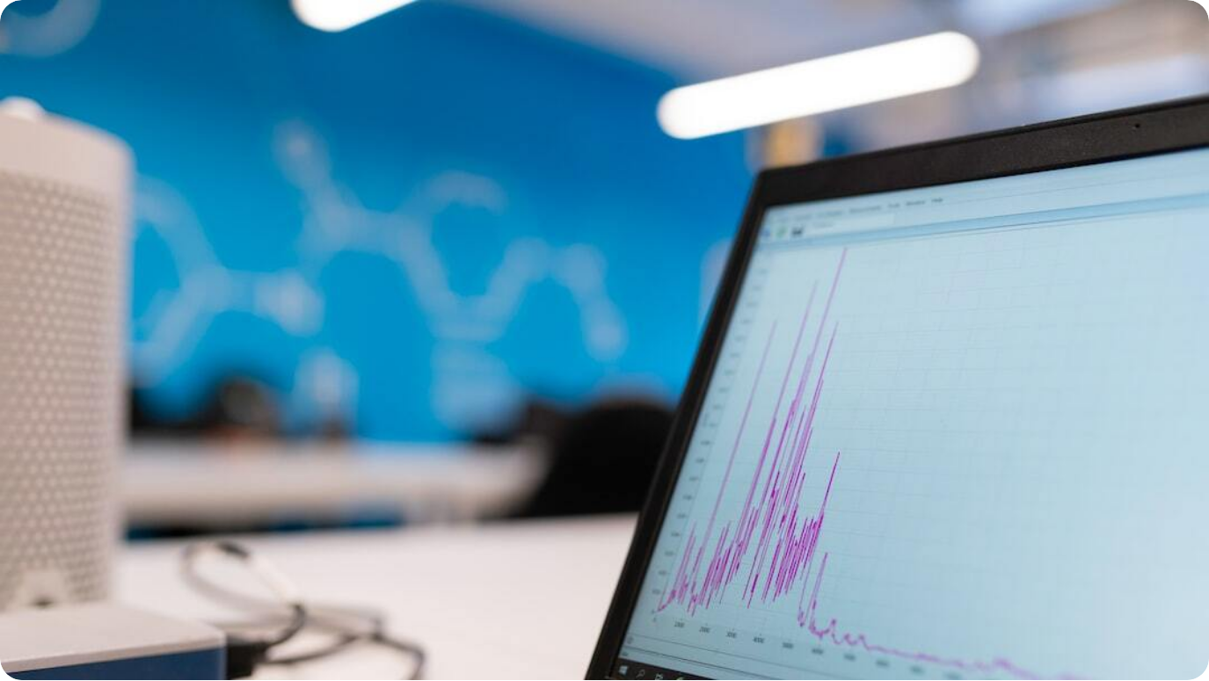
FIR Filter Application Logic
Noise Reduction via DSP
Preprocessing: DC removal, pre-emphasis filtering, and noise gating to clean raw signal.
Dynamic Filter Design: FIR filter coefficients generated based on user-specified cutoff and type.
Spectral Subtraction: Post-filtering noise attenuation by subtracting estimated noise spectrum.
Normalization & Output: Audio is centered and amplitude-normalized before playback or saving.
Photo by ThisisEngineering RAEng on Unsplash

Slide 4
Procedure
1) Get User Inputs
2) Validate Inputs by applying checks
3 Preprocess Audio
x = filter(fir1(100,40/(Fs/2),'high'),1,raw_audio);
x = filter([1 -0.97],1,x); (IIR Filter)
x = x / max(abs(x)); (Maximum Amplitude 1 & -1)
x(abs(x)<0.02)=0; (Removes Quiet Sounds)
4) Design FIR Filter
coeffs = fir1(N-1, ..., ..., kaiser(N,5)); (Used with fir1 to shape the filter response)
5) Apply Filter
y = filter(coeffs,1,x); (Filtering the pre filtered signal)
y = y - mean(y); (Remove DC Offset)
y = y / max(abs(y)) * 0.98; (Normalize Output)

Slide 5




Signal Visualization Modules
Multi-Domain Analysis Tools
Time-Domain View
Visualizes raw and filtered waveforms to show temporal noise suppression.
Frequency Spectrum
FFT-based display of spectral content for pre- and post-filtered signals.
Filter Magnitude
Plots 20log10 magnitude response of designed FIR filter.
Phase Response
Unwrapped phase plot reveals frequency-dependent delays.
Notes:
A critical educational feature of the FIR Audio Noise Removal Studio is its ability to visually dissect audio transformations. Time-domain plots juxtapose original and filtered signals, making it clear how filtering reshapes the waveform over time.
The frequency domain display, generated via FFT, highlights how much unwanted spectral content has been removed by the filter. These two panels alone provide a powerful understanding of signal behavior.
Additionally, FIR filter characteristics—magnitude and phase responses—are plotted in real-time. Users can see the attenuation behavior and phase shift across frequencies, essential for interpreting how the filter alters audio fidelity and timing. These tools turn signal theory into tangible insight.

Slide 6




Audio Playback & Export Features
Interactive Output Utilities
Dual Playback
Supports listening to both original and filtered audio for comparison.
On-Demand Filtering
Real-time response to user-initiated playback or processing commands.
Export to WAV
Saves the filtered audio to disk with standard sampling rate.
Status Updates
Live messages guide user actions and system state.
Notes:
A well-rounded audio tool is not complete without intuitive playback and export capabilities. The FIR Audio Noise Removal Studio features dual playback options, letting users instantly compare unprocessed and filtered audio signals to assess noise reduction effectiveness.
Thanks to real-time filtering, users can experiment with different FIR parameters and hear immediate changes. Once satisfied, they can export the enhanced audio directly to a WAV file format for external use or analysis.
A subtle yet effective feature is the status text area, which provides continual feedback—whether it's playback confirmation, export success, or error notifications—keeping users fully in the loop.

Slide 7




Project Impact & Learning Outcomes
Reflections on DSP Application
Applied Theory
Translates FIR filter and spectral processing concepts into practical use.
Hands-On DSP
Gained skills in MATLAB programming and GUI-based signal design.
Audio Engineering Insight
Improved understanding of noise suppression and perceptual audio quality.
Project Versatility
Usable for education, prototyping, and real-world filtering scenarios.
Notes:
This project bridges theory and practice in digital signal processing. By developing a full-featured GUI around FIR filtering, students experience firsthand how theoretical DSP models can be translated into real-world solutions.
In building the GUI, participants enhance their MATLAB fluency, gain experience with signal chain engineering, and deepen their appreciation of spectral behavior in audio signals. Every design decision—from filter length to interface layout—fosters practical learning.
Beyond academics, this tool demonstrates practical value in diverse audio processing contexts—whether cleaning up recordings, preparing datasets, or teaching signal processing. It stands as a robust example of applied systems engineering.

