Slide 1
生成AI基礎とビジネス応用 • FINAL PROJECT
Toyama Buddy
A weather-aware AI travel guide
for foreign visitors to Toyama
Arshad Muhammad Bilal
226C1059
Verified local knowledge + live weather-aware recommendations
TOYAMA BUDDY • FINAL PROJECT
01

Slide 2
THE TRAVEL-PLANNING GAP
02
Visitors need answers that stay true
to conditions on the ground.
Information is fragmented
Weather can change the plan
Generic chatbots can hallucinate
Japanese-only signage and scattered tourism details make planning harder.
Outdoor highlights such as the Alpine Route need a viable backup.
Facts, prices, and even the current date can be confidently invented.
The consequence: visitors may receive plausible answers that are neither current nor trustworthy.
TOYAMA BUDDY • FINAL PROJECT
02

Slide 3
SOLUTION OVERVIEW
03
One travel assistant. Two layers of reliability.
Toyama Buddy grounds tourism answers in curated sources and checks live weather before outdoor recommendations.
RAG • grounded answers
AGENT • weather-aware
MULTILINGUAL • accessible
14 curated Toyama documents provide factual context. Answers are cited so visitors can trace the source.
The agent decides when to retrieve a live forecast and adapts recommendations to outdoor conditions.
Tested in English and Japanese so international visitors can ask naturally.
Design principle: do not ask a model to “know” the answer when it can retrieve or verify it.
TOYAMA BUDDY • FINAL PROJECT
03

Slide 4
ARCHITECTURE
04
The model chooses the right tool —
retrieval for facts, weather for conditions.
ChromaDB
search_kb
14 curated
Toyama documents
Visitor
Gemini Agent
Verified facts
Gradio chat UI
Autonomous tool calling
Open-Meteo
get_weather
Live 3-day
forecast
Live forecast
Built in Google Colab with the Gemini API — tool use is model-directed, not hardcoded.
TOYAMA BUDDY • FINAL PROJECT
04

Slide 5
DEMO: THE KEY MOMENT
05
A recommendation that responds to the mountain — not just the city.
VISITOR
AGENT ACTIONS
Can I visit the Alpine Route tomorrow?
1 Pinpoint location
Murodo / Alpine Route — not Toyama City
TOYAMA BUDDY
2 Call live weather
I’ll check Murodo conditions first.
If weather is unfavorable, I’ll suggest an indoor alternative.
Mountain forecast for the specific activity
3 Adapt the plan
Outdoor recommendation or indoor backup
TOYAMA BUDDY • FINAL PROJECT
05

Slide 6
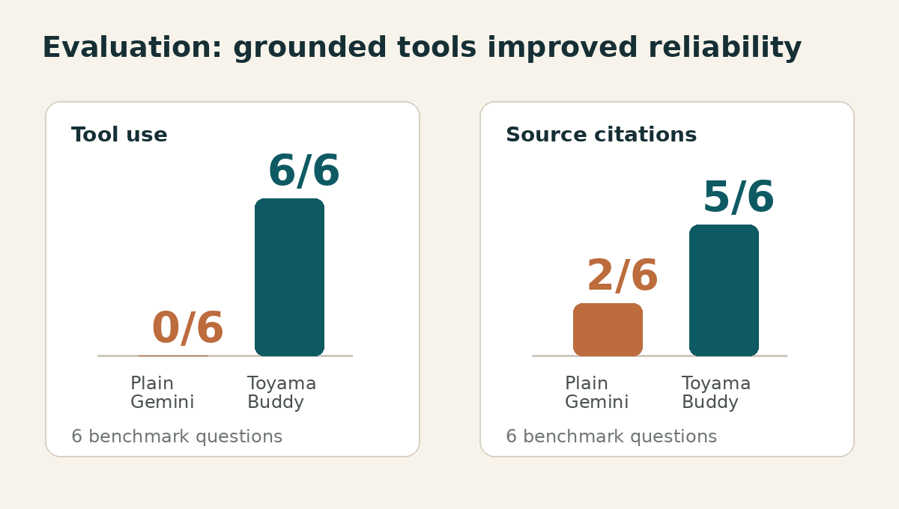
EVALUATION
06
Tools turn confident guesses into
verifiable travel guidance.
TODAY’S WEATHER IN TOYAMA
Plain Gemini
“As of today, Monday, May 20, 2024…”
Wrong date • invented weather • no real data
Toyama Buddy
Live forecast via API
73% chance of rain • weather-aware response
Across 6 test questions: Toyama Buddy used a tool 6/6 times and cited sources 5/6 times.
TOYAMA BUDDY • FINAL PROJECT
06

Slide 7
BUSINESS VALUE
07
A deployable concierge for tourism
operators and hospitality partners.
Target user
Potential adopters
Competitive edge
Foreign tourists with limited Japanese who are planning weather-dependent trips.
Toyama tourism association, hotels and ryokan, and tourist information centers.
Always current. Always sourced. Always in the visitor’s language.
From a generic chatbot to an operationally useful, up-to-date visitor service.
TOYAMA BUDDY • FINAL PROJECT
07

Slide 8
LIMITATIONS & FUTURE WORK
08
The prototype proves the workflow.
The next step is production readiness.
CURRENT LIMITATIONS
FUTURE WORK
Manually curated knowledge base
Production architecture
14 authored documents; production should refresh automatically from official sources.
Move toward AWS Bedrock + OpenSearch for scale and maintainability.
Citation consistency
Richer visitor experience
One weather answer used correct live data but missed its source citation.
Photo input for signs/menus, persistent memory, and LoRA tone fine-tuning.
TOYAMA BUDDY • FINAL PROJECT
08

Slide 9
TOYAMA BUDDY
Travel guidance that checks
before it recommends.
Thank you — questions?
GitHub: [https://github.com/Muhammad-Bilal-Arshad/toyama-buddy/blob/main/toyama_buddy.ipynb]
TOYAMA BUDDY • FINAL PROJECT
09

