Slide 1
Seaborn
Seaborn is a statistical plotting library
It is designed to work very well with pandas dataframe objects
It has beautiful default styles

Slide 2
Installing Seaborn
Seaborn library can be installed using pip or conda distribution.
Either of the following commands are to be used in the command line interface or terminal to install seaborn.
pip install seaborn
conda install seaborn
Since seaborn is open-source, its available on Github.
Seaborn is imported conventially as svs. You can import it using the following code. Additionally we would like for us to have our plots printed automatically, for that we’ll include the matplotlib inline statement.
import seaborn as sns
%matplotlib inline

Slide 3
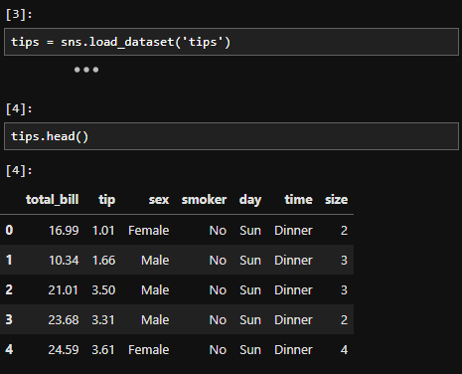
Data
Seaborn comes with in-built datasets.
Following command is used to load datasets.
sns.load_dataset(‘tips’)
# tips is an in-built dataset.

Slide 4
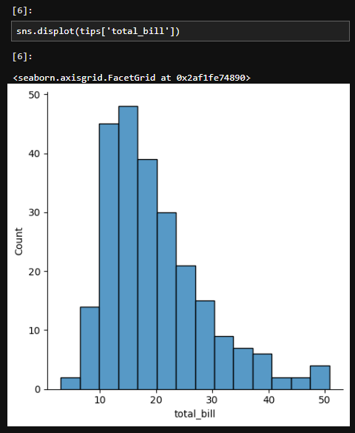
Distribution Plots
The displot shows the distribution of a univariate set of observations.
In any case a warning is given, it is completely safe to ignore it.

Slide 5
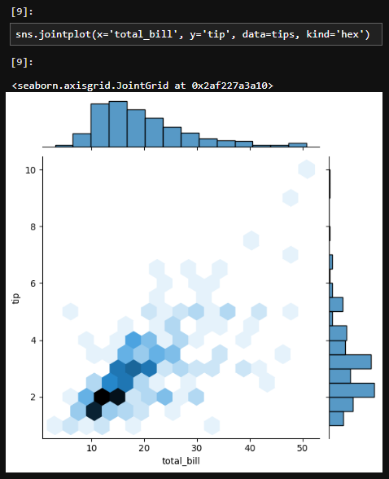
Joint Plot
jointplot() allows you to basically match up two distplots for bivariate data. With your choice of what kind parameter to compare with:
“scatter”
“reg”
“resid”
“kde”
“hex”

Slide 6
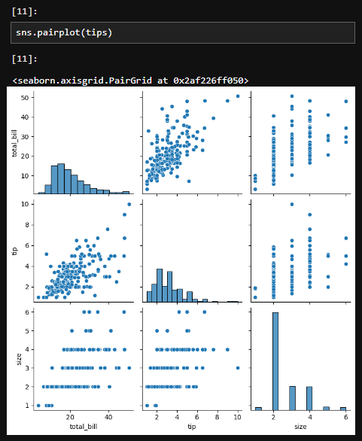
Pair Plot
pairplot will plot pairwise relationships across an entire dataframe (for the numerical columns) and supports a color hue argument (for categorical columns).
For relationship between same columns, it generates a histogram.

Slide 7
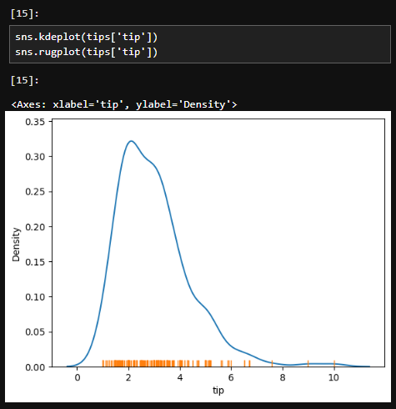
KDE and Rug Plot
rugplots are actually a very simple concept, they just draw a dash mark for every point on a univariate distribution. They are the building block of a KDE plot.
kdeplots are Kernel Density Estimation plots. These KDE plots replace every single observation with a Gaussian (Normal) distribution centered around that value.

Slide 8
Categorical Data Plots
We can also use seaborn to plot categorical data! There are a few main plot types for this:
boxplot
violinplot
stripplot
swarmplot
barplot
countplot

Slide 9
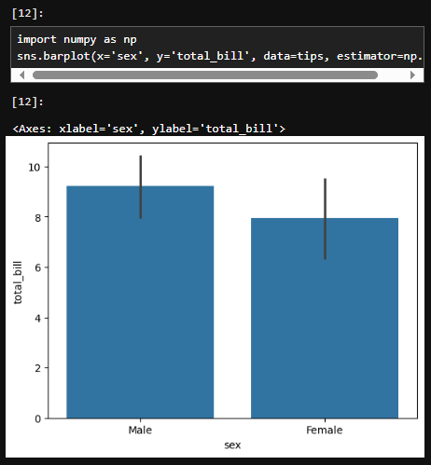
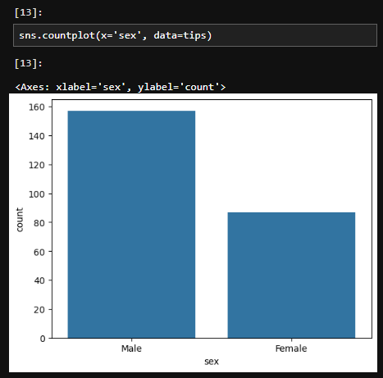
Barplot and Countplot
These very similar plots allow you to get aggregate data off a categorical feature in your data. barplot is a general plot that allows you to aggregate the categorical data based off some function, by default the mean.
It is possible to change the estimator object to a custom function, that converts a vector to a scalar.
countplot is essentially the same as barplot except the estimator is explicitly counting the number of occurrences. Which is why we only pass the x value.

Slide 10
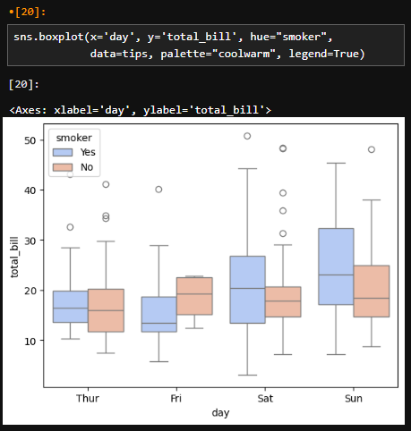
Boxplot
Boxplots are used to shown the distribution of categorical data.
A box plot (or box-and-whisker plot) shows the distribution of quantitative data in a way that facilitates comparisons between variables or across levels of a categorical variable.
The box shows the quartiles of the dataset while the whiskers extend to show the rest of the distribution, except for points that are determined to be “outliers” using a method that is a function of the inter-quartile range.

Slide 11
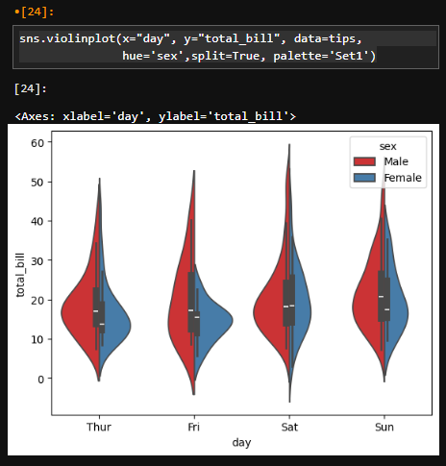
Violinplot
A violin plot plays a similar role as a box and whisker plot.
It shows the distribution of quantitative data across several levels of one (or more) categorical variables such that those distributions can be compared.
Unlike a box plot, in which all the plot components correspond to actual datapoints, the violin plot features a kernel density estimation of the underlying distribution.

Slide 12
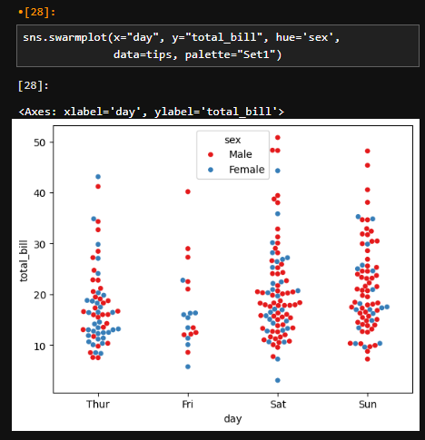
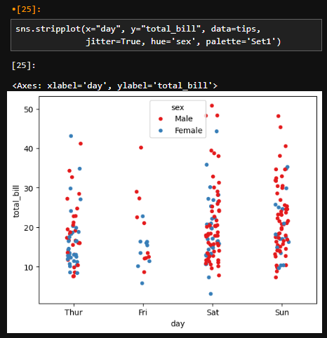
Stripplot and Swarmplot
The stripplot will draw a scatterplot where one variable is categorical.
A strip plot can be drawn on its own, but it is also a good complement to a box or violin plot in cases where you want to show all observations along with some representation of the underlying distribution.
The swarmplot is similar to stripplot(), but the points are adjusted (only along the categorical axis) so that they don’t overlap.
This gives a better representation of the distribution of values, although it does not scale as well to large numbers of observations (both in terms of the ability to show all the points and in terms of the computation needed to arrange them).

Slide 13
Grids
Grids are general types of plots that allow you to map plot types to rows and columns of a grid, this helps you create similar plots separated by features.
Pairgrid is a subplot grid for plotting pairwise relationships in a dataset.
pairplot is a simpler version of PairGrid.
FacetGrid is the general way to create grids of plots based off of a feature.
JointGrid is the general version for jointplot() type grids.

Slide 14

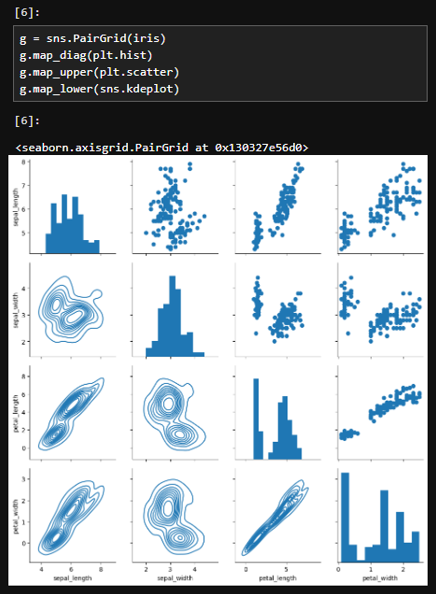
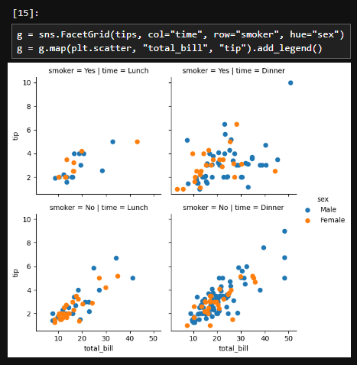
Use of Seaborn Grids
An example with use of PairGrid and FacetGrid is given in the shown figures.

Slide 15
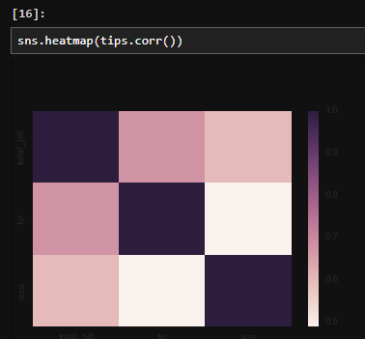
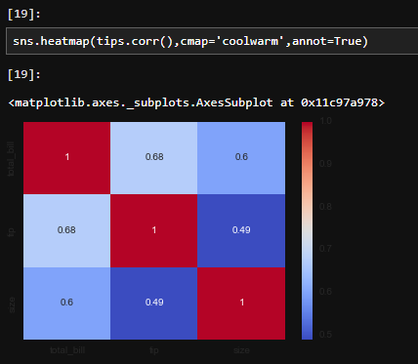
Matrix Plots (Heatmap)
In order for a heatmap to work properly, your data should already be in a matrix form, the sns.heatmap function basically just colors it in for you.
You can use the cmap parameter to generate a colormap for your heatmap, and annotate the values inside the heatmap for better visualization.

Slide 16
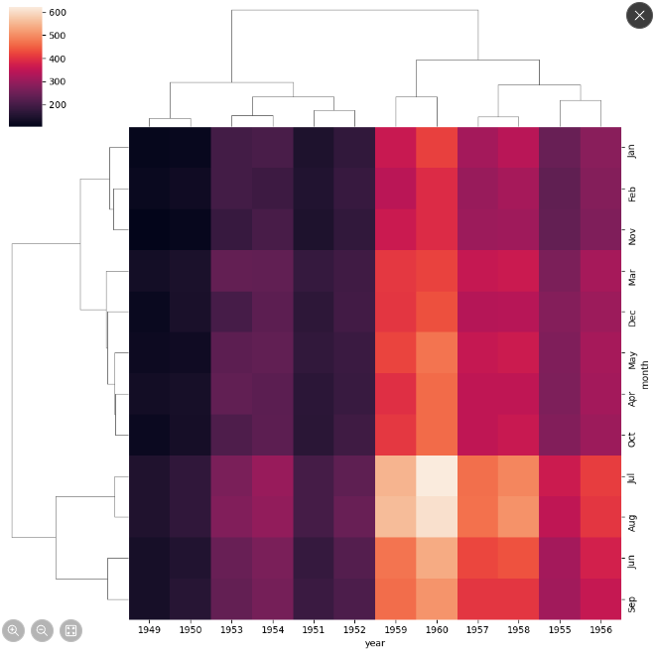
Matrix Plots (Clustermap)
The clustermap uses hierarchal clustering to produce a clustered version of the heatmap.
sns.clustermap(pvflights)
pvflights is a pivot table made out of flights dataframe.

Slide 17
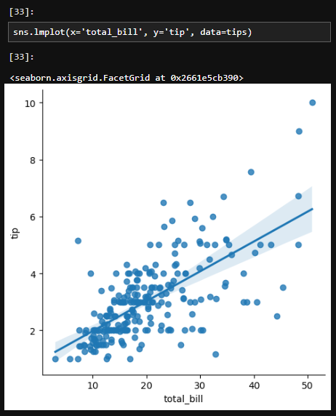
Linear Model Plot
lmplot allows you to display linear models, but it also conveniently allows you to split up those plots based off of features, as well as coloring the hue based off of features.

Slide 18
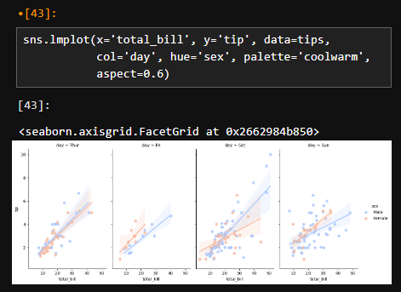
Aspect Ratio
Seaborn figures can have their aspect ratio adjusted with aspect parameters:
sns.lmplot(x='total_bill', y='tip', data=tips, col='day’, hue='sex’, palette='coolwarm', aspect=0.6)
Other parameters used here include col, hue, palette.

Slide 19
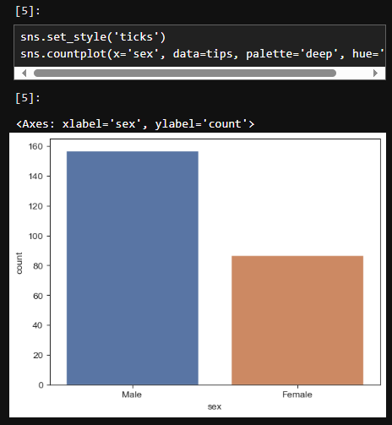
Styles and Color
set_style() method is used to set a style for your plots.
Style parameter requires you to input either one of these strings.
darkgrid
whitegrid
dark
white
ticks

Slide 20
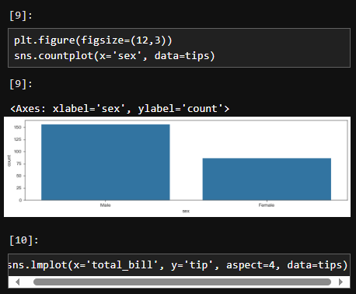
Styling using plt
Seaborn is made of contents from matplotlib.
You can use plt.figure() parameters to configure it’s figsize etc.

Slide 21
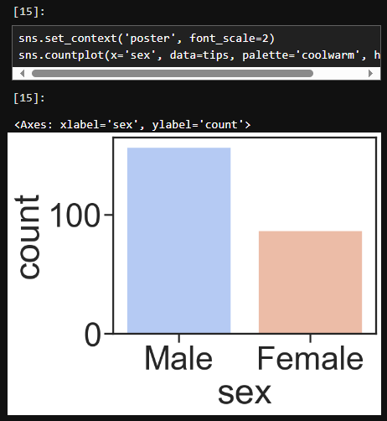
Font size and plot size
You can modify how large the font or the plot is using sns.set_context() method.
Context parameter requires one of the following strings:
paper
notebook
talk
poster
Font_scale parameter requires an int.

Slide 22
Conclusion
Data visualization is a powerful way to communicate insights from data.
Python’s Seaborn library, built on top of Matplotlib, offers an elegant and high-level interface for creating visually appealing and informative visualizations.

