Slide 1
Matplotlib
A Data Visualization library in Python

Slide 2
What is Matplotlib?
Matplotlib is a powerful plotting library for the Python programming language.
It provides an object-oriented API for embedding plots into applications.
Widely used for creating static, interactive, and animated visualizations.
Key advantage: Highly customizable plots for various data visualization needs.

Slide 3
Installing Matplotlib
To install Matplotlib, use one of the following commands:
pip install matplotlib
conda install matplotlib
Note: Make sure you have either pip or conda installed on your system for the above commands to work.

Slide 4
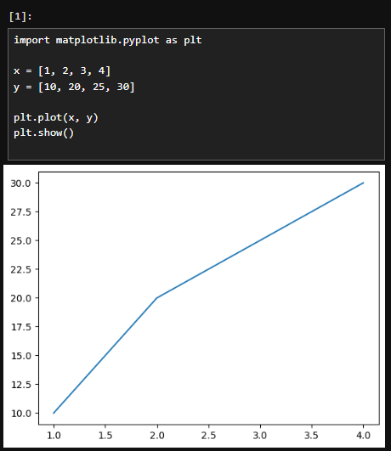
Basic Plotting with pyplot
matplotlib.pyplot is a collection of functions that make Matplotlib work like MATLAB.
Example of creating a simple line plot is given in the figure.
plt.plot() creates a line plot with x and y values.
plt.show() displays the plot

Slide 5
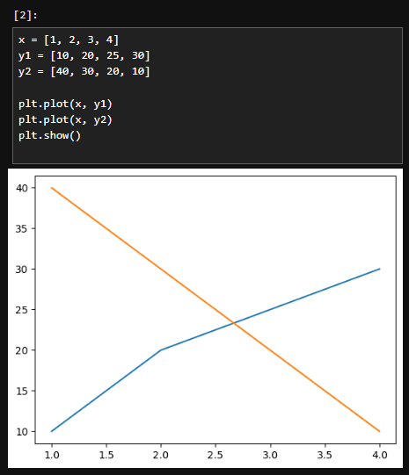
Plotting Multiple Lines
Multiple lines can be plotted on the same figure.
The label parameter in plt.plot() is used to label each line.
plt.legend() displays a legend for the lines.

Slide 6
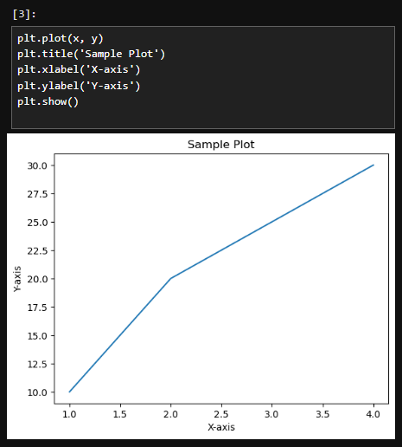
Adding Titles and Labels
Titles and labels enhance the readability of plots.
plt.title() sets the title of the plot.
plt.xlabel() and plt.ylabel() labels the x-axis and y-axis respectively.

Slide 7
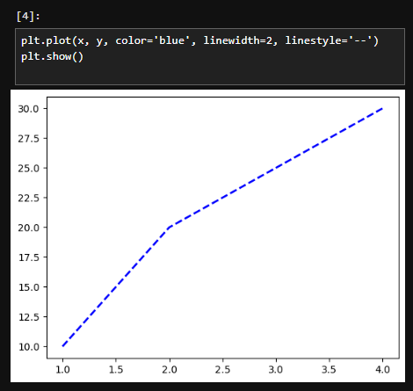
Customizing Line Styles
Line styles, colors and widths can be customized.
Color parameter sets the line color.
Linewidth parameter adjusts the line width
Linestyle parameter changes the style of the line. (e.g., dashed, dotted)

Slide 8
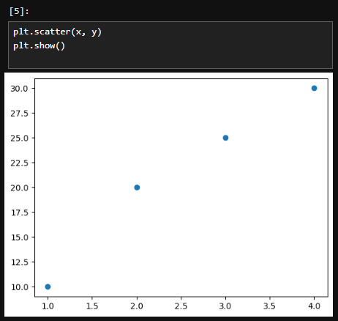
Scatter Plots
Scatter plots display data points and their relationships.
plt.scatter() function creates a scatter plot with x and y values.
Useful for visualizing the distribution and correlation of data.

Slide 9
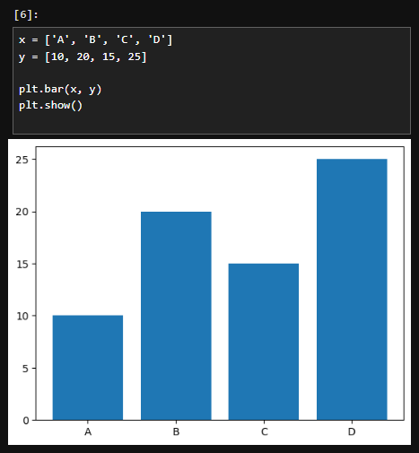
Bar Charts
Bar charts represent data with rectangular bars.
plt.bar() function creates a bar chart.
Bar charts are useful for comparing quantities across categories.

Slide 10
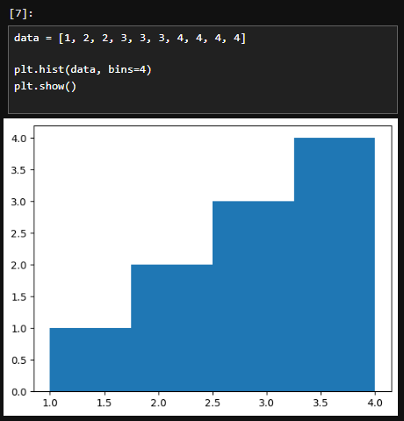
Histograms
Histograms show the distribution of a dataset.
plt.hist() function creates a histogram.
bins parameter adjusts the number of bins for grouping data.

Slide 11
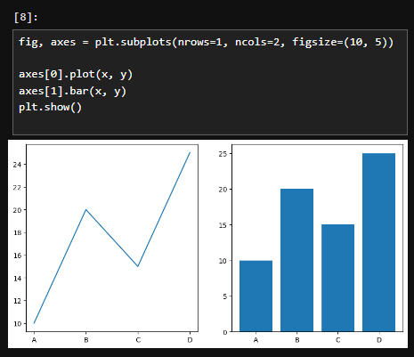
Subplots
Subplots allow creating multiple plots in one figure.
plt.subplots() function returns a figure and an array of axes.
figsize parameter adjusts the size of the figure.

Slide 12
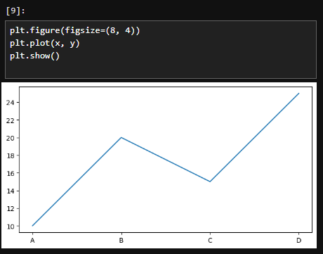
Figure Size and Aspect Ratio
Adjusting figure size and aspect ratio enhances visualization.
Figsize parameter in plt.figure() sets the figure size (width, height)

Slide 13
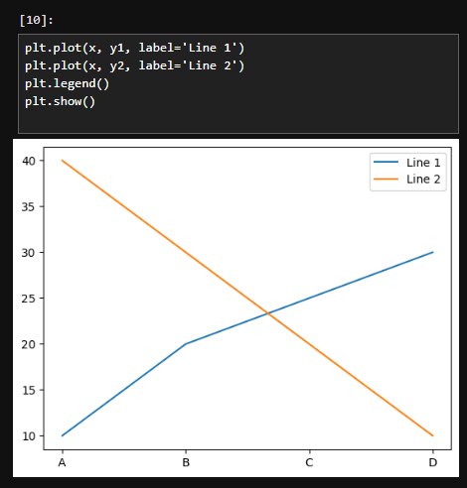
Legends
Legends describe the elements of the plot.
plt.legend() function adds a legend to the plot.
Legend help identify different lines or data series.

Slide 14
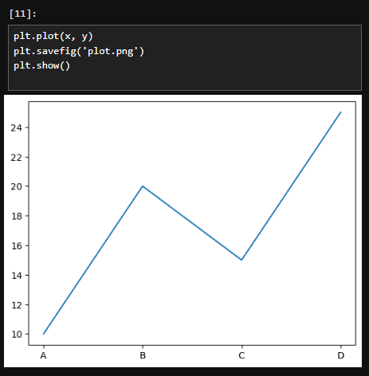
Saving Plots
Plots can be saved as an image file.
plt.savefig() function saves the plot to a file.
File formats include PNG, JPG, PDF, and more.

Slide 15
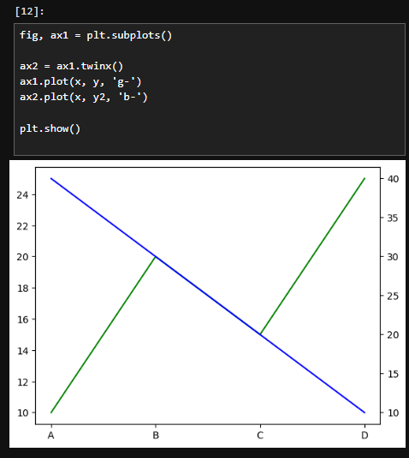
Combining Plots
Different types of plots can be combined in one figure.
twinx() function creates a second y-axis sharing the same x-axis.
Useful for displaying different data sets with shared axes.

Slide 16
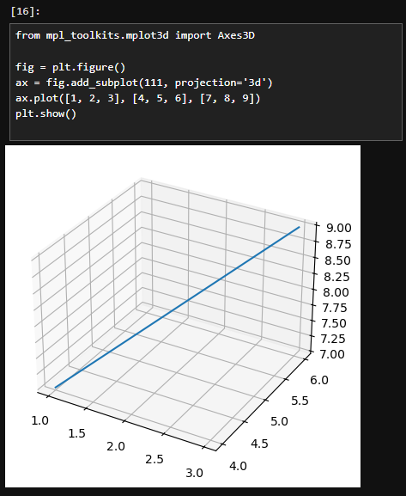
3D Plotting
3D plotting extends visualization capabilities.
mpl_toolkids.mplot3d module enables 3D plotting.
Useful for visualizing data with three dimensions.

Slide 17

Conclusion
Matplotlib is a versatile and powerful library for data visualization in Python.
Key features: Customizable plots, support for various plot types, and ability to save and combine plots.
Encouragement to explore Matplotlib documentation for advanced features and techniques.

