Slide 1

PMP TOP MODULE DIAGRAM
By Salman Aslam
2022-EE-123

Slide 2
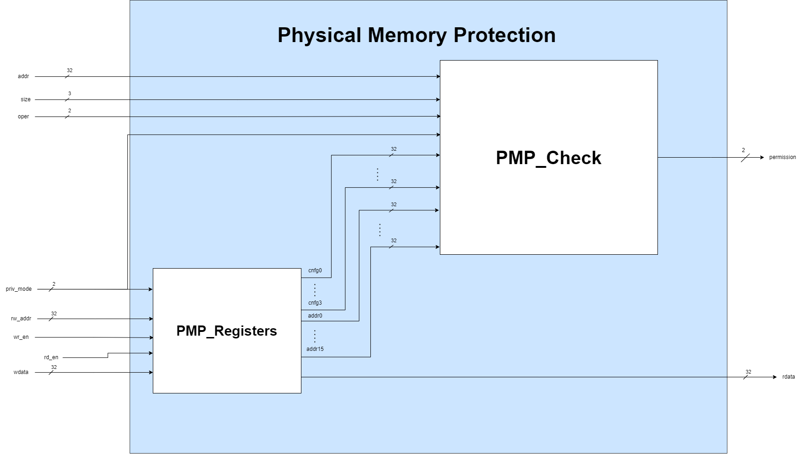
Top Module Diagram

Slide 3
Inputs of Top Module
addr (32-bits): address of the memory region which we want to access
size (3-bits): accessing No. of bytes
Byte-->(001) = 1 byte
half word--> (010) = 2 bytes
word (100)--> = 4 bytes
Rest of the values are illegal
oper (2-bits): Operation to be carried out on memory address data
Read (00)
Write (01)
Execute (10)

Slide 4
Inputs of Top Module
priv_mode (2-bits): The privilege mode, on which the processor is operating
Machine mode (00)
Supervisor mode (01)
User mode (10)
rw_addr: Selects which PMP register to read or write.
wr_en: when high, allows writing into the PMP registers.
rd_en: when high, allows reading data from PMP registers.
wdata: Data to be written into a PMP register

Slide 5
Outputs of Top Module
permission (2-bits):
i) Access granted (00)
ii) Load access fault (01)
iii) Store access fault (10)
iv) Instruction access fault (11)
rdata:
Output read data from PMP_Registers when accessing the registers

Slide 6
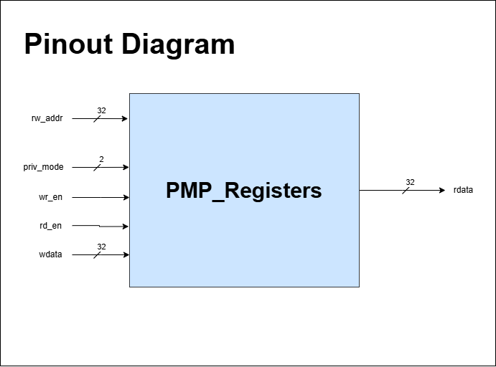
PMP Register
Inputs:
priv_mode
rw_addr
wr_en
rd_en
wdata
Outputs:
rdata

Slide 7
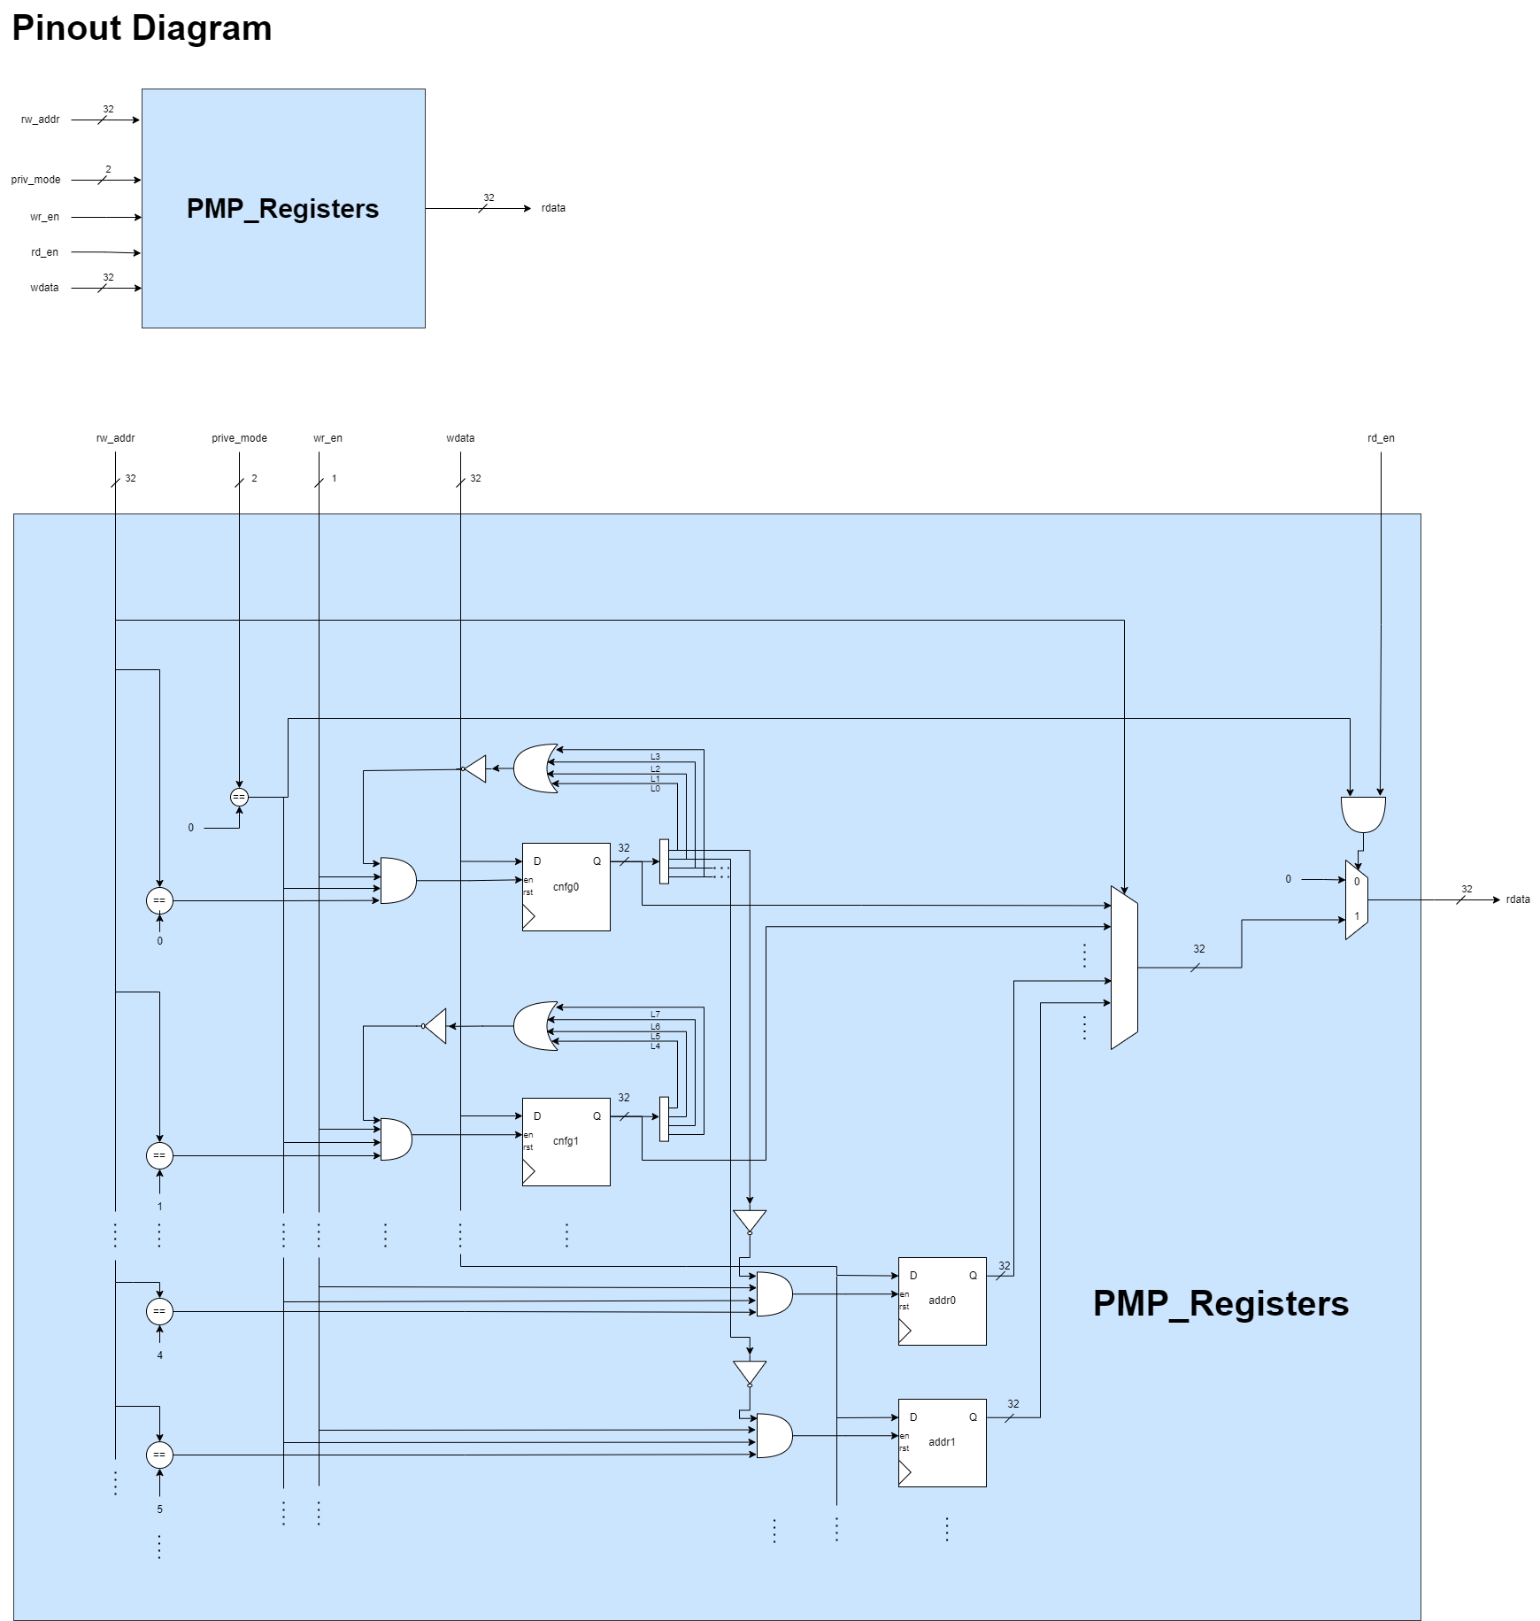

Slide 8
PMP Check Block
By Muhammad Furrukh
2022-EE-111

Slide 9
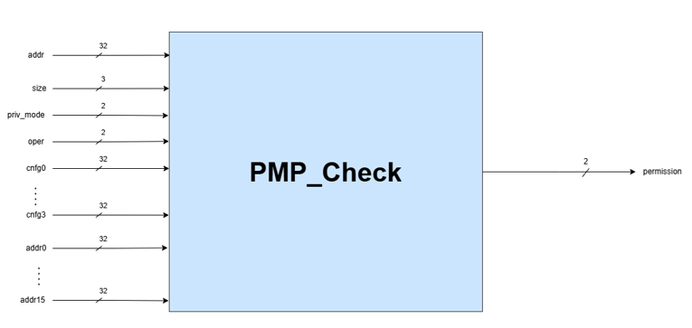
Inputs
addr (32-bits): address that needs to be accessed
size (3-bits): number of bytes we want to access
i) byte(001) = 1 byte
ii) half word (010) = 2 bytes
iii) word (100) = 4 bytes
Rest of the values are illegal

Slide 10
Continued
3. oper (2-bits): Operation to be carried out on memory address data
i) Read (00)
ii) Write (01)
iii) Execute (10)
4. priv_mode (2-bits): The privilege mode, on which the processor is operating
i) Machine mode (00)
ii) Supervisor mode (01)
iii) User mode (10)
5. PMP address and configuration registers data (32-bits each)

Slide 11
Output
Permission (2-bits):
i) Access granted (00)
ii) Load access fault (01)
iii) Store access fault (10)
iv) Instruction access fault (11)

Slide 12
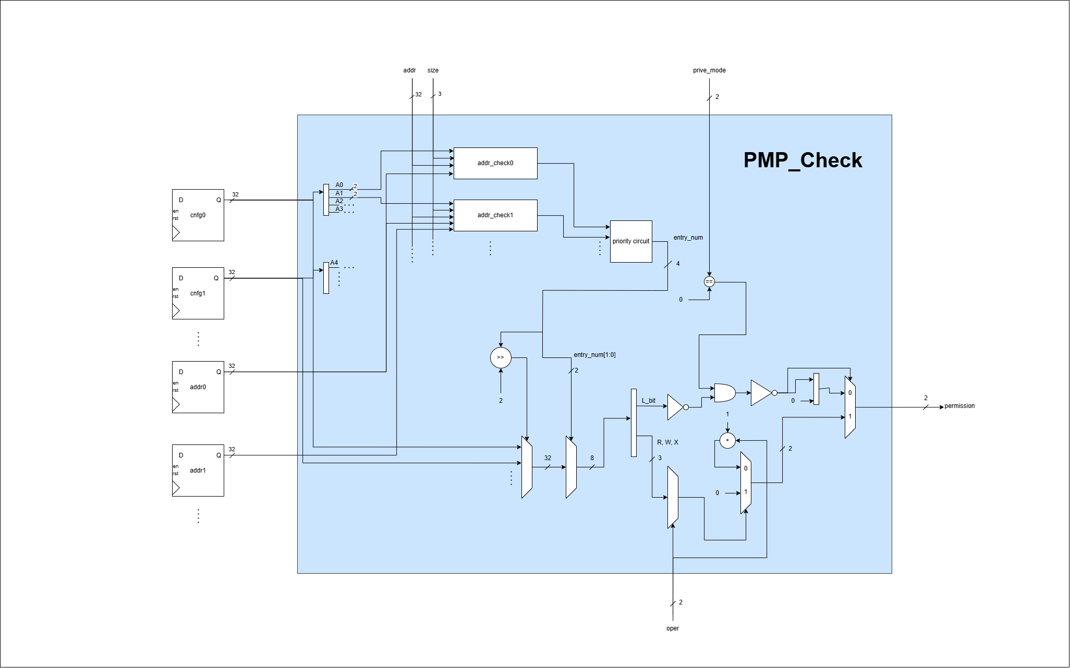
PMP Check Logic

Slide 13
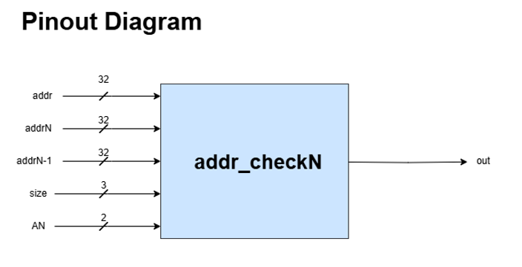
Breaking Logic: addr_checkN
Purpose:
Check whether the desired memory byte(s) lie in the Nth pmp entry, where 0 < N ≤ 15
Inputs:
addr (32-bits): Address we are checking
addrN (32-bits): Data from Nth pmp_addr register
addrN-1 (32-bits): Data from (N-1)th pmp_addr register
size (3-bits): Number of bytes we want to access

Slide 14
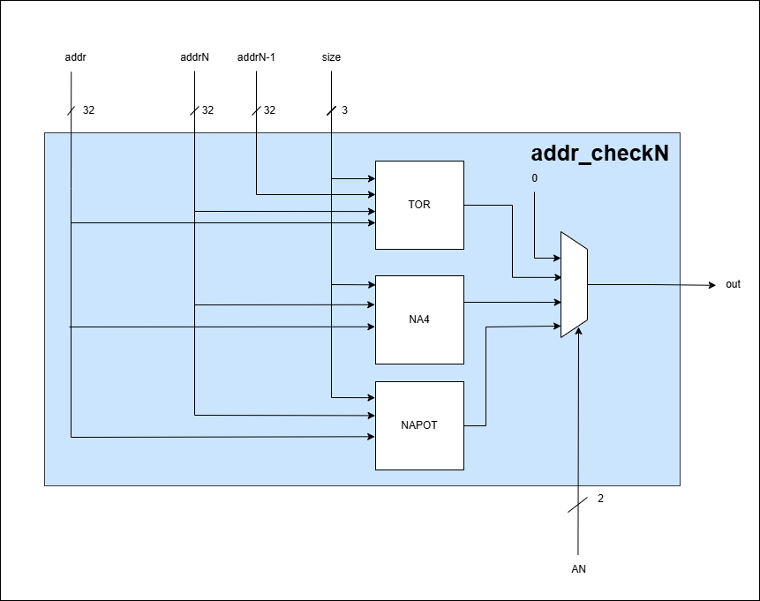
Continued
AN (2-bits): Address mode configured for Nth pmp entry
i) OFF mode (00)
ii) TOR mode (01)
iii) NA4 mode (10)
iv) NAPOT mode (11)
Ouputs:
Out (1-bit):
Present in the given entry (1)
Absent in the given entry (0)

Slide 15
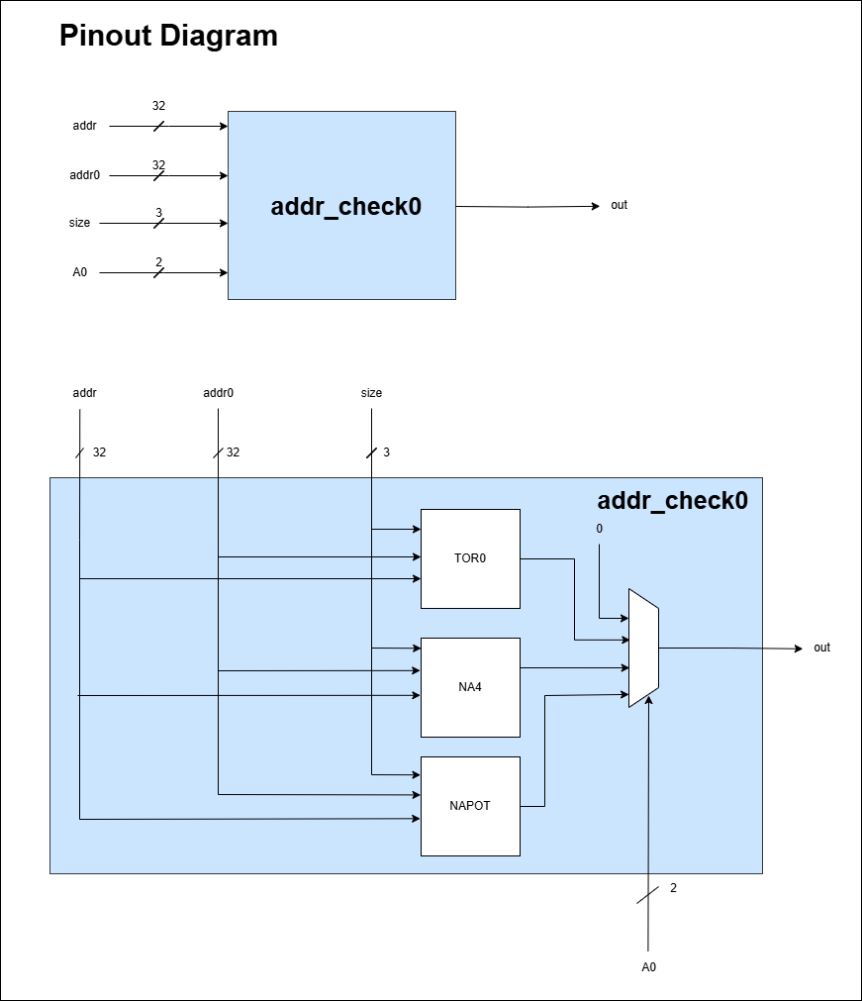
Difference between addr_check0 and addr_checkN
No addrN-1 input
Because there is no entry before 0th entry
As a result, it contains TOR0 instead of TOR
Rest of the logic is same

Slide 16
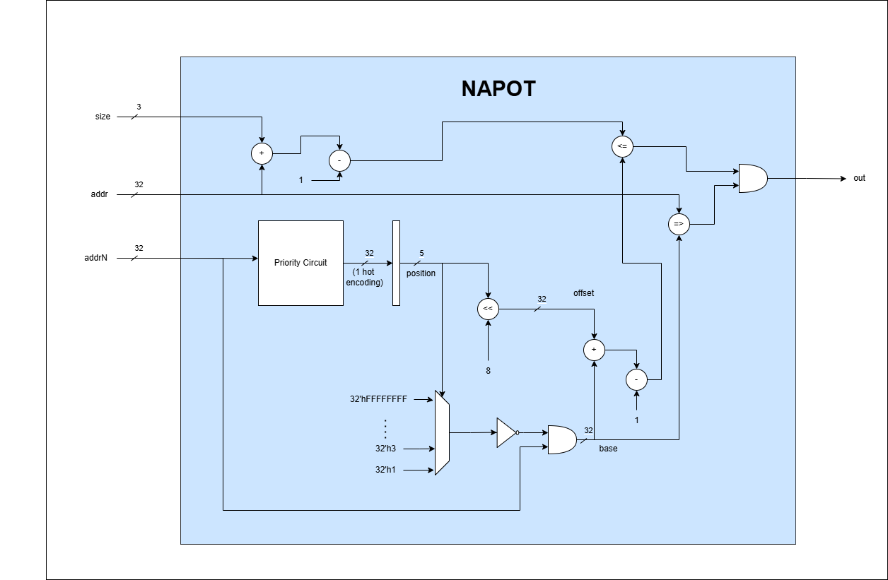
NAPOT Block
In NAPOT mode:
For addrN = yyyy...yy011...1
Number of bits before and including the first 0, on lsb side, determine size of protected region
Say, the number of these bits is n. Then size of region is 2^(n+3)
Base address will be yyy...yy000...0
NAPOT block computes the base address and the size of the region (offset), then use it to check if the desired memory block lies in this region

Slide 17
Top of Range(TOR) Block
By Umair Ahmad
2022-EE-113

Slide 18
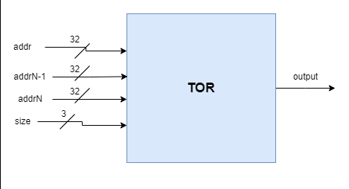
Inputs and Outputs
Inputs:
addr (32-bit): Address that we want to access
addrN-1 (32-bit): Lower bound
addrN (32-bit): Upper bound
size (3-bit): Size we want to access 000 -> 1 byte 010 -> 2 bytes(Half word) 100 -> 4 bytes(Full word)
Output:
Out (1-bit):
0 -> Region not in TOR
1 -> Region in TOR

Slide 19
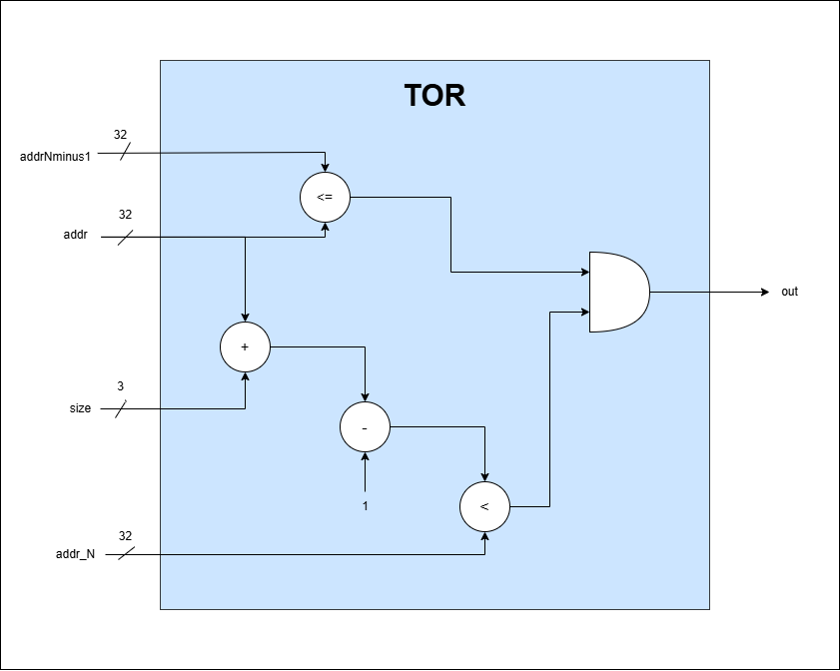
Logic Implementation

Slide 20
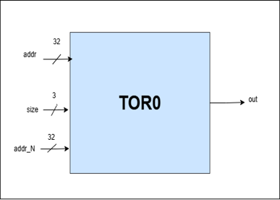
Inputs
Inputs:
addr (32-bit): Address that we want to access
addrN (32-bit): Upper bound
size (3-bit): Size we want to access 000 -> 1 byte 010 -> 2 bytes(Half word) 100 -> 4 bytes(Full word)
Output:
Out (1-bit):
0 -> Region not in TOR0
1 -> Region in TOR0

Slide 21
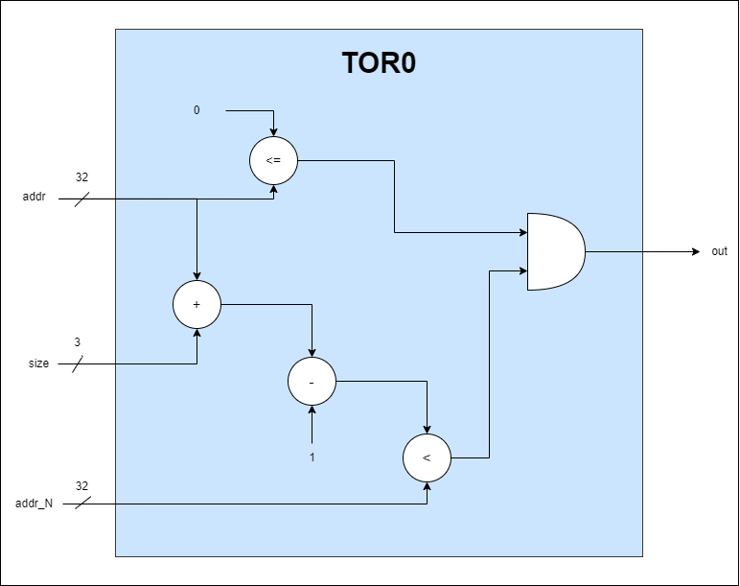
Logic Implementation

Slide 22
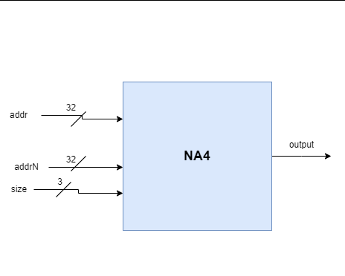
Inputs
Inputs:
addr (32-bit): Address that we want to access
addrN (32-bit): Upper bound
size (3-bit): Size we want to access 000 -> 1 byte 010 -> 2 bytes(Half word) 100 -> 4 bytes(Full word)
Output:
Out (1-bit):
0 -> Region not in TOR0
1 -> Region in TOR0

Slide 23
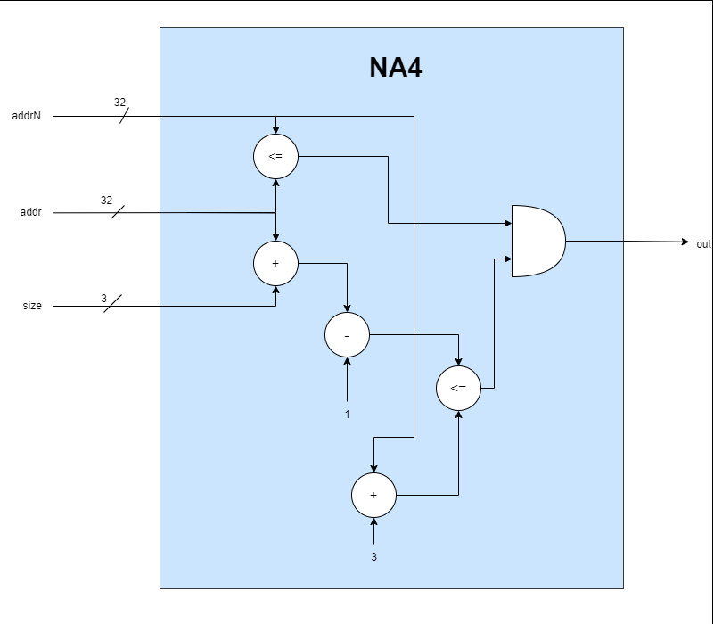
Logic Implementation

Slide 24
Implementation in System Verilog
By Muhammad Boota & Waleed Tariq
2022-EE-134 2022-EE-124

Slide 25

Thank you

