Slide 1
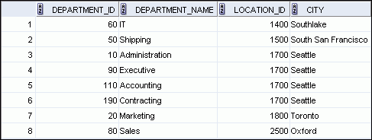
Retrieving Records with Natural Joins
SELECT department_id, department_name,
location_id, city
FROM departments
NATURAL JOIN locations ;
Notes:
Retrieving Records with Natural Joins
In the example in the slide, the LOCATIONS table is joined to the DEPARTMENT table by the LOCATION_ID column, which is the only column of the same name in both tables. If other common columns were present, the join would have used them all.
Natural Joins with a WHERE Clause
Additional restrictions on a natural join are implemented by using a WHERE clause. The following example limits the rows of output to those with a department ID equal to 20 or 50:
SELECT department_id, department_name,
location_id, city
FROM departments
NATURAL JOIN locations
WHERE department_id IN (20, 50);

Slide 2
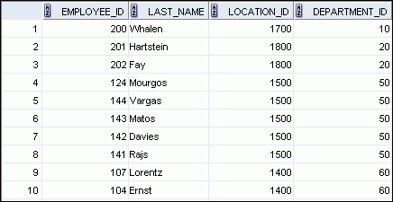
Retrieving Records with the USING Clause
SELECT employee_id, last_name,
location_id, department_id
FROM employees JOIN departments
USING (department_id) ;
…
Notes:
Retrieving Records with the USING Clause
In the example in the slide, the DEPARTMENT_ID columns in the EMPLOYEES and DEPARTMENTS tables are joined and thus the LOCATION_ID of the department where an employee works is shown.

Slide 3
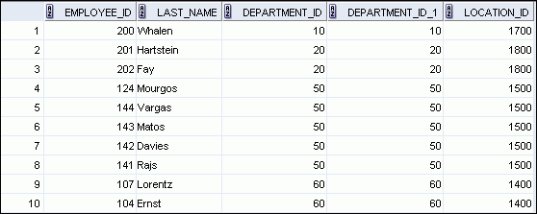
Retrieving Records with the ON Clause
SELECT e.employee_id, e.last_name, e.department_id,
d.department_id, d.location_id
FROM employees e JOIN departments d
ON (e.department_id = d.department_id);
…
Notes:
Retrieving Records with the ON Clause
In this example, the DEPARTMENT_ID columns in the EMPLOYEES and DEPARTMENTS table are joined using the ON clause. Wherever a department ID in the EMPLOYEES table equals a department ID in the DEPARTMENTS table, the row is returned. The table alias is necessary to qualify the matching column_names.
You can also use the ON clause to join columns that have different names. The parenthesis around the joined columns as in the slide example, (e.department_id = d.department_id) is optional. So, even ON e.department_id = d.department_id will work.
Note: SQL Developer suffixes a ‘_1’ to differentiate between the two department_ids.

Slide 4
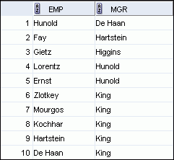
Self-Joins Using the ON Clause
SELECT worker.last_name emp, manager.last_name mgr
FROM employees worker JOIN employees manager
ON (worker.manager_id = manager.employee_id);
…
Notes:
Self-Joins Using the ON Clause
The ON clause can also be used to join columns that have different names, within the same table or in a different table.
The example shown is a self-join of the EMPLOYEES table, based on the EMPLOYEE_ID and MANAGER_ID columns.
Note: The parenthesis around the joined columns as in the slide example, (e.manager_id = m.employee_id) is optional. So, even ON e.manager_id = m.employee_id will work.

Slide 5
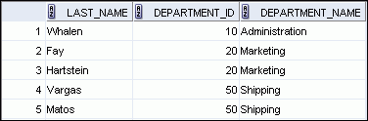

LEFT OUTER JOIN
SELECT e.last_name, e.department_id, d.department_name
FROM employees e LEFT OUTER JOIN departments d
ON (e.department_id = d.department_id) ;
…
Notes:
LEFT OUTER JOIN
This query retrieves all rows in the EMPLOYEES table, which is the left table, even if there is no match in the DEPARTMENTS table.

Slide 6
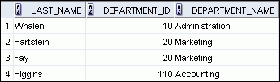

RIGHT OUTER JOIN
SELECT e.last_name, e.department_id, d.department_name
FROM employees e RIGHT OUTER JOIN departments d
ON (e.department_id = d.department_id) ;
…
Notes:
RIGHT OUTER JOIN
This query retrieves all rows in the DEPARTMENTS table, which is the right table, even if there is no match in the EMPLOYEES table.

Slide 7
FULL OUTER JOIN
SELECT e.last_name, d.department_id, d.department_name
FROM employees e FULL OUTER JOIN departments d
ON (e.department_id = d.department_id) ;
…
Notes:
FULL OUTER JOIN
This query retrieves all rows in the EMPLOYEES table, even if there is no match in the DEPARTMENTS table. It also retrieves all rows in the DEPARTMENTS table, even if there is no match in the EMPLOYEES table.

Slide 8
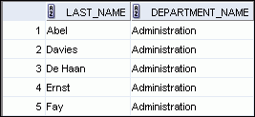

Creating Cross Joins
The CROSS JOIN clause produces the cross-product of two tables.
This is also called a Cartesian product between the two tables.
SELECT last_name, department_name
FROM employees
CROSS JOIN departments ;
…
Notes:
Creating Cross Joins
The example in the slide produces a Cartesian product of the EMPLOYEES and DEPARTMENTS tables.

Slide 9
Les 7: Using Subqueries to Solve Queries

Slide 10
Subquery Syntax
SELECT select_list
FROM table
WHERE expr operator
(SELECT select_list
FROM table);
The subquery (inner query) executes before the main query (outer query).
The result of the subquery is used by the main query.
Notes:
Subquery Syntax
A subquery is a SELECT statement that is embedded in the clause of another SELECT statement. You can build powerful statements out of simple ones by using subqueries. They can be very useful when you need to select rows from a table with a condition that depends on the data in the table itself.
You can place the subquery in a number of SQL clauses, including the following:
WHERE clause
HAVING clause
FROM clause
In the syntax:
operator includes a comparison condition such as >, =, or IN
Note: Comparison conditions fall into two classes: single-row operators (>, =, >=, <, <>, <=) and multiple-row operators (IN, ANY, ALL).
The subquery is often referred to as a nested SELECT, sub-SELECT, or inner SELECT statement. The subquery generally executes first, and its output is used to complete the query condition for the main (or outer) query.

Slide 11
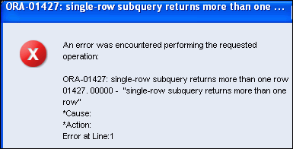
What Is Wrong with This Statement?
SELECT employee_id, last_name
FROM employees
WHERE salary =
(SELECT MIN(salary)
FROM employees
GROUP BY department_id);
Single-row operator with multiple-row subquery
Notes:
What Is Wrong with This Statement?
A common error with subqueries occurs when more than one row is returned for a single-row subquery.
In the SQL statement in the slide, the subquery contains a GROUP BY clause, which implies that the subquery will return multiple rows, one for each group that it finds. In this case, the results of the subquery are 4400, 6000, 2500, 4200, 7000, 17000, and 8300.
The outer query takes those results and uses them in its WHERE clause. The WHERE clause contains an equal (=) operator, a single-row comparison operator that expects only one value. The = operator cannot accept more than one value from the subquery and, therefore, generates the error.
To correct this error, change the = operator to IN.

Slide 12
Multiple-Row Subqueries
Return more than one row
Use multiple-row comparison operators
Operator
Meaning
IN
Equal to any member in the list
ANY
Must be preceded by =, !=, >, <, <=, >=. Compares a value to each value in a list or returned by a query. Evaluates to FALSE if the query returns no rows.
ALL
Must be preceded by =, !=, >, <, <=, >=. Compares a value to every value in a list or returned by a query. Evaluates to TRUE if the query returns no rows.
Notes:
Multiple-Row Subqueries
Subqueries that return more than one row are called multiple-row subqueries. You use a multiple-row operator, instead of a single-row operator, with a multiple-row subquery. The multiple-row operator expects one or more values:
SELECT last_name, salary, department_id
FROM employees
WHERE salary IN (SELECT MIN(salary)
FROM employees
GROUP BY department_id);
Example:
Find the employees who earn the same salary as the minimum salary for each department.
The inner query is executed first, producing a query result. The main query block is then processed and uses the values that were returned by the inner query to complete its search condition. In fact, the main query appears to the Oracle server as follows:
SELECT last_name, salary, department_id
FROM employees
WHERE salary IN (2500, 4200, 4400, 6000, 7000, 8300, 8600, 17000);

Slide 13
Les8: Using the Set Operators

Slide 14


Using the UNION Operator
Display the current and previous job details of all employees. Display each employee only once.
SELECT employee_id, job_id
FROM employees
UNION
SELECT employee_id, job_id
FROM job_history;
…
…
Notes:
Using the UNION Operator
The UNION operator eliminates any duplicate records. If records that occur in both the EMPLOYEES and the JOB_HISTORY tables are identical, the records are displayed only once. Observe in the output shown in the slide that the record for the employee with the EMPLOYEE_ID 200 appears twice because the JOB_ID is different in each row.
Consider the following example:
SELECT employee_id, job_id, department_id
FROM employees
UNION
SELECT employee_id, job_id, department_id
FROM job_history;
…
…

Slide 15

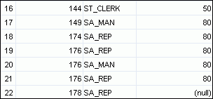
Using the UNION ALL Operator
Display the current and previous departments of all employees.
SELECT employee_id, job_id, department_id
FROM employees
UNION ALL
SELECT employee_id, job_id, department_id
FROM job_history
ORDER BY employee_id;
…
…
Notes:
Using the UNION ALL Operator
In the example, 30 rows are selected. The combination of the two tables totals to 30 rows. The UNION ALL operator does not eliminate duplicate rows. UNION returns all distinct rows selected by either query. UNION ALL returns all rows selected by either query, including all duplicates. Consider the query in the slide, now written with the UNION clause:
SELECT employee_id, job_id,department_id FROM employees UNION SELECT employee_id, job_id,department_id FROM job_history ORDER BY employee_id;
The preceding query returns 29 rows. This is because it eliminates the following row (because it is a duplicate):

Slide 16

Using the INTERSECT Operator
Display the employee IDs and job IDs of those employees who currently have a job title that is the same as their previous one (that is, they changed jobs but have now gone back to doing the same job they did previously).
SELECT employee_id, job_id
FROM employees
INTERSECT
SELECT employee_id, job_id
FROM job_history;
Notes:
Using the INTERSECT Operator
In the example in this slide, the query returns only those records that have the same values in the selected columns in both tables.
What will be the results if you add the DEPARTMENT_ID column to the SELECT statement from the EMPLOYEES table and add the DEPARTMENT_ID column to the SELECT statement from the JOB_HISTORY table, and run this query? The results may be different because of the introduction of another column whose values may or may not be duplicates.
Example:
SELECT employee_id, job_id, department_id
FROM employees
INTERSECT
SELECT employee_id, job_id, department_id
FROM job_history;
Employee 200 is no longer part of the results because the EMPLOYEES.DEPARTMENT_ID value is different from the JOB_HISTORY.DEPARTMENT_ID value.

Slide 17
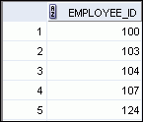

Using the MINUS Operator
Display the employee IDs of those employees who have not changed their jobs even once.
SELECT employee_id
FROM employees
MINUS
SELECT employee_id
FROM job_history;
…
Notes:
Using the MINUS Operator
In the example in the slide, the employee IDs in the JOB_HISTORY table are subtracted from those in the EMPLOYEES table. The results set displays the employees remaining after the subtraction; they are represented by rows that exist in the EMPLOYEES table, but do not exist in the JOB_HISTORY table. These are the records of the employees who have not changed their jobs even once.

Slide 18
Matching the SELECT Statements
Using the UNION operator, display the location ID, department name, and the state where it is located.
You must match the data type (using the TO_CHAR function or any other conversion functions) when columns do not exist in one or the other table.
SELECT location_id, department_name "Department",
TO_CHAR(NULL) "Warehouse location"
FROM departments
UNION
SELECT location_id, TO_CHAR(NULL) "Department",
state_province
FROM locations;
Notes:
Matching the SELECT Statements
Because the expressions in the SELECT lists of the queries must match in number, you can use the dummy columns and the data type conversion functions to comply with this rule. In the slide, the name, Warehouse location, is given as the dummy column heading. The TO_CHAR function is used in the first query to match the VARCHAR2 data type of the state_province column that is retrieved by the second query. Similarly, the TO_CHAR function in the second query is used to match the VARCHAR2 data type of the department_name column that is retrieved by the first query.
The output of the query is shown:
…

