Slide 1
Final Project CS307
House of Representatives.
By Omar Goda & Muhammad H. Bakr.

Slide 2
1.1: Database Modelling / SQL :
Construct an entity relational diagram (ERD) for the requirements specification. Then, map this diagram into a relational model diagram (RMD).
The following stages should be undertaken:
Identify the relevant Entities and label them appropriately.
Link these with the relevant Relationships, these should be: Labeled appropriately.
Define the type of relationship (1:1, 1:M or M:M)
Resolve any many-to-many relationships.
Identify attributes for each entity and identify Primary and Foreign Keys.

Slide 3
Specification: U.S. House of Representatives
Design an ER schema for keeping track of information about votes taken in the U.S. House of Representatives during the current two-year congressional session.

Slide 4
Objectives:
1. The database needs to keep track of each U.S. STATE’s Name (e.g., ‘Texas’, ‘New York’, ‘California’) and include the Region of the state (whose domain is {‘Northeast’, ‘Midwest’, ‘Southeast’, ‘Southwest’, ‘West’}).

Slide 5
Objectives (Continued):
2. Each CONGRESS_PERSON in the House of Representatives is described by his or her Name, plus the District represented, the Start_date when the congressperson was first elected, and the political Party to which he or she belongs (whose domain is {‘Republican’, ‘Democrat’, ‘Independent’, ‘Other’}).

Slide 6
Objectives (Continued):
3. The database keeps track of each BILL (i.e., proposed law), including the Bill_name, the Date_of_vote on the bill, whether the bill Passed_or_failed (whose domain is {‘Yes’, ‘No’}), and the Sponsor (the congressperson(s) who sponsored—that is, proposed—the bill). The database also keeps track of how each congressperson voted on each bill (domain of Vote attribute is {‘Yes’, ‘No’, ‘Abstain’, ‘Absent’}).

Slide 7
Additional Information:
• There are 435 congresspersons in the U.S. House of Representatives.
• States have between one (AK, DE, MT, ND, SD, VT, and WY) and 52 (CA) representatives.
• N represents the number of bills during the 2-year session.

Slide 8
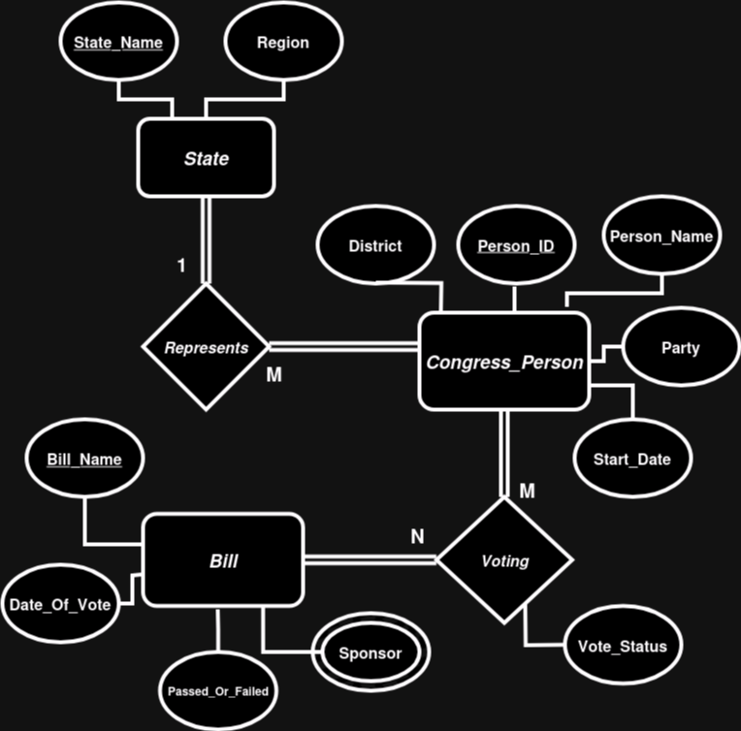
The ERD:

Slide 9
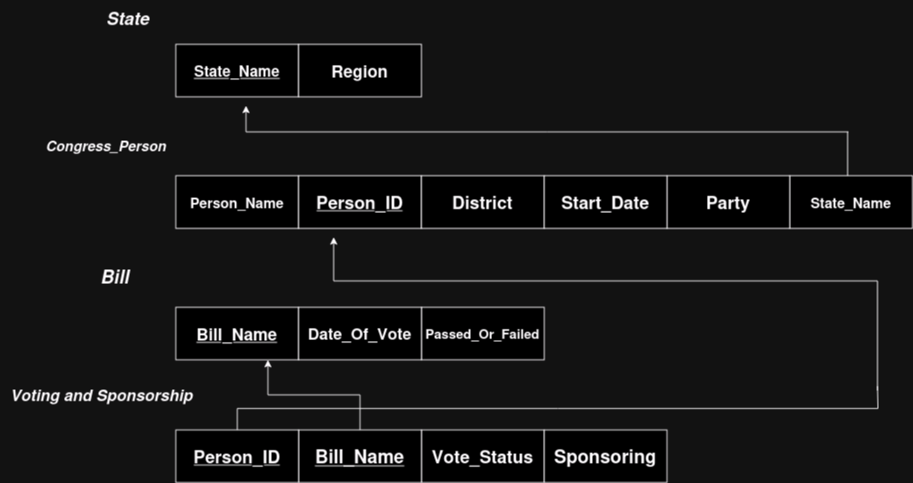
The Relational Model:

Slide 10
1.2 Design Tables:
Login to oracle through Oracle SQL Developer and create appropriate tables with all constraints which reflects the ER diagram designed in Q1.1.
The report needs to have all SQL scripts to create tables, add constraints on them.

Slide 11
Design State table:
-- Create state table (for sampling only 1 state from every region, Could use a check constraint on the name to be one of the current 50 states):
Create Table State(State_Name Varchar2(25) Constraint X1 Primary Key, Region Varchar2(25) Constraint X2 Check(Region In('Northeast', 'Midwest', 'Southeast', 'Southwest','West')));

Slide 12
Design Congressperson Table:
-- Create congress_person table (for sampling only 15 congress persons):
Create Table Congress_Person (Person_Id Number(3) Constraint X3 Primary Key, Person_Name Varchar2(25) Constraint X4 Not Null,
District Varchar2(25) Constraint X5 Not Null, Start_Date Date Constraint X6 Not Null, Party Varchar2(25) Constraint X7
Check(Party In('Republican','Democrat', 'Independent','Other')),
State_Name Varchar2(25) Constraint X8 References State(State_Name));

Slide 13
Create Bill Table:
-- Create bill table (for sampling only 4 bills):
Create Table Bill(Bill_Name Varchar2(25) Constraint X9 Primary Key, Date_Of_Vote Date Constraint X10 Not Null,
Passed_Or_Failed Varchar2(25) Constraint X11 Check (Passed_Or_Failed In('Yes', 'No')) );

Slide 14
Create Voting_Sponsorship Table:
-- Create voting_sponsorship table (that is going to have 60 records for our sample):
Create Table Voting_Sponsorship (Person_Id Number(3) Constraint X12 References Congress_Person(Person_Id),
Bill_Name Varchar2(25) Constraint X13 References Bill(Bill_Name), Voting_Status Varchar2(25) Constraint X14
Check(Voting_Status In('Yes', 'No', 'Abstain', 'Absent')),
Sponsorship Varchar2(25) Constraint X15 Check (Sponsorship In('Yes', 'No')), Constraint X16 Primary Key(Person_Id, Bill_Name));

Slide 15
1.3 Insert Data:
Now write an appropriate SQL statement (INSERT) to populate the tables with records under the previous specification.

Slide 16
Dynamic Insertion:
Insert Into State
Values('&state_name', '&region');
Insert Into Congress_Person
Values (&person_Id, '&person_name', '&district','&date', '&party', '&state_name');
Insert Into Bill
Values ('&bill_name', '&date_of_vote', '&passed_or_failed');
Insert Into Voting_Sponsorship
Values (&person_Id, '&bill_name', '&voting_status', '&sponsor_ship');

Slide 17
1.4 SQL VIEWS:
A. Create a view named ‘SponsoredBills’ which displays the bills and the congresspersons who sponsored them.
B. Ensure that the view is READ-ONLY

Slide 18
View Using Our Modification:
Create Or Replace View SponsoredBills
As Select Bill_Name "Bill", Person_Id "Congresspersons"
From Voting_Sponsorship
Where Sponsorship = 'Yes'
With Read Only;

Slide 19
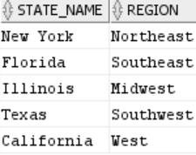
A snap shot using dummy data, States Table:

Slide 20
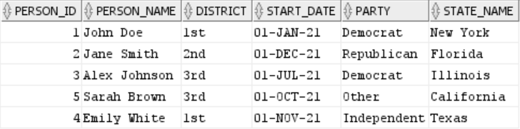
Congress persons Table:

Slide 21
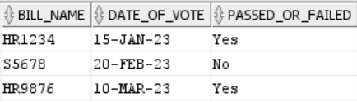
Bill Table:

Slide 22
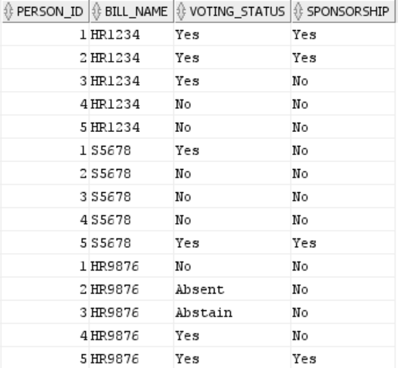
Voting_Sponsorship Table:

Slide 23
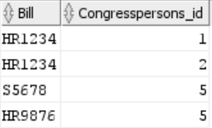
SponsoredBills View:

