Slide 1



Your Custom
{{service_selected}} Growth Proposal.
Digital Dream Works LLC
{{today_date}}
We merge creativity with code to build intelligent systems for modern brands.
Prepared for {{client_name}}
+1 786 735 2988
7901 4th ST N 23948 ST Petersburg, Fl 33702
www.DigitalDreamWorksAgency.com

Slide 2


Digital Dream Works LLC
{{today_date}}
About Our Company
Digital Dream Works LLC is an AI-native growth studio that combines creative strategy, automation, and software engineering to build smarter businesses. We design and deploy intelligent systems from AI-powered marketing funnels and SEO automation to custom software and performance dashboards. That help brands grow faster with less effort. Our core belief is that creativity should scale, not slow down. Headquartered in the United States with operations in Europe and UK, Digital Dream Works LLC partners with ambitious companies worldwide to engineer growth through technology, precision, and design excellence.

Slide 3
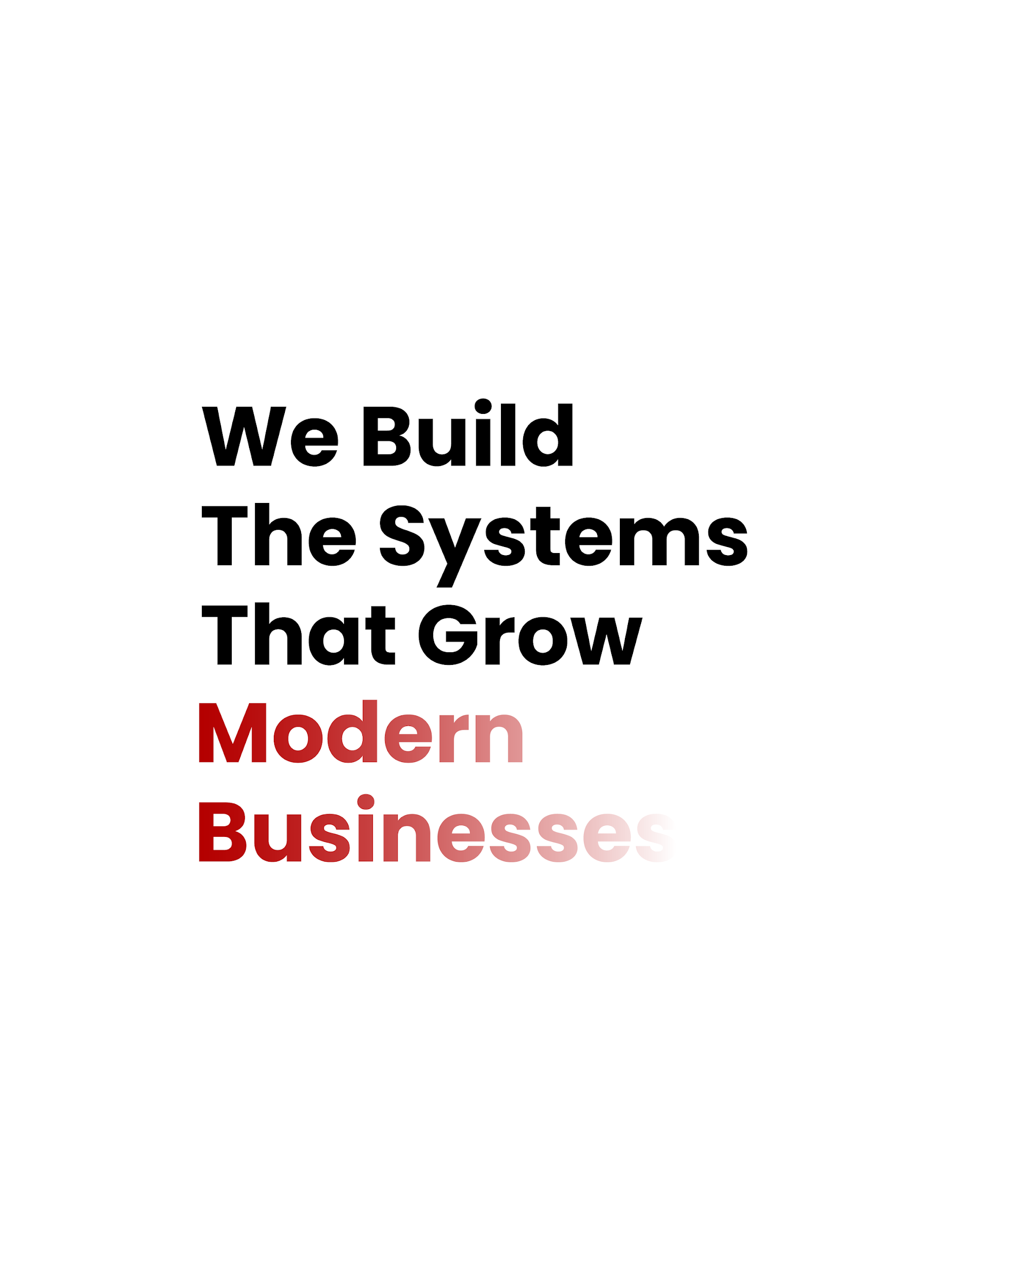
What we do?
Digital Dream Works LLC
{{today_date}}
Our Core Services
Custom Software & SaaS Development
AI Marketing Systems
Web Development
At Digital Dream Works LLC, we design connected systems that blend creativity, data, and technology. From building world-class websites to engineering AI-powered automation, our mission is to help businesses grow smarter ,not harder. Every DDW project combines precision engineering, growth strategy, and design excellence to deliver measurable results.
Consulting & White-Label Solutions
AUTOMATION & INTEGRATIONS

Slide 4
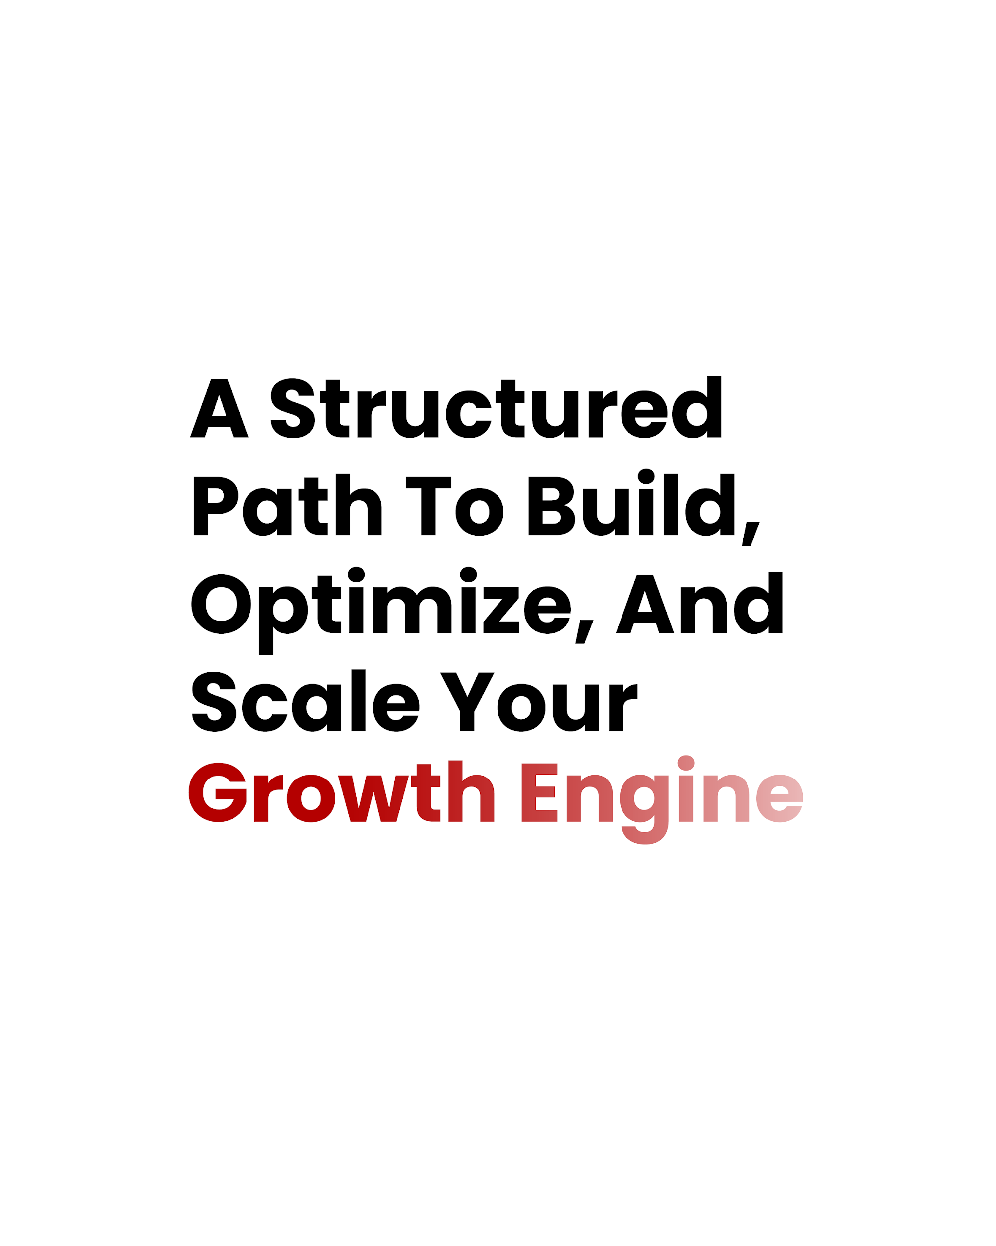
Plan of Action
Digital Dream Works LLC
{{today_date}}
To accelerate {{client_name}}’s growth, we’ve structured a clear, data-backed roadmap tailored to your brand’s goals. Each phase below represents a key milestone — blending strategy, automation, and creative execution to deliver measurable results.
Foundation Setup
{{phase1_summary}}
Automation & Optimization
{{phase2_summary}}
Launch and Scale
{{phase3_summary}}
Launch & Scale

Slide 5
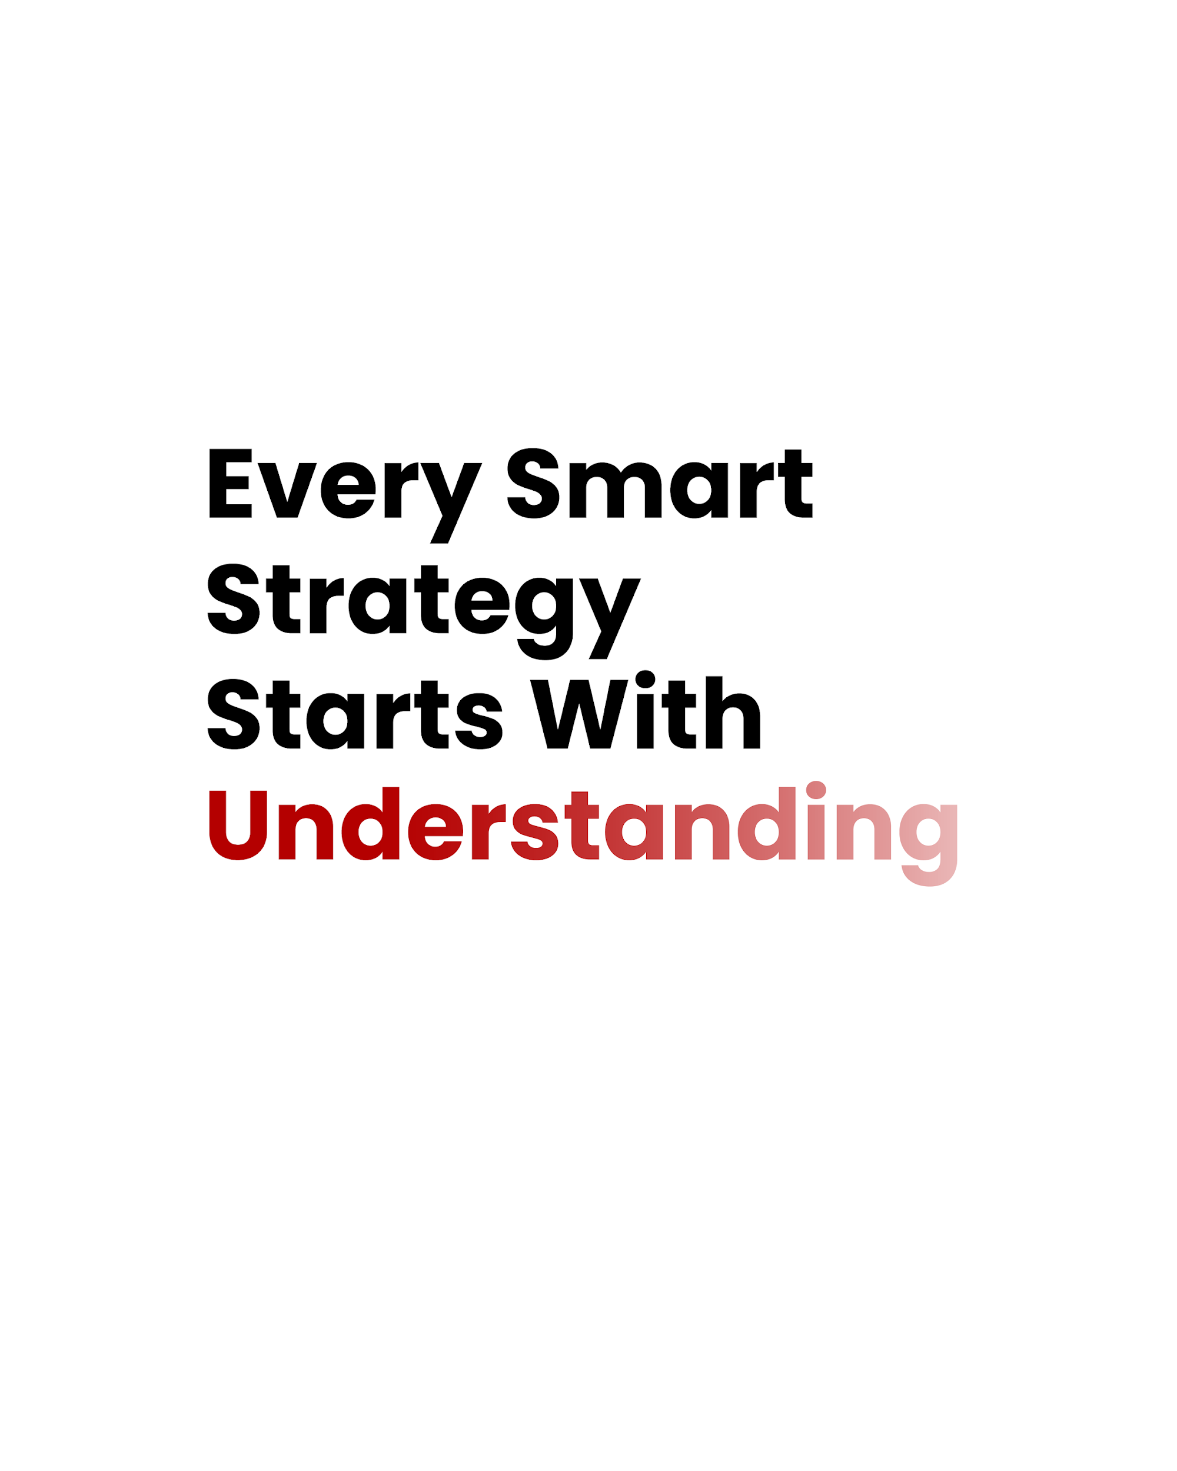
Understanding Your Business
Digital Dream Works LLC
{{today_date}}
Every brand has unique challenges that shape its growth potential. At Digital Dream Works LLC, we analyze your digital presence, audience behavior, and market positioning to pinpoint the factors that limit your current results.
This insight is generated through our AI-powered audit system — blending data, design, and strategic logic to identify what matters most for your next phase of growth.
Brand Positioning
{{brand_positioning_summary}}
Marketing Systems
{{marketing_systems_summary}}
Growth Potential
{{growth_potential_summary}}

Slide 6
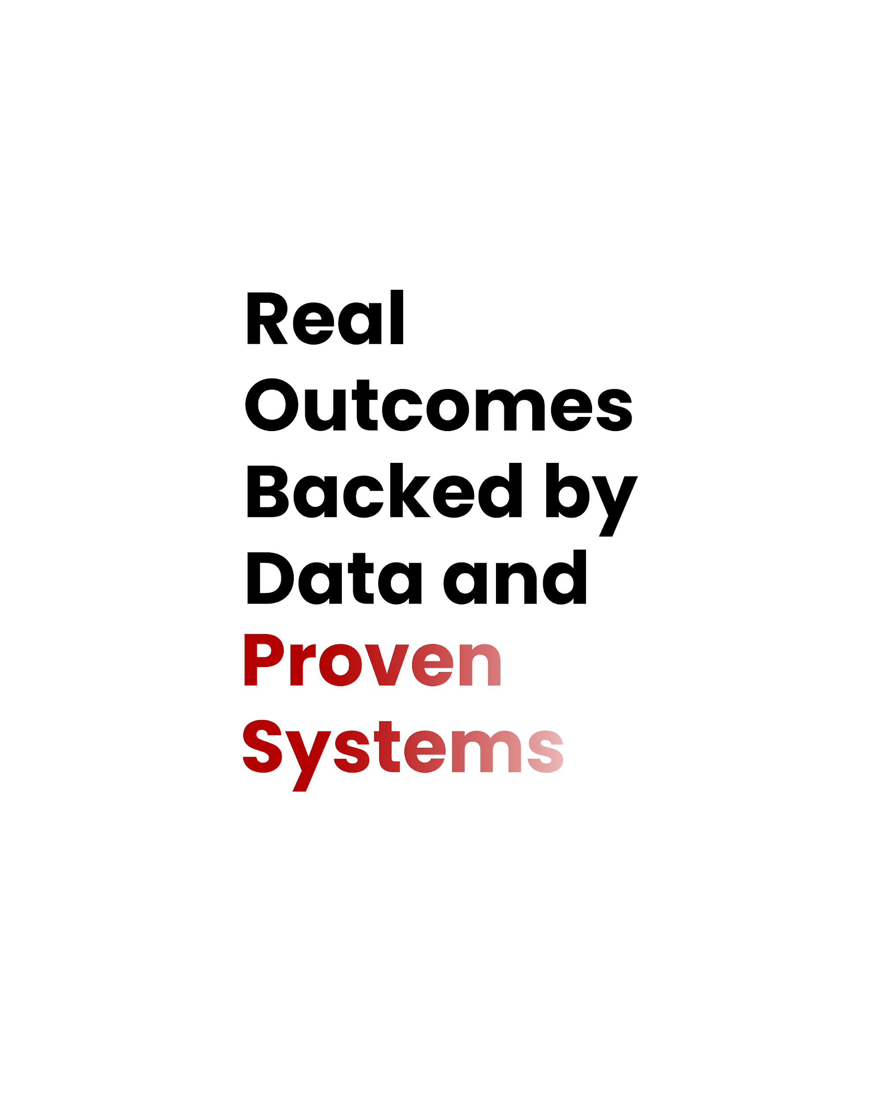
Projected Results
Digital Dream Works LLC
{{today_date}}
Based on our analysis of {{client_industry}} trends and performance data, we project measurable growth opportunities once the proposed systems are implemented. The following figures represent benchmark outcomes achieved through similar strategies executed by Digital Dream Works clients.
Benchmarks based on recent Digital Dream Works campaigns in similar industries.
Website Conversion Growth
+{{growth_rate}}%
Cost Efficiency Increase
{{efficiency_rate}}%
Average ROI
{{roi_value}}x

Slide 7
Your Growth Offer & Next Steps
Digital Dream Works LLC
{{today_date}}
Base Investment
{{base_price}}
This is the standard rate for {{service_selected}}, including setup, design, development, and optimization. It reflects the current market average in the {{client_industry}} sector based on your business size and target region.
Based on your project goals, we’ve structured a transparent investment plan to launch your {{service_selected}} campaign.
This plan includes onboarding, setup, and performance optimization — with a 15 % launch discount valid for the next 24 hours.
Limited Offer Discount
{{discount_value}}
As part of our onboarding incentive, we’re extending a 15 % discount valid for the next 24 hours. This limited- time reduction ensures you lock in our best rate while accelerating your campaign’s launch window
Here’s your personalized investment plan for your {{service_selected}} growth system.
Based on your project details, this package covers everything from setup to launch and optimization — at an exclusive 15% discount for the next 24 hours.
[Confirm & Pay Now]
{{stripe_payment_link}}
[Book Your Onboarding Call]
{{calendly_link}}
Your Total Today
{{discounted_price}}
The final amount includes your full service scope, after-discount pricing, and implementation readiness. Once confirmed, your project will be queued for onboarding within 24 hours through our AI-powered workflow.

Slide 8


Thank You
Digital Dream Works LLC
{{today_date}}
We appreciate the opportunity to collaborate on your project.
Our team at Digital Dream Works LLC is excited to help you grow faster with the power of AI-driven strategy and automation.
7901 4th ST N 23948 ST Petersburg, Fl 33702
We are ready to assist you
+1 786 735 2988
www.DigitalDreamWorksAgency.com

