Slide 1
CLOUD DATA ENGINEERING & ML PLATFORM
Clickstream Lakehouse
End-to-End Real-Time Data Platform & Purchase Propensity Machine Learning on Azure Databricks
⚡ Azure Event Hubs
🧱 Databricks Auto Loader
⚙️ dbt Transformation
🎯 LightGBM + MLflow
☁️ Salesforce Reverse ETL
2.75M
Clickstream Events Processed
0.97
ROC-AUC Purchase Prediction
< 40 min
Bronze to Gold Pipeline Runtime
3,862
Daily Salesforce CRM Syncs
Clickstream Lakehouse | Azure + Databricks + dbt + MLflow

Slide 2
CLOUD DATA ENGINEERING & ML PROJECT
Clickstream Lakehouse Overview
End-to-End Data Platform with Purchase Propensity ML on Azure Databricks
Problem Statement
Solution
Current Bottlenecks & Legacy Limitations
Modern Medallion Architecture & ML Pipeline
• Raw clickstream data (2.75M events) stored in flat CSVs with no pipeline or automation.
• No real-time ingestion: analyzing user behavior required manual bulk data loads.
• No purchase prediction capability: marketing teams made decisions without data-driven signals.
• Data quality unverified: duplicate events, null keys, and invalid types went undetected.
• No connection between analytics and CRM: Salesforce had zero visibility into visitor engagement.
• Medallion Lakehouse (Bronze/Silver/Gold) on Azure Databricks with Unity Catalog governance.
• Event Hubs + Azure Function for real-time streaming ingestion with Auto Loader checkpoint.
• dbt data transformation: 12 models, 25 automated tests for quality gating.
• ML purchase propensity model: 10 algorithms compared, isotonic-calibrated LightGBM deployed.
• Reverse ETL via Fivetran: 3,862 visitor engagement records synced to Salesforce daily.
• Streamlit scoring app: real-time model serving on 20,000 candidate interactions.
IMPACT OF THE SOLUTION
0.395
PR-AUC (Calibrated Model)
0.97
ROC-AUC Score
84%
Max Calibrated Probability
3,862
Salesforce Records Synced
Clickstream Lakehouse | Azure + Databricks + dbt + MLflow
1

Slide 3
ML Model Deep Dive
Input Parameters
Training Dataset
Features fed to the purchase propensity model
clickstream.ml_training.ml_training_purchase_propensity
• view_count: Number of times the visitor viewed this item
• addtocart_count: Number of cart-add events for this item
• days_since_last_interaction: Recency (days since last activity)
• item_is_available: Boolean flag from item properties
• item_category_id deliberately EXCLUDED: nominal ID with no ordering
• transaction_count excluded as feature to prevent label leakage
• 2,144,652 total rows (one per visitor-item interaction pair)
• 20,743 positive labels (actual purchases = ~0.97% positive rate)
• Train/Test split: 75% / 25% with stratified sampling
• Source: RetailRocket clickstream dataset (2.75M events)
• Label: label_purchased (1 if transaction_count > 0, else 0)
10-Candidate Algorithm Comparison (sorted by PR-AUC)
Candidate | Type | PR-AUC | ROC-AUC | Status
lightgbm_depth6 (WINNER) | Gradient Boosting (LightGBM) | 0.3916 | 0.9726 | Calibrated & Registered
xgboost_depth6 | Gradient Boosting (XGBoost) | 0.3893 | 0.9720 | Passed
random_forest_depth6 | Ensemble (Random Forest) | 0.3890 | 0.9741 | Passed
random_forest_depth3 | Ensemble (Random Forest) | 0.3657 | 0.9724 | Passed
logistic_regression (C=0.1) | Linear Model | 0.3421 | 0.9699 | Passed
logistic_regression (C=0.01) | Linear Model | 0.3416 | 0.9717 | Passed
logistic_regression (C=0.001) | Linear Model | 0.3414 | 0.9717 | Passed
logistic_regression (C=1.0) | Linear Model | 0.3421 | 0.9699 | Passed
extra_trees_depth6 | Ensemble (Extra Trees) | 0.3240 | 0.9702 | Passed
naive_bayes | Probabilistic (Gaussian NB) | 0.2825 | 0.9685 | Passed
Clickstream Lakehouse | Azure + Databricks + dbt + MLflow
2

Slide 4
Model Accuracy & Calibration
Isotonic Calibration (v7)
Model Selection Criteria
CalibratedClassifierCV wraps LightGBM winner
Beyond PR-AUC: two mandatory checks
• BEFORE: rows scored 90-100% only converted ~31% in reality
• AFTER: predicted vs. actual match closely across every band
• Predicted 0-10% -> Actual 0.09% observed conversion
• Predicted 30-40% -> Actual 35.5% observed conversion
• Predicted 40-50% -> Actual 42.4% observed conversion
• Predicted 60-70% -> Actual 65.6% observed conversion
• Max output across 20K candidates: 84% (no false 99%)
• PR-AUC after calibration: 0.395 (ranking quality preserved)
• Non-degenerate probability spread: test-set std > 0.02
• Stress test: hand-built 'disengaged' vs 'engaged' examples
• Low engagement (0 views, 60 days stale) must score < 50%
• Gap between high and low engagement must be >= 30 points
• All 10 candidates pass both checks at full data scale
• At demo scale (20 positives), EVERY candidate failed
• class_weight='balanced' used across all models
Tech Stack
Azure Databricks
Azure Event Hubs
dbt (dbt-databricks)
Unity Catalog-governed Lakehouse: Auto Loader, Delta Lake, MLflow experiment tracking & model registry
Streaming ingestion: 3 hubs (events, item-properties, category-tree) with Avro Capture to ADLS Gen2
12 SQL models across Silver/Gold/ML schemas, 25 automated tests for data quality gating
scikit-learn + MLflow
LightGBM / XGBoost
Streamlit + Fivetran
10-candidate comparison, isotonic calibration, auto-registration to Unity Catalog model registry
Gradient-boosted tree algorithms: LightGBM won (PR-AUC 0.392), XGBoost runner-up (0.389)
Real-time scoring app (20K candidates) + daily reverse ETL sync to Salesforce (3,862 records)
Clickstream Lakehouse | Azure + Databricks + dbt + MLflow
3

Slide 5
Business Impact: Before & After
Dimension | BEFORE (Manual / No Pipeline) | AFTER (Clickstream Lakehouse)
Data Ingestion | Manual CSV bulk loads, no schedule, hours of effort | Automated streaming via Event Hubs + Auto Loader (every 30 min)
Data Quality | No validation: duplicates, null keys, invalid types | 25 automated dbt tests: not-null, uniqueness, accepted-values
Data Freshness | Stale: analysis only after manual refresh | Near real-time: Bronze to Gold in < 40 min end-to-end
Purchase Prediction | None: no ML, marketing relies on gut feeling | Calibrated LightGBM: PR-AUC 0.395, scores 20K candidates/sec
CRM Integration | Zero: Salesforce blind to clickstream behavior | 3,862 visitor records synced daily with engagement data
Analytics / BI | Ad-hoc queries on raw CSVs, no KPI dashboards | Power BI Gold layer: funnel trends, conversion rates, item perf
Model Reliability | N/A | Isotonic-calibrated: predicted scores match actual rates within 3%
Infrastructure | Manual setup, no IaC, unreproducible | Full Terraform + deploy.sh: one-command full rebuild
KEY BUSINESS OUTCOMES
~95%
Less Manual Data Effort
< 40 min
End-to-End Pipeline Time
25/25
Automated Quality Tests
100%
Records Synced Successfully
38.4 min
Full Pipeline Runtime
Clickstream Lakehouse | Azure + Databricks + dbt + MLflow
4

Slide 6
How Can We Improve the Model More
Feature Engineering
Data Enhancements
Richer features for better signal extraction
More data, better data, richer signals
• Session-level features: session duration, page-sequence patterns, bounce rates
• Temporal features: time-of-day, day-of-week purchase patterns, seasonality
• Category embedding: learn dense representations instead of excluding category_id
• Visitor-level aggregates: lifetime value, cross-category interest breadth
• Interaction velocity: rate of engagement change over recent time windows
• Real product metadata: names, prices, images for content-based features
• External data: marketing campaigns, promotions, seasonal events as signals
• Continuous ingestion: move from batch-replay to real-time event streaming
• A/B testing framework: controlled experiments on model-driven recommendations
• User demographic data: age, location, device type for segmentation
Advanced Modeling
Operational Improvements
More sophisticated algorithms & techniques
Production hardening & monitoring
• Deep learning: TabNet or Wide & Deep neural networks for tabular data
• Sequence models: LSTM / Transformer on clickstream event sequences
• Hyperparameter tuning: Optuna/Hyperopt systematic search
• Ensemble stacking: combine LightGBM + XGBoost + RF for marginal gains
• Online learning: incremental updates without full retraining
• Uplift modeling: predict incremental lift of interventions
• Model monitoring: data drift detection (PSI) + automated retraining triggers
• A/B model serving: shadow deploy new versions alongside production
• Databricks Model Serving: server-side REST endpoint instead of client-side
• Feature Store: centralized, versioned features for train/serve parity
• Automated scheduling: retrain on data volume thresholds, not ad-hoc
• Explainability: SHAP/LIME dashboards for stakeholder trust
Clickstream Lakehouse | Azure + Databricks + dbt + MLflow
5

Slide 7
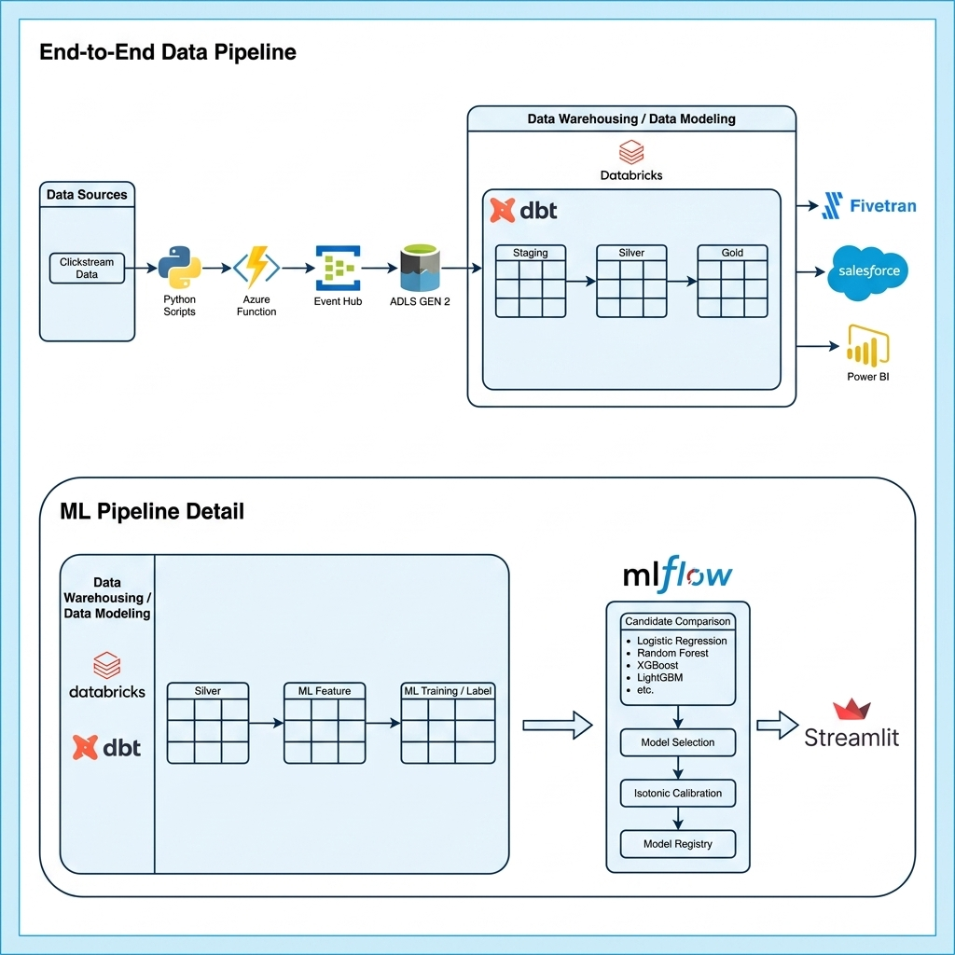
System Architecture
Clickstream Lakehouse | Azure + Databricks + dbt + MLflow
6

