Slide 1
MR
y
UL
x
Listener
[3.00,2.12,1.00]
Sofa
Source
[2.24,1.31,1.07]
Armchair
Sofa
[0.33,2.12,1.00]
Sofa
[2.27,3.58,1.07]
Sofa
x
y
LR
x
y
ST
[2.80,0.51,1.20]
y
x
[5.00,4.94,1.50]
[2.79,2.55,1.08]
Chairs
[5.00,6.94,1.50]
Door

Slide 2
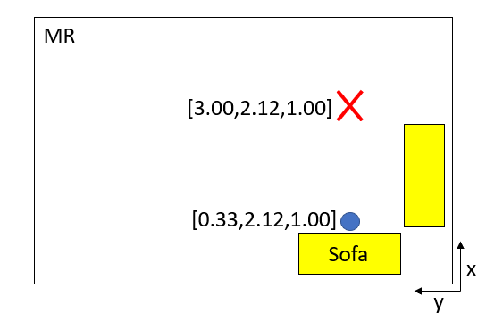
MR
[3.00,2.12,1.00]
[0.33,2.12,1.00]
Sofa
x
y

Slide 3
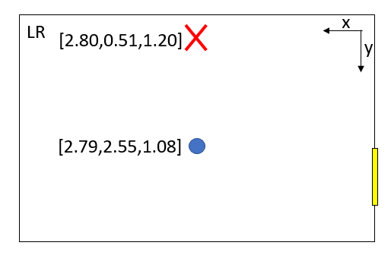
LR
x
[2.80,0.51,1.20]
y
[2.79,2.55,1.08]

Slide 4
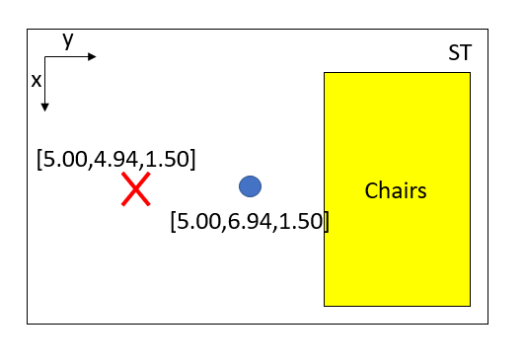
y
ST
x
[5.00,4.94,1.50]
Chairs
[5.00,6.94,1.50]

Slide 5
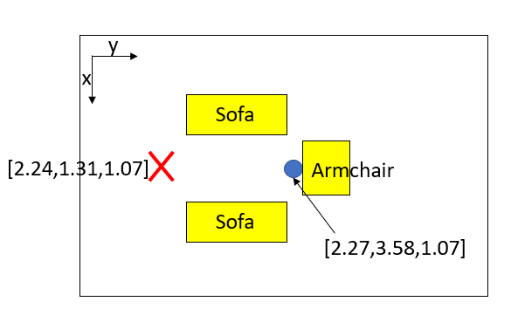
y
x
Sofa
[2.24,1.31,1.07]
Armchair
Sofa
[2.27,3.58,1.07]

Slide 6
