Slide 1

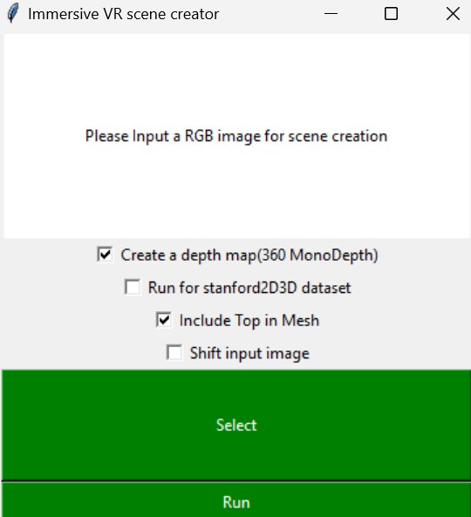
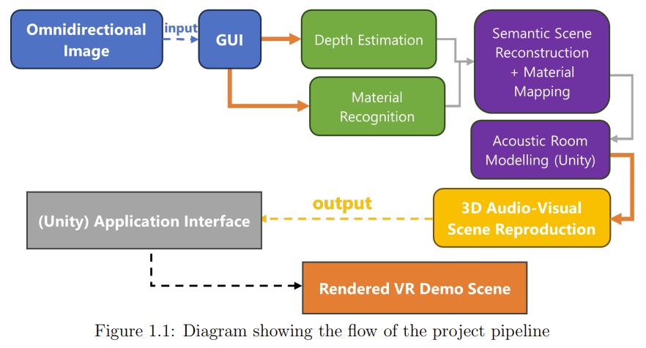
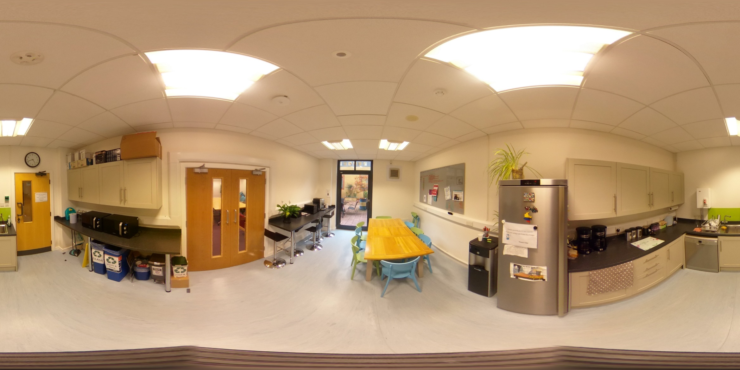
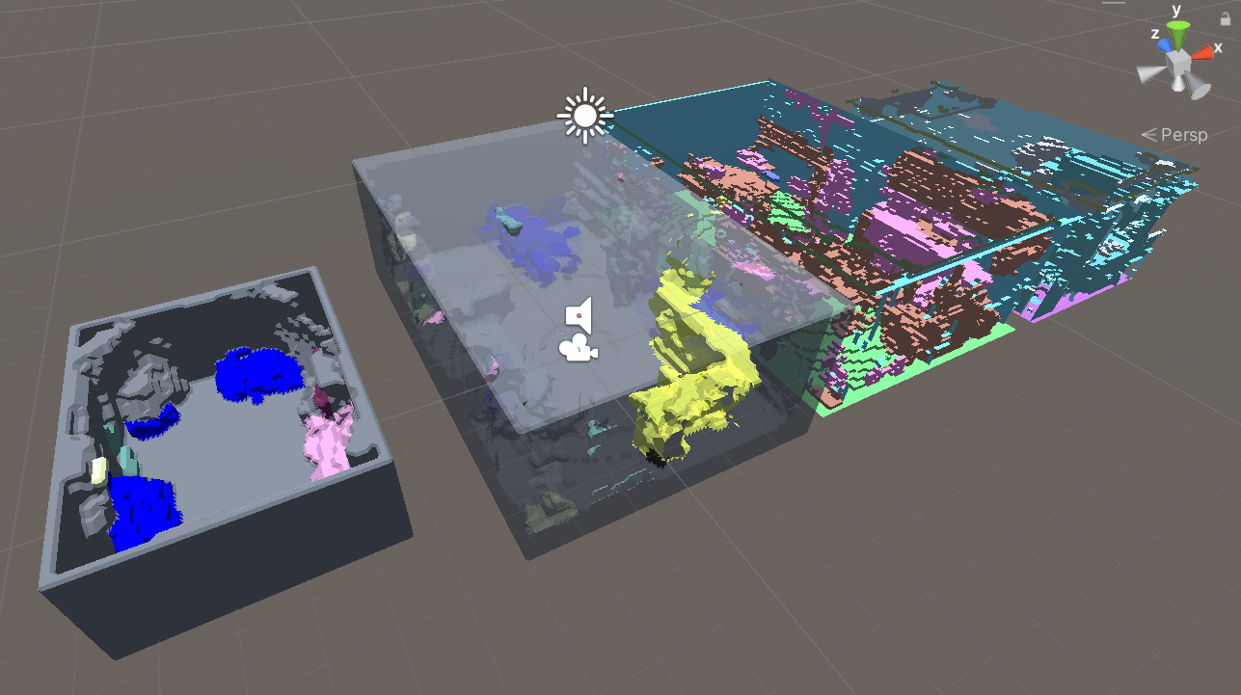
Muhammad Hazimi Bin Yusri mhby1g21@soton.ac.uk
Immersive Audio-Visual Virtual Reality
Scene Reproduction
The motivation behind this project is to pioneer the development of a comprehensive pipeline capable of generating a VR scene with realistic visual and acoustic properties from a single omnidirectional image on a single device, ultimately optimizing the user experience.
Fig 2 (top): The QR code directs to the project’s GitHub repository.
Fig 1: Diagram showing the flow of the project pipeline.
Fig 3 (left): The GUI app for the pipeline, which is only a few clicks provided setup is done properly.
Fig 4:Input image of Kitchen indoor room scene.
Fig 5: Comparison of different meshes generated by proposed method, LiDAR scan, Kim19 and Kim21.
Audio Evaluation Results
Figure 6: Early Decay Times for the five rooms, related to the estimated RIRs in VR environment. The dashed lines show the JND limit of 5% (Vorländer 1995).
Figure 7: Reverberation Times (60dB) for the five rooms, related to the estimated RIRs in VR environment. The dashed lines show the JND limit of 20% (Meng et al. 2006).

