Slide 1
SDGP
Health and Fitness Monitoring System
Mid Project Presentation
Muhammad Ijlal
UOB # 14031197
Group 2

Slide 2
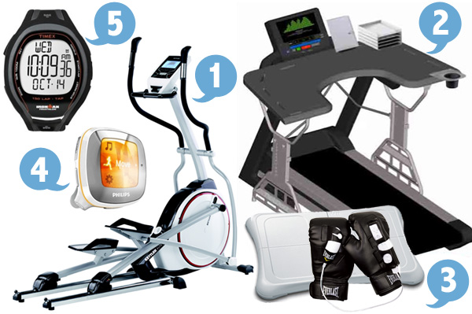
Health And Fitness Monitoring Systems
Increased cardio diseases due to inactive life styles.
Variety of products available for adding activity to life style.
Integrating these systems into normal routine to track physical health.

Slide 3
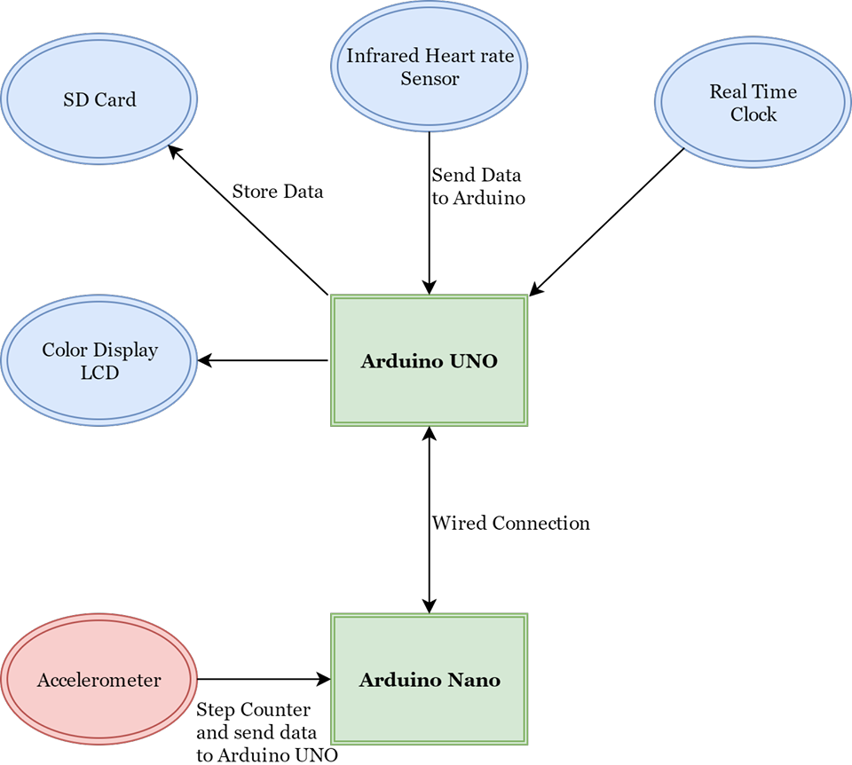
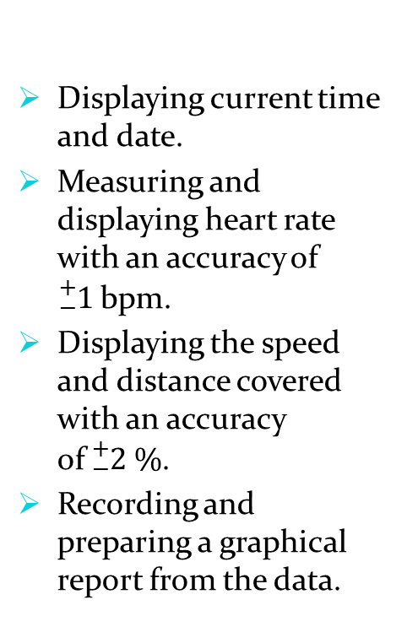
System Specifications and Proposed Solution
Displaying current time and date.
Measuring and displaying heart rate with an accuracy of ${}_{−}^{+}{1 }$bpm.
Displaying the speed and distance covered with an accuracy of${}_{ −}^{+}2 \%$.
Recording and preparing a graphical report from the data.

Slide 4
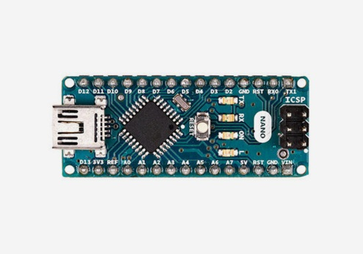
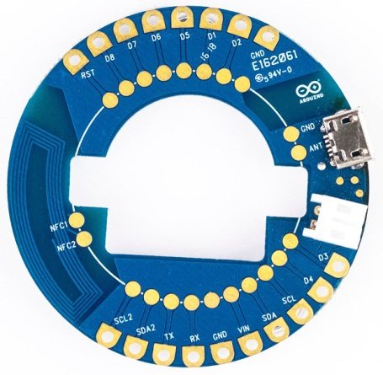
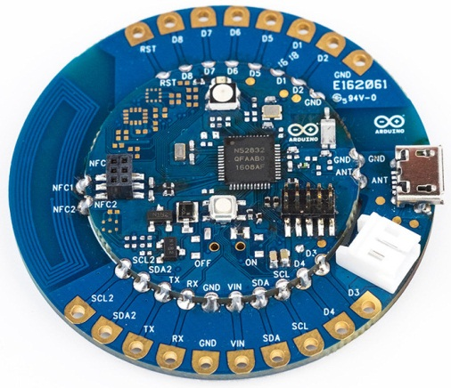
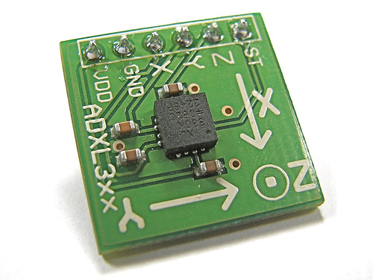
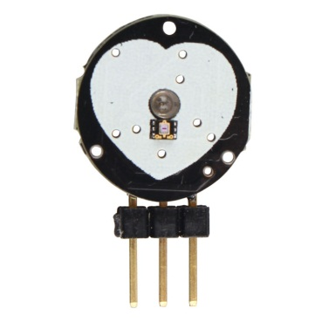
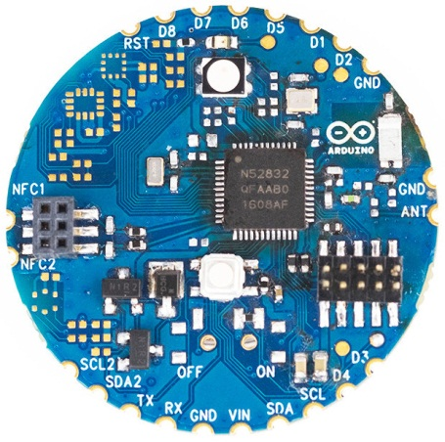
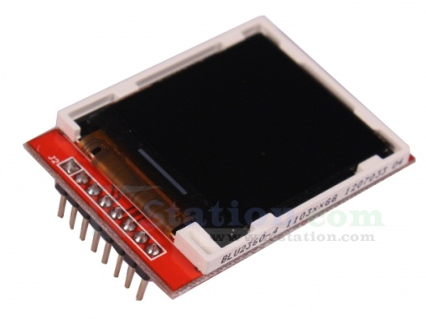
Finding best fit Hardware
Currently Using
Best Fit Found

Slide 5
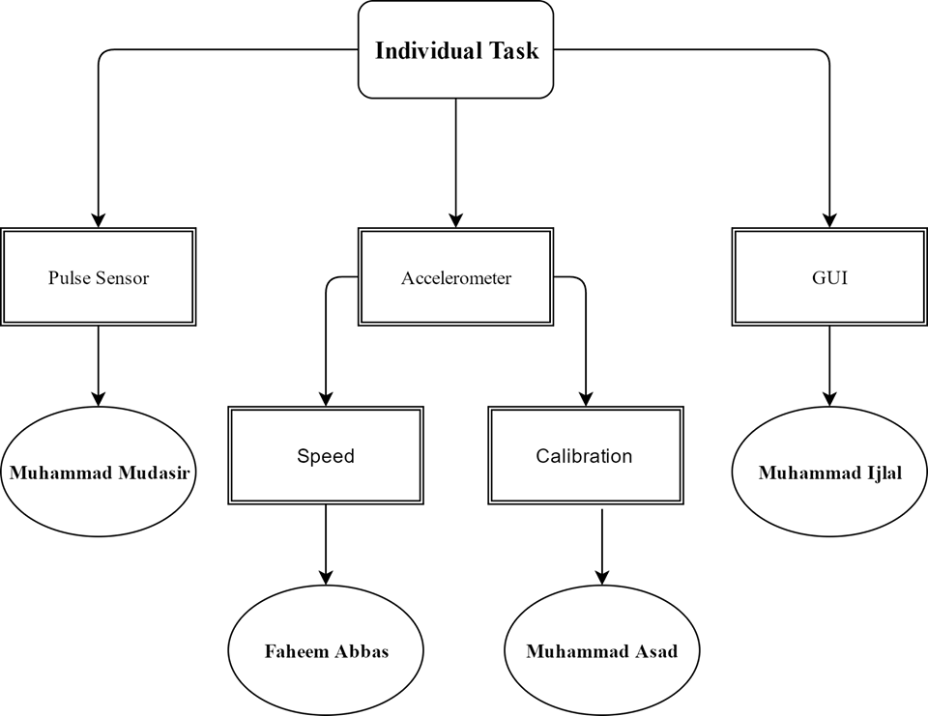
Task Breakdown Structure

Slide 6
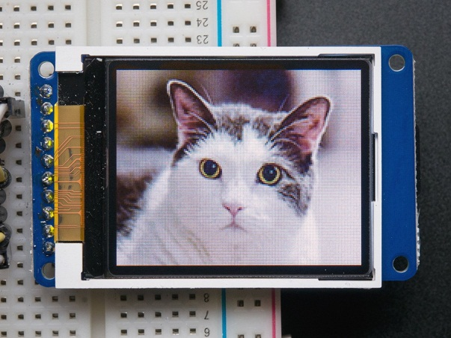
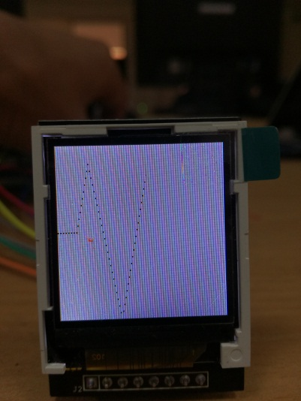
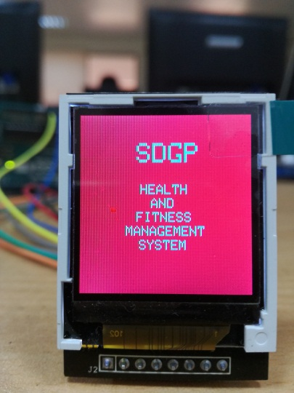
Gadget Graphical Display
Full color TFT display
1.44 inch in size
128 x 128 pixels
SPI communication
Adruino Libraries
SPI.h
Adafruit GFX.h
Adafruit ST7735.h

Slide 7
Problems and Solutions
Unavailiabitly Of Desired Components
Use of alternative components
Problem in connecting Arduino Nano
Read internet blogs and downloaded libraries
Huge library size of Graphical Display
Trying to optimize the library to required use only.

Slide 8
What’s Next
Completing the whole layout of display
Optimize the graphical library as far as possible
Generating Reports from the data stored in SD card.
Designing a platform to display reports and graphs.

Slide 9


