Slide 1
System Design Group Project (SDGP)
Health and Fitness Monitoring System
Group#2
Muhammad Mudasir
Muhammad Asad
Faheem Abbas Shah
Muhammad Ijlal

Slide 2
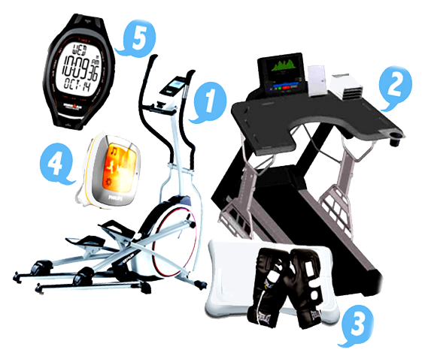
Impotence of Health And Fitness
Monitoring Systems
Increased cardio diseases due to inactive life styles.
Variety of products available for adding activity to life style.
Integrating these systems into normal routine to track physical health.

Slide 3
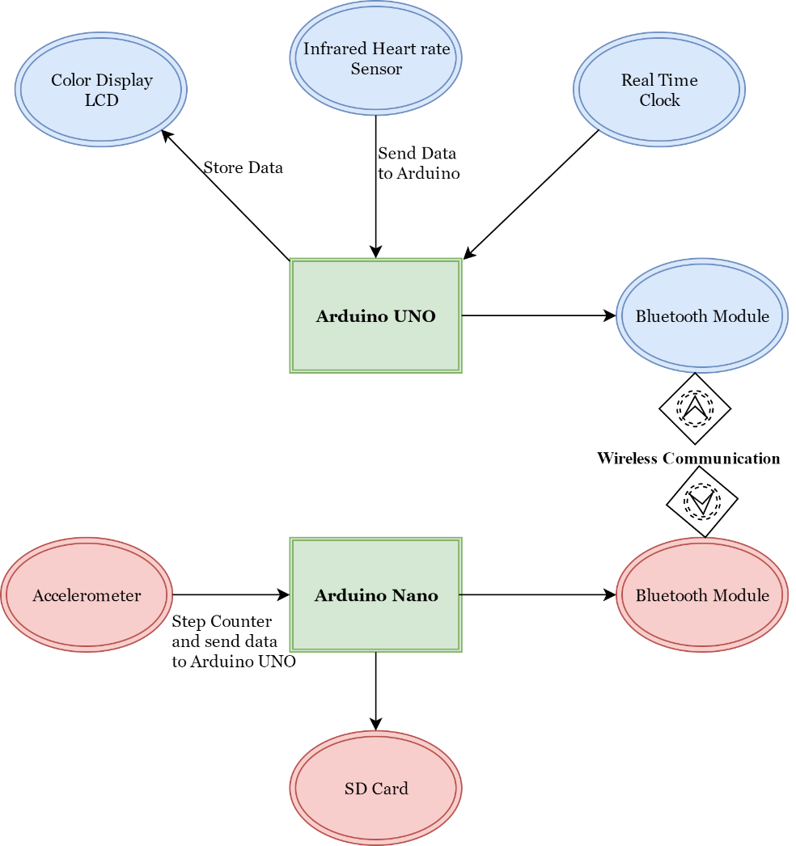
Proposed Solution
Display current time and date
Measuring and displaying heart rate
Displaying the speed and distance
Recording and preparing a graphical report

Slide 4
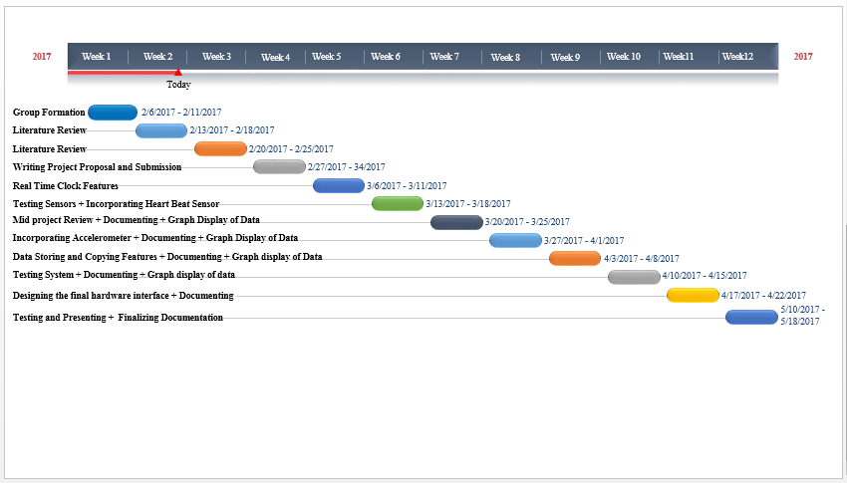
Work Schedule

Slide 5
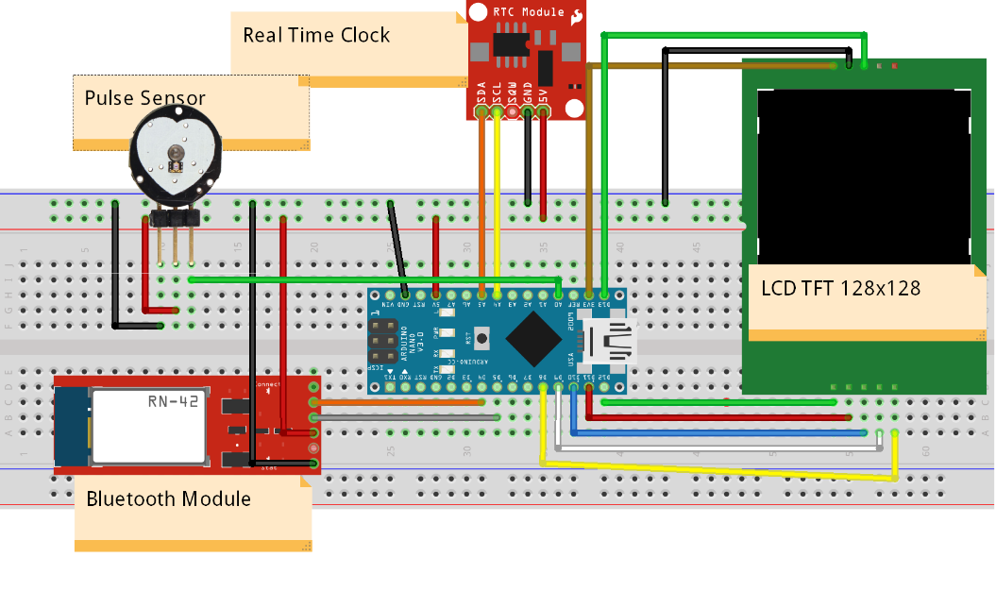
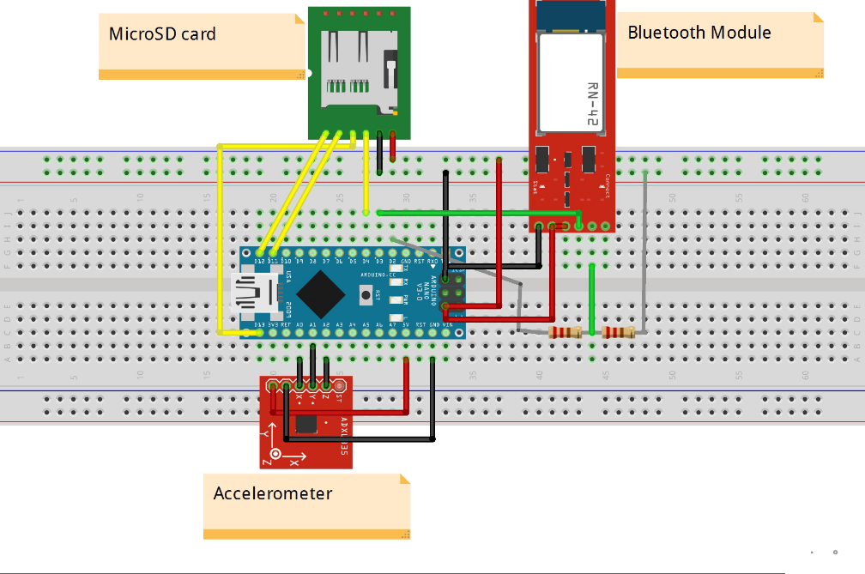
Hardware Description
Arm Mounted Piece
Foot Mounted Piece

Slide 6
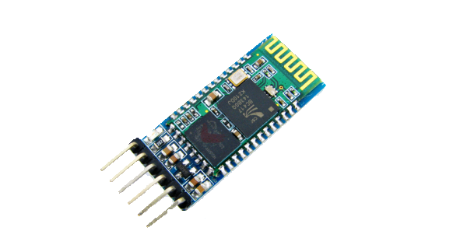
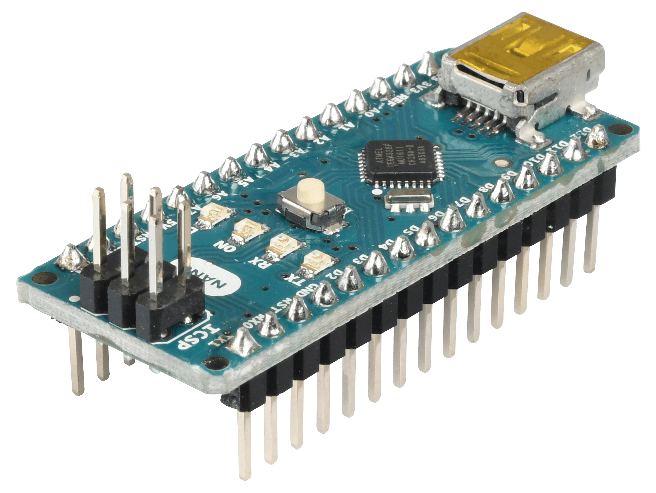
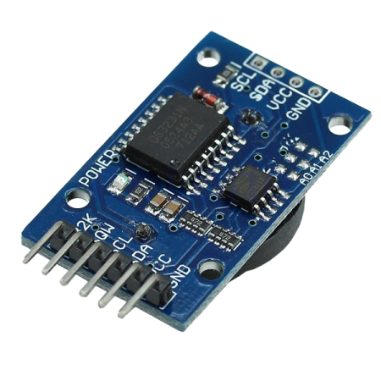
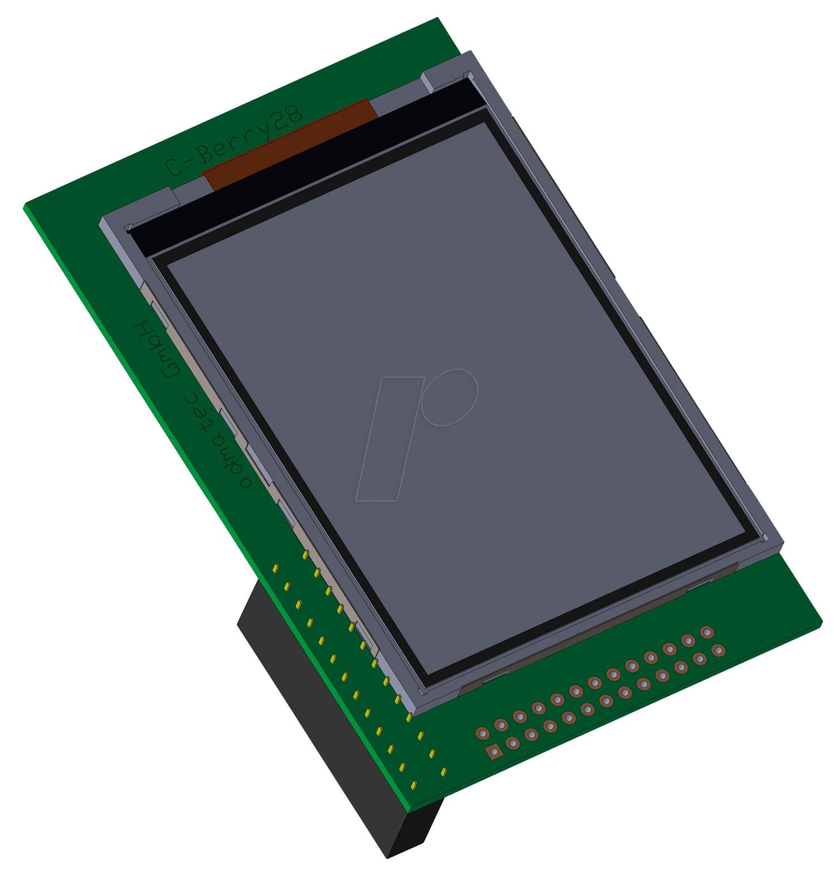
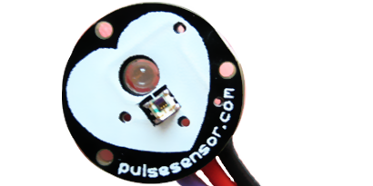
Arm Mounted Piece
Arduino nano
Bluetooth Module
RTC
Pulse Sensor(SEN11574)
TFT LCD 128x128

Slide 7
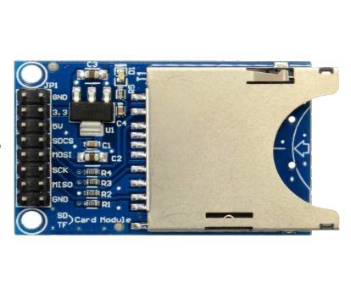
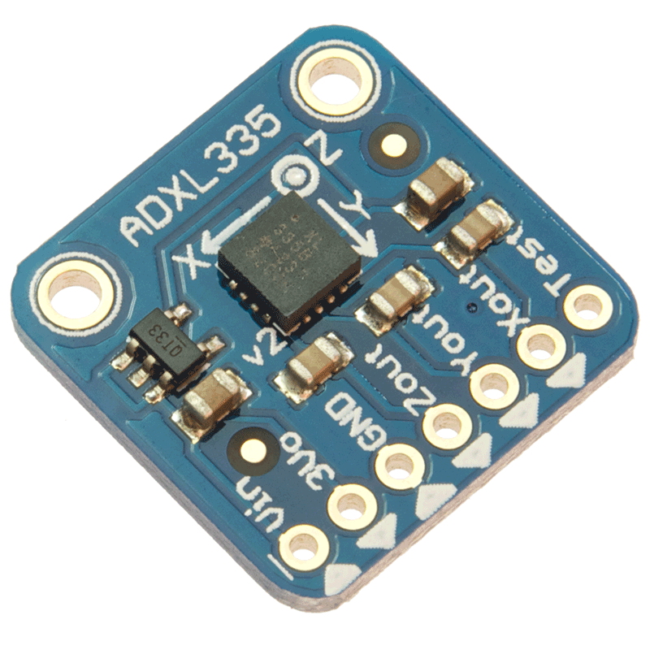
Foot Mounted Piece
Arduino nano
Bluetooth Module
SD_Card
Accelerometer

Slide 8
Software Description
Use of Interrupts
Peak Detection
Bitmap In program Memory
Integration (∫)
Scaling
Spi Communication
Software Serial Communication
I2c communication

Slide 9
Software Description
Pulse Sensor (SEN11574)
peak_detection()
{
loop(100 times)
{
if(present value is less than next value)
{
if(next value is greater than 2nd next value)
{
peak values array=next value
increase the index of peak values array
}
}
}
}
ThreshHold(size of peak values array)
{
high_peak=1st index of array
loop(size of peak array times)
{
binary search in array to find highest peak
}
thresh=98% of high_peak
}

Slide 10
Software Description
Pulse Sensor (SEN11574)
Number of peaks()
{
loop(size of peak array times)
{
if(index of array is greater than threshhold)
{
variable ++;
}
}
}
Beats over 10secs()
{
loop(5 times)
{
recall function of (number of peaks)
add all peaks
}
}

Slide 11
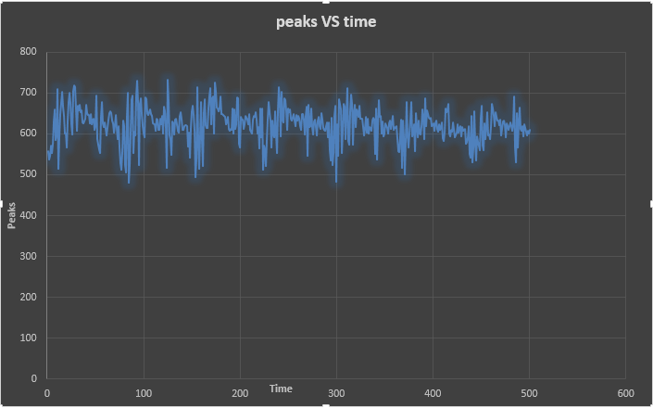
Pulse sensor output

Slide 12
Software Description
Accelerometer (ADXL335)
void loop()
{
x=Read value of x-axis of accelerometer
y=Read value of y-axis of accelerometer
z=Read value of z-axis of accelerometer
Below converting from a 0 to 1023 digital range
to 0 to 3.3 volts (each 1 reading equals ~ 3.3 millivolts)
Conversion:
convert all three axise values into voltages (x=3.3*x/1023)
Offset:
Set offsets for all three axises(x1=(x-1.45))
Difference:
calculate the crosponding difference all three axises (x=sq(x2-x1))
Saving:
After that saved the difference of all three axise in a Array A=[]

Slide 13
Software Description
Accelerometer (ADXL335)
if(values of Array ==50)
{
Loop(size of Array)
{
compare the Index values of Array
if (Val1>Val2)
{
findout the Hight through Array (A[size of array]-A[size of array +1])
}
else
{
findout the Hight through Array (A[size of array +1]-A[size of array])
}
Area of triangle =(0.02*h)/2
Area of Reactagle=(A[size of array]*0.02
Required Value=Required Value+(Area of Reactagle- Area of triangle)
}
}
Speed=Required Value in m/s
Calculate Speed in Km/h S_km = Speed*3600/1000;
Calculate Speed in Miles/h = S_km*0.62miles
}

Slide 14
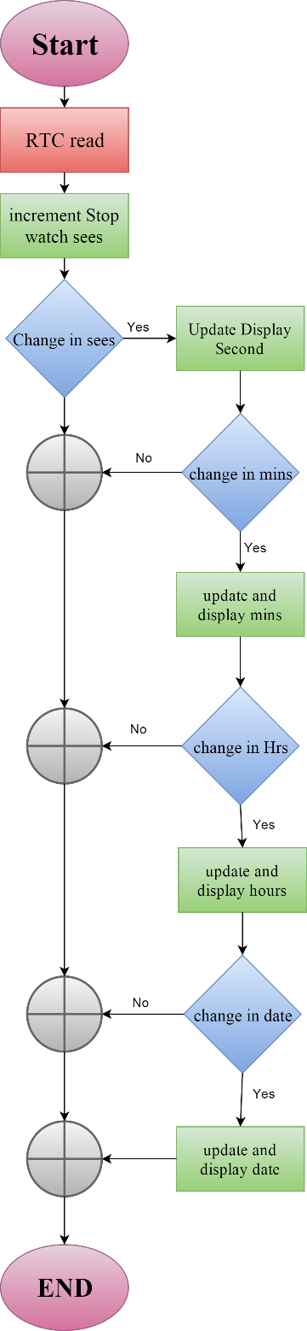
Software Description
Interrupts

Slide 15
?

