Slide 1
Aircraft Family Recognition Using Deep Learning and Grad-CAM
Deep Learning semester project | Muhammad Ishtiaq Haider
79.96%
94.06%
70
test top-1
test top-5
aircraft families
aircraft-family-gradcam.vercel.app

Slide 2
Problem and dataset
Task: name the aircraft family in a photo (70 classes)
Fine-grained: many families look alike, so small details decide the answer
Second question: does the model look at the aircraft or at the background?
Goal: accurate, honestly evaluated, explainable and deployed
Dataset: FGVC-Aircraft
Secondary, public benchmark (Oxford VGG, 2013)
Family-level labels: 70 classes
Official split: 3,334 train / 3,333 val / 3,333 test
20 px copyright banner cropped off
Resized to 224 x 224, ImageNet normalisation
Non-commercial research use
Aircraft Family Recognition Using Deep Learning and Grad-CAM

Slide 3
Method: transfer learning
MobileNetV2
ResNet18
EfficientNet-B0
2.31 M parameters
11.21 M parameters
4.10 M parameters
Depthwise convolutions, very light
Residual connections
Balanced depth, width, resolution
All start from ImageNet weights; every layer is fine-tuned
AdamW (max lr 5e-4), OneCycle schedule, label smoothing 0.1, 20 epochs, batch 64, seed 42
Augmentation: random resized crop, horizontal flip, light colour jitter
Fair protocol: model chosen on validation accuracy, test set evaluated once
Aircraft Family Recognition Using Deep Learning and Grad-CAM

Slide 4
Results on the test set
EfficientNet-B0 selected
79.96% top-1, 94.06% top-5, 78.21% macro F1
95% interval for top-1: 78.6% to 81.3%
Validation 78.64% vs test 79.96%: no selection overfitting
Lead over ResNet18 (2.9 pts) beats the noise; over MobileNetV2 (1.9 pts) is suggestive, one run each
Aircraft Family Recognition Using Deep Learning and Grad-CAM

Slide 5
Where the model goes wrong
True family | Predicted as | Count
C-47 | DC-3 | 16
Boeing 777 | Boeing 767 | 11
A320 | A330 | 9
MD-90 | MD-80 | 7
MD-80 | MD-90 | 7
MD-11 | DC-10 | 7
Errors are between close relatives
C-47 is the military DC-3, so that confusion is mostly a labelling ambiguity
777/767, MD-80/MD-90 and MD-11/DC-10 share a maker and similar layouts
Training flattens by about epoch 15 for all three models
Aircraft Family Recognition Using Deep Learning and Grad-CAM

Slide 6
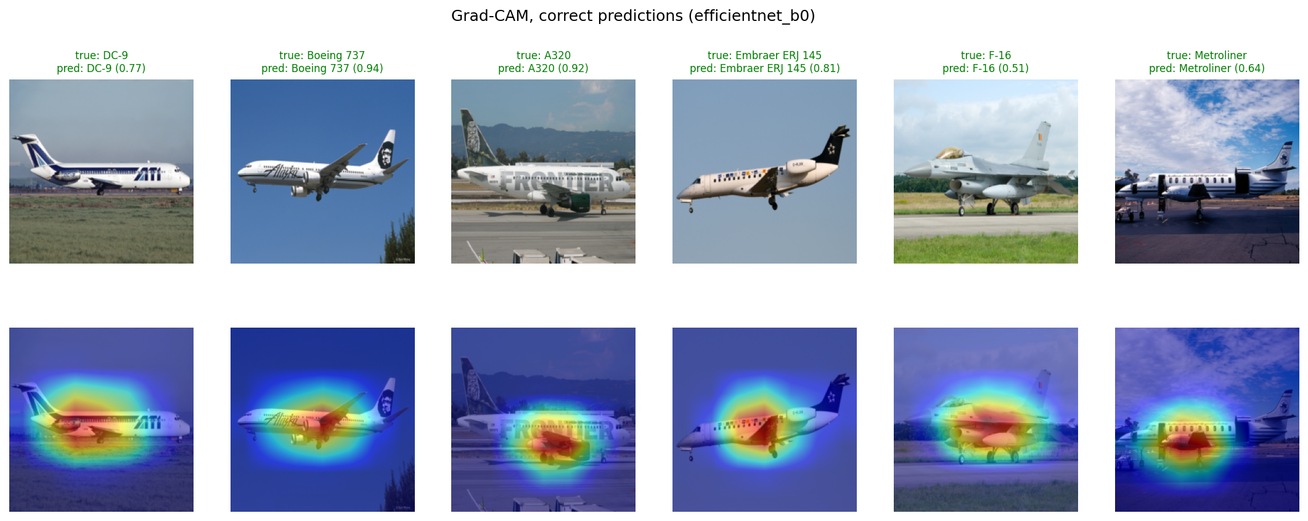
Explaining predictions with Grad-CAM
Heat sits on the aircraft body (fuselage, wings, engines), not on sky or ground; maps are coarse (7 x 7)
Deletion test, 300 images: hiding the most important 25% cuts true-class probability by 0.738, the least important 25% by only 0.007 (300 of 300 images)
Aircraft Family Recognition Using Deep Learning and Grad-CAM

Slide 7
Demo, limitations and conclusion
Deployed
Limitations
ONNX model runs in the browser, no server
Public repo: code, weights, results, notebook
aircraft-family-gradcam.vercel.app
One run, one seed
No systematic test on outside photos
No 'not an aircraft' option
224 x 224 squash loses fine detail
EfficientNet-B0 reaches 79.96% top-1 and 94.06% top-5. Errors are close look-alikes, and Grad-CAM with a deletion test supports that the model looks at the aircraft.
Aircraft Family Recognition Using Deep Learning and Grad-CAM

