Slide 1
Linux Command
Muhammad Waseem

Slide 2
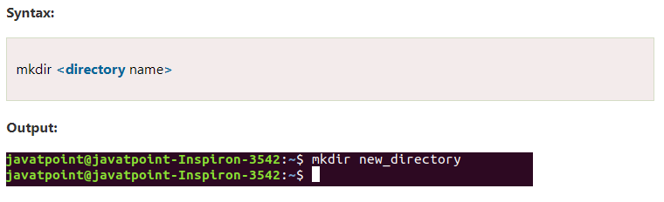
Linux Directory Commands
mkdir Command
The mkdir command is used to create a new directory under any directory.

Slide 3
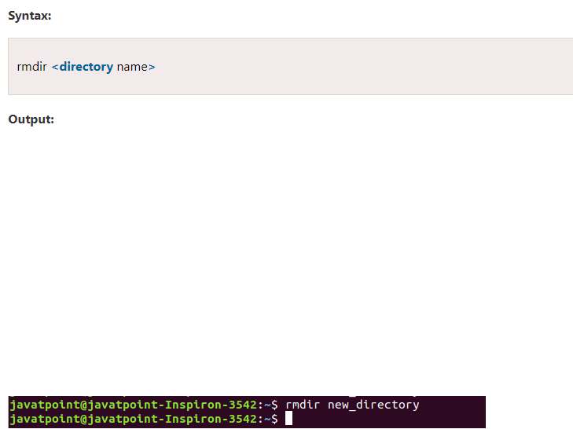
Linux Directory Commands
rmdir Command
The rmdir command is used to delete a directory.

Slide 4

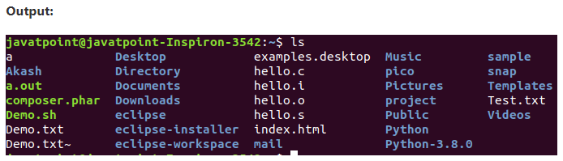
Linux Directory Commands
ls Command
The ls command is used to display a list of content of a directory.
Syntax

Slide 5
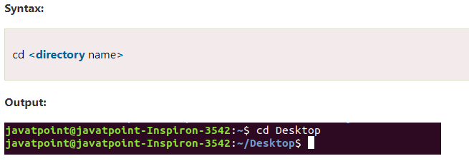
Linux Directory Commands
cd Command
The cd command is used to change the current directory.

Slide 6
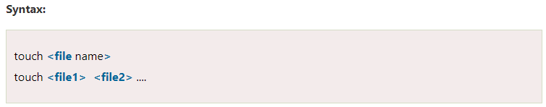
Linux Directory Commands
touch Command
The touch command is used to create empty files. We can create multiple empty files by executing it once.

Slide 7
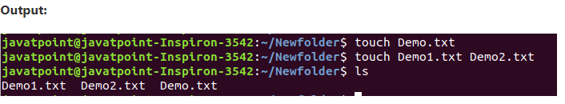
Linux Directory Commands

Slide 8
Linux Directory Commands
cat Command
The cat command is a multi-purpose utility in the Linux system. It can be used to create a file, display content of the file, copy the content of one file to another file, and more.

Slide 9
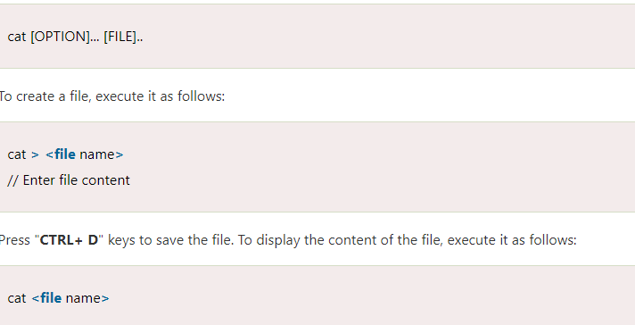
Linux Directory Commands
Syntax

Slide 10
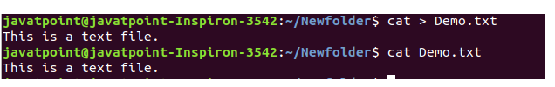
Linux Directory Commands
output

Slide 11
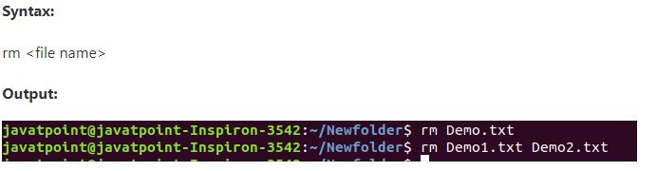
Linux Directory Commands
rm Command
The rm command is used to remove a file.

Slide 12
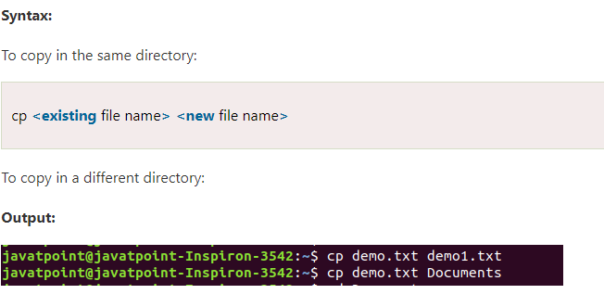
Linux Directory Commands
cp Command
The cp command is used to copy a file or directory.

Slide 13
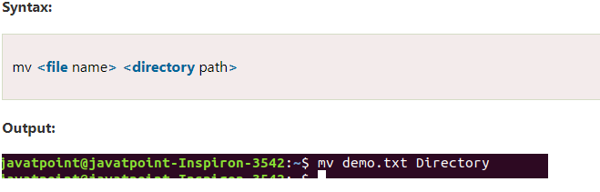
Linux Directory Commands
mv Command
The mv command is used to move a file or a directory form one location to another location.

Slide 14
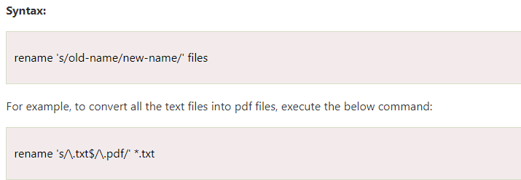
Linux Directory Commands
rename Command
The rename command is used to rename files. It is useful for renaming a large group of files.

Slide 15
Linux Directory Commands
head Command
The head command is used to display the content of a file. It displays the first 10 lines of a file.

Slide 16
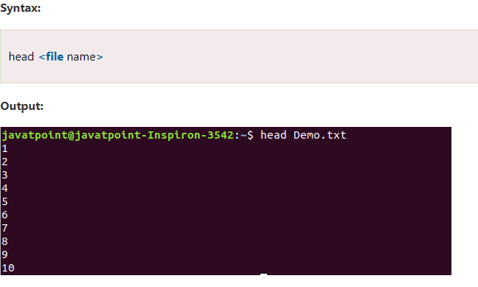
Linux Directory Commands

Slide 17
Linux Directory Commands
tail Command
The tail command is similar to the head command. The difference between both commands is that it displays the last ten lines of the file content. It is useful for reading the error message.

Slide 18
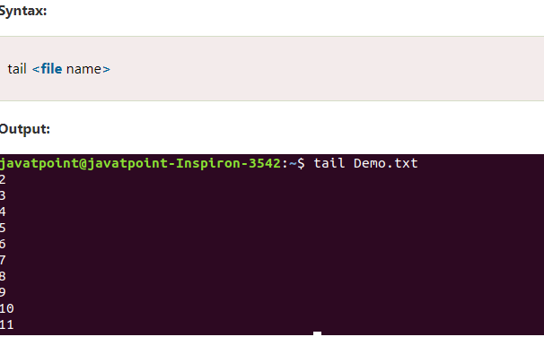
Linux Directory Commands

Slide 19
Linux Directory Commands
tac Command
The tac command is the reverse of cat command, as its name specified. It displays the file content in reverse order (from the last line).

Slide 20
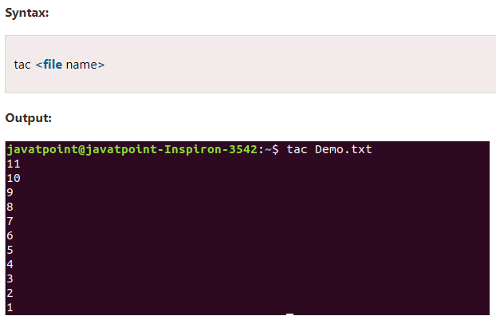
Linux Directory Commands

Slide 21
Linux Directory Commands
ore command
The more command is quite similar to the cat command, as it is used to display the file content in the same way that the cat command does. The only difference between both commands is that, in case of larger files, the more command displays screenful output at a time.
In more command, the following keys are used to scroll the page:

Slide 22
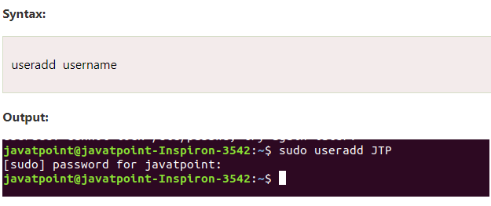
Linux Directory Commands
useradd Command
The useradd command is used to add or remove a user on a Linux server.

Slide 23
Linux Directory Commands

Slide 24
Linux Directory Commands
passwd Command
The passwd command is used to create and change the password for a user.

Slide 25
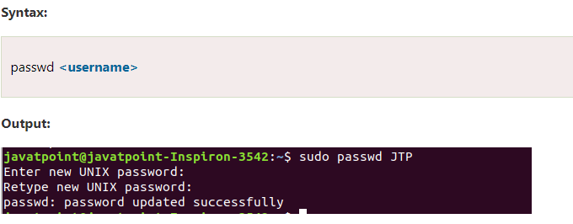
Linux Directory Commands

