Slide 1

TakeMyPhoto
Improving photography through camera & poses

Slide 2
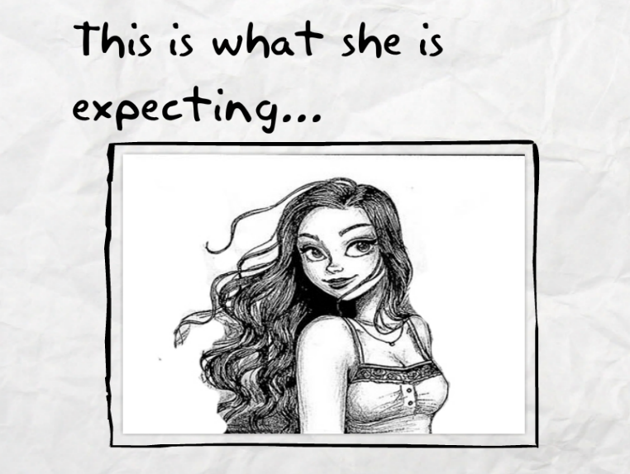
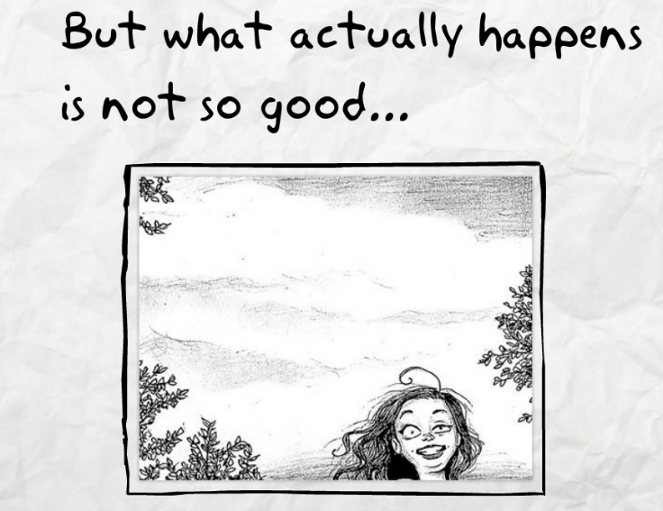
Problem
We believe that taking a photograph can be a bit challenging and intimidating for a common user
A layman is unaware about the size, angle & style of photograph
An example of a girl asking her friend to take her picture

Slide 3
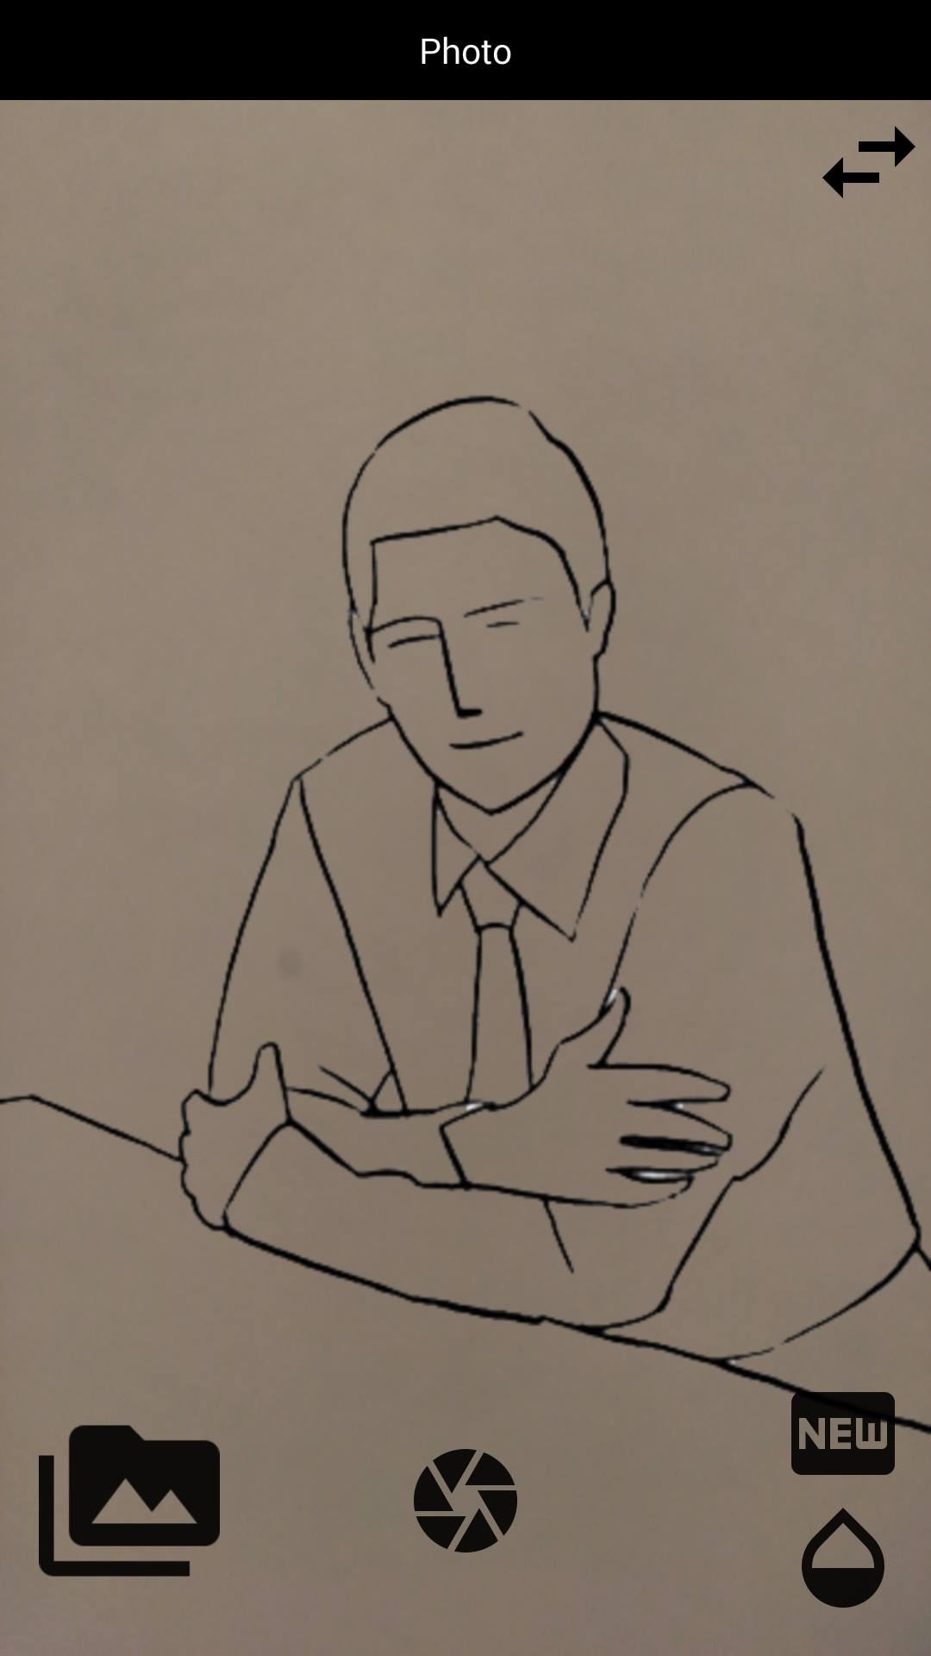
Solution
To solve the mentioned problem, we have created “TakeMyPhoto”
It is a camera app that will help you in capturing best possible photographs, with the help of sketch poses taken by professional photographers

Slide 4
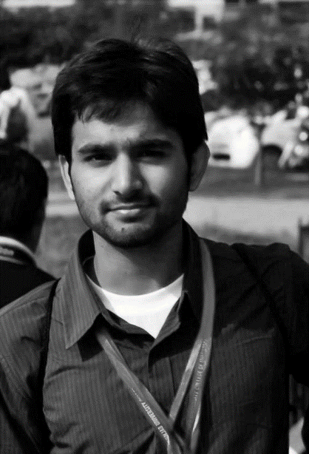
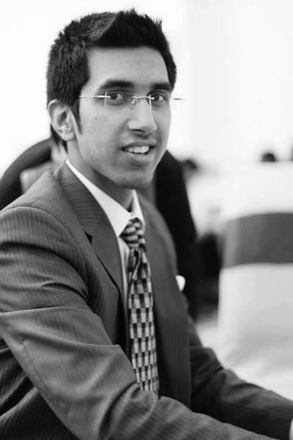
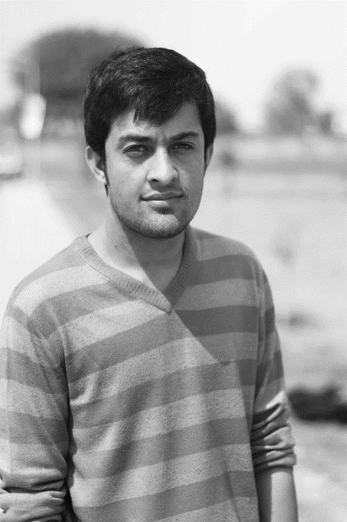
The Team
All of us are from software engineering background with over an year of experience on Android Development
Saim Mehmood
Marketing Head
Mehdi Raza
Designer
Ali Husnain
Developer

Slide 5
Market Segmentation
2 billion smartphone users in the world
The age group between 18-35 uses camera app 42.3 %
The age group above 35+ uses camera app 57.7%
http://www.realitymine.com/does-your-age-impact-how-you-use-your-mobile-device/

Slide 6
The famous apps like Retrica, Candy Camera & selfie apps like B612 has over 100 million+ downloads
Our very first users will be selfie and photography enthusiast young people
Photography
TakeMyPhoto
Boring
Fun
B612
Retrica, Candy Camera
Editing

Slide 7
Go to market strategy
We will search for potential competitors and look for their market. If they have a market, then we’ll have a better chance at monetizing our app
Our successful competitors will get us a prebuilt market if we develop something slightly better than them
Ambassadorship programs will help us to get our app delivered to university and college students

Slide 8
Investment
We would be requiring an investment of almost Rs.900,000 for product launch to be consumed in six months
We have to hire a professional designer and marketing person
External expenses would include working space and purchase of technology devices for team members
After six months we need another Rs.300,000 for marketing and growth

Slide 9
Financial Summary
To generate money, we will use Freemium model for global users of our app
For the first year we will be generating roughly Rs.50,000 from our global user subscriptions
From local users we want to gain maximum user base without any business model
As soon as our downloads increase above 30 to 40 thousand, we will try to make a contract with a local smartphone company
At the end of the day, we wish to make our app as a default app of local smartphones i.e. QMobile & G’Five etc.
Under the contract, monetization will be done on app installation per phone basis

Slide 10
Competition
Our potential competitors are the already existing apps on the play store which provides photo poses
Apps like Photo Poses and Posing App are among our contestants
What differentiates us is the ability to use poses as sketches inside our camera app
And the ability of our app to give automatic pose suggestion as the person appears within camera

