Slide 1

OOP PROJECT
Chess with login and registration system

Slide 2

Login and Registration system
The main idea is to allow a user to make an account to play the game.
It will save the data of the user. How many games he has played, how many wins and losses and the rank.
It will also save the total history with time.

Slide 3
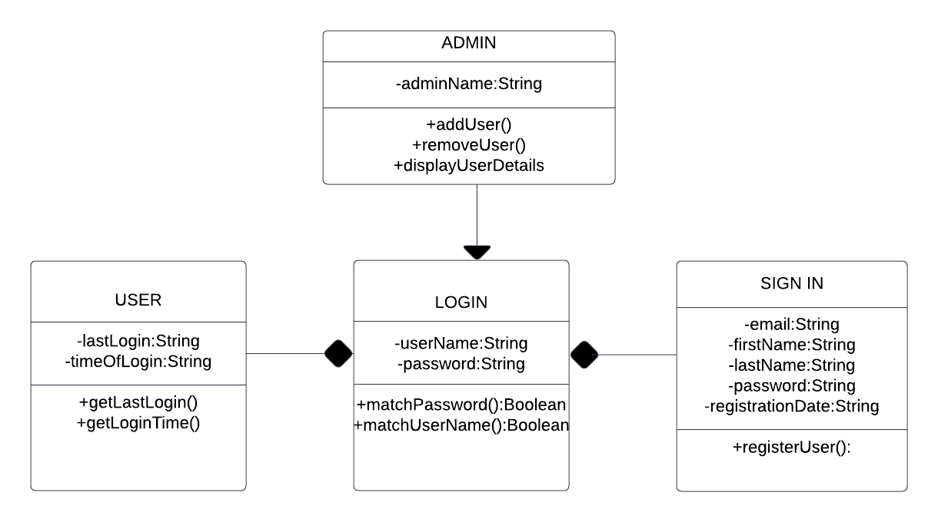

Login and registration system UML

Slide 4
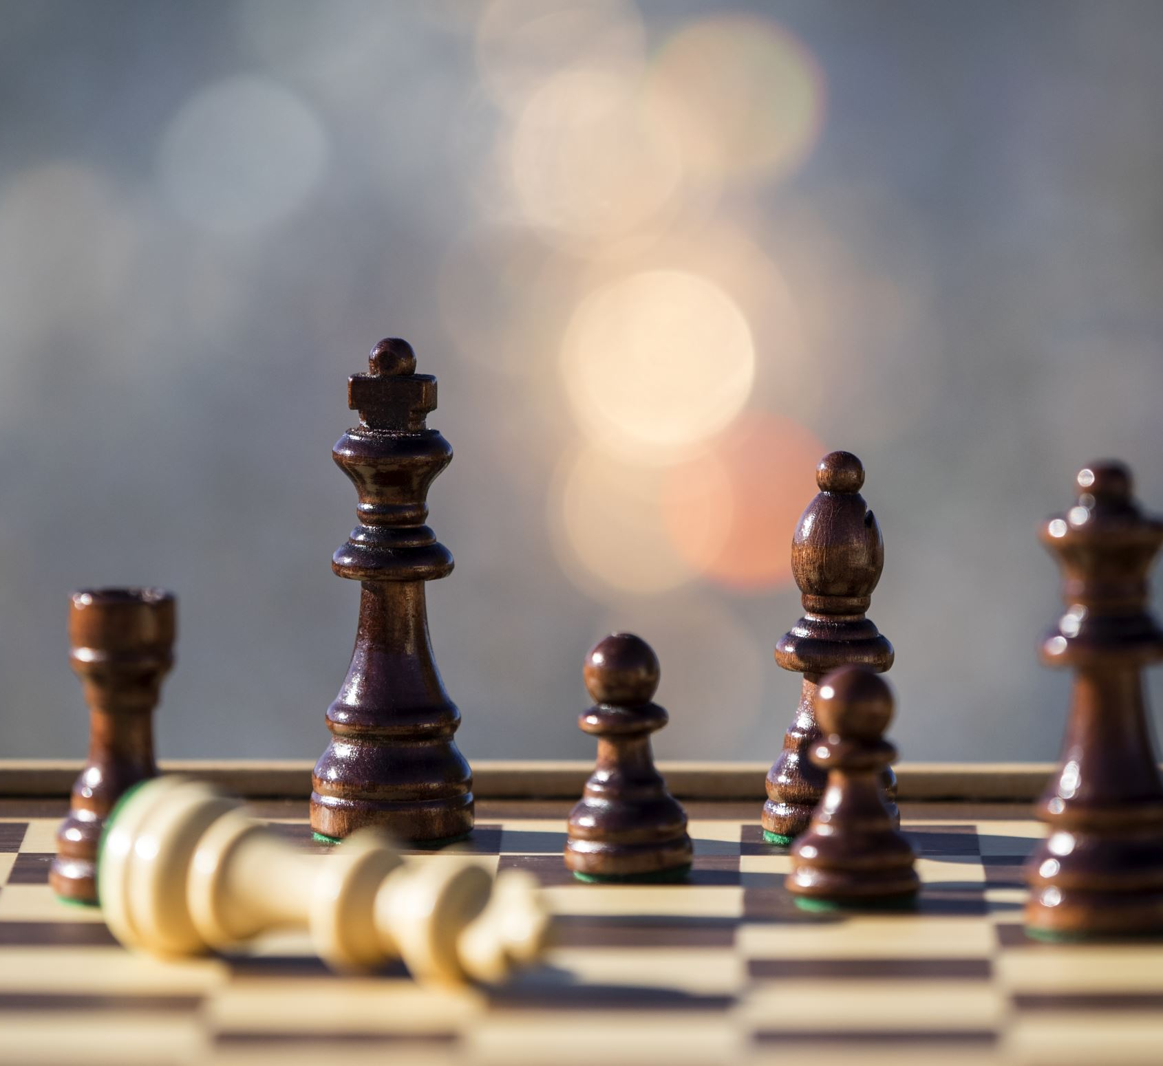
Chess
This will be a game that is played between two players.
The players will choose to play either as guest or login with an account. And there will be an option to continue a previous game
Players will be assigned either black or white and the game will proceed as regular

Slide 5
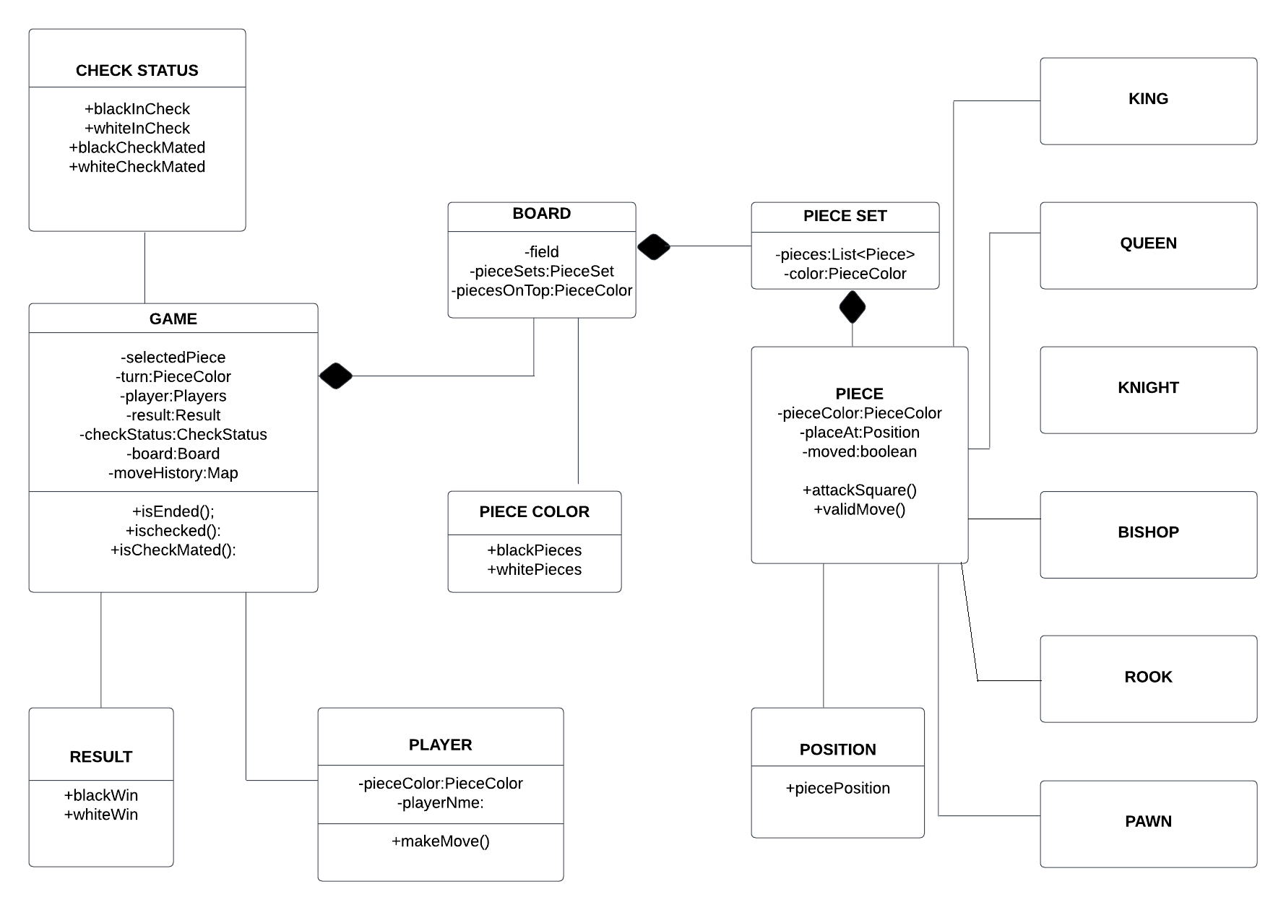


Chess UML

