Slide 1
Amazon Web Service Cloud Architecture

Slide 2
Section Title

Slide 3
Introduction & Solution
Amazon Web Services (AWS) is the world’s most comprehensive and broadly adopted cloud, offering over 200 fully featured services from data centers globally. Millions of customers—including the fastest-growing startups, largest enterprises, and leading government agencies—are using AWS to lower costs, become more agile, and innovate faster
AWS Solution
Amazon Web Services offers purpose-built services, ready-to-deploy software packages, and customizable architectures with instructional information to rapidly solve business challenges. Solutions are built by AWS and AWS Partners to address specific industry, cross-industry, and technology use cases.
.

Slide 4
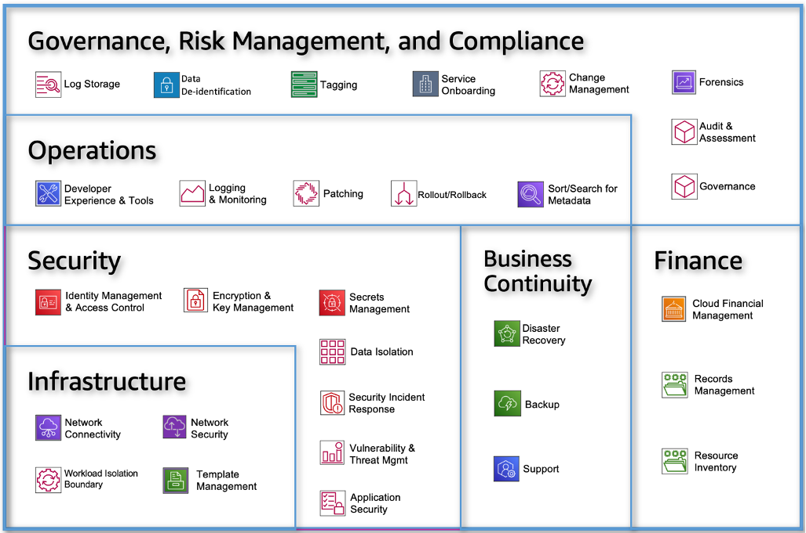
Introduction & Solution
AWS 30 Capabilities across 6 categories

Slide 5
AWS Regions and Availability Zones
The AWS Cloud spans 99 Availability Zones within 31 geographic regions around the world, with announced plans for 15 more Availability Zones and 5 more AWS Regions in Canada, Israel, Malaysia, New Zealand, and Thailand.
AWS Global Infrastructure
The AWS Global Cloud Infrastructure is the most secure, extensive, and reliable cloud platform, offering over 200 fully featured services from data centers globally. Whether you need to deploy your application workloads across the globe in a single click, or you want to build and deploy specific applications closer to your end-users with single-digit millisecond latency, AWS provides you the cloud infrastructure where and when you need it.

Slide 6
Getting Started AWS
To get started with AWS:
1. Learn best practices to set up your account and environment »
Create a new AWS account
Secure the root user
Create an IAM user to use in the account
Set up the AWS CLI
Set up an AWS Cloud9 environment
3. Learn to control your AWS costs »
2.. Get to know the AWS Management Console »
The AWS Management Console is a web application that comprises a broad collection of service consoles for managing AWS resources. When you first sign in, you see the Console Home page. The home page provides access to each service console and offers a single place to access the information you need to perform your AWS related tasks. You can also customize the Console Home page by adding, removing, and rearranging widgets, such as recently visited, AWS Health, Trusted Advisor, and more.

Slide 7








AWS Products Offering
AWS Compute
AWS Storage
AWS Analytics
AWS Database
AWS Networking and Content Delivery
AWS Compute

Slide 8
AWS Storage-Files,Objects,BLock Storage
Simple Storage Service (S3)
Elastic File System (EPS)
Elastic Block Store (EBS)
Amazon File Cache
Amazon FSX
Manage File Transfer
Transfer Files Family
AWS Data Migration
AWS DataSyncs
AWS Snow Family
Hybrid Cloud storage and Edge Computing
AWS Storage Gateway
AWS Snow Family
DR &Backup
AWS Elastic Disaster Recovery
AWS Backup

