Slide 1
Cloud Computing
Sir Syed University Of Engg & Technology
By Ahsan Farooqui

Slide 2
Course/Domains Road Map
Cloud Computing Concepts and Architecture
Governing in the Cloud
Governance and Enterprise Risk Management
Legal Issues:Contracts and Electronic Discovery
Compliance and Audit Management
Information Governance
Operating in the Cloud
Management Plane and Business Continuity
Infrastructure Security
Virtualization and Containers
Incident Response
Application Security
Data Security & encryption
Identity, Entitlement and Access Management
Security As Service

Slide 3
How we approach this Course ?
Domains covering with vendor neutral contents
Cloud Strategic Alliance (CSA)
NIST International Standards
ISO/IEC 17788 ISO/IEC17789
LABS and Hands On with Amazon Web Service (AWS)
Applying the learned concepts based on AWS terminologies

Slide 4
Why Cloud Computing Knowledge?
Transformative and Disruptive
Free up Organizations from obsolete IT infrastructure quickly
Provide new opportunities and mindsets
Better Security and Resilience
Knowledge and Certifications
Cloud Consultants
AWS,Google, CSA,Microsoft Azure ,Oracle Cloud,SAP CLoud,Autocad Cloud
Majors Enterprise applications are available in cloud offerings
Building up a better business case for Cloud vs on-premises proposition

Slide 5
Cloud Computing Certifications
Cloud Security Alliance
CCSK Cloud Computing security Knowledge Certificate
CSA & ISACA
Certificate of Cloud Auditing (CCAK)
ISC2 Certified Cloud Security Professional (CCSP) Preparations
CCSP certification has been approved for 3 semester of lower division credit by American Council on Education ACE-Credit
AWS /Google/Microsoft Cloud Certifications Tracks

Slide 6
Cloud Computing Audiences
Entry Level to Senior Level IT security leaders responsible for apply best practices to cloud security architectures
Cloud Architect
Cloud Engineer
Cloud Consultant
Cloud Administrator
Cloud Security analyst
Cloud Specialist
Cloud Auditor
Cloud Professional Developer

Slide 7
CC-Concepts and Architecture
transformative and disruptive.
agility, resiliency, and economy.
Defining cloud computing
The cloud logical model
Cloud conceptual, architectural, and reference model
Cloud security and compliance scope, responsibilities, and models

Slide 8
Defining Cloud Computing
It is a disruptive technology that has the potential to enhance
collaboration,
agility,
scaling, and availability,
as well as providing the opportunities for cost reduction through optimized and efficient computing.
The cloud model envisages a world where components can be rapidly orchestrated, provisioned, implemented and decommissioned, and scaled up or down to provide an on-demand utility-like model of allocation and consumption.
Cloud computing is a new operational model and set of technologies for managing shared pools of computing resources.

Slide 9
Defining Cloud Computing-NIST/ISO/IEC
NIST
Cloud computing is a model for enabling ubiquitous, convenient, on-demand network access to a shared pool of configurable computing resources (e.g., networks, servers, storage, applications, and services) that can be rapidly provisioned and released with minimal management effort or service provider interaction.
ISO/IEC
Paradigm for enabling network access to a scalable and elastic pool of shareable physical or virtual resources with self-service provisioning and administration on-demand.

Slide 10
Defining Cloud Computing-AWS
Cloud computing is the on-demand delivery of IT resources over the Internet with pay-as-you-go pricing. Instead of buying, owning, and maintaining physical data centers and servers, you can access technology services, such as computing power, storage, and databases, on an as-needed basis from a cloud provider like Amazon Web Services (AWS).

Slide 11
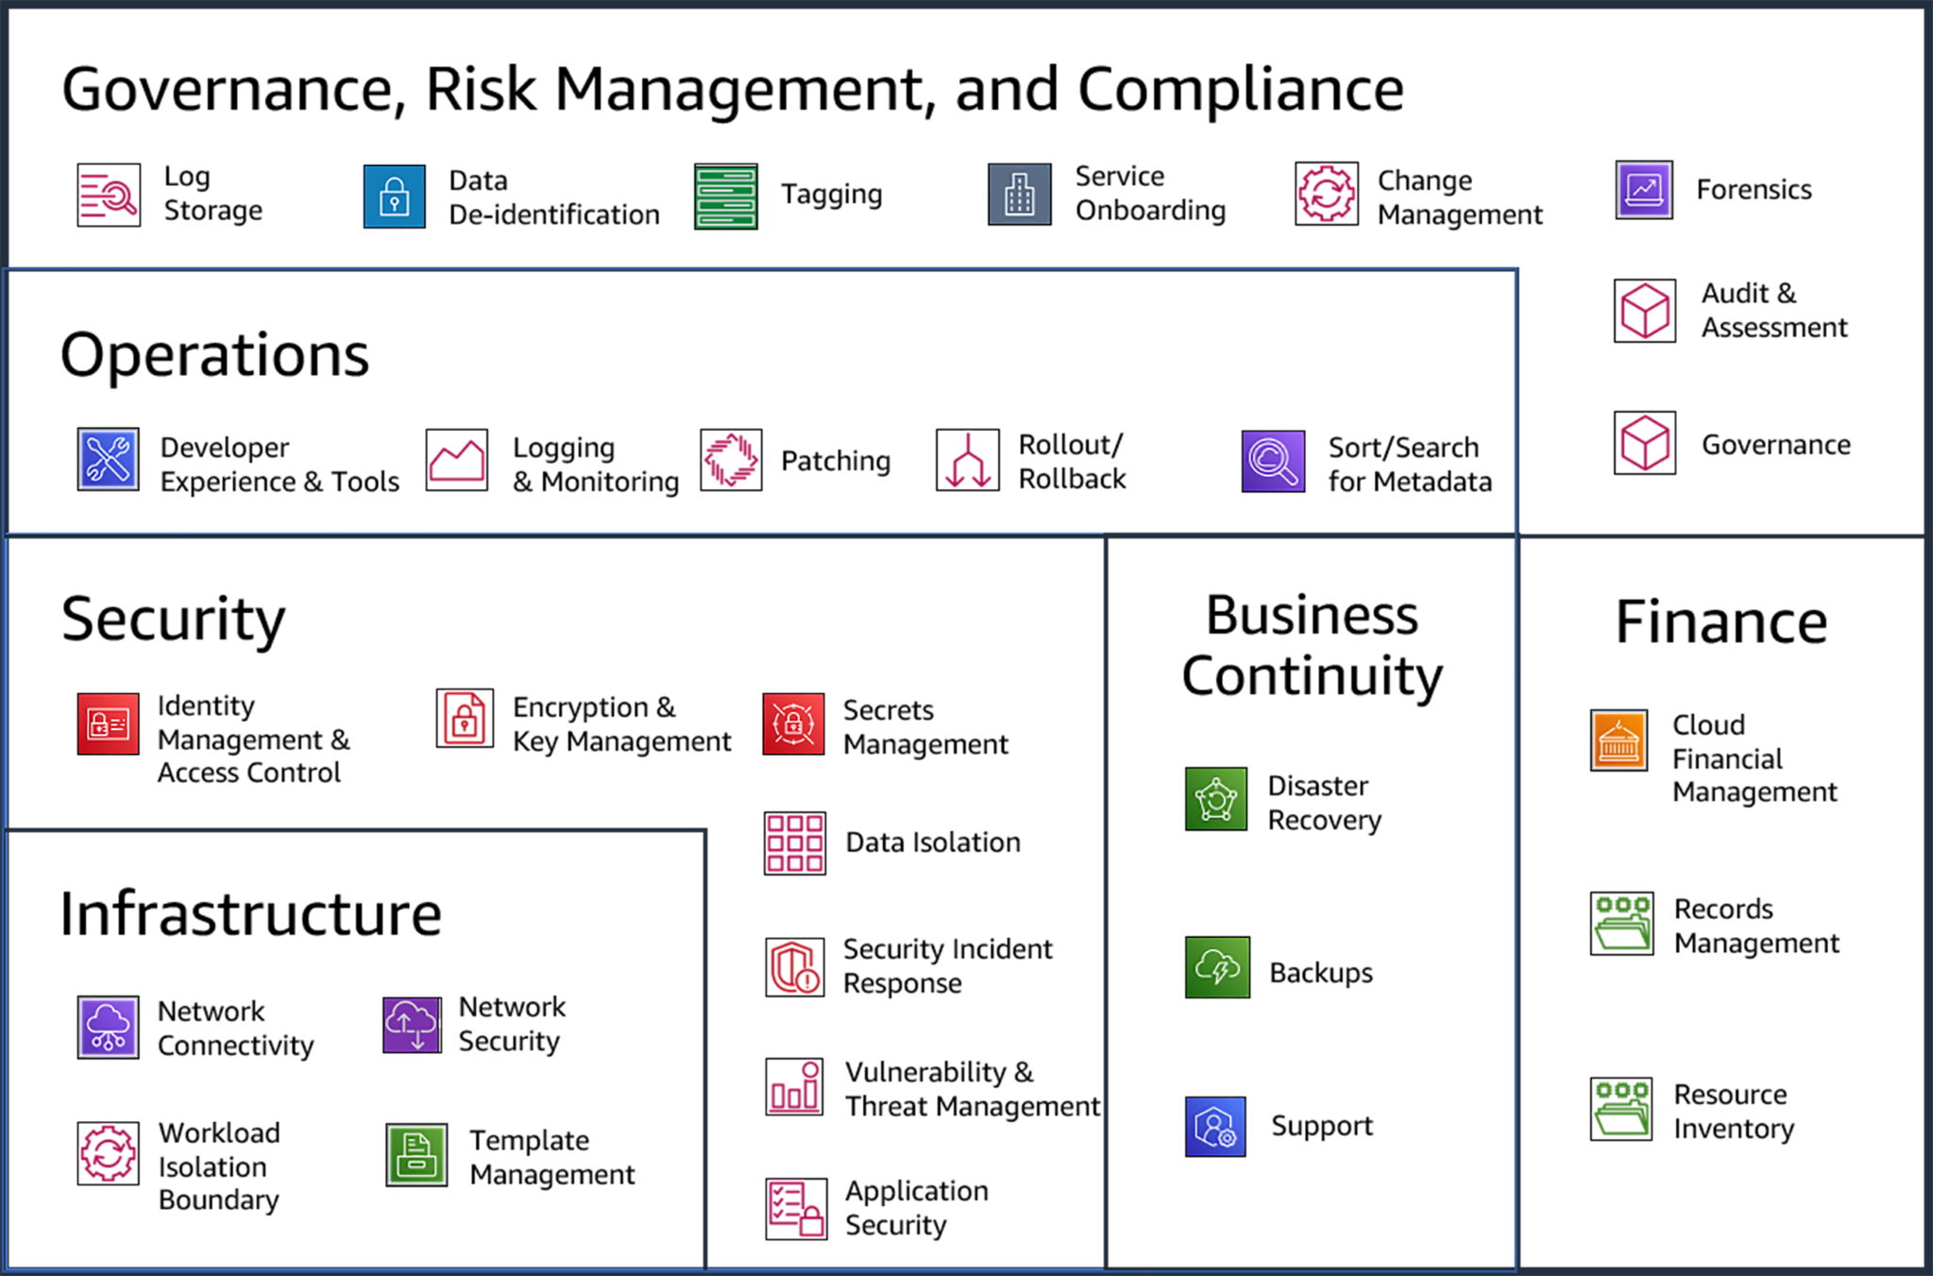
AWS 30 Capabilities and 6 Categories

Slide 12
Who is using it?
Organizations of every type, size, and industry are using the cloud for a wide variety of use cases, such as
data backup, disaster recovery, email,
virtual desktops, software development and testing,
big data analytics, and customer-facing web applications.
Healthcare companies are using the cloud to develop more personalized treatments for patients.
Financial services companies are using the cloud to power real-time fraud detection and prevention. And video game makers are using the cloud to deliver online games to millions of players around the world.

Slide 13
Defining Cloud Computing-Resources
A cloud can consist of nearly any
computing resources processors and memory to networks, storage,
and higher level resources like databases,SDKs and applications.
For example, subscribing to a customer-relations management application for 500 employees on a service shared by hundreds of other organizations is just as much cloud computing as launching 100 remote servers on a compute cloud.

Slide 14
Defining Cloud Computing-Setup
It takes a set of resources, such as processors and memory, and puts them into a big pool (in this case, using virtualization).
Consumers ask for what they need out of the pool, such as 8 CPUs and 16 GB of memory,
and the cloud assigns those resources to the client, who then connects to and uses them over the network.
When the client is done, they can release the resources back into the pool for someone else to use.

Slide 15
Users and Providers
A cloud user /client /Consumer is the person or organization requesting and using the resources, and the
cloud provider /service/Cloud is the person or organization who delivers it.
NIST 500-292 uses the term “cloud actor” and adds roles for cloud brokers, carriers, and auditors. ISO/IEC 17788 uses the terms cloud service customer, cloud service partner, and cloud service provider.

Slide 16
Cloud Computing Creation Techniques
The key techniques to create a cloud are
Abstraction
Orchestration.
We abstract the resources from the underlying physical infrastructure to create our pools, and use orchestration (and automation) to coordinate carving out and delivering a set of resources from the pools to the consumers. As you will see, these two techniques create all the essential characteristics we use to define something as a “cloud.”

Slide 17
Cloud Computing vs Virtualization
virtualization abstracts resources, but it typically lacks the orchestration to pool them together and deliver them to customers on demand, instead relying on manual processes.
Cloud Computing uses Virtualization tools but it have both abstraction and Orchestration

Slide 18
Its Multitenants
Clouds are multitenant by nature.
Multiple different consumer constituencies share the same pool of resources but are segregated and isolated from each other.
Segregation allows the cloud provider to divvy up resources to the different groups
Isolation ensures they can’t see or modify eachother’s assets. Multitenancy doesn’t only apply across different organizations; it’s also used to divvy up resources between different units in a single business or organization.

Slide 19
Cloud Definitional Model
NIST defines cloud computing by describing
five essential characteristics
three cloud service models, and
four cloud deployment models.
As shown in the diagram below

Slide 20
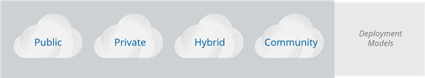
 |  |  | Essential Characteristics
SaaS Software as service | PaaS Platform as service | IaaS Infrastructure as service | Service Models
Broad Access
Rapid Elasticity
Measured Service
On Demand Service
Resource Pooling

Slide 21
NIST Essential Characteristics
Resource pooling is the most fundamental characteristic, as discussed above. The provider
abstracts resources and collects them into a pool, portions of which can be allocated to different consumers (typically based on policies).
Consumers provision the resources from the pool using on-demand self-service. They manage their resources themselves, without having to talk to a human administrator.
Broad network access means that all resources are available over a network, without any need for direct physical access; the network is not necessarily part of the service.
Rapid elasticity allows consumers to expand or contract the resources they use from the pool (provisioning and deprovisioning), often completely automatically. This allows them to more closely match resource consumption with demand (for example, adding virtual servers as demand increases, then shutting them down when demand drops).
Measured service meters what is provided, to ensure that consumers only use what they are allotted, and, if necessary, to charge them for it. This is where the term utility computing comes from, since computing resources can now be consumed like water and electricity, with the client only paying for what they use.
ISO/IEC 17788 lists six key characteristics, the first five of which are identical to the NIST characteristics. The only addition is multitenancy, which is distinct from resource pooling.

Slide 22
NIST Service Model
NIST defines three service models which describe the different foundational categories of cloud services:
Software as a Service (SaaS) is a full application that’s managed and hosted by the provider. Consumers access it with a web browser, mobile app, or a lightweight client app.
Platform as a Service (PaaS) abstracts and provides development or application platforms, such as databases, application platforms (e.g. a place to run Python, PHP, or other code), file storage and collaboration, or even proprietary application processing (such as machine learning, big data processing, or direct Application Programming Interfaces (API) access to features of a full SaaS application). The key differentiator is that, with PaaS, you don’t manage the underlying servers, networks, or other infrastructure.
Infrastructure as a Service (IaaS) offers access to a resource pool of fundamental computing infrastructure, such as compute, network, or storage.
ISO/IEC uses a more complex definition with a cloud capabilities type that maps closely to the SPI tiers (application, infrastructure, and platform capability types). It then expands into cloud service categories that are more granular, such as Compute as a Service, Data Storage as a Service, and then even includes IaaS/PaaS/SaaS.

Slide 23
Cloud Deployments Model
Both NIST and ISO/IEC use the same four cloud deployment models. These are how the technologies are deployed and consumed, and they apply across the entire range of service models:
Public Cloud. The cloud infrastructure is made available to the general public or a large industry group and is owned by an organization selling cloud services.
Private Cloud. The cloud infrastructure is operated solely for a single organization. It may be managed by the organization or by a third party and may be located on-premises or off-premises.
Community Cloud. The cloud infrastructure is shared by several organizations and supports a specific community that has shared concerns (e.g. mission, security requirements, policy, or compliance considerations). It may be managed by the organizations or by a third party and may be located on-premises or off-premises.
Hybrid Cloud. The cloud infrastructure is a composition of two or more clouds (private, community, or public) that remain unique entities but are bound together by standardized or proprietary technology that enables data and application portability (e.g., cloud bursting for load balancing between clouds). Hybrid is also commonly used to describe a non-cloud data center bridged directly to a cloud provider.

Slide 24
Deployment Models and Ownership Chart
 | Infrastructure Managed by | Infrastructure Owned by | Infrastructure Location | Accessible and Consumed by
Public | 3rd party provider | 3rd party provider | Off-Premises | Untrusted
Private/Community | Organization/3rd party | Organization/3rd Party | on-Premises/Off Premises | Trusted
Hybrid | Both Organization &3rd Party | Both Organization &3rd Party | Both On-Premises &Off-Premises | Both Trusted &Untrusted

Slide 25
Reference and Architectural Model
Cloud computing is as a stack where Software as a Service is built on Platform as a Service, which is built on Infrastructure as a Service.
For an in-depth reference architectural model, we again recommend ISO/IEC 17789 and NIST 500-292, which complement the NIST definition model.

Slide 26
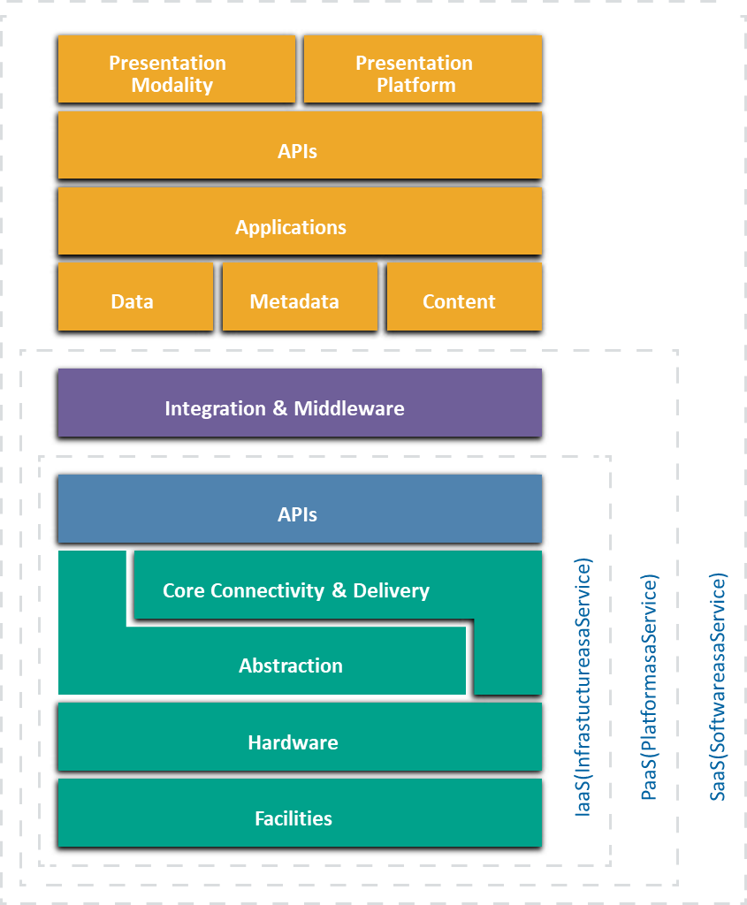
Reference and Architectural Model Diagram

Slide 27
IaaS-Infrastructure as Service
Physical facilities and infrastructure hardware form the foundation of IaaS.
Abstraction, often via virtualization, frees the resources from their physical constraints to enable pooling.
Then a set of core connectivity and delivery tools (orchestration) ties these abstracted resources together, creates the pools, and provides the automation to deliver them to customers.
All this is facilitated using Application Programming Interfaces. APIs are typically the underlying communications method for components within a cloud,
In most cases, those APIs are both remotely accessible and wrapped into a web-based user interface. This combination is the cloud management plane, since consumers use it to manage and configure the cloud resources, such as launching virtual machines (instances) or configuring virtual networks.

Slide 28
IaaS Security risk
IaaS consists of a facility, hardware, an abstraction layer, an orchestration (core connectivity and delivery) layer to tie together the abstracted resources, and APIs to remotely manage the resources and deliver them to consumers.
From a security perspective, it is both the biggest difference from protecting physical infrastructure (since you can’t rely on physical access as a control) and the top priority when designing a cloud security program. If an attacker gets into customer management plane, they potentially have full remote access to your entire cloud deployment.

Slide 29
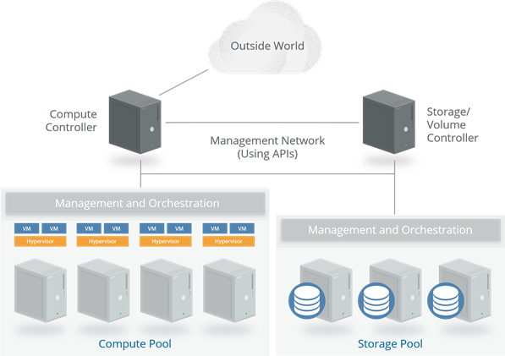
Compute Iaas -Example

Slide 30
Compute IaaS -Example Details
.A series of physical servers each run two components: a hypervisor (for virtualization) and the management/orchestration software to tie in the servers and connect them to the compute controller.
A customer asks for an instance (virtual server) of a particular size and the
cloud controller determines which server has the capacity and allocates an instance of the requested size.
The controller then creates a virtual hard drive by requesting storage from the storage controller, which allocates storage from the storage pool, and connects it to the appropriate host server and instance over the network (a dedicated network for storage traffic). Networking, including virtual network interfaces and addresses, is also allocated and connected to the necessary virtual network.
The controller then sends a copy of the server image into the virtual machine, boots it, and configures it; this creates an instance running in a virtual machine (VM), with virtual networking and storage all properly configured. Once this entire process is complete, the metadata and connectivity information is brokered by the cloud controller and available to the consumer, who can now connect to the instance and log in.

Slide 31
Platform As Service (PaaS)
PaaS model, is to build a platform on top of IaaS.
A layer of integration and middleware is built on IaaS, then pooled together, orchestrated, and exposed to customers using APIs as PaaS.
For example, a Database as a Service could be built by deploying modified database management system software on instances running in IaaS. The customer manages the database via API (and a web console) and accesses it either through the normal database network protocols, or, again, via API.
In PaaS the cloud user only sees the platform, not the underlying infrastructure. In our example, the database expands (or contracts) as needed based on utilization, without the customer having to manage individual servers, networking, patches, etc.
Another example is an application deployment platform. That’s a place where developers can load and run application code without managing the underlying resources. Services exist for running nearly any kind of application in any language on PaaS, freeing the developers from configuring and building servers, keeping them up to date, or worrying about complexities like clustering and load balancing.

Slide 32
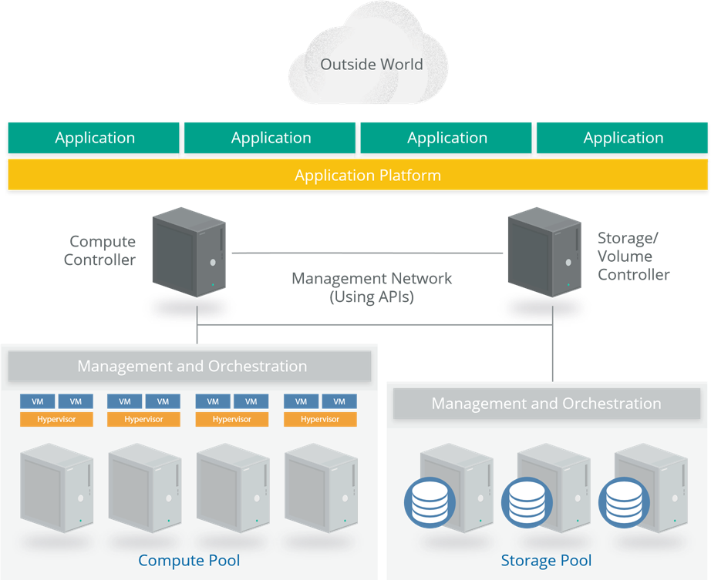
PaaS Example

Slide 33
SaaS-Software As Service
SaaS services are full, multitenant applications, with all the architectural complexities of any large software platform.
Many SaaS providers build on top of IaaS and PaaS due to the increased agility, resilience, and (potential) economic benefits.
Most modern cloud applications (SaaS or otherwise) use a combination of IaaS and PaaS, sometimes across different cloud providers.
Many also tend to offer public APIs for some (or all) functionality. They often need these to support a variety of clients, especially SaaS tends to have an application/logic layer and data storage, with an API on top.
Then there are one or more presentation layers, often including web browsers, mobile applications, and public API access.y web browsers and mobile applications.

Slide 34
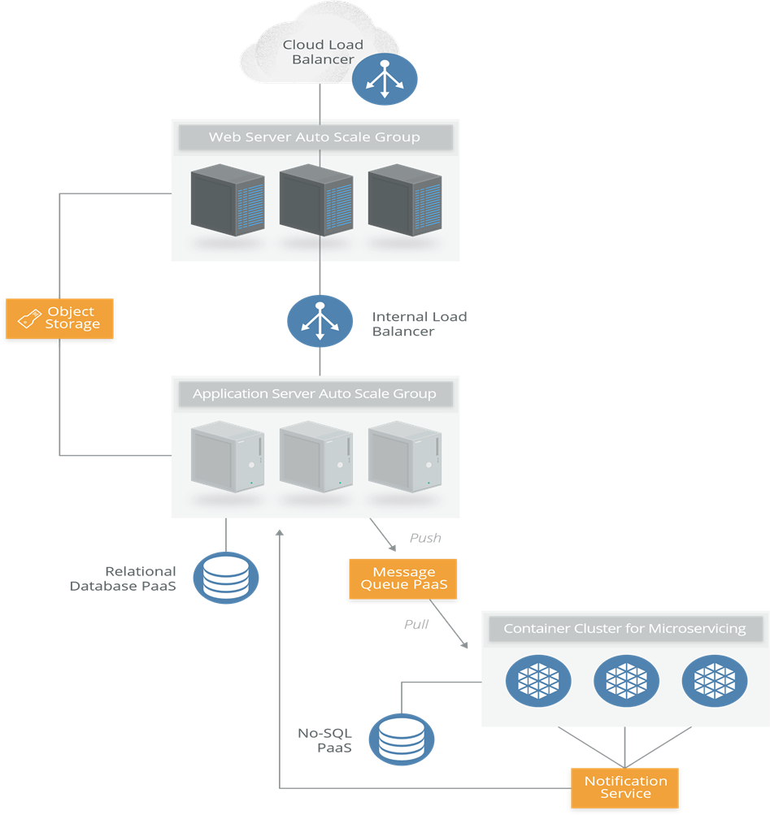
SaaS Example

Slide 35
Cloud Computing Logical Model
At a high level, both cloud and traditional computing adhere to a logical model that helps identify different layers based on functionality. This is useful to illustrate the differences between the different computing models themselves:
Infrastructure: The core components of a computing system: compute, network, and storage. The foundation that everything else is built on. The moving parts.
Metastructure: The protocols and mechanisms that provide the interface between the infrastructure layer and the other layers. The glue that ties the technologies and enables management and configuration.
Infostructure: The data and information. Content in a database, file storage, etc.
Applistructure: The applications deployed in the cloud and the underlying application services used to build them. For example, Platform as a Service features like message queues, artificial intelligence analysis, or notification services

Slide 36
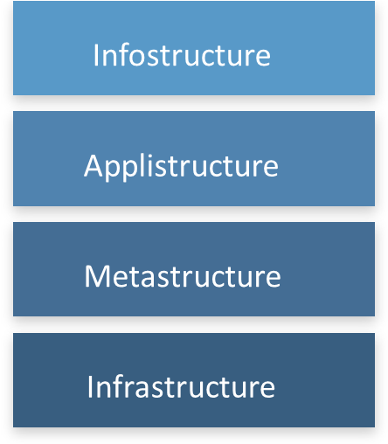
Logical Model
The key difference between cloud and traditional computing is the metastructure. Cloud metastructure includes the management plane components, which are network-enabled and remotely accessible. Another key difference is that, in cloud, you tend to double up on each layer.

Slide 37
Cloud Security and Compliance scope and Responsibilities
• Software as a Service: The cloud provider is responsible for nearly all security, since the cloud user can only access and manage their use of the application, and can’t alter how the application works. For example, a SaaS provider is responsible for perimeter security, logging/ monitoring/auditing, and application security, while the consumer may only be able to manage authorization and entitlements.
• Platform as a Service: The cloud provider is responsible for the security of the platform, while the consumer is responsible for everything they implement on the platform, including how they configure any offered security features. The responsibilities are thus more evenly split. For example, when using a Database as a Service, the provider manages fundamental security, patching, and core configuration, while the cloud user is responsible for everything else, including which security features of the database to use, managing accounts, or even authentication methods.
• Infrastructure as a Service: Just like PaaS, the provider is responsible for foundational security, while the cloud user is responsible for everything they build on the infrastructure. Unlike PaaS, this places far more responsibility on the client. For example, the IaaS provider will likely monitor their perimeter for attacks, but the consumer is fully responsible for how they define and implement their virtual network security, based on the tools available on the service.

Slide 38
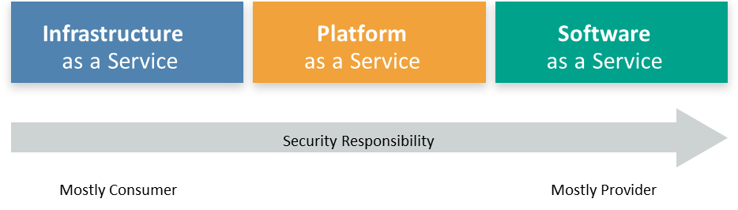
Cloud security Scope and Responsibilities

Slide 39
Shared Responsibilities Recommendations
This shared responsibility model directly correlates to two recommendations:
• Cloud providers -”Security of the Cloud” should clearly document their internal security controls and customer security features so the cloud user can make an informed decision. Providers should also properly design and implement those controls.
• Cloud users -”Security in the Cloud” should, for any given cloud project, build a responsibilities matrix to document who is implementing which controls and how. This should also align with any necessary compliance standards.
The Cloud Security Alliance provides two tools to help meet these requirements:
• The Consensus Assessments Initiative Questionnaire (CAIQ). A standard template for cloud providers to document their security and compliance controls.
• The Cloud Controls Matrix (CCM), which lists cloud security controls and maps them to multiple security and compliance standards. The CCM can also be used to document security responsibilities.
Both documents will need tuning for specific organizational and project requirements, but provide a comprehensive starting template and can be especially useful for ensuring compliance requirements are met.

Slide 40
AWS LABS

