Slide 1

UNIVERSITY of Karachi

Slide 2
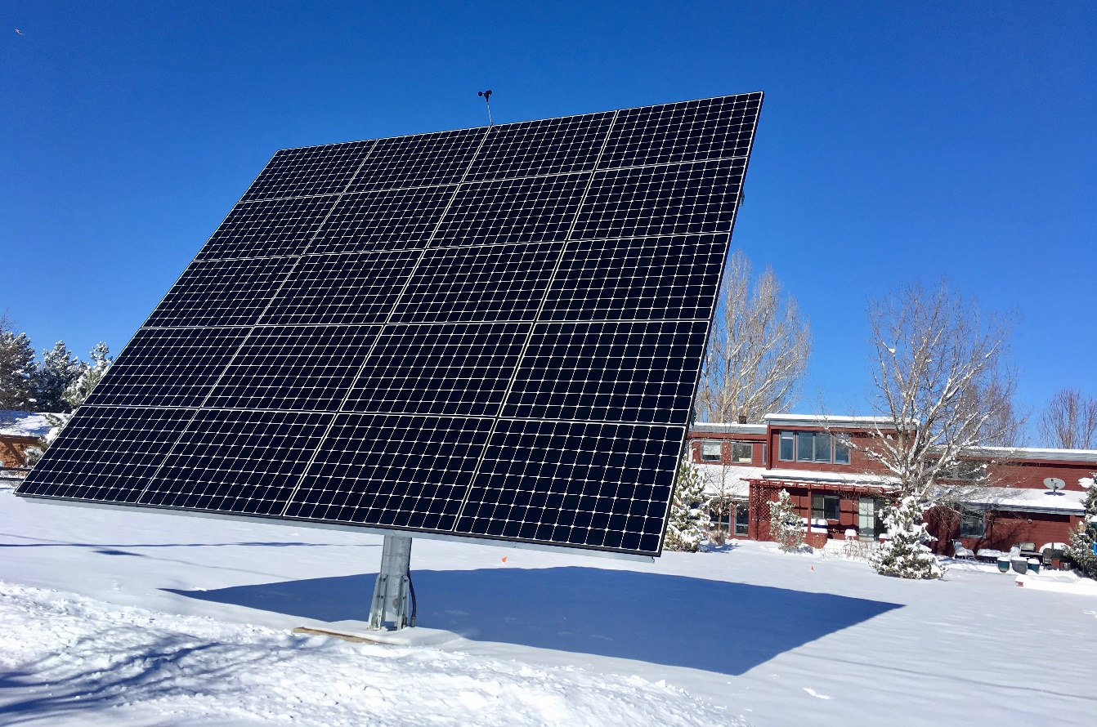
DUAL AXIS SOLAR TRACKING SYSTEM

Slide 3
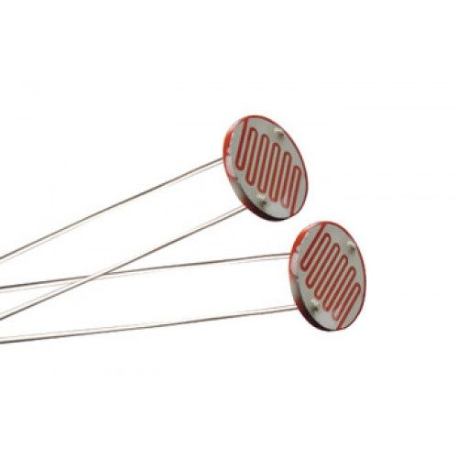
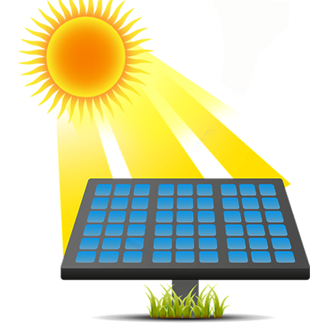
ABSTRACT:
We used LDR's (Light Detecting Resistors) as sensors and two servomotors to direct the position of the solar panel, based on the code that is uploaded to the Arduino Uno controller, to achieve automated solar energy tracking in real time.
The most effective way of getting more energy out of a solar panel is to track the sun, which makes the smart solar energy tracking system the most appropriate method of utilizing the maximum possible solar energy through the solar cell, thereby maximizing power generation.

Slide 4
BACKGROUND:
It can be used to create electricity once relatively simpler equipment is set up, and prevents one from having to rely on purchasing electricity from external energy producers and from facing the many problems like power shortages that come hand in hand.
Our project is an attempt to materialize this idea, and showcase the exploitation of solar energy as the cheaper, more efficient and cleaner alternative to the conventional form of energy sources, in the form of a solar tracker.
Solar energy has been harnessed by humans since the ancient times, when they would construct homes and buildings in a way to receive the maximum possible sunlight.

Slide 5
INTRODUCTION:
A solar tracker is a device that changes its orientation to follow the sun's path and maximize solar energy capture, by directing the photovoltaic solar panel toward the sun to harness more sunlight.
The basic idea of a solar tracker is to be able to tilt the solar panel in the direction that the sun moves, thereby ensuring that it receives the maximum possible solar energy at all times.
Tracking systems are classified into two categories based on their type of rotation:
Single axis solar tracker
Dual axis solar tracker.

Slide 6
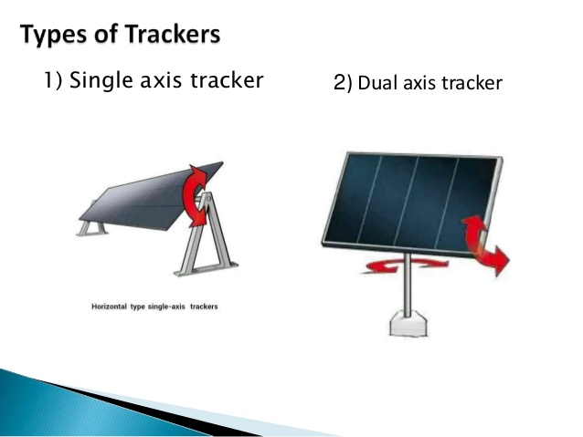

Slide 7
DESIGN:
The charge controller is placed between the output of the solar panel and the input of the battery.
The charge controller, connected directly to the panel, stabilizes the electrical output in order to minimize any fluctuations in the voltage and current values.
The panel captures the entire light incident on it and converts it into electrical energy with the help of semiconductor layers.
This causes the panel to tilt in the direction of the LDR offering the least resistance and thus, ensures that there is maximum light incident on the panel.
Depending on which of the two LDRs has more light incident on it, its resistance and hence the magnitude of current flowing into the Arduino will vary.
A 7 or 9 Volt battery is used to power the Arduino, which takes analog input from LDRs and provides power to the servomotors.
When the intensity of sunlight is high the solar panel produces more electrical output, and when sunlight is less intense the output of the panel is less.

Slide 8
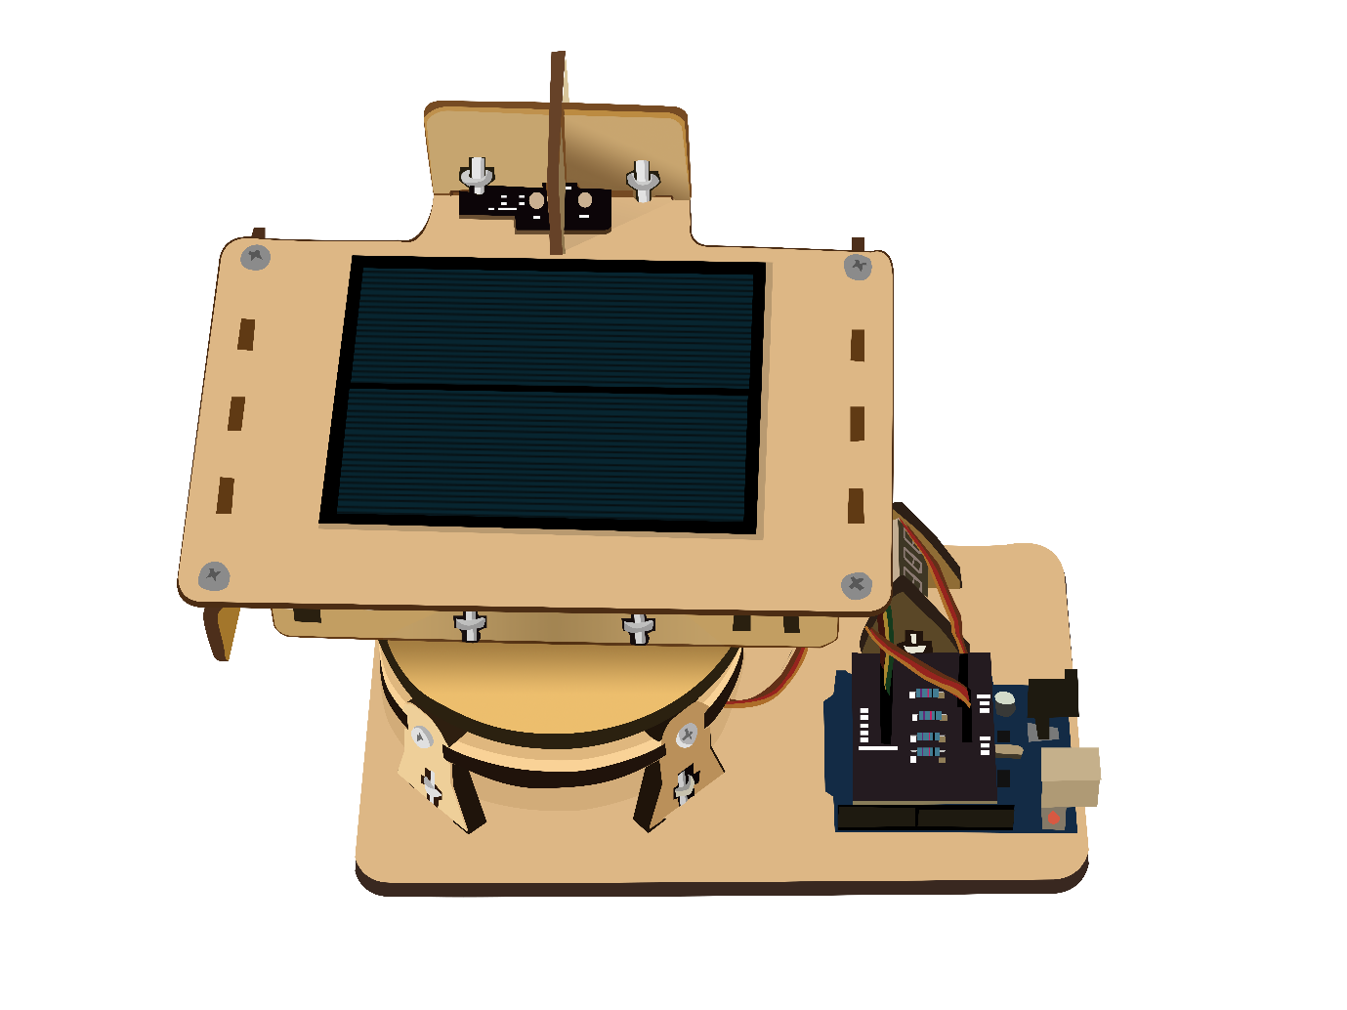
STRUCTURE OF DESIGN:

Slide 9
USES:
Trackers generate more electricity.
Reduction of long-term maintenance concerns.
Helps maximize the energy gains during peak-hours.

Slide 10
CONCLUSION:
Dual-axis tracking utilizes solar panels with relatively greater efficiency, generating 40% more power from each panel.
The same power can be attained with fewer panels or frames, thus reducing the project's upfront costs.
ACKNOWLEDGEMENT:
Our special thanks and sincere gratitude to Mr. Khurram Iqbal, from the Institute of Space and Planetary Astrophysics of the University of Karachi, whose courteous encouragement and guidance was the foremost contribution to this educational project.

Slide 11
REFERENCES:
https://www.browndoggadgets.com/pages/dual-axis-solar-tracker
https://www.solarpowerworldonline.com/2017/09/dual-axis-solar-tracker/
http://www.instructables.com/id/Simple-Dual-Axis-Solar-Tracker/

Slide 12
PRESENTED BY:
BSCS Second Year, Section C (2018)
Department of UBIT, University of Karachi.
THANK YOU!

