Slide 1
Simple Document Search Engine
Presented by:
Muhammad Shahzaib Ijaz 2021-CS-75
Submitted to:
Prof. Syed Kahldoon Khurshid.

Slide 2
Agenda
Project Overview
Indexing
Understanding TF-IDF
DFD

Slide 3

01
Project overview

Slide 4

Project overview
Primary Goal: Create a search engine that helps user find relevant document easily.
Key Objective:
• Search for specific words or phrases in Documents.
• Rank Documents based on relevance to user queries.
• Provide flexible search options (title, author, content).
• Suggest Keywords to improve the search experience.

Slide 5
02
Indexing

Slide 6
Indexing
Definition:
A data structure that maps terms to the documents where they appear, enabling fast and efficient information retrieval.
Key Components:
Term: A unique word from the document set.
Posting List: A list of documents containing the term
Example:
Term: “machine”
Posting List: [Doc1, Doc2, Doc3]

Slide 7
03
Understanding TF-IDF

Slide 8
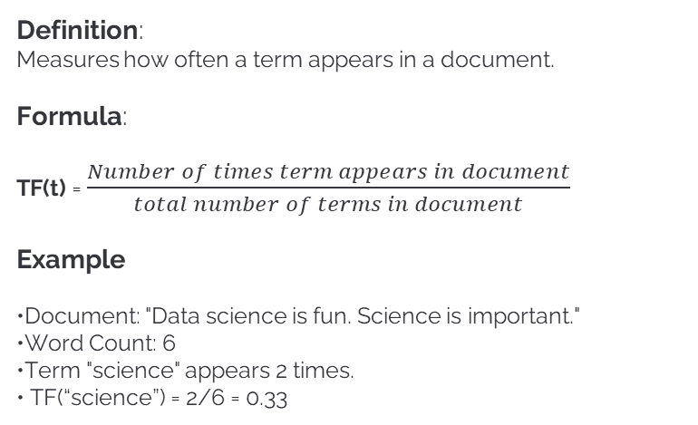
Understanding TF
Definition:
Measures how often a term appears in a document.
Formula:
TF(t) = $\frac{Number of times term appears in document}{total number of terms in document}$
Example
•Document: "Data science is fun. Science is important."
•Word Count: 6
•Term "science" appears 2 times.
• TF(“science”) = 2/6 = 0.33

Slide 9
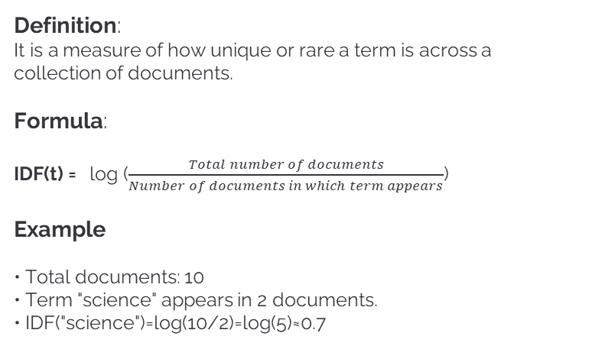
Understanding IDF
Definition:
It is a measure of how unique or rare a term is across a collection of documents.
Formula:
IDF(t) = log ($\frac{Total number of documents}{Number of documents in which term appears}$)
Example
• Total documents: 10
• Term "science" appears in 2 documents.
• IDF("science")=log(10/2)=log(5)≈0.7

Slide 10
TF-IDF
Definition:
It is a statistical measure used to evaluate the importance of a term in a document relative to a collection (or corpus) of documents.
Formula:
TF-IDF = TF X IDF
Example
• Document: "Science is amazing!"
• Term "science“
• TF=0.33, IDF=0.7
• TF-IDF=0.33×0.7=0.231

Slide 11
Challenges and Improvements
Challenges
Future Improvements
Data Variability:
Titles or authors may not follow a standard format.
Complex Queries:
Matching phrases accurately with large datasets.
Performance:
Optimizing TF-IDF computation for scalability.
Add support for PDFs and other document formats.
Use advanced ranking techniques like cosine similarity.
Integrate a more user-friendly interface with filters (e.g., date, category).

Slide 12


