Slide 1
Simple Document Search Engine
Presented by:
Muhammad Shahzaib Ijaz 2021-CS-75
Submitted to:
Prof. Syed Kahldoon Khurshid.

Slide 2
Agenda
Project Overview
Motivation
Understanding Cosine Similarity
Architecture
Examples

Slide 3

01
Project overview

Slide 4

Project overview
Primary Goal: Create a search engine with ranking that helps user find relevant document easily.
Key Objective:
• Search for specific words or phrases in Documents.
• Rank Documents based on relevance to user queries.
• Provide flexible search options (title, author, content).
• Suggest Keywords to improve the search experience.

Slide 5
02
Motivation

Slide 6
Why Use Cosine Similarity?
Keyword-based Search Engine often fails to understand context or measure how semantically close two documents are.
Cosine Similarity provides a numerical method to compute the similarity between two entities (query and document).
Advantages:
Handles contextual relevance by analyzing patterns and relationships.
Effective for high-dimensional data, like documents represented as vectors.
Suitable for use with TF-IDF or word embeddings.

Slide 7
03
Understanding Cosine Similarity

Slide 8
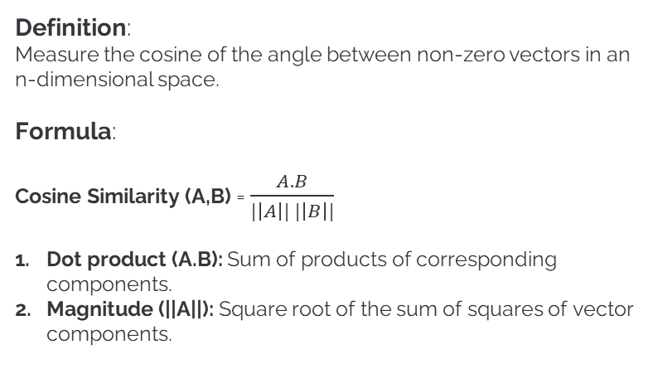
Understanding Cosine Similarity
Definition:
Measure the cosine of the angle between non-zero vectors in an n-dimensional space.
Formula:
Cosine Similarity (A,B) = $\frac{A.B}{|\left|A\right|| |\left|B\right||}$
Dot product (A.B): Sum of products of corresponding components.
Magnitude (||A||): Square root of the sum of squares of vector components.

Slide 9
04
Architecture

Slide 10
How Cosine Similarity Fits into the system
Data Collection:
Collect data from docx files stored in local storage.
Preprocessing:
Tokenization: Break text into words
Stop-words Removal: Eliminate common words (e.g., “the”, “and”).
Stemming/Lemmatization: Reduce words to their root forms (e.g., “running” -> “run”).

Slide 11
How Cosine Similarity Fits into the system
Vectorization:
Convert documents and query into a vector space using TF-IDF or word embeddings.
Similarity Computation:
Calculate Cosine similarity between query and document vector.
Result Presentation:
Rank documents by descending similarity scores and present to the user.

Slide 12
05
Example of Cosine Similarity

Slide 13
Practical Example of Cosine Similarity
Let suppose
Query: “Artificial Intelligence in healthcare”
Documents:
1. Doc1: “Application of AI in healthcare”
2. Doc2: “History of Machine learning”
TF-IDF Representation:
Query and documents are transformed into vectors
Example vectors:
1. Query: [0.3, 0.5, 0.7]
2. Doc1: [0.3, 0.4, 0.6]
3. Doc2: [0.1, 0.2, 0.1]

Slide 14
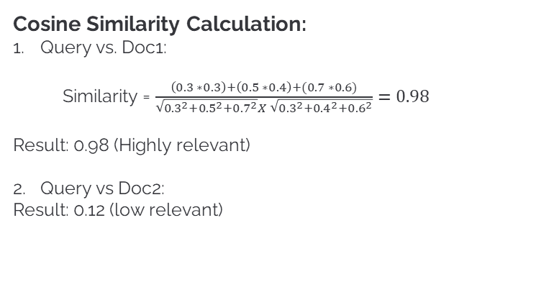
Practical Example of Cosine Similarity
Cosine Similarity Calculation:
Query vs. Doc1:
Similarity = $\frac{\left(0.3 ∗0.3\right)+\left(0.5 ∗0.4\right)+(0.7 ∗0.6)}{\sqrt{{0.3}^{2}+{0.5}^{2}+{0.7}^{2}}X \sqrt{{0.3}^{2}+{0.4}^{2}+{0.6}^{2}}}=0.98$
Result: 0.98 (Highly relevant)
Query vs Doc2:
Result: 0.12 (low relevant)

Slide 15


