Slide 1
BIM, Non-overlapped list and proximal nodes models
Presented by:
Muhammad Shahzaib Ijaz 2021-CS-75
Submitted to:
Prof. Syed Kahldoon Khurshid.

Slide 2
Agenda
Introduction
Objectives
Probabilistic Model
Non-overlapped Model
Proximal Nodes Model

Slide 3

01
Introduction

Slide 4

Introduction
Focus:
In this presentation, we explore three advance IR models:
Probabilistic Model: Focuses on the likelihood of relevance between query and documents
Non-overlapped Model: Ensure retrieved documents belong to distinct sets for diversity.
Proximal Nodes Model: Utilizes proximity between terms to enhance retrieval accuracy.

Slide 5
02
Objectives

Slide 6
Objectives
Primary Goals:
To evaluate and implement three retrieval models to understand their effectiveness and applications in real-world IR systems.
Specific Objectives:
Probabilistic Model: Analyze document relevance based on probabilistic measures.
Non-overlapped Model: Ensure diversity and non-redundancy in document retrieval.
Proximal Nodes Model: Enhance retrieval accuracy using term proximity within documents.
Outcomes:
To compare the strengths and weakness of these models and recommend their application in specific IR Scenarios.

Slide 7
03
Probabilistic Model

Slide 8
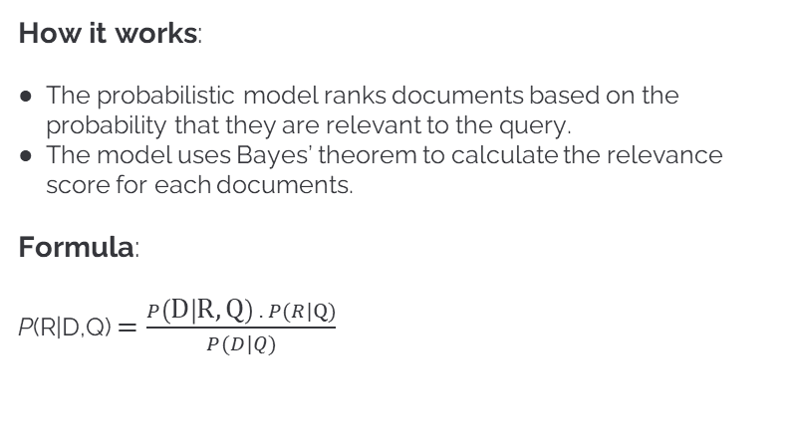
Understanding BIM
How it works:
The probabilistic model ranks documents based on the probability that they are relevant to the query.
The model uses Bayes’ theorem to calculate the relevance score for each documents.
Formula:
P(R|D,Q) $=\frac{P\left(D | R,Q\right) . P(R|Q)}{P(D|Q)}$

Slide 9
Understanding BIM
Where,
P(R|D, Q): Probability of relevance given the document D and the query Q.
P(D|R, Q): Probability of retrieving the document D given that it is relevant.
P(R|Q): Prior probability of relevance given the query.
P(D|Q): Probability of observing the document given the query.

Slide 10
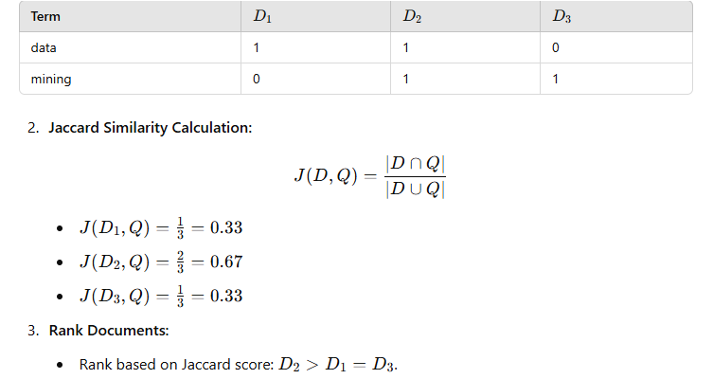
Understanding BIM
Example:
Query = {data, mining}
Documents:
1. D1 = {data, analysis, machine}
2. D2 = {data, mining, learning}
3. D3 = {mining, algorithm, structure}
Steps:
Binary representation of terms.
Create a binary matrix indicating whether each query term appears in document.

Slide 11
04
Non-overlapped List Model

Slide 12
Understanding Non-overlapped Model
How it works:
The model ensures that retrieved documents belong to distinct sets or categories to maximize diversity and reduce redundancy.
Each document is represented in a non-overlapped manner in the result set.
Formula:
There is no specific mathematical formula for this model, but it can be expressed algorithmically:
Partition the document sets D into non-overlapped subsets.
For a query Q, retrieve one document from each subset Di.
Select documents based on their individual relevance score while ensuring

Slide 13
Understanding NOLM
Example:
Query = {AI, ethics}
Documents:
1. Category 1:
1. D1 = {data, analysis, machine}
2. D2 = {data, mining, learning}
2. Category 2:
3. D3 = {mining, algorithm, structure}
4. D4 = {mining, algorithm, structure}
Steps:
Retrieve the top-ranked document from each category.
From category 1: D1
From category 2: D3

Slide 14
05
Proximal Node Model

Slide 15

Understanding Proximal Node model
How it works:
The proximal node model retrieves documents by evaluating the proximity of query terms within a documents.
Formula:
A common proximity-based scoring functions is:

Slide 16
Understanding Proximal Node model
Where,
ti, tj: terms in the query Q.
d(ti, tj): Distance (in terms of word positions) between the terms ti and tj in document D.
S(D, Q): Proximity score of the document D.
Steps:
Identify all occurrences of query terms in a documents.
Compute distances between all pairs of query terms.
Sum the reciprocal distances to calculate the proximity score.
Rank documents by their proximity scores.

Slide 17
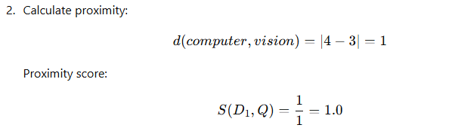
Understanding BIM
Example:
Query = {computer, vision}
Documents:
D1 = {machine, learning, computer, vision,
system}
Steps:
Find the position of query terms:
Computer at position 3.
Vision at position 4.
Rank documents based on proximity scores. Higher scores indicate closer term proximity, making the document more relevant.

Slide 18


