Slide 1
Graph-Based Classification of Web
Muhammad Shahzaib Ijaz
2021 - CS - 75

Slide 2
Introduction
Importance of efficient document classification in managing vast amounts of textual data.
Exploration of a novel approach grounded in graph theory and machine learning.

Slide 3
Objective
01
ENHANCING CLASSIFICATION ACCURACY THROUGH DIRECTED GRAPHS AND K- NEAREST NEIGHBORS (KNN) ALGORITHM.
02
HANDS-ON EXPERIENCE FOSTERING SKILLS IN DATA REPRESENTATION, ALGORITHM IMPLEMENTATION, AND ANALYTICAL THINKING.
03
CONVERGENCE OF GRAPH THEORY AND MACHINE LEARNING FOR INNOVATIVE SOLUTIONS IN DOCUMENT CLASSIFICATION.

Slide 4
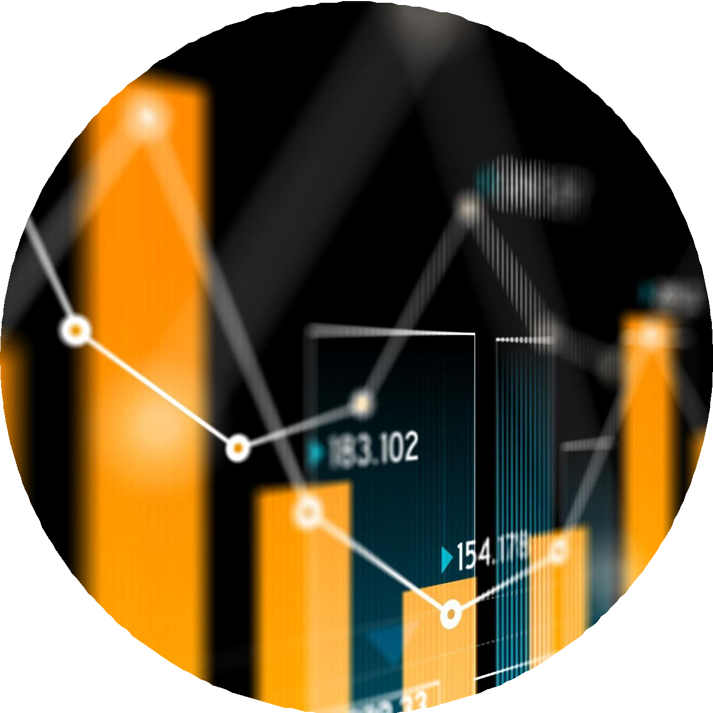



Milestones
Data Collection
Graph Construction
Feature Extraction via Common Subgraphs
Classification with KNN

Slide 5
Data Collection
Utilized Selenium, a powerful web scraping tool, to automate the data collection process.
Identified relevant websites containing documents related to each of the three assigned topics.
Developed custom scripts to navigate through web pages and extract text data.
Utilized XPath or CSS selectors to pinpoint the location of document links on web pages.
Extracted text content from each document page and stored it in a text files.

Slide 6
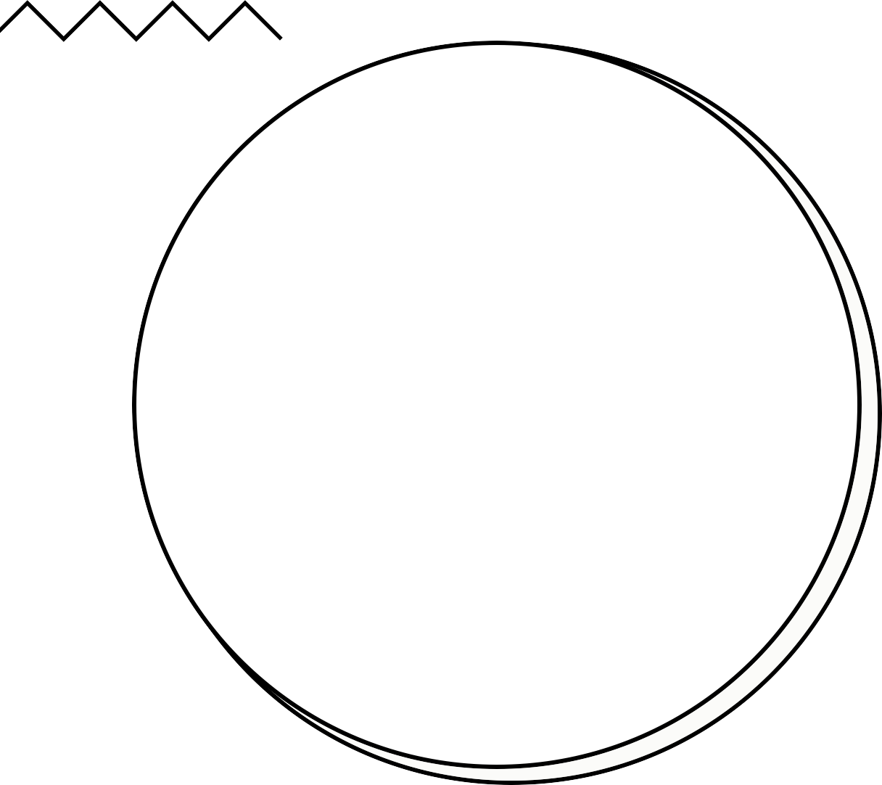


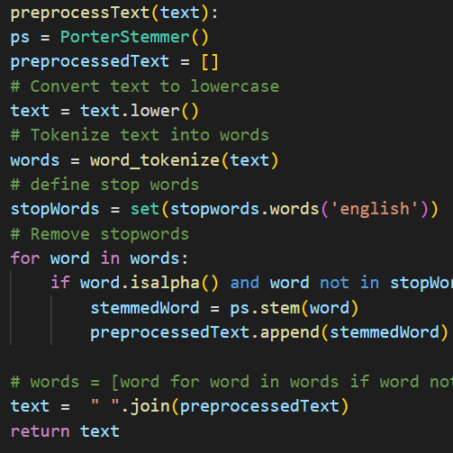












Preprocessing
Converts the text to lowercase for consistency.
Tokenizes the text into words using NLTK's word tokenizer.
Retrieves English stopwords and removes them along with non-alphabetic characters.
Reconstructs the preprocessed text by joining the stemmed words.
Stems each word using the Porter Stemmer
to reduce inflectional forms.

Slide 7
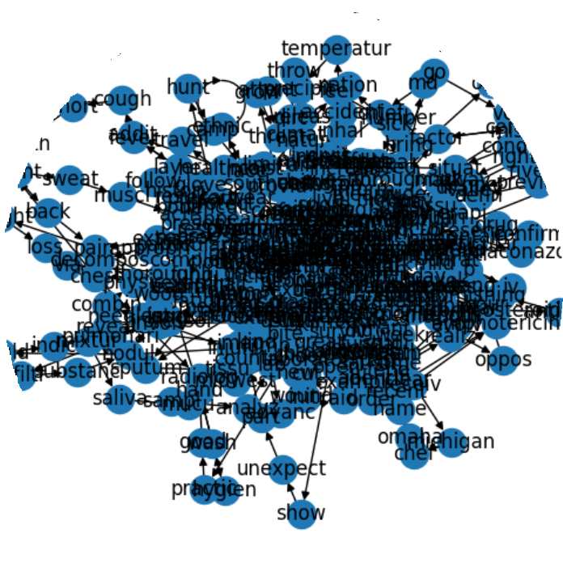
Graph construction
Iterated through preprocessed documents for each topic.
Created an empty graph for each document.
Added nodes for unique words in the document.
Created edges between adjacent words to represent co- occurrence.
Appended the graph to the corresponding topic's list.

Slide 8
Frequent Subgraph Mining(gSpan)
gSpan is a popular algorithm for frequent subgraph mining, widely used in graph data mining tasks.
It efficiently discovers recurring patterns, or subgraphs, within a collection of graphs.
Constructed composite graphs for each topic using NetworkX.
Saved the composite graphs into files to prepare for gSpan input.
Defined gSpan arguments for each topic, specifying support threshold and output options.
Executed gSpan to extract frequent subgraphs from each category graph.
Utilized parser to handle gSpan arguments.
Extracted frequent subgraphs using gSpan's main function.

Slide 9
KNN Classification
KNN is a simple and effective machine learning algorithm used for classification and regression tasks.
It classifies an unlabeled data point based on the majority class among its k nearest neighbors.

Slide 10
Challenges
THE INITIAL CHALLENGE AROSE DURING MCS GENERATION, ATTRIBUTED TO CPU ISSUES.
A FURTHER CHALLENGE EMERGED WITH THE FEATURE EXTRACTOR FUNCTION.

Slide 11


Future Work
I will focus on improving the model's accuracy

Slide 12
T H A N K
Y O U
A N Y Q U E ST I O N S

