Slide 1

Automated Handwritten Quiz Checking using LLMs

Slide 2

Problem Statement
Grading handwritten quizzes is a labor-intensive and time-consuming task.
Existing OCR technologies can extract text but lack the capability to evaluate and grade responses accurately.
There is a need for a system that uses robust LLMs to streamline grading, ensuring accuracy, consistency, and efficiency.

Slide 3
Introduction
Developed an end-to-end application leveraging LLMs to automate handwritten quiz evaluation.
Retrieves scanned quizzes from a designated folder and processes them through an LLM pipeline.
Evaluates responses using fine-tuned LLMs with quiz images along a refined prompt.
Outputs results, including scores and feedback, in structured format and creates a zip file of text files.

Slide 4
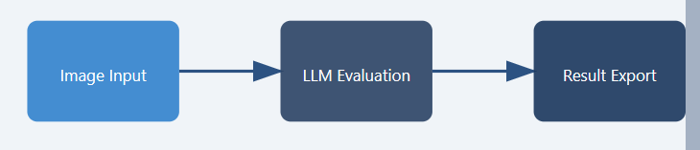
Methodology

Slide 5
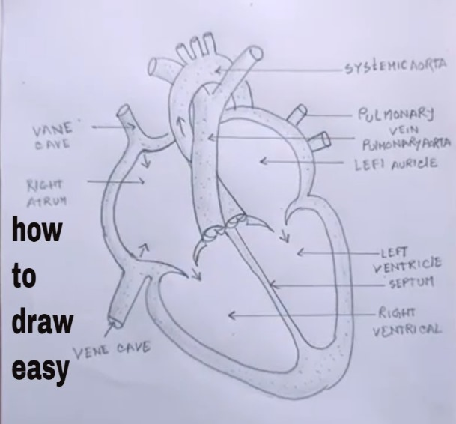
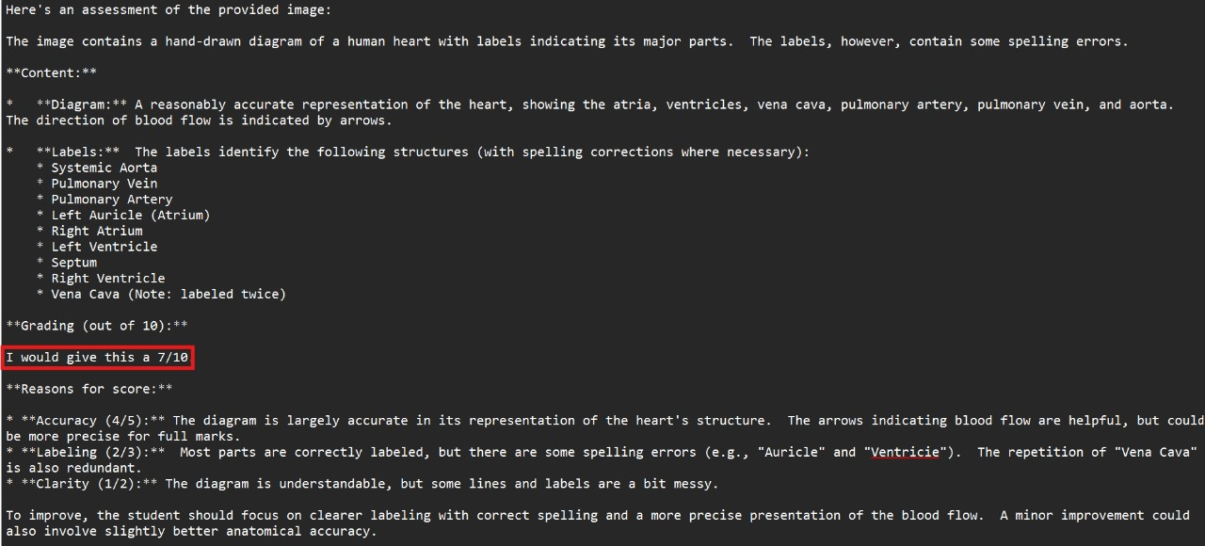
Results
Output Result
Input Image

Slide 6
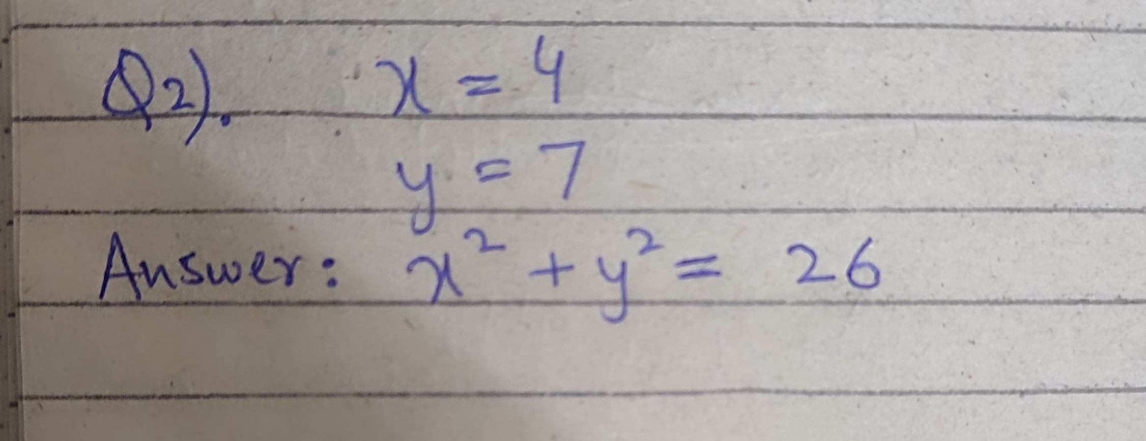
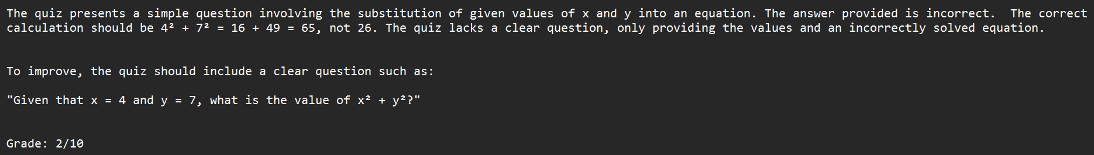

Slide 7
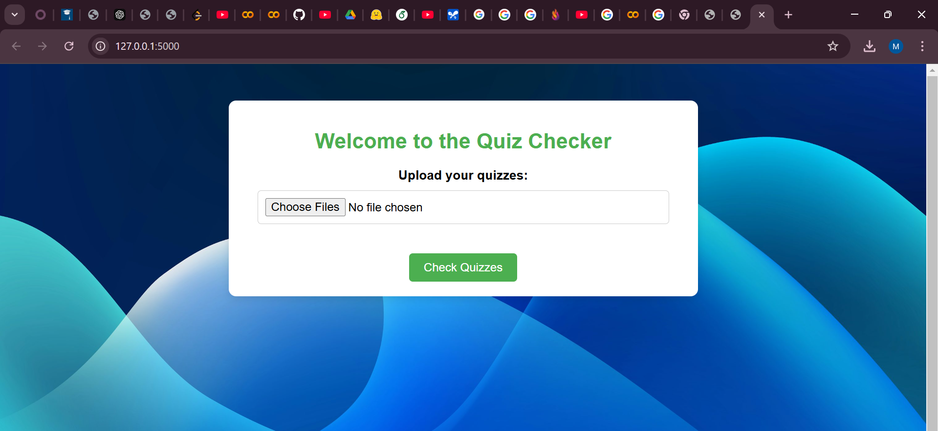
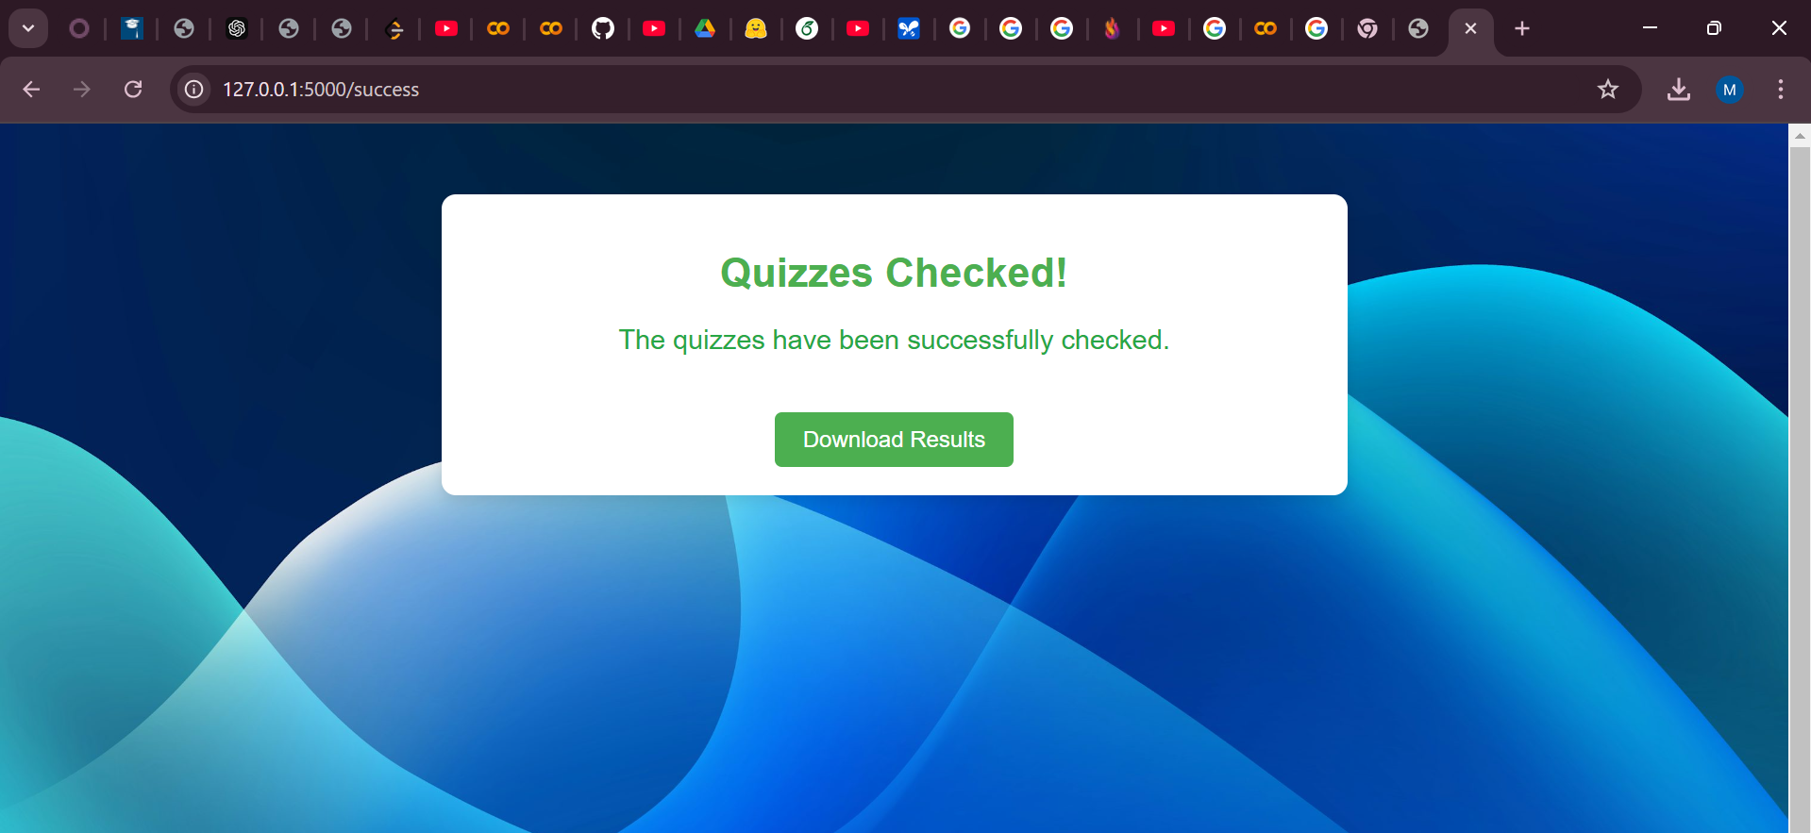
Web Page:

Slide 8
Challenges & Discussion
Accuracy of grading depends on the fine-tuning of LLMs.
Handling diverse handwriting styles remains a significant challenge for LLM evaluation.
High-end LLMs like GPT-4 provide superior accuracy but involve significant costs and usage constraints.
Free alternatives, such as Gemini 1.5, offer cost-effective solutions but may compromise slightly on performance.
Future efforts should focus on enhancing the pipeline’s robustness and scalability for diverse educational contexts.

Slide 9
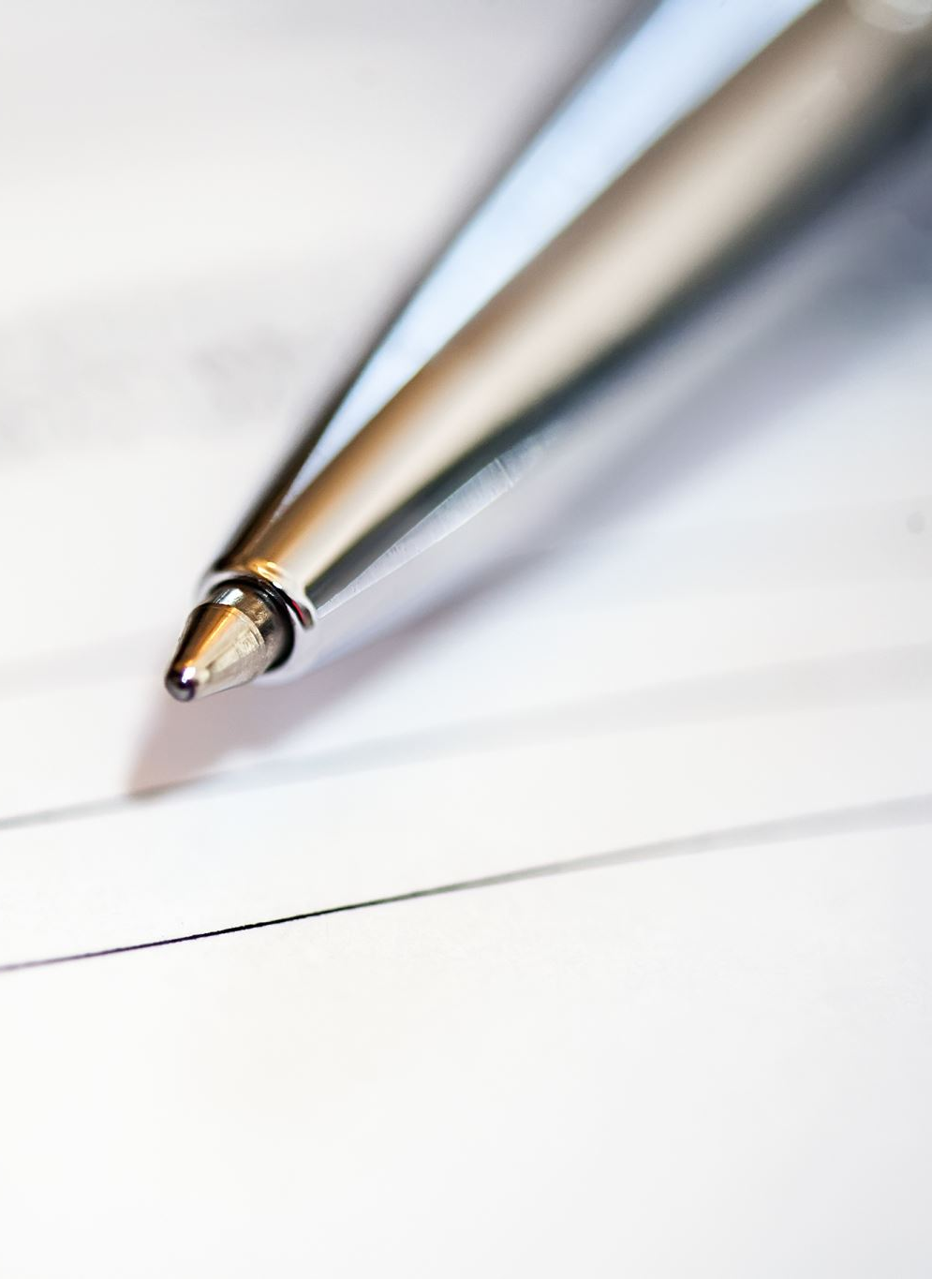
Conclusion
Demonstrates the potential of using LLMs to automate handwritten quiz evaluation.
Offers a scalable and efficient solution for automated assessment.
Optimize LLM fine-tuning for domain-specific grading criteria.

Slide 10

Thank You Any Questions!!

