Slide 1

SOFTWARE ENGINEERING WS 24/25 ML 24/25–03 Implement Anomaly Detection Sample Presented by : Team Synergy
Mohammad Talha Saleem talha.saleem@stud.fra-uas.de | Samra Arif samra.arif@stud.fra-uas.de | Waqas Ahmed waqas.ahmed@stud.fra-uas.de

Slide 2
Agenda
Objective
Introduction
Data Collection and Preprocessing
Algorithm Design
Anomaly Detection Logic
Processing Elements
Results
Performance Metrics
Conclusion

Slide 3
OBJECTIVE
The objective of this experiment is to design and implement an Anomaly Detection system using the NEOCORTEX API framework. The system will learn multiple sequences representing patterns of normal behavior and later predict the next values in new sequences. If the predicted values deviate beyond a defined tolerance from the actual observed values, the system will detect an anomaly.
3

Slide 4
Introduction
Anomaly detection is the process of identifying data points that do not conform to expected patterns.
Using NeocortexAPI, we train models on normal sequences and detect deviations.
Application areas: Power consumption prediction, fraud detection, sensor data monitoring, etc.
4

Slide 5
Data Collection and Preprocessing
Train a model using multiple similar sequences representing normal behavior.
Use the trained model to predict the next value in new sequences.
Compare predicted and actual values to detect anomalies.
Log results in a CSV file and generate graphical representations.
Sequence 1: 22, 24, 26, 28, 26, 24, 26, 27, 29, 30, 32, 33, 30, 31, 34, 36, 35, 37, 38, 36, 37, 39, 40, 41, 43, 44
Sequence 2: 22, 24, 25, 27, 26, 25, 26, 27, 28, 30, 31, 33, 30, 32 , 34, 36, 37, 35, 38, 36, 37, 39, 40, 41, 43, 44
Sequence 3: 22, 24, 23, 24, 26, 24, 26, 28, 29, 30, 33, 34, 32, 31 , 34, 36, 35, 37, 38, 36, 37, 39, 40, 41, 43, 44
5

Slide 6
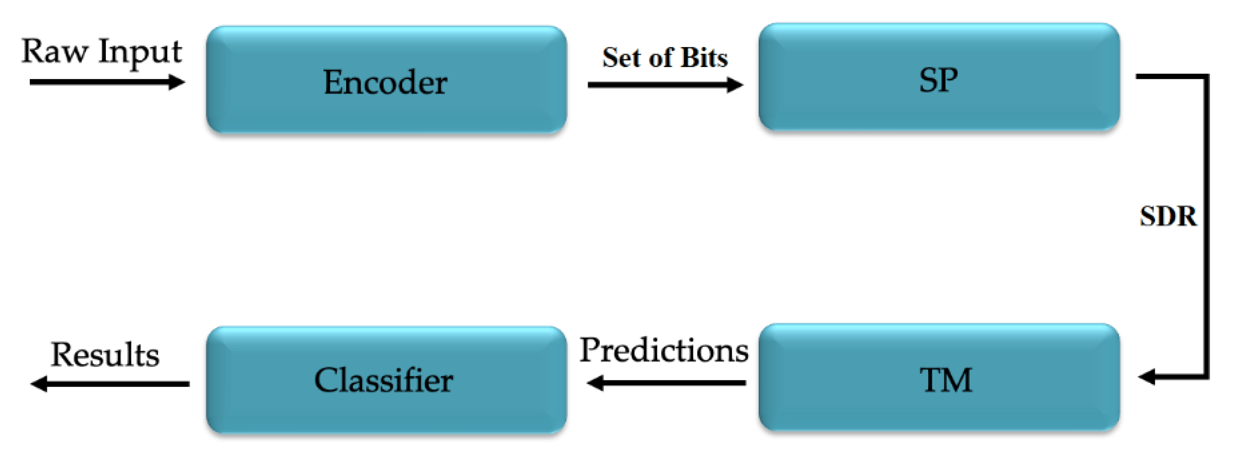
Algorithm Design
A machine learning algorithm inspired by the human brain.
Uses spatial and temporal memory for detecting anomalies.
Key advantage: Works with streaming data in real time.
Data preprocessing for HTM model training.
HTM core processing for learning sequences.
Anomaly scoring and alerting mechanisms.
Hierarchical Temporal Memory (HTM) is a machine learning algorithm that attempts to replicate the functioning of human neocortex. The HTM architecture consists of Spatial Pooler (SP) that transforms input data into Sparse Distributed Representation (SDR) and Temporal Memory (TM) which is responsible for the learning process. Precisely, the input data are fed to the encoder that converts them to binary values that is received by the SP which then generates SDR values.
6

Slide 7
Anomaly Detection Logic
Predicted value at time t is denoted as p(t).
Actual observed value at time t is v(t).
Anomaly Condition:
If |p(t) - v(t)| > threshold, then Anomaly Detected.
7

Slide 8
Processing Elements
Processing Element | Next Value | Predicted Sequence | Similarity Score | Anomaly Flag | Expected | Found
22 | 24 | 24 | 100 | No
24 | 23 | 26 | 100 | No
26 | 24 | 28 | 56.45 | No
28 | 29 | 40 | 100 | Yes | 29 | 40
24 | 26 | 26 | 67.5 | No
26 | 24 | 27 | 58 | No
27 |  |  |  |  | Skip
29 | 30 | 30 | 89.29 | No
30 | 33 | 32 | 100 | No
32 | 34 | 14 | 88.89 | Yes | 34 | 14
31 | 34 | 34 | 80 | No
34 | 36 | 36 | 100 | No
36 | 35 | 35 | 100 | No
35 | 37 | 37 | 100 | No
37 | 38 | 38 | 100 | No
38 | 36 | 50 | 100 |  | 36 | 50
37 |  |  |  |  | Skip
39 | 40 | 40 | 100 | No
40 | 41 | 41 | 100 | No
41 | 43 | 43 | 100 | No
43 | 44 | 44 | 100 | No
8

Slide 9
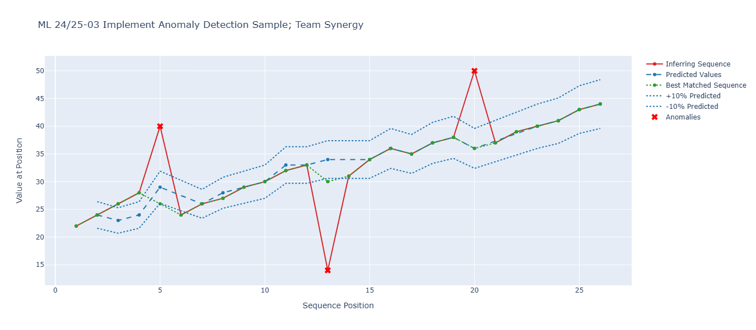
Result
9

Slide 10
Performance Metrics
Metric | Value
False Negative Rate | 0
False Positive Rate | 0
Anomaly Recall | 100%
Project Repository https://github.com/Muhammad-Talha-S/synergy-neocortex-ad/tree/master/source/MySEProject
10

Slide 11
Conclusion
We present a working HTM implementation for temporal anomaly detection, demonstrating effective pattern learning through spatial-temporal processing. Future work will address:
Dynamic threshold adaptation
Distributed training
Streaming data support
11

Slide 12
THANK YOU
12

