Slide 1

Intro to HTML
Notes:
NOTE:
To change the image on this slide, select the picture and delete it. Then click the Pictures icon in the placeholder to insert your own image.

Slide 2
Introduction to HTML
Covered in this Session:
Introduction to HTML
Basic Structure of an HTML page
ID Vs Classes
Text formatting tags in HTML
Lists in HTML
Using images as links
HTML FORMS
HTML Responsive Web Design(Media Queries)

Slide 3
Introduction to HTML
HTML stands for Hyper Text Markup Language
HTML is not a programming language, it is a Markup Language
A markup language is a set of markup tags
HTML is not case sensitive language

Slide 4
Basic Structure of an HTML page
<!DOCTYPE html> <html> <head> <title>Page Title</title> </head> <body> <h1>My First Heading</h1> <p>My first paragraph.</p> </body> </html>

Slide 5
Basic Structure of an HTML page
The <!DOCTYPE html> declaration defines that this document is an HTML5 document
The <html> element is the root element of an HTML page
The <head> element contains meta information about the HTML page
The <title> element specifies a title for the HTML page (which is shown in the browser's title bar or in the page's tab)
The <body> element defines the document's body, and is a container for all the visible contents, such as headings, paragraphs, images, hyperlinks, tables, lists, etc.
The <h1> element defines a large heading
The <p> element defines a paragraph

Slide 6
Basic HTML Tags
<h1>to<h6>
<p></p>
<a href="https://www.google.com"></a>
<img src="" alt="" width="104" height="142">
<br>
<hr>
<label></label>
<span></span>
<div></div>

Slide 7
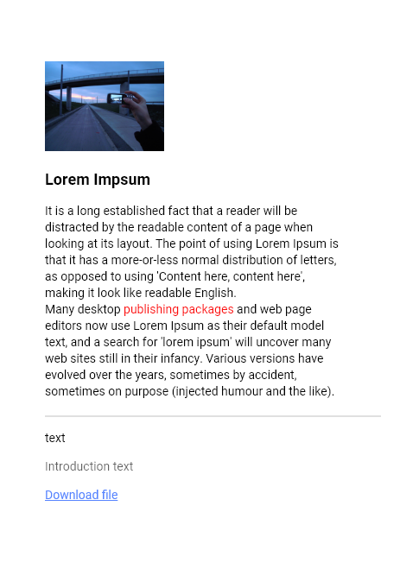
Example

Slide 8
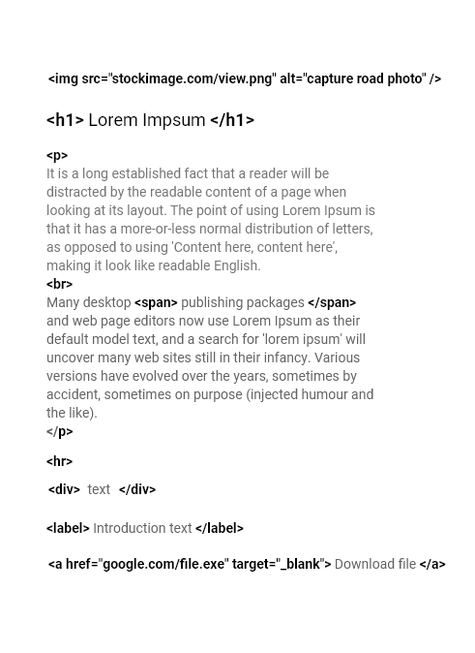
Example

Slide 9
Text formatting tags in HTML
<strong> - Important text
<em> - Emphasized text
<mark> - Marked text
<small> - Smaller text
<del> - Deleted text
<sub> - Subscript text
<sup> - Superscript text

Slide 10
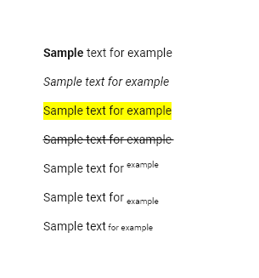
Example

Slide 11
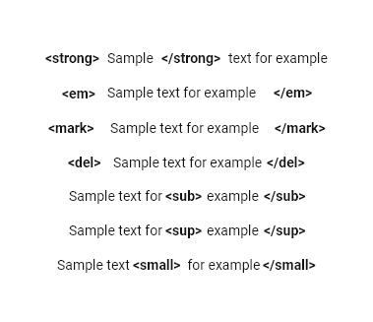
Example

Slide 12
HTML 5 Tags
<header></header>
<footer> </footer>
<nav> </nav>
<aside> </aside>
<article> </article>
<audio></audio>
<video></video>

Slide 13
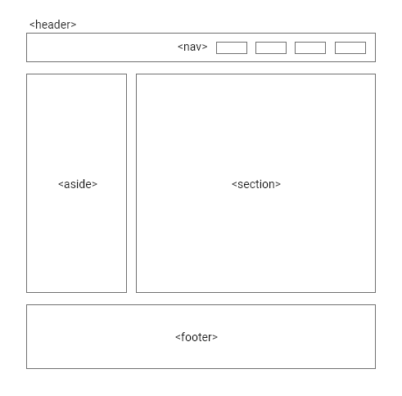
Example

Slide 14
Lists in HTML
Unordered HTML List
The list items will be marked with bullets (small black circles) by default:
<ul> <li>Coffee</li> <li>Tea</li> <li>Milk</li> </ul>
Ordered HTML List
The list items will be marked with numbers by default:
<ol> <li>Coffee</li> <li>Tea</li> <li>Milk</li> </ol>

Slide 15
HTML Links and navigation
<nav> <a href="/html/">HTML</a> | <a href="/css/">CSS</a> | <a href="/js/">JavaScript</a> | <a href="/python/">Python</a> </nav>

Slide 16
HTML Block and Inline Elements
Block-level Elements
A block-level element always starts on a new line.
A block-level element always takes up the full width available
Here are the some block-level elements in HTML
<div>, <p>,<header>,<footer>,<h1>-<h6>, <aside>,<section>,<ul>,<li>,<table>
Inline Elements
An inline element does not start on a new line.
An inline element only takes up as much width as necessary.
Here are the some inline elements in HTML
<a>, <span>,<img>, <strong>, <sub>,<sup>,<input>

Slide 17
HTML Tables
A table in HTML consists of table cells inside rows and columns
<table> <tr> <th>Company</th> <th>Contact</th> <th>Country</th> </tr> <tr> <td>Alfreds Futterkiste</td> <td>Maria Anders</td> <td>Germany</td> </tr> <tr> <td>Centro comercial Moctezuma</td> <td>Francisco Chang</td> <td>Mexico</td> </tr> </table>

Slide 18
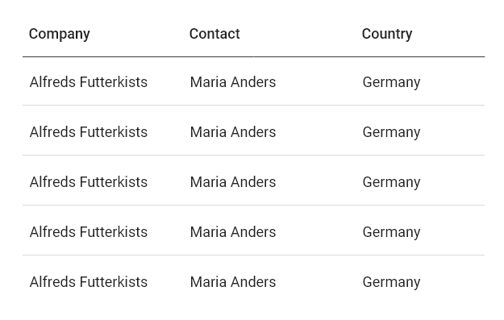

Slide 19
HTML Table Colspan
To make a cell span over multiple columns, use the colspan attribute: <table> <tr> <th colspan="2">Name</th> <th>Age</th> </tr> <tr> <td>Jill</td> <td>Smith</td> <td>43</td> </tr> <tr> <td>Jackson</td> <td>57</td> </tr> </table>

Slide 20
HTML Forms
<input type="text" id="fname" value="John">
<input type=“password" id="fname" value="John">
<input type=“number" id="fname" value="John">
<input type="date">
<input type="radio" id="html" name="fav_language" value="HTML">
<input type="checkbox" id="vehicle1" name="vehicle1" value="Bike">
<input type="file">
<textarea></textarea>

Slide 21
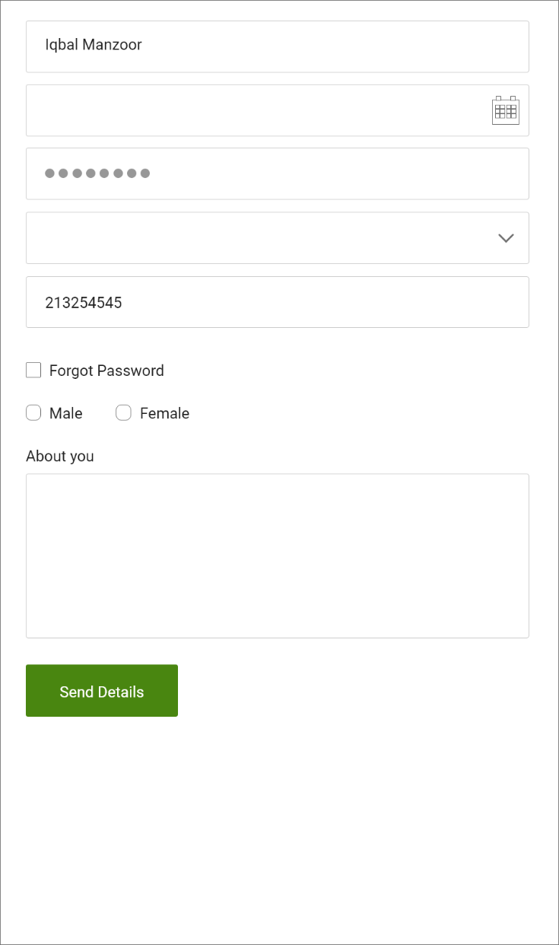
HTML Forms

Slide 22
HTML Forms Attributes
The input ”value” attribute specifies an initial value for an input field
The input “readonly” attribute specifies that an input field is read-only.
The input “disabled” attribute specifies that an input field should be disabled.
The input “placeholder” attribute specifies a short hint that describes the expected value of an input field. (The “placeholder” attribute works with the following input types: text, search, url, tel, email, and password)
The input “required” attribute specifies that an input field must be filled out before submitting the form.

Slide 23
HTML Responsive Web Design
Responsive web design is about creating web pages that look good on all devices!
A responsive web design will automatically adjust for different screen sizes and viewports.
Setting The Viewport
<meta name="viewport" content="width=device-width, initial-scale=1.0">
This will set the viewport of your page, which will give the browser instructions on how to control the page's dimensions and scaling.

Slide 24
Responsive Images
Responsive images are images that scale nicely to fit any browser size.
Using the width Property
If the CSS width property is set to 100%, the image will be responsive and scale up and down:
Using the max-width Property
If the max-width property is set to 100%, the image will scale down if it has to, but never scale up to be larger than its original size:

Slide 25
Thank you
&
Any Questions.

