Slide 1
Fair Use Notice
The material used in this presentation i.e., pictures/graphs/text, etc. is solely intended for educational/teaching purpose, offered free of cost to the students for use under special circumstances of Online Education due to COVID-19 Lockdown situation and may include copyrighted material - the use of which may not have been specifically authorised by Copyright Owners. It’s application constitutes Fair Use of any such copyrighted material as provided in globally accepted law of many countries. The contents of presentations are intended only for the attendees of the class being conducted by the presenter.
Simulation Modeling and Analysis – Chapter 1 – Basic Simulation Modeling
Slide <number>

Slide 2
Chapter 1
Basic Simulation Modeling
Simulation Modeling and Analysis – Chapter 1 – Basic Simulation Modeling
Slide <number> of 51

Slide 3
CONTENTS
1.1 The Nature of Simulation
1.2 Systems, Models, and Simulation
1.3 Discrete-Event Simulation
1.4 Simulation of a Single-Server Queueing System
1.5 Simulation of an Inventory System
1.6 Alternative Approaches to Modeling and Coding Simulations
1.7 Steps in a Sound Simulation Study
1.8 Other Types of Simulation
1.9 Advantages, Disadvantages, and Pitfalls of Simulation
Simulation Modeling and Analysis – Chapter 1 – Basic Simulation Modeling
Slide <number> of 51

Slide 4
1.1 THE NATURE OF SIMULATION
Simulation: Imitate the operations of a facility or process, usually via computer
  What’s being simulated is the system
  To study system, often make assumptions/approximations, both logical and mathematical, about how it works
  These assumptions form a model of the system
  If model structure is simple enough, could use mathematical methods to get exact information on questions of interest — analytical solution
Simulation Modeling and Analysis – Chapter 1 – Basic Simulation Modeling
Slide <number> of 51

Slide 5
1.1 The Nature of Simulation (cont’d.)
But most complex systems require models that are also complex (to be valid)
  Must be studied via simulation — evaluate model numerically and collect data to estimate model characteristics
Example: Manufacturing company considering extending its plant
  Build it and see if it works out?
  Simulate current, expanded operations — could also investigate many other issues along the way, quickly and cheaply
Simulation Modeling and Analysis – Chapter 1 – Basic Simulation Modeling
Slide <number> of 51

Slide 6
1.1 The Nature of Simulation (cont’d.)
Some (not all) application areas
  Designing and analyzing manufacturing systems
  Evaluating military weapons systems or their logistics requirements
  Determining hardware requirements or protocols for communications networks
  Determining hardware and software requirements for a computer system
  Designing and operating transportation systems such as airports, freeways, ports, and subways
  Evaluating designs for service organizations such as call centers, fast-food restaurants, hospitals, and post offices
  Reengineering of business processes
  Determining ordering policies for an inventory system
  Analyzing financial or economic systems
Simulation Modeling and Analysis – Chapter 1 – Basic Simulation Modeling
Slide <number> of 51

Slide 7
1.1 The Nature of Simulation (cont’d.)
Impediments to acceptance, use of simulation
  Models of large systems are usually very complex
    But now have better modeling software … more general, flexible, but still (relatively) easy to use
  Can consume a lot of computer time
    But now have faster, bigger, cheaper hardware to allow for much better studies than just a few years ago … this trend will continue
    However, simulation will also continue to push the envelope on computing power in that we ask more and more of our simulation models
  Impression that simulation is “just programming”
    There’s a lot more to a simulation study than just “coding” a model in some software and running it to get “the answer”
    Need careful design and analysis of simulation models – simulation methodology
Simulation Modeling and Analysis – Chapter 1 – Basic Simulation Modeling
Slide <number> of 51

Slide 8
1.2 SYSTEMS, MODELS, AND SIMULATION
System: A collection of entities (people, parts, messages, machines, servers, …) that act and interact together toward some end (Schmidt and Taylor, 1970)
  In practice, depends on objectives of study
  Might limit the boundaries (physical and logical) of the system
  Judgment call: level of detail (e.g., what is an entity?)
  Usually assume a time element – dynamic system
State of a system: Collection of variables and their values necessary to describe the system at that time
  Might depend on desired objectives, output performance measures
  Bank model: Could include number of busy tellers, time of arrival of each customer, etc.
Simulation Modeling and Analysis – Chapter 1 – Basic Simulation Modeling
Slide <number> of 51

Slide 9
1.2 Systems, Models, and Simulation (cont’d.)
Types of systems
  Discrete
    State variables change instantaneously at separated points in time
    Bank model: State changes occur only when a customer arrives or departs
  Continuous
    State variables change continuously as a function of time
    Airplane flight: State variables like position, velocity change continuously
Many systems are partly discrete, partly continuous
Simulation Modeling and Analysis – Chapter 1 – Basic Simulation Modeling
Slide <number> of 51

Slide 10
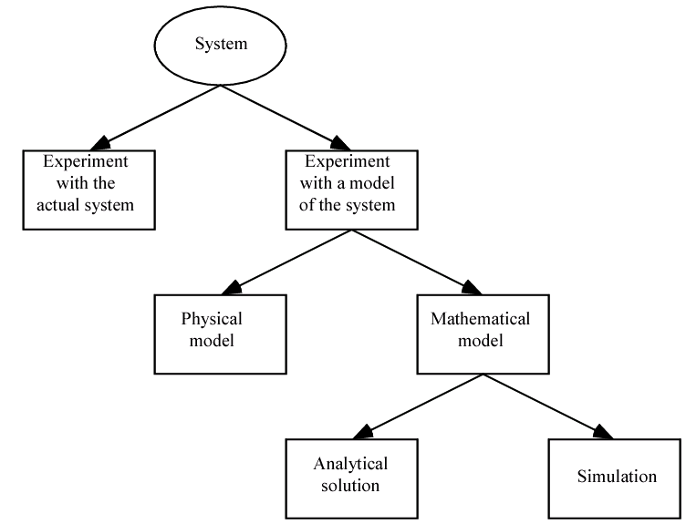
1.2 Systems, Models, and Simulation (cont’d.)
Ways to study a system
  Simulation is “method of last resort?” Maybe …
  But with simulation there’s no need (or less need) to “look where the light is”
Simulation Modeling and Analysis – Chapter 1 – Basic Simulation Modeling
Slide <number> of 51
Notes:
Analytical Solution vs. Simulation: Once we have built a mathematical model, it must then be examined to see how it can be used to answer the
questions of interest about the system it is supposed to represent. If the model is simple enough, it may be possible to work with its relationships and
quantities to get an exact, analytical solution. In the d = rt example, if we know the distance to be traveled and the velocity, then we can work with the
model to get t = dlr as the time that will be required. This is a very simple, closed-form solution obtainable with just paper and pencil, but some analytical
solutions can become extraordinarily complex, requiring vast computing resources; inverting a large nonsparse matrix is a well-known example of a
situation in which there is an analytical formula known in principle, but obtaining it numerically in a given instance is far from trivial. If an analytical
solution to a mathematical model is available and is computationally efficient, it is usually desirable to study the model in this way rather than via a
simulation. However, many systems are highly complex, so that valid mathematical models of them are themselves complex, precluding any
possibility of an analytical solution. In this case, the model must be studied by means of simulation, i.e. , numerically exercising the model for the inputs
in question to see how they affect the output measures of performance.

Slide 11
1.2 Systems, Models, and Simulation (cont’d.)
Classification of simulation models
  Static vs. dynamic
  Deterministic vs. stochastic
  Continuous vs. discrete
Most operational models are dynamic, stochastic, and discrete – will be called discrete-event simulation models
Simulation Modeling and Analysis – Chapter 1 – Basic Simulation Modeling
Slide <number> of 51

Slide 12
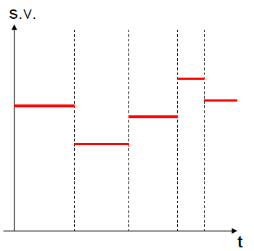
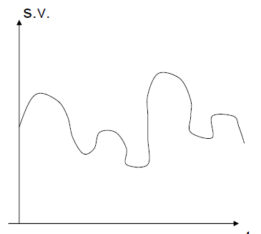
Discrete versus Continuous System
Discrete system
State variable changes at discrete points in time (events)
Numerical method: use computational procedures to solve mathematical models
Continuous Systems
State variable changes continuously, as a function of time
Analytical method: use detective mathematical reasoning to define system and solve
Simulation Modeling and Analysis – Chapter 1 – Basic Simulation Modeling
Slide <number>

Slide 13
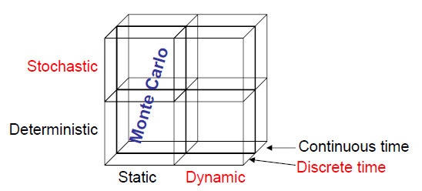
Types of Models
A simulation model –a particular type of mathematical model of a system. A mathematical model uses symbolic notations and mathematical equations to represent the system.
Static simulation–Monte Carlo simulation: represents a system at a particular point
in time.
Dynamic simulation: represents systems as they change over time.
Deterministic simulation: contains no random variables. Known set of inputs will result in a unique set of outputs
Stochastic simulation: random inputs -> random outputs
outputs –estimates of the true characteristics of the model.
Simulation Modeling and Analysis – Chapter 1 – Basic Simulation Modeling
Slide <number>
Notes:
The decision whether to use a discrete or a continuous model for a particular system depends on the specific objectives of the study. For example, a model of traffic flow on a freeway would be discrete if the characteristics and movement of individual cars are important. Alternatively, if the cars can be treated "in the aggregate,"
the flow of traffic can be described by differential equations in a continuous model.

Slide 14
1.3 DISCRETE-EVENT SIMULATION
Discrete-event simulation: Modeling of a system as it evolves over time by a representation where the state variables change instantaneously at separated points in time
  More precisely, state can change at only a countable number of points in time
  These points in time are when events occur
Event: Instantaneous occurrence that may change the state of the system
  Sometimes get creative about what an “event” is … e.g., end of simulation, make a decision about a system’s operation
Can in principle be done by hand, but usually done on computer
Simulation Modeling and Analysis – Chapter 1 – Basic Simulation Modeling
Slide <number> of 51

Slide 15
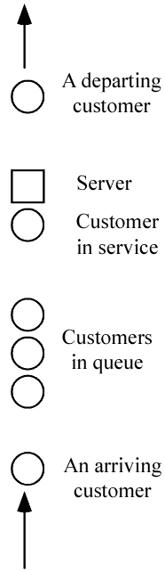
1.3 Discrete-Event Simulation (cont’d.)
Example: Single-server queue
  Estimate expected average delay in queue (line, not service)
  State variables
    Status of server (idle, busy) – needed to decide what to do with an arrival
    Current length of the queue – to know where to store an arrival that must wait in line
    Time of arrival of each customer now in queue – needed to compute time in queue when service starts
  Events
    Arrival of a new customer
    Service completion (and departure) of a customer
    Maybe – end-simulation event (a “fake” event) – whether this is an event depends on how simulation terminates (a modeling decision)
Simulation Modeling and Analysis – Chapter 1 – Basic Simulation Modeling
Slide <number> of 51

Slide 16
1.3.1 Time-Advance Mechanisms
Simulation clock: Variable that keeps the current value of (simulated) time in the model
  Must decide on, be consistent about, time units
  Usually no relation between simulated time and (real) time needed to run a model on a computer
Two approaches for time advance
  Next-event time advance (usually used) … described in detail below
  Fixed-increment time advance (seldom used) … Described in Appendix 1A
    Generally introduces some amount of modeling error in terms of when events should occur vs. do occur
    Forces a tradeoff between model accuracy and computational efficiency
Simulation Modeling and Analysis – Chapter 1 – Basic Simulation Modeling
Slide <number> of 51

Slide 17
1.3.1 Time-Advance Mechanisms (cont’d.)
More on next-event time advance
  Initialize simulation clock to 0
  Determine times of occurrence of future events – event list
  Clock advances to next (most imminent) event, which is executed
    Event execution may involve updating event list
  Continue until stopping rule is satisfied (must be explicitly stated)
  All state changes occur only at event times for a discrete event simulation model, Clock “jumps” from one event time to the next, and doesn’t “exist” for times between successive events … periods of inactivity are ignored
Simulation Modeling and Analysis – Chapter 1 – Basic Simulation Modeling
Slide <number> of 51
Notes:
This process of advancing the simulation clock from one event time to another is continued until eventually some prespecified stopping condition is satisfied. Since all state
changes occur only at event times for a discrete-event simulation model, periods of inactivity are skipped over by jumping the clock from event time to
event time. (Fixed-increment time advance does not skip over these inactive periods, which can eat up a lot of computer Time

Slide 18
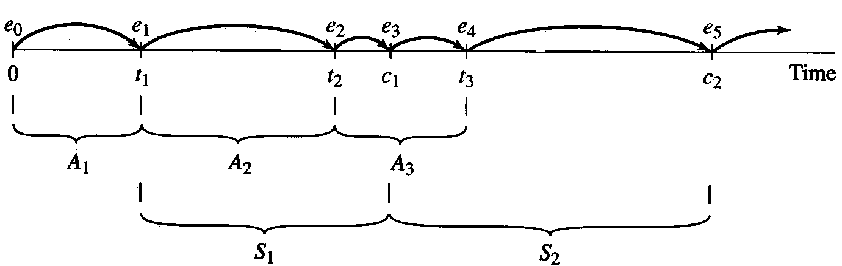
1.3.1 Time-Advance Mechanisms (cont’d.)
Next-event time advance for the single-server queue
    t_{i} = time of arrival of ith customer (t₀ = 0)
    A_{i} = t_{i} – t_{i-1} = interarrival time between (i-1)st and ith customers (usually assumed to be a random variable from some probability distribution)
    S_{i} = service-time requirement of ith customer (another random variable)
    D_{i} = delay in queue of ith customer
    C_{i} = t_{i} + D_{i} + S_{i} = time ith customer completes service and departs
    e_{j} = time of occurrence of the jth event (of any type), j = 1, 2, 3, …
  Possible trace of events (detailed narrative in text)
Simulation Modeling and Analysis – Chapter 1 – Basic Simulation Modeling
Slide <number> of 51
Notes:
Consider a service facility with a single server---e.g. , a one·operator barbershop or an information desk at an airport-for which we would like to
estimate the (expected) average delay in queue (line) of arriving customers, where the delay in queue of a customer is the length of the time interval from the
instant of his arrival at the facility to the instant he begins being served. For the objective of estimating the average delay of a customer, the state variables for a
discrete·event simulation model of the facility would be the status of the server , i.e., either idle or busy, the number of customers waiting in queue to be served (if any), and the time of arrival of each person waiting in queue. The status of the server is needed to determine, upon a customer's arrival , whether the customer can be served immediately or must join the end of the queue. When the server completes serving a customer, the number of customers in the queue is used to determine whether the server will become idle or begin serving the first customer in the queue. The time of arrival of a customer is needed to compute his delay in queue, which is the time he begins being served (which will be known) minus his time of arrival. There are two types of events for this system: the arrival of a customer and the completion of service for a customer, which results in the customer's departure. An arrival is an event since it causes the (state variable) server status to change from idle to busy or the (state variable) number of customers in the queue to increase by 1. Correspondingly, a departure is an event because it causes the server status to change from busy to idle or the number of customers in the queue to decrease by 1.

Slide 19
1.3.1 Time-Advance Mechanisms (cont’d.)
At time e₀ = 0 the status of server is idle, and the first arrival time is t₁ determined by generating A₁
Simulation clock is advanced from e₀ to the time of next event e₁ = t₁
At t₁ server is idle, customer enters service and has delay D₁ = 0 and after completing service generates S1
Time of second arrival t₂ = t₁ + A₂
Customer arriving at t₂ finds server busy, number of customers in queue is increased to 1.
Time of third arrival t₃ = t₂ + A₃
Delay in the queue D₂= c₁- t₂
Service completion time c₂= c₁- S₂
Simulation Modeling and Analysis – Chapter 1 – Basic Simulation Modeling
Slide <number> of 51

Slide 20
1.3.2 Components and Organization of a Discrete-Event Simulation Model
Each simulation model must be customized to target system
But there are several common components, general organization
  System state – variables to describe state
  Simulation clock – variable giving current value of simulated time
  Event list – times of future events (as needed)
  Statistical counters – variables to accumulate quantities for output
  Initialization routine – subprogram to initialize model at time 0
  Timing routine – subprogram to determine next event time, type; advance clock
  Event routines – subprogram to carry out logic for each event type
  Library routines – utility routines to generate random variates, etc.
  Report generator – subprogram to summarize, report results at end
  Main program – ties routines together, executes them in right order
Simulation Modeling and Analysis – Chapter 1 – Basic Simulation Modeling
Slide <number> of 51

Slide 21
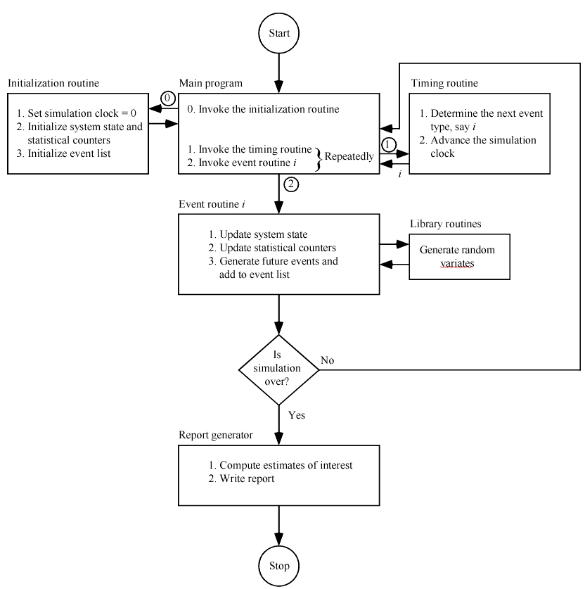
1.3.2 Components and Organization of a Discrete-Event Simulation Model (cont’d.)
Simulation Modeling and Analysis – Chapter 1 – Basic Simulation Modeling
Slide <number> of 51
Notes:
The main program invokes event routine i, where typically three types of activities occur: (1) the system state is updated to account for the fact that an event of type i has
occurred; (2) information about system performance is gathered by updating the statistical counters; and (3) the times of occurrence of future events are
generated and this information is added to the event list

Slide 22
1.3.2 Components and Organization of a Discrete-Event Simulation Model (cont’d.)
More on entities
  Objects that compose a simulation model
  Usually include customers, parts, messages, etc. … may include resources like servers
  Characterized by data values called attributes
  For each entity resident in the model there’s a record (row) in a list, with the attributes being the columns
Approaches to modeling
  Event-scheduling – as described above, coded in general-purpose language
  Process – focuses on entities and their “experience,” usually requires special-purpose simulation software
Simulation Modeling and Analysis – Chapter 1 – Basic Simulation Modeling
Slide <number> of 51

Slide 23
1.4 SIMULATION OF A SINGLE-SERVER QUEUEING SYSTEM
Will show how to simulate a specific version of the single-server queueing system
Book contains code in C and slides will focus on C version
Though simple, it contains many features found in all simulation models
Simulation Modeling and Analysis – Chapter 1 – Basic Simulation Modeling
Slide <number> of 51

Slide 24
1.4.1 Problem Statement
Recall single-server queueing model
Assume interarrival times are independent and identically distributed (IID) random variables
Assume service times are IID, and are independent of interarrival times
Queue discipline is FIFO
Start empty and idle at time 0
First customer arrives after an interarrival time, not at time 0
Stopping rule: When nth customer has completed delay in queue (i.e., enters service) … n will be specified as input
Simulation Modeling and Analysis – Chapter 1 – Basic Simulation Modeling
Slide <number> of 51
Notes:
A customer who arrives and finds the server idle enters service immediately, and the service times S" S2, ... of the successive customers are lID random variables that are independent of the interarrival times. A customer who arrives and finds the server busy joins the end of a single queue. Upon completing service for a customer, the server chooses a customer from the queue (if any) in a first-in,. first-out (FlFO) manner.

Slide 25
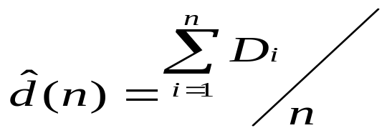
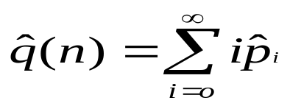

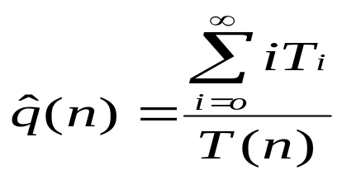
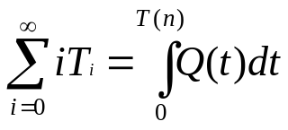
1.4.1 Problem Statement (cont’d.)
Quantities to be estimated
  Expected average delay in queue (excluding service time) of the n customers completing their delays, denoted by d(n)
  Expected average number of customers in queue (excluding any in service), denoted by q(n)
    A continuous-time average
    Where pi is observed proportion of time during simulation. T_{i} is total time during simulation and T(n)= T₀ + T₁ +………………..
    Area under curve is an integral
Simulation Modeling and Analysis – Chapter 1 – Basic Simulation Modeling
Slide <number> of 51
Notes:
The word "expected" in the definition of d(n) means this: On a given run of the simulation, the actual average delay observed of the n customers depends on the interarrival and service-time random variable observations that happen to have been obtained. Thus, the average delay on a given run of the simulation is properly
regarded as a random variable itself.

Slide 26
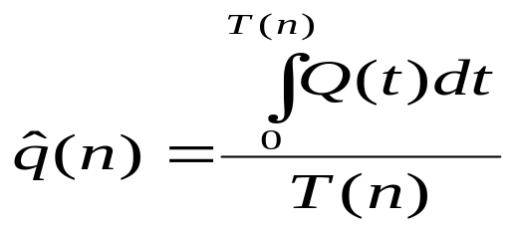
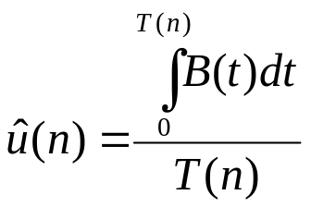
  Area under Q(t) = queue length at time t, divided by T(n) = time required to observe n delays in queue (simulation ends)
  Expected utilization (proportion of time busy) of the server
    Another continuous-time average
    Area under B(t) = server-busy function (1 if busy, 0 if idle at time t), divided by T(n)
  Many others are possible (maxima, minima, time or number in system, proportions, quantiles, variances …)
Simulation Modeling and Analysis – Chapter 1 – Basic Simulation Modeling
Slide <number> of 51

Slide 27
1.4.2 Intuitive Explanation
Given (for now) interarrival times (all times are in minutes):
  0.4, 1.2, 0.5, 1.7, 0.2, 1.6, 0.2, 1.4, 1.9, …
Given service times:
  2.0, 0.7, 0.2, 1.1, 3.7, 0.6, …
n = 6 delays in queue desired
“Hand” simulation:
  Display system, state variables, clock, event list, statistical counters … all after execution of each event
  Use above lists of interarrival, service times to “drive” simulation
  Stop when number of delays hits n = 6, compute output performance measures
Simulation Modeling and Analysis – Chapter 1 – Basic Simulation Modeling
Slide <number> of 51

Slide 28
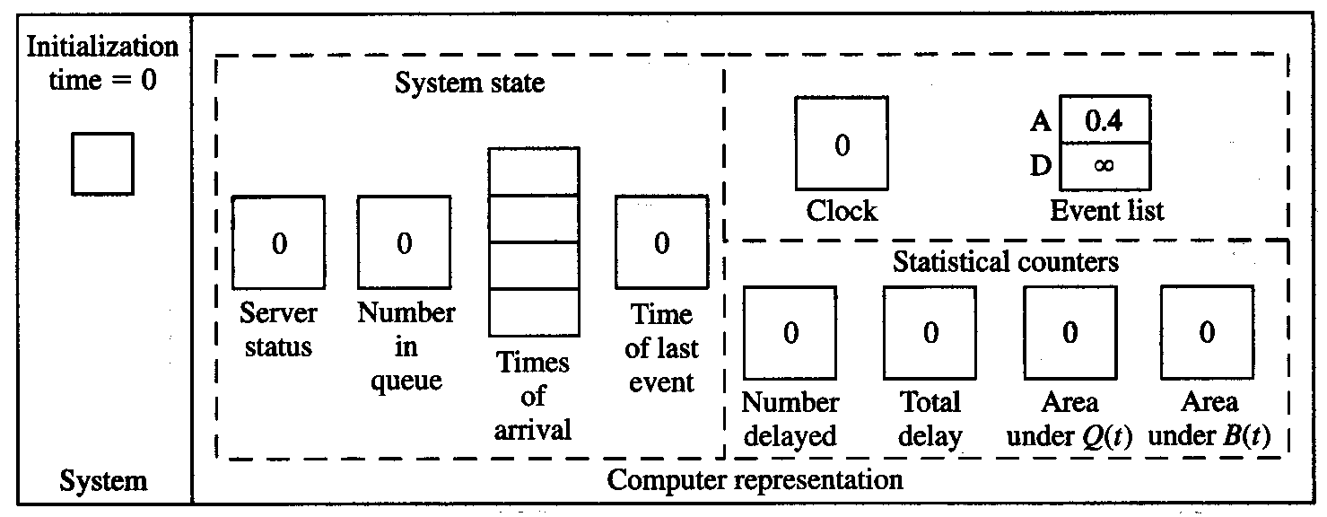
1.4.2 Intuitive Explanation (cont’d)
Status shown is after all changes have been made in each case …
Interarrival times: 0.4, 1.2, 0.5, 1.7, 0.2, 1.6, 0.2, 1.4, 1.9, …
Service times: 2.0, 0.7, 0.2, 1.1, 3.7, 0.6, …
Simulation Modeling and Analysis – Chapter 1 – Basic Simulation Modeling
Slide <number> of 51
Notes:
We begin our explanation of how to simulate a single-server queueing system by showing how its simulation model would be represented inside the computer
at time eo = 0 and the times e l' e2 , . . . , e 13 at which the 13 successive events occur that are needed to observe the desired number, n = 6, of delays in
queue. Thus, between time 0 and the time of the first arrival there is 0.4 time unit, between the arrivals of the first and second customers there are 1.2 time units,
etc., and the service time required for the first customer is 2.0 time units, etc. Figure 1. 7 gives a snapshot of the system itself and of a computer representation of the system at each of the times eo = 0, e, = 0.4, ... ,en = 8.6. In the "system" pictures, the square represents the server, and circles represent customers; the numbers inside the customer circles are the times of their arrivals. In the "computer representation" pictures, the values of the variables shown are .after all processing has been completed at that event.

Slide 29
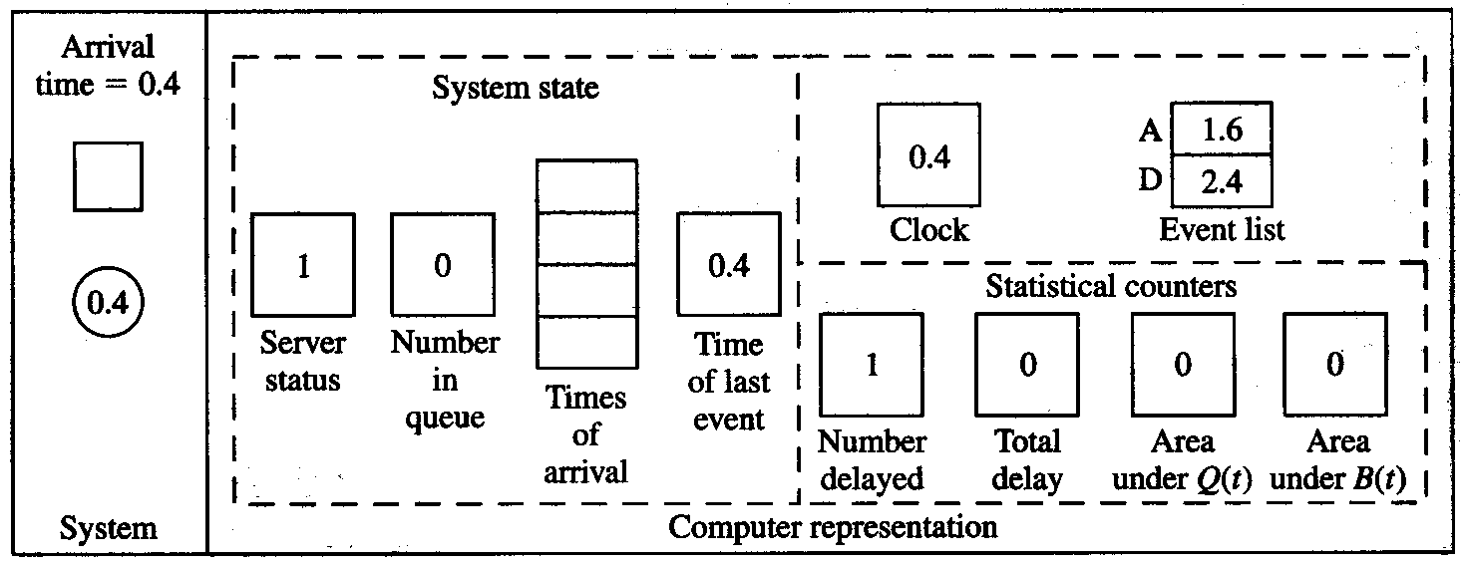
1.4.2 Intuitive Explanation (cont’d)
Interarrival times: 0.4, 1.2, 0.5, 1.7, 0.2, 1.6, 0.2, 1.4, 1.9, …
Service times: 2.0, 0.7, 0.2, 1.1, 3.7, 0.6, …
t+A₂= 0.4+1.2=1.6
Departure =0.4+2.0=2.4
Q(t) is updated by adding in the product of previous value of
Q(t) times the width of interval of time from last event to now, t- time
Of last event = 0.4-0
Simulation Modeling and Analysis – Chapter 1 – Basic Simulation Modeling
Slide <number> of 51

Slide 30
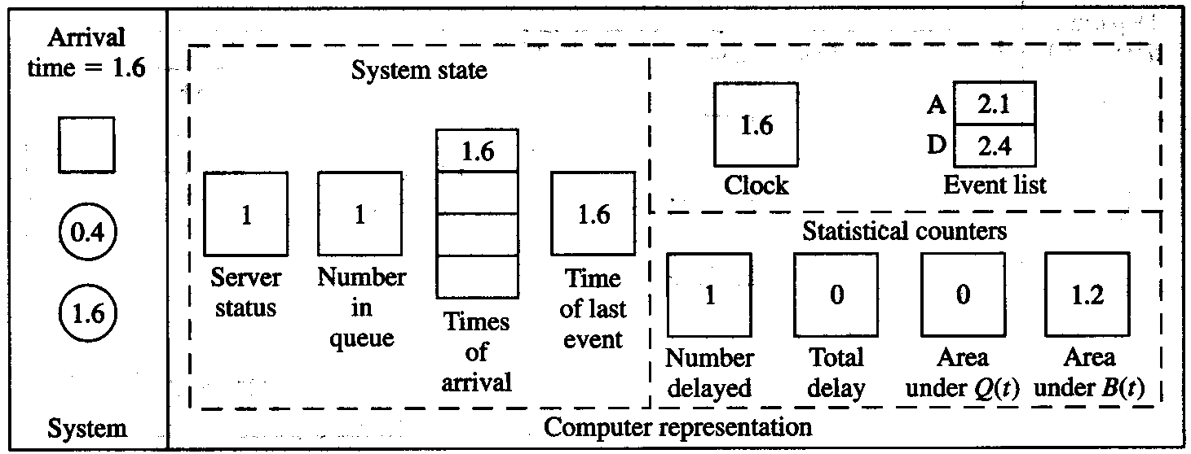
1.4.2 Intuitive Explanation (cont’d)
Interarrival times: 0.4, 1.2, 0.5, 1.7, 0.2, 1.6, 0.2, 1.4, 1.9, …
Service times: 2.0, 0.7, 0.2, 1.1, 3.7, 0.6, …
t+A3=0.5+1.6=2.1
Q(t) is increased by 0 times the time since the last event,
1.6-0.4=1.2
B(t) is increased by 1 times the same interval of time, 1.2
Simulation Modeling and Analysis – Chapter 1 – Basic Simulation Modeling
Slide <number> of 51

Slide 31
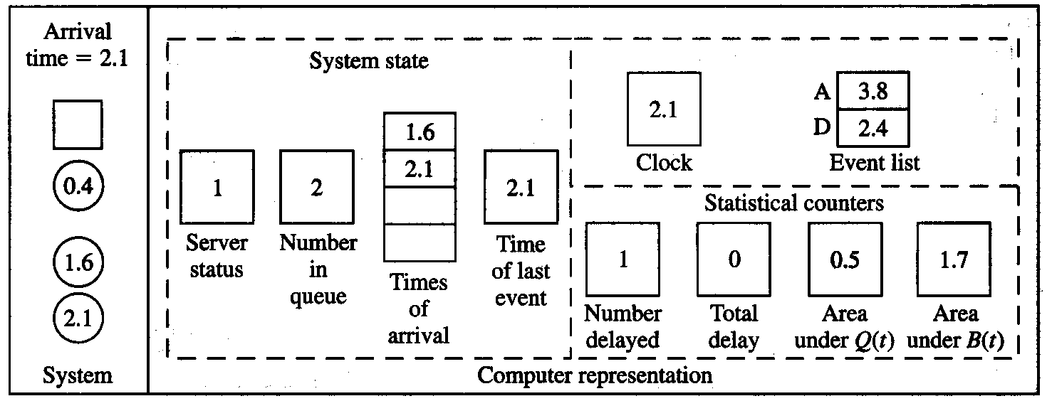
1.4.2 Intuitive Explanation (cont’d)
Interarrival times: 0.4, 1.2, 0.5, 1.7, 0.2, 1.6, 0.2, 1.4, 1.9, …
Service times: 2.0, 0.7, 0.2, 1.1, 3.7, 0.6, …
t+A₄=2.1+1.7=3.8
Q(t) is increased by adding in 1, 2.1-1.6= 0.5
B(t) is increased by 1 x (2.1 – 1.6)= 0.5
1.2+0.5=1.7
Simulation Modeling and Analysis – Chapter 1 – Basic Simulation Modeling
Slide <number> of 51

Slide 32
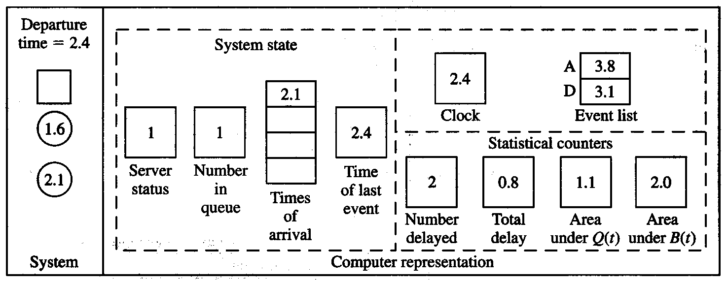
1.4.2 Intuitive Explanation (cont’d)
Interarrival times: 0.4, 1.2, 0.5, 1.7, 0.2, 1.6, 0.2, 1.4, 1.9, …
Service times: 2.0, 0.7, 0.2, 1.1, 3.7, 0.6, …
Next departure in the event list is 2.4+0.7=3.1
Delay= current time – 2nd customer’s time of arrival
D₂= 2.4- 1.6= 0.8
Q(t)= 2 x (2.4- 2.1)=0.6 Q(t) = 0.5+0.6=1.1
B(t)= 1 x (2.4 -2.1 ) = 0.3 B(t) = 1.7 +0.3 =2.0
Simulation Modeling and Analysis – Chapter 1 – Basic Simulation Modeling
Slide <number> of 51

Slide 33
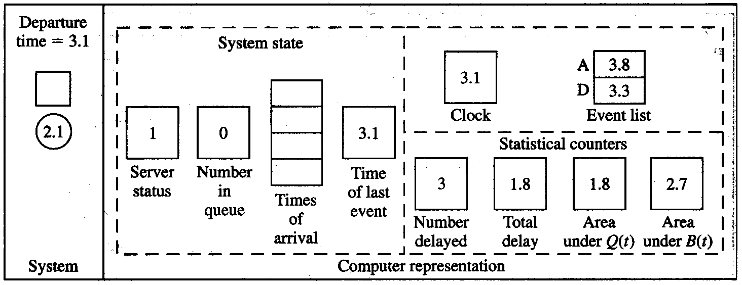
1.4.2 Intuitive Explanation (cont’d)
Interarrival times: 0.4, 1.2, 0.5, 1.7, 0.2, 1.6, 0.2, 1.4, 1.9, …
Service times: 2.0, 0.7, 0.2, 1.1, 3.7, 0.6, …
Next departure in the event list is 3.1+0.2=3.3
Delay= current time – 3rd customer’s time of arrival
D₃= 3.1- 2.1= 1.0
Q(t)= 1 x (3.1- 2.4)=0.7 Q(t) = 0.7+1.1=1.8
B(t)= 1 x (3.1- 2.4) = 0.7 B(t) = 0.7 + 2.0 =2.7
Simulation Modeling and Analysis – Chapter 1 – Basic Simulation Modeling
Slide <number> of 51

Slide 34
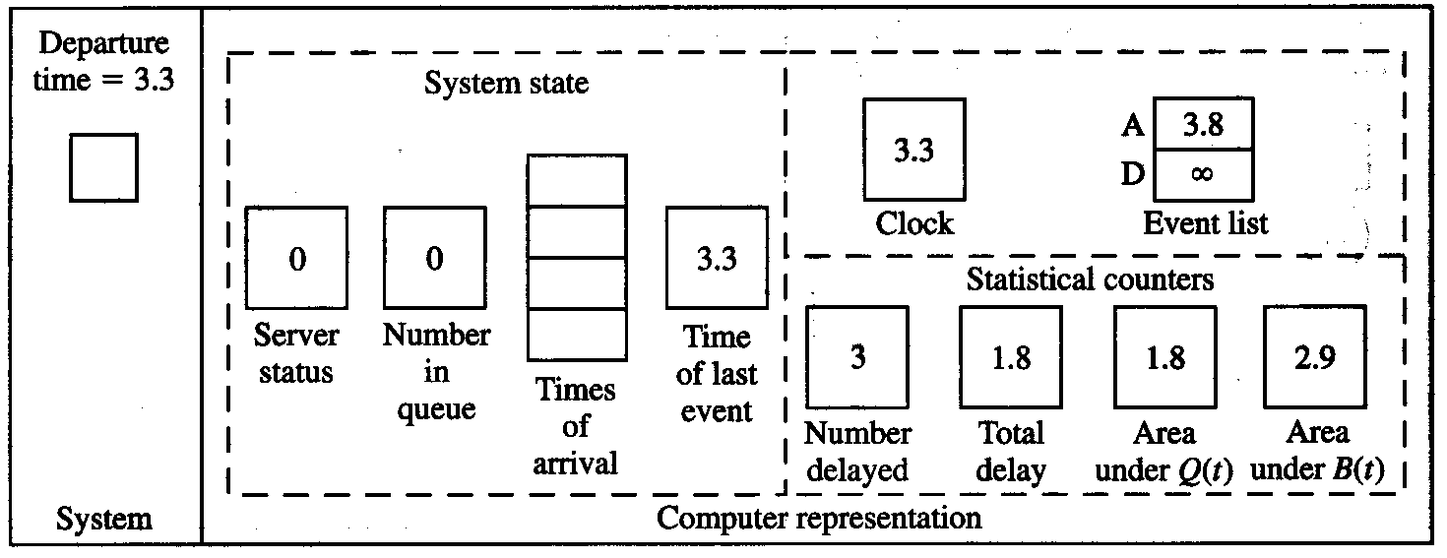
1.4.2 Intuitive Explanation (cont’d)
Interarrival times: 0.4, 1.2, 0.5, 1.7, 0.2, 1.6, 0.2, 1.4, 1.9, …
Service times: 2.0, 0.7, 0.2, 1.1, 3.7, 0.6, …
Simulation Modeling and Analysis – Chapter 1 – Basic Simulation Modeling
Slide <number> of 51

Slide 35
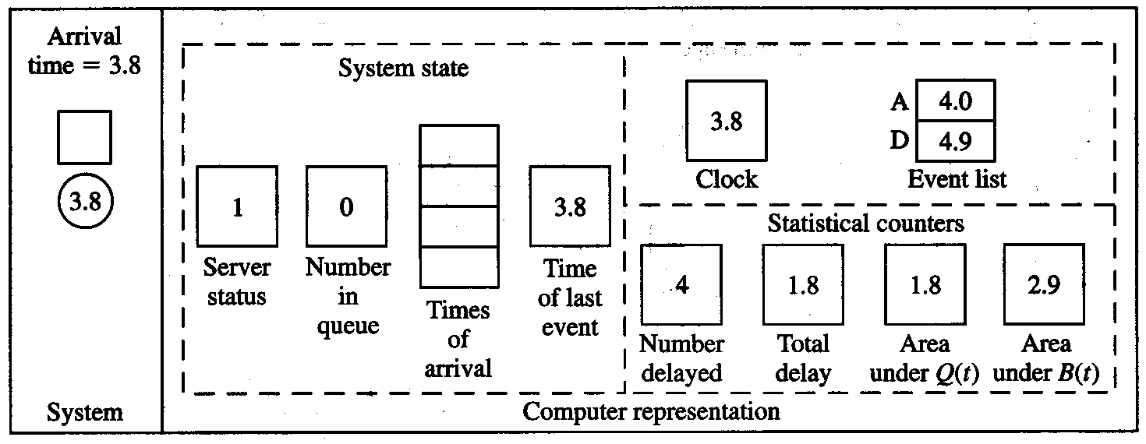
1.4.2 Intuitive Explanation (cont’d)
Interarrival times: 0.4, 1.2, 0.5, 1.7, 0.2, 1.6, 0.2, 1.4, 1.9, …
Service times: 2.0, 0.7, 0.2, 1.1, 3.7, 0.6, …
t+A₅=3.8+0.2=4.0
Next departure in the event list is 3.8+1.1= 4.9
Simulation Modeling and Analysis – Chapter 1 – Basic Simulation Modeling
Slide <number> of 51

Slide 36
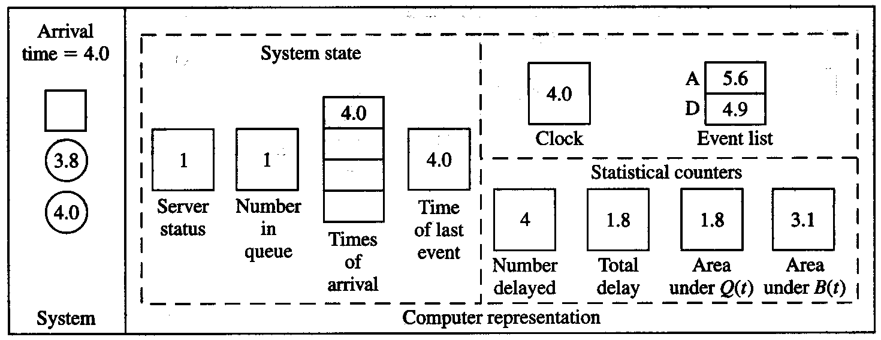
1.4.2 Intuitive Explanation (cont’d)
Interarrival times: 0.4, 1.2, 0.5, 1.7, 0.2, 1.6, 0.2, 1.4, 1.9, …
Service times: 2.0, 0.7, 0.2, 1.1, 3.7, 0.6, …
t+A₆=4.0+1.6= 5.6
B(t)= 1 x (4.0- 3.8) = 0.2 B(t) = 0.2 + 2.9 = 3.1
Simulation Modeling and Analysis – Chapter 1 – Basic Simulation Modeling
Slide <number> of 51

Slide 37
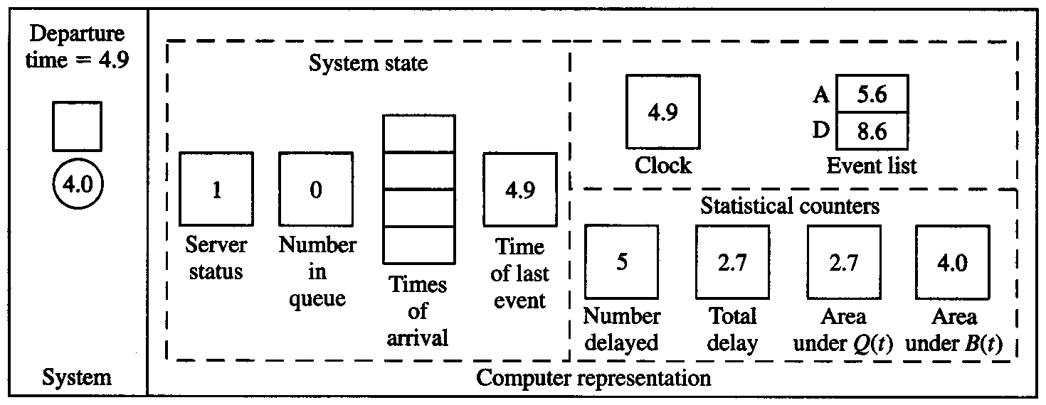
1.4.2 Intuitive Explanation (cont’d)
Interarrival times: 0.4, 1.2, 0.5, 1.7, 0.2, 1.6, 0.2, 1.4, 1.9, …
Service times: 2.0, 0.7, 0.2, 1.1, 3.7, 0.6, …
Next departure in the event list is 4.9 +3.7 =8.6
Delay= current time – 4th customer’s time of arrival
Delay = 4.9 – 4.0 = 0.9
Q(t)= 1 x (4.9- 4.0)=0.9 Q(t) = 1.8+ 0.9 = 2.7
B(t)= 1 x (4.9- 4.0) = 0.9 B(t) = 3.1 + 0.9 = 4.0
Simulation Modeling and Analysis – Chapter 1 – Basic Simulation Modeling
Slide <number> of 51

Slide 38
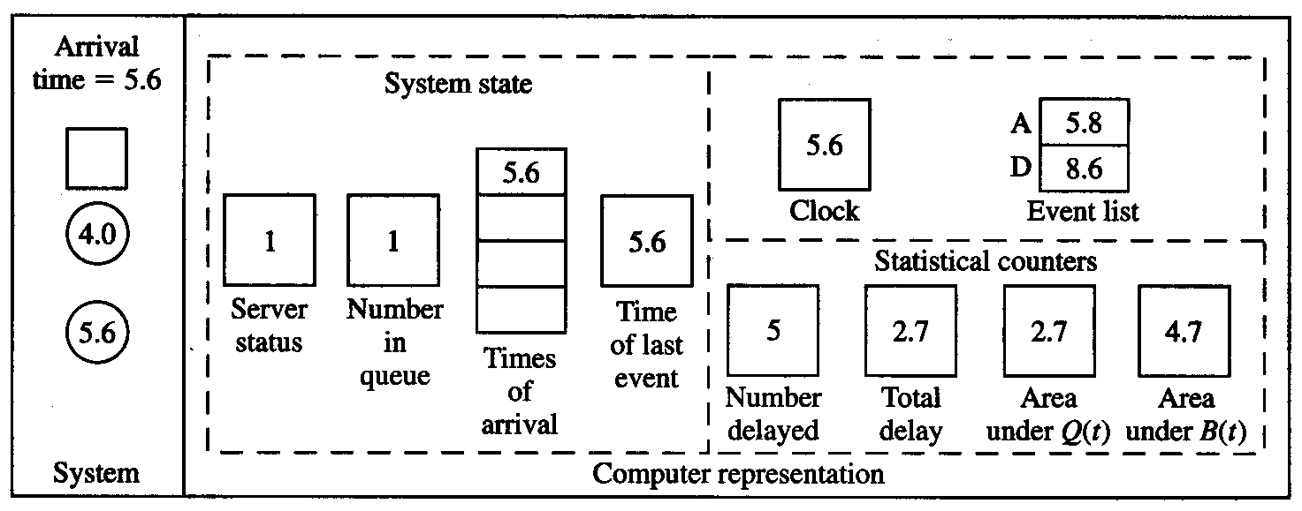
1.4.2 Intuitive Explanation (cont’d)
Interarrival times: 0.4, 1.2, 0.5, 1.7, 0.2, 1.6, 0.2, 1.4, 1.9, …
Service times: 2.0, 0.7, 0.2, 1.1, 3.7, 0.6, …
Simulation Modeling and Analysis – Chapter 1 – Basic Simulation Modeling
Slide <number> of 51

Slide 39
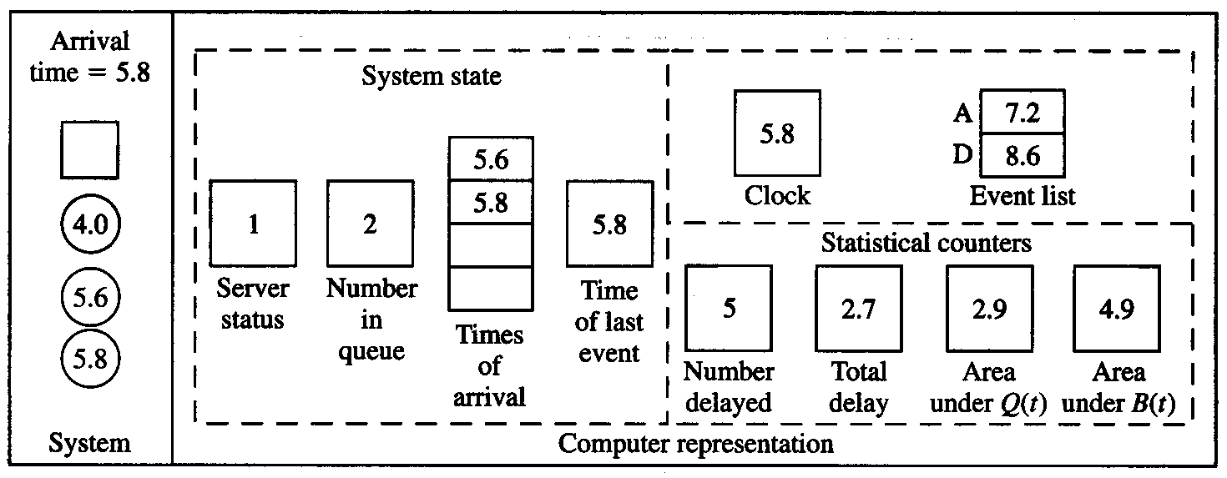
1.4.2 Intuitive Explanation (cont’d)
Interarrival times: 0.4, 1.2, 0.5, 1.7, 0.2, 1.6, 0.2, 1.4, 1.9, …
Service times: 2.0, 0.7, 0.2, 1.1, 3.7, 0.6, …
Simulation Modeling and Analysis – Chapter 1 – Basic Simulation Modeling
Slide <number> of 51

Slide 40
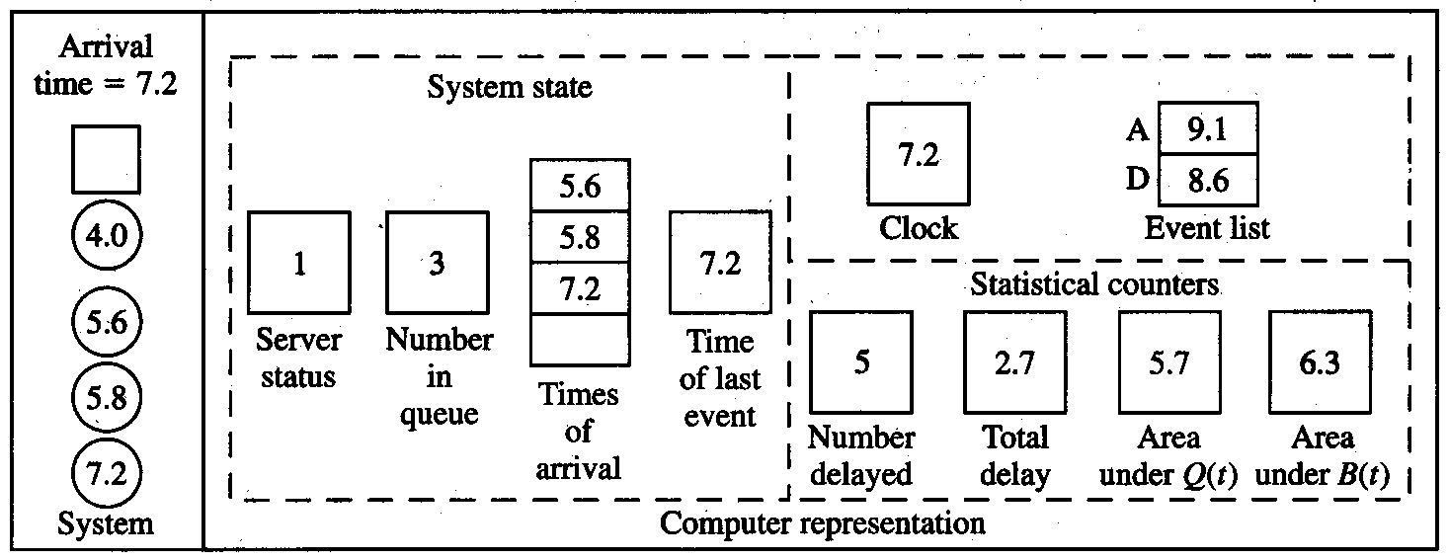
1.4.2 Intuitive Explanation (cont’d)
Interarrival times: 0.4, 1.2, 0.5, 1.7, 0.2, 1.6, 0.2, 1.4, 1.9, …
Service times: 2.0, 0.7, 0.2, 1.1, 3.7, 0.6, …
Simulation Modeling and Analysis – Chapter 1 – Basic Simulation Modeling
Slide <number> of 51

Slide 41
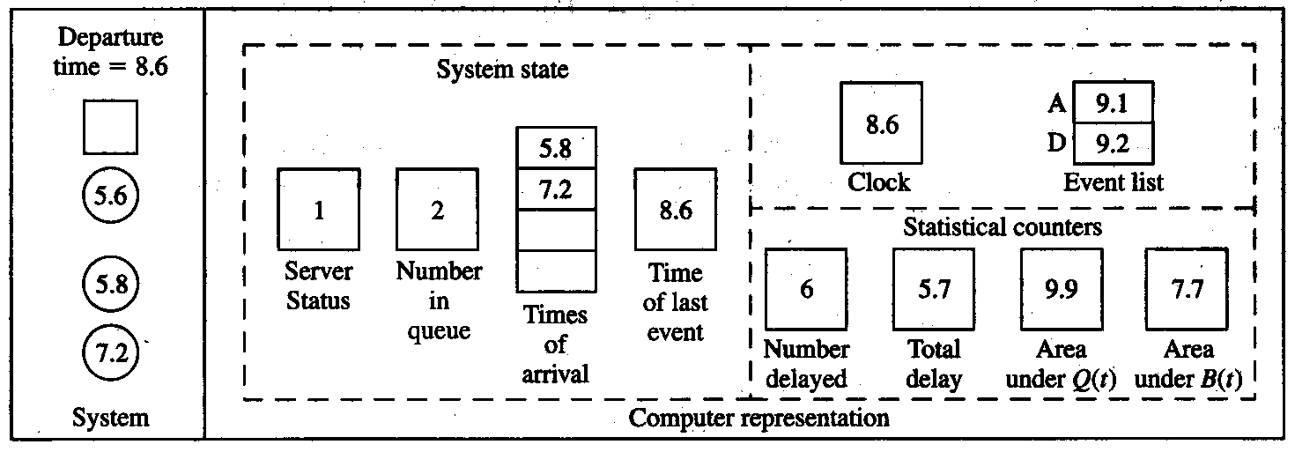
1.4.2 Intuitive Explanation (cont’d)
Interarrival times: 0.4, 1.2, 0.5, 1.7, 0.2, 1.6, 0.2, 1.4, 1.9, …
Service times: 2.0, 0.7, 0.2, 1.1, 3.7, 0.6, …
Final output performance measures:
Average delay in queue = 5.7/6 = 0.95 min./cust.
Time-average number in queue = 9.9/8.6 = 1.15 custs.
Server utilization = 7.7/8.6 = 0.90 (dimensionless)
Simulation Modeling and Analysis – Chapter 1 – Basic Simulation Modeling
Slide <number> of 51

Slide 42
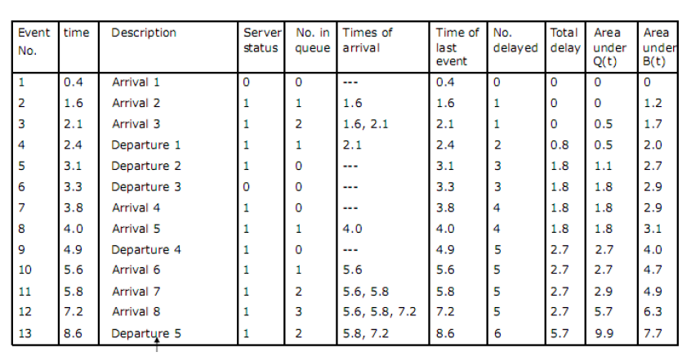
Simulation Result
Simulation Modeling and Analysis – Chapter 1 – Basic Simulation Modeling
Slide <number> of 51

Slide 43
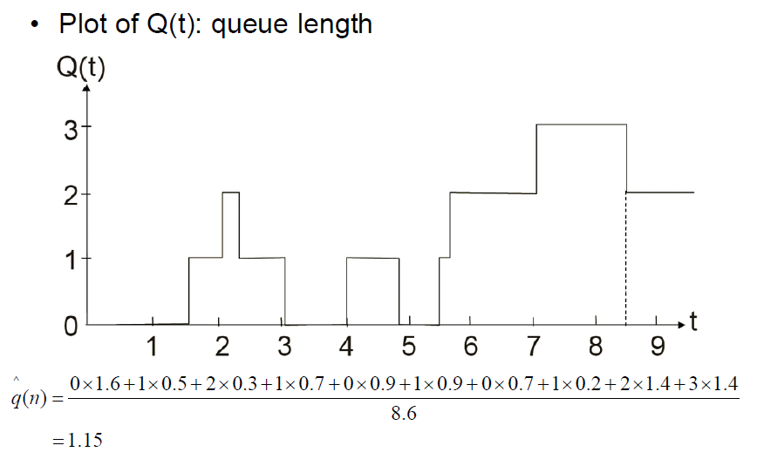
Expected Queue Lenth
Simulation Modeling and Analysis – Chapter 1 – Basic Simulation Modeling
Slide <number> of 51

Slide 44
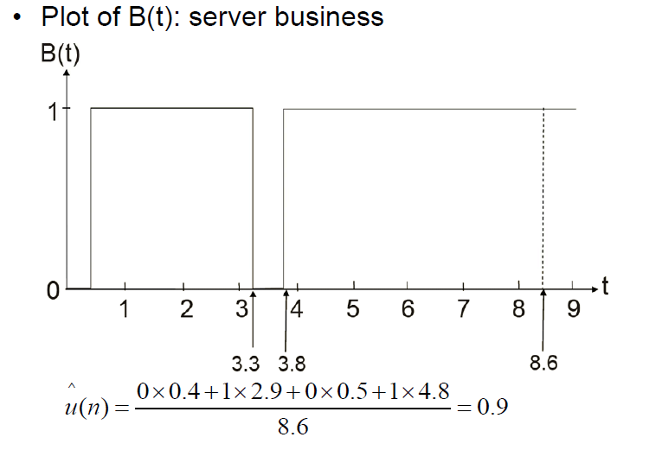
Expected Server Utilization
Simulation Modeling and Analysis – Chapter 1 – Basic Simulation Modeling
Slide <number> of 51

Slide 45
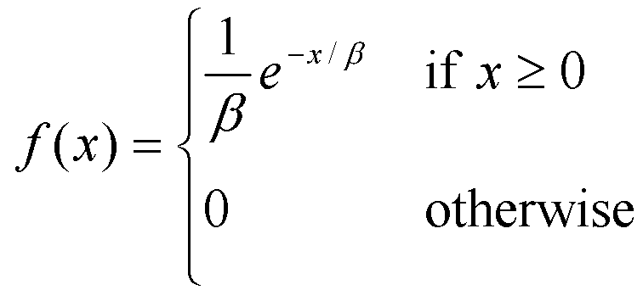
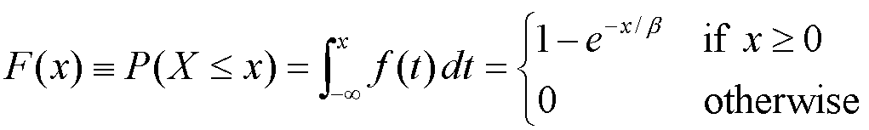
1.4.3 Program Organization and Logic
C program to do this model
Event types: 1 for arrival, 2 for departure
  Modularize for initialization, timing, events, library, report, main
Changes from hand simulation:
  Stopping rule: n = 1000 (rather than 6)
  Interarrival and service times “drawn” from an exponential distribution (mean β = 1 for interarrivals, 0.5 for service times)
    Density function
    Cumulative distribution function
Simulation Modeling and Analysis – Chapter 1 – Basic Simulation Modeling
Slide <number> of 51

Slide 46
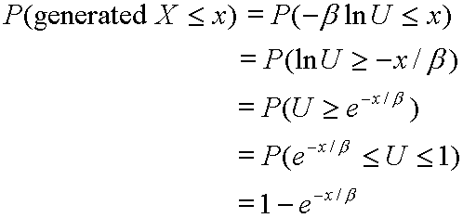
1.4.3 Program Organization and Logic (cont’d.)
How to “draw” (or generate) an observation (variate) from an exponential distribution?
Proposal:
  Assume a perfect random-number generator that generates IID variates from a continuous uniform distribution on [0, 1] … denoted the U(0, 1) distribution … see Chap. 7
  Algorithm:
    1. Generate a random number U
    2. Return X = – β ln U
  Proof that algorithm is correct:
Simulation Modeling and Analysis – Chapter 1 – Basic Simulation Modeling
Slide <number> of 51

Slide 47
1.4.8 Determining the Events and Variables
For complex models, it might not be obvious what the events are
Also difficult to specify state variables
Event-graph method (Schruben 1983, and subsequent papers) gives formal graph-theoretic method of analyzing event structure
Can analyze what needs to be initialized, possibility of combining events to simplify model
Events are represented by nodes, connected by directed arcs, showing how events may be scheduled from other events and from themselves.
Simulation Modeling and Analysis – Chapter 1 – Basic Simulation Modeling
Slide <number> of 51

Slide 48
Event-graph method
Arrival event schedules another future occurrence of itself and a departure event
Departure event schedules another future occurrence of itself.
Arrival event must be initially scheduled in order to get simulation going.
Arrival
Departure
Simulation Modeling and Analysis – Chapter 1 – Basic Simulation Modeling
Slide <number> of 51
Notes:
Event graphs connect the proposed set of events (nodes) by arcs indicating the type of event scheduling that can occur. In Fig. 1.51 we show the event graph for our
single-server queueing system, where the heavy smooth arrows indicate that an event at the end of the arrow may be scheduled from the event at the
beginning of the arrow in a (possibly) nonzero amount of time, and the thin jagged arrow indicates that the event at its end is scheduled initially. Thus, the
arrival event reschedules itself and may schedule a departure (in the case of an arrival who finds the server idle), and the departure event may reschedule itself
(if a departure leaves. behind someone else in queue).

Slide 49
Event-graph method
Event-graph of queuing model with fixed run length
A dummy end simulation event is added
This event is itself a strongly connected component without any combining arcs.
It is scheduled as a part of initialization.
Arrival
Departure
End simulation
Simulation Modeling and Analysis – Chapter 1 – Basic Simulation Modeling
Slide <number> of 51

Slide 50
Event-graph method
Other features are
Event canceling relations, ways to combine similar events into one, refining the event scheduling arcs to include conditional scheduling and incorporating state variables.
Software package (SIGMA) to build, execute a simulation model via event-graph representation
Simulation Modeling and Analysis – Chapter 1 – Basic Simulation Modeling
Slide <number> of 51
Notes:
In modeling a system, the event-graph technique can be used to simplify the structure and to detect certain kinds of errors, and is especially useful in
complex models involving a large number of interrelated events.

Slide 51
1.5 SIMULATION OF AN INVENTORY SYSTEM;
1.5.1 Problem Statement
A company that sells a single product would like to decide how many items it should have in inventory for each of the next n months.
The times between demands are IID exponential random variables with a mean of 0.1 month.
The size of demands, D, are IID random variables.
Simulation Modeling and Analysis – Chapter 1 – Basic Simulation Modeling
Slide <number> of 51

Slide 52
1.5 SIMULATION OF AN INVENTORY SYSTEM;
1.5.1 Problem Statement
Single-product inventory
Decide how many items to have in inventory for the next
n = 120 months; initially (time 0) have 60 items on hand
Demands against inventory
  Occur with inter-demand time ~ exponential with mean 0.1 month
  Demand size = 1, 2, 3, 4 with resp. probabilities 1/6, 1/3, 1/3, 1/6
Inventory review, reorder – stationary (s, S) policy … at beginning of each month, review inventory level = I
  If I ≥ s, don’t order (s is an input constant); no ordering cost
  If I < s, order Z = S – I items (S is an input constant, order “up to” S); ordering cost = 32 + 3Z; delivery lag ~ U(0.5, 1) month
Simulation Modeling and Analysis – Chapter 1 – Basic Simulation Modeling
Slide <number> of 51
Notes:
When an order is placed, the time required for it to arrive (called the delivery lag or lead time) is a random variable that is distributed uniformly between 0.5 and 1
month.

Slide 53
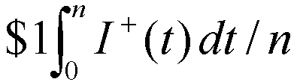
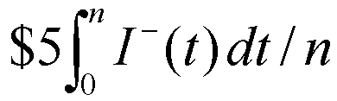
1.5.1 Problem Statement (cont’d.)
Demand in excess of current (physical) inventory is backlogged and satisfied by future deliveries.
Let I(t) be (accounting) inventory level at time t (+, 0, –)
  I⁺(t) = max {I(t), 0} = number of items physically on hand at time t
  I –(t) = max {–I(t), 0} = number of items in backlog at time t
Holding cost: Incur $1 per item per month in (positive) inventory
  Time-average (per month) holding cost =
Shortage cost: Incur $5 per item per month in backlog
  Time-average (per month) backlog cost =
Average total cost per month: Add ordering, holding, shortage costs per month
  Try different (s, S) combinations to try to reduce total cost
Simulation Modeling and Analysis – Chapter 1 – Basic Simulation Modeling
Slide <number> of 51

Slide 54
1.5.2 Program Organization and Logic
State variables: Inventory level, amount of an outstanding order, time of the last (most recent) event
Events:
  1. Arrival of an order from the supplier
  2. Demand for the product
  3. End of the simulation after n = 120 months
  4. Inventory evaluation (maybe ordering) at beginning of a month
Random variates needed
  Interdemand times: exponential, as in queueing model
  Delivery lags ~ U(0.5, 1): 0.5 + (1 – 0.5)U, where U ~ U(0, 1)
  Demand sizes: Split [0, 1] into subintervals of width 1/6, 1/3, 1/3, 1/6; generate U ~ U(0, 1); see which subinterval U falls in; return X = 1, 2, 3, or 4, respectively
Why the ordering
of event types
3 and 4?
Simulation Modeling and Analysis – Chapter 1 – Basic Simulation Modeling
Slide <number> of 51

Slide 55

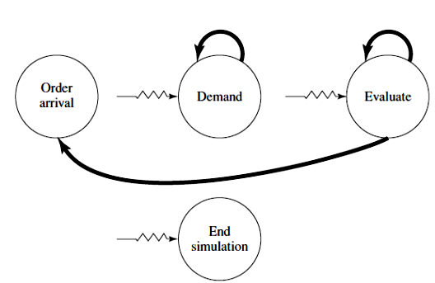
Event graph, inventory model
Simulation Modeling and Analysis – Chapter 1 – Basic Simulation Modeling
Slide <number>

Slide 56
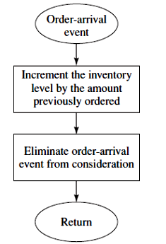
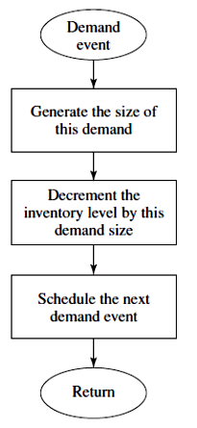
Inventry System
Flowchart for order-arrival routine
Flowchart for demand routine
Simulation Modeling and Analysis – Chapter 1 – Basic Simulation Modeling
Slide <number>

Slide 57
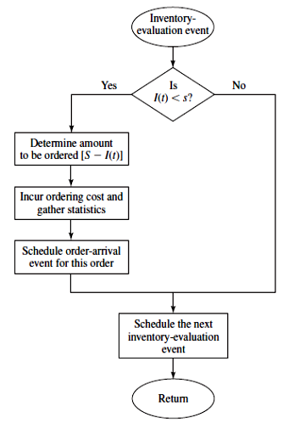
Flowchart for inventory evaluation routine, inventory model.
Simulation Modeling and Analysis – Chapter 1 – Basic Simulation Modeling
Slide <number>

Slide 58
1.6 ALTERNATIVE APPROACHES TO MODELING AND CODING SIMULATIONS
Parallel and distributed simulation
  Various kinds of parallel and distributed architectures
  Break up a simulation model in some way, run the different parts simultaneously on different parallel processors
  Different ways to break up model
    By support functions – random-number generation, variate generation, event-list management, event routines, etc.
    Decompose the model itself; assign different parts of model to different processors – message-passing to maintain synchronization, or forget synchronization and do “rollbacks” if necessary … “virtual time”
Web-based simulation
  Central simulation engine, submit “jobs” over the web
  Wide-scope parallel/distributed simulation
Simulation Modeling and Analysis – Chapter 1 – Basic Simulation Modeling
Slide <number> of 51

Slide 59
1.6.1 Parallel simulation
Model is decomposed into several logical process (LPs).
Individual LPs are assigned to different processors and work on its piece of model
LPs communicate with each other by sending time-stamped messages or events.
Two types of synchronization mechanisms:
Conservative Synchronization: The goal is to determine when it is safe to process a particular event, i.e., guarantee that no event will later be received by this LP with a smaller event time.
Simulation Modeling and Analysis – Chapter 1 – Basic Simulation Modeling
Slide <number> of 51

Slide 60
Parallel Simulation
Disadvantages
  Cannot fully exploit the parallelism available in a simulation application. If event A could possibly affect event B in any way, then A and B must be executed sequentially.
  A small change in the model can result in serious degradation in performance.
Optimistic synchronization: Violations of local causality constraint are allowed to occur but the synchronization mechanisms detects violations and recovers from them.
Disadvantages
  Incur overhead computations associated with executing rollbacks.
  Require more memory to save state of each LP periodically to recover from a roll back
Simulation Modeling and Analysis – Chapter 1 – Basic Simulation Modeling
Slide <number>

Slide 61
1.6.2 Distributed simulation and high level Architecture
Overall simulation model, composition of two or more individual simulation models located on networked computers.
HLA (High level architecture) is a software architecture to promote the reuse and interoperation of simulations.
A totally different use of simulation is to make independent replications, of a standalone simulation model on networked computers.
This helps to optimize the performance of a system by simulating a larger number of different system configurations in a given amount of time.
The simulation package AutoMod supports this concept.
Simulation Modeling and Analysis – Chapter 1 – Basic Simulation Modeling
Slide <number>

Slide 62
1.7 STEPS IN A SOUND SIMULATION STUDY
1. Formulate the problem and plan the study
  An iterative process, overall objectives of the study
  Performance measures, scope of the model
  System configurations, time frame
2. Collect data and define a model
  No single person or document is sufficient
  Specify model parameters and input probability distributions
  Choose the level of model detail : project objective, performance measures, data availability, computer constraints, time and money constraints.
  Start with a simple model and extend it as needed
Simulation Modeling and Analysis – Chapter 1 – Basic Simulation Modeling
Slide <number>

Slide 63
Steps
3. Is the assumption document valid?
  Ensure model assumptions are correct and complete
  Promote interactions among project members
  Take place before programming begins, to avoid significant reprogramming later
4. Construct a computer program and verify
  Program the model in programming language or simulation software
  Verify the simulation computer program
5. Make pilot runs for validation purposes
6. Is programmed model valid?
  If there is an existing system, then compare model and system performance measures
  Review the model results for correctness, use sensitivity analyses

Slide 64
steps
7. Design Experiment
Length of each simulation run
Length of the warmup period, if one is appropriate
Number of independent simulation runs using different random numbers
8. Make production runs
9. Analyze output data
  Determine absolute performance of certain system configurations
  Compare alternative system configurations
10 .Document, present and use results
  Document assumptions, computer program, and study’s results
  Present study’s results by using animation
  Results are used in decision making if they are both valid and credible.
Simulation Modeling and Analysis – Chapter 1 – Basic Simulation Modeling
Slide <number>

Slide 65
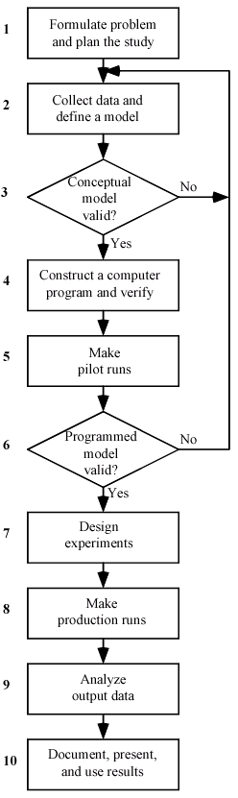
1.7 STEPS IN A SOUND SIMULATION STUDY
Simulation Modeling and Analysis – Chapter 1 – Basic Simulation Modeling
Slide <number> of 51

Slide 66
1.8 OTHER TYPES OF SIMULATION
Continuous simulation
  Typically, solve sets of differential equations numerically over time
  May involve stochastic elements
  Some specialized software available; some discrete-event simulation software will do continuous simulation as well
Combined discrete-continuous simulation
  Continuous variables described by differential equations
  Discrete events can occur that affect the continuously-changing variables
  A continuous state variable achieving a threshold value may cause a discrete event to occur
  Some discrete-event simulation software will do combined discrete-continuous simulation as well
Simulation Modeling and Analysis – Chapter 1 – Basic Simulation Modeling
Slide <number> of 51

Slide 67
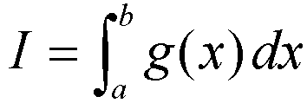
1.8 Other Types of Simulation (cont’d.)
Monte Carlo Simulation
  A scheme employing random numbers, U(0,1) random variates, which is used for solving certain stochastic or deterministic problems.
  No time element (usually)
  Wide variety of mathematical problems
  Suppose we want to evaluate the integral
  Where g(x) is a real valued function that is not analytically integrable.
Simulation Modeling and Analysis – Chapter 1 – Basic Simulation Modeling
Slide <number>

Slide 68
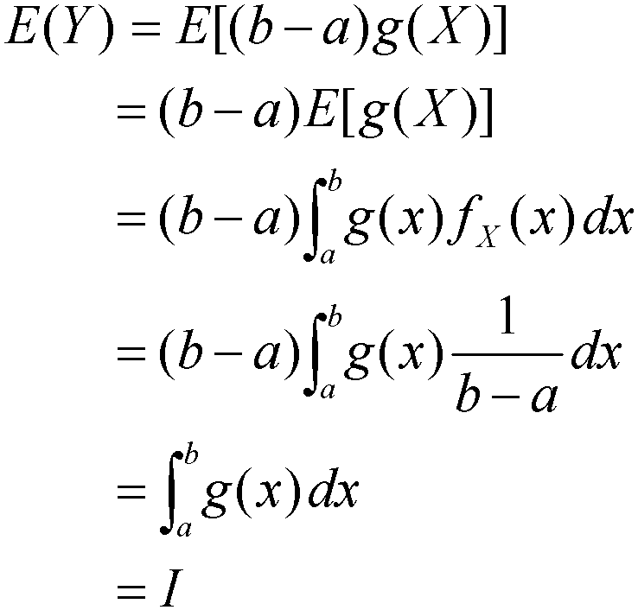
1.8 Other Types of Simulation (cont’d.)
Monte Carlo simulation
    Let X ~ U(a, b), and let Y = (b – a) g(X)
    Then expected value of Y is
    Where fx(x)=1/(b-a) is the probability density function of a U(a, b) random variable.
Simulation Modeling and Analysis – Chapter 1 – Basic Simulation Modeling
Slide <number> of 51
Notes:
Algorithm: Generate X ~ U(a, b), let Y = (b – a) g(X); repeat; average the Y’s … this average will be an unbiased estimator of I

Slide 69
1.8 Other Types of Simulation (cont’d.)
Spreadsheet simulation
  Discrete event simulation and monte carlo simulation can be done in spreadsheets such as Excel
  Excel provides random number generator, the ability to generate random values from some basic probability distributions (e.g., normal, uniform, binomial and Poisson), summary statistics and graphical plots such as histogram.
  Used in application areas such as finance, manufacturing, project management, oil and gas discovery.
  Limitations
  Only simple data structures are available
  Complex algorithms are difficult to implement
Simulation Modeling and Analysis – Chapter 1 – Basic Simulation Modeling
Slide <number>

Slide 70
1.9 ADVANTAGES, DISADVANTAGES OF SIMULATION
Advantages
  Simulation allows great flexibility in modeling complex systems, so simulation models can be highly valid
  Easy to compare alternatives
  Control experimental conditions
  Can study system with a very long time frame
Disadvantages
  Stochastic simulations produce only estimates – with noise
  Simulation models can be expensive to develop
  Simulations usually produce large volumes of output – need to summarize, statistically analyze appropriately
Simulation Modeling and Analysis – Chapter 1 – Basic Simulation Modeling
Slide <number> of 51
Notes:
Pitfalls
Failure to identify objectives clearly up front
In appropriate level of detail (both ways)
Inadequate design and analysis of simulation experiments
Inadequate education, training

Slide 71
PITFALLS OF SIMULATION
Pitfalls
  Failure to identify objectives clearly up front
  In appropriate level of detail (both ways)
  Inadequate design and analysis of simulation experiments
  Inadequate education, training
  Inappropriate simulation software
  Misunderstanding of simulation by management
Simulation Modeling and Analysis – Chapter 1 – Basic Simulation Modeling
Slide <number>

