Slide 1


2025-26

Slide 2
Table of Content
01
1
Introduction
6
System Result Overview
2
7
System Limitations
Literature Review
3
System Overview
8
Future Work
03
4
Dataset, Finetune
9
United Nation SDGS
5
Proposed Methodology
10
Conclusion
Human Re-Identification for Crowd Management
02

Slide 3
Introduction
01
01
Crowd Monitoring Need
02
Unique Counting Problem
Events require accurate people counting.
Returning persons may be counted again.
02
03
03
Human Re-ID Concept
04
Project Main Aim
Recognizes previously seen individuals.
Reduces repeated counting errors.
04
Human Re-Identification for Crowd Management
03

Slide 4
Literature Review
01
Paper (Year) | Focus | Method | Key Contribution
Wang et al. (2015) [1] | Feature learning | ResNet50 (CNN) | Strong deep feature extraction
Ye et al. (2022) [2] | Domain robustness | CNN models | Works under different environments
Zhou et al. (2019) [3] | Feature extraction | OSNet | Lightweight omni-scale
Mang Ye et al. (2024) [4] | Transformer Re-ID | Vision Transformer | Captures global dependencies
Sivakumar et al. (2024) [5] | Real-time tracking | YOLO + SORT | Fast detection & tracking
Basavaraja et al. (2024) [6] | Lightweight system | MobileNet-SSD | Efficient on CPU systems
Our Approach (2026) | Detection + Re-ID counting | YOLOv8 + OSNet | Combines detection with deep Re-ID
02
03
04
Human Re-Identification for Crowd Management
04

Slide 5
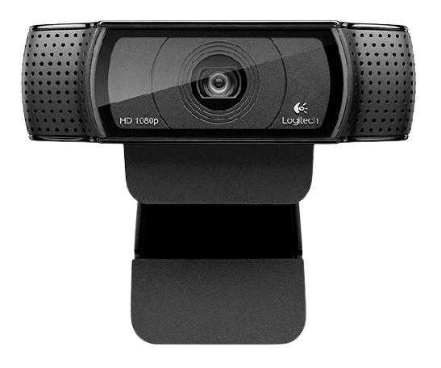
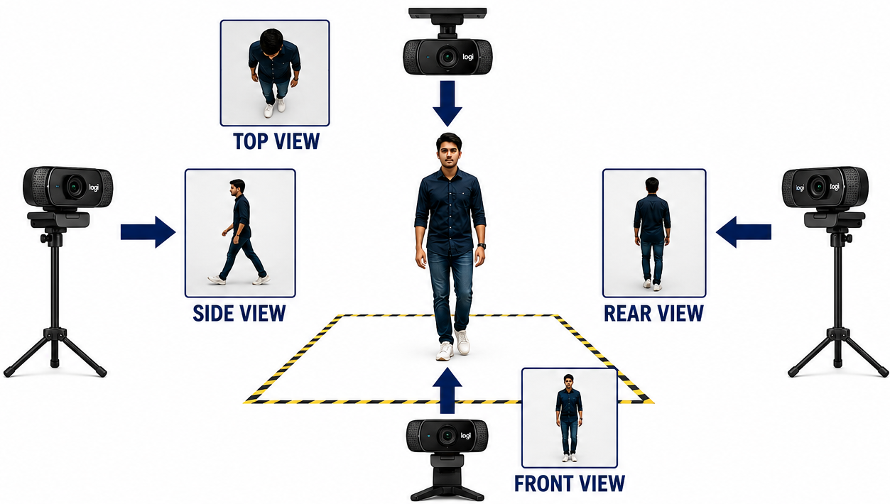
System Overview
01
Camera Specifications
Camera Views
02
03
Max Resolution: 1080 p
Camera mega pixel: 3
Focus type: Autofocus
04
Human Re-Identification for Crowd Management
05

Slide 6
IMPLEMENTATION
Dataset, Fine-Tuning & Engineering Choices
11,335
2,830
35
Training Images
Gallery Images
Query Images
OSNet Fine-Tuning
Identity Reference Set
Rank-1 Evaluation
14,200 cropped images · 30+ unique individuals · front, side & back views · normal & low light
Fine-Tuning Configuration
Base Model | OSNet-AIN x1.0
Epochs | 60
Loss | Triplet
Optimiser | AdamW
Feature Dim. | 512
Input Size | 256×128 px
Human Re-Identification for Crowd Management
06

Slide 7
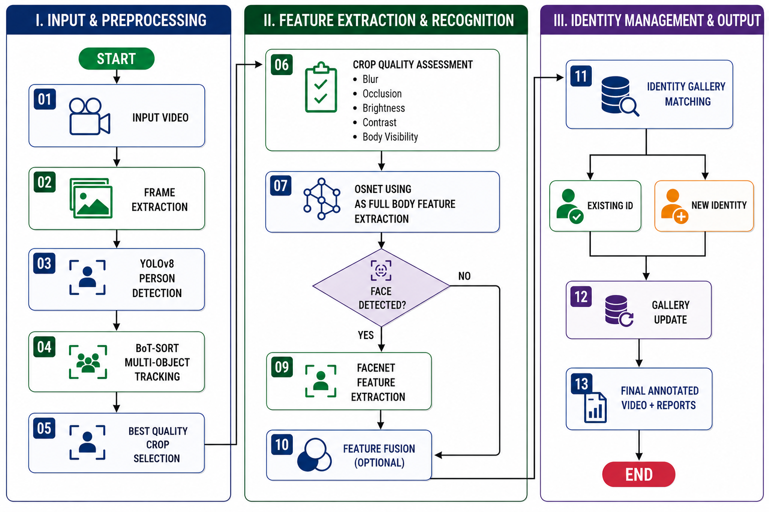
Proposed Methodology
01
02
03
08
04
Human Re-Identification for Crowd Management
07

Slide 8
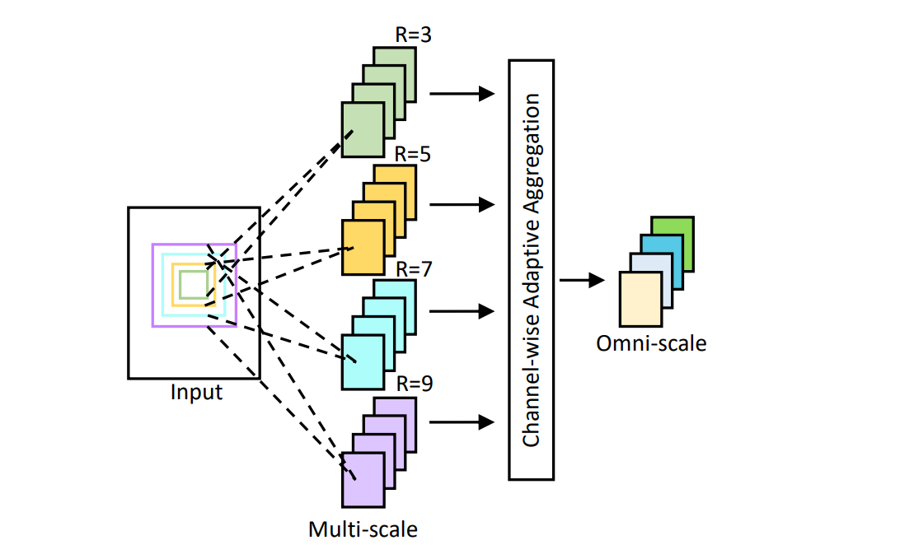
Proposed Methodology
01
02
08
03
04
[7]
Human Re-Identification for Crowd Management
08

Slide 9
Proposed Methodology
01
08
02
03
08
04
Human Re-Identification for Crowd Management
09

Slide 10
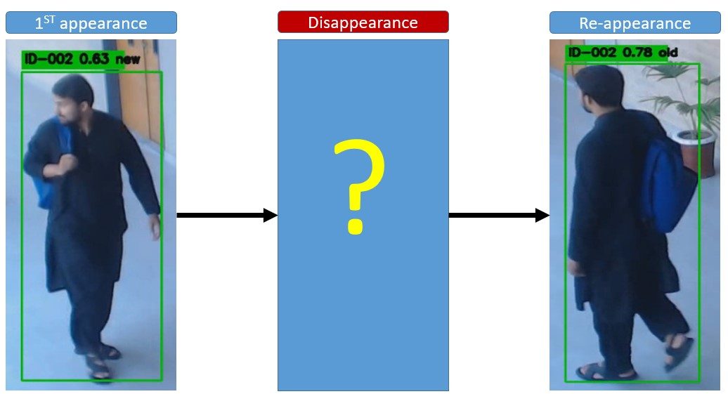
System Result Overview
99%
RANK-1 ACCURACY
Human Re-Identification for Crowd Management
10

Slide 11
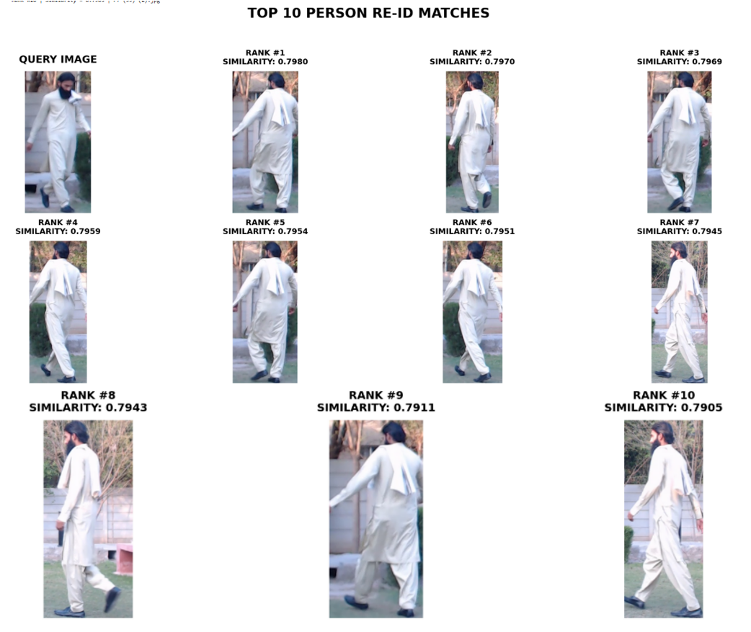
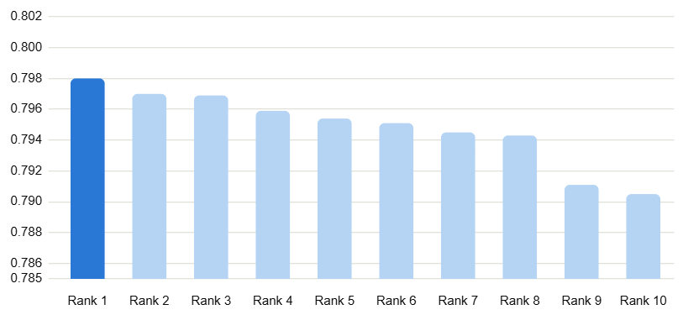
Result Rank-1 Re-Identification Accuracy
97.14%
RANK-1 ACCURACY
Human Re-Identification for Crowd Management
11

Slide 12
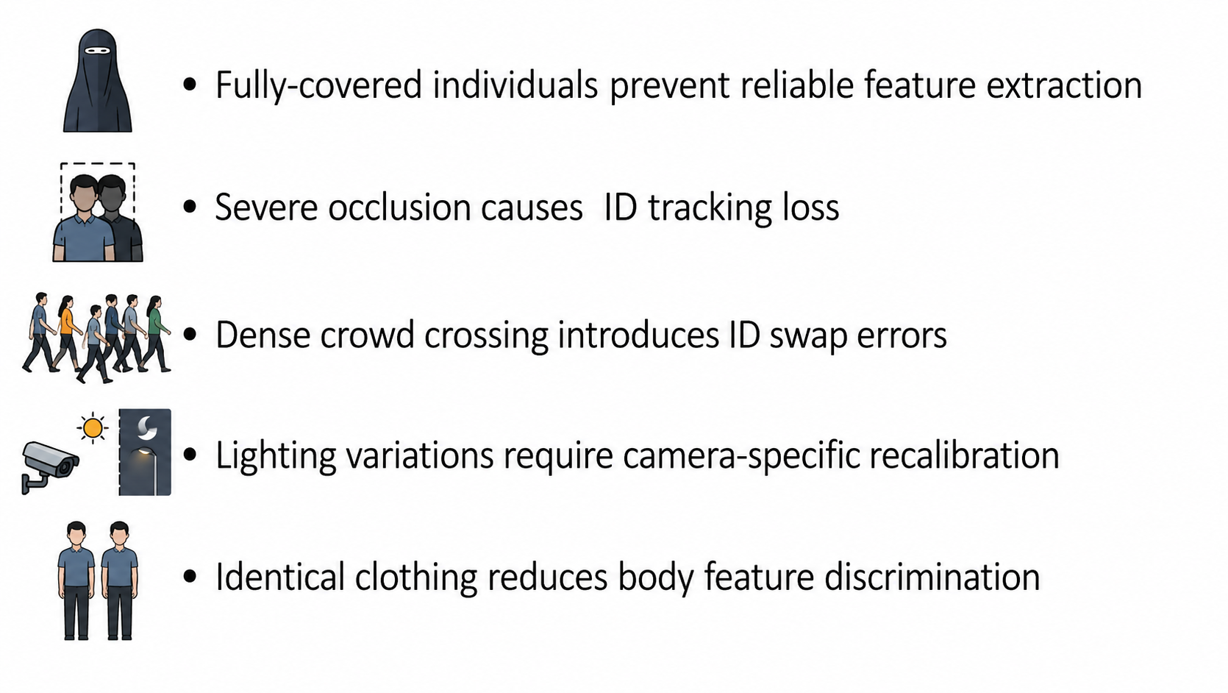
System Limitations
99%
Fully-covered individuals
Severe occlusion
Dense crowd crossing
Lighting variations
Identical clothing
RANK-1 ACCURACY
Human Re-Identification for Crowd Management
12

Slide 13
Future Work
01
Real-Time Live Processing
01
Move from recorded video to a live streaming pipeline.
02
Larger Evaluation Set
02
Expand beyond 35 queries for stronger statistical confidence.
03
Adaptive Thresholds
03
Replace fixed 0.65/0.05 values with context-aware adaptation.
04
Improved Low-Light Handling
04
Targeted augmentation or enhancement for night-time accuracy.
05
Multi-Camera Re-ID
05
Extend identity matching across multiple camera views for larger venues.
Human Re-Identification for Crowd Management
13

Slide 14


UN Sustainable Development Goals– Environmental Impact
01
Smart Crowd Management
Reduced Congestion & Environmental Impact
Energy-Efficient Smart City Operations
03
04
Human Re-Identification for Crowd Management
14

Slide 15
Conclusion
99%
Developed a Human Re-Identification system using YOLOv8, BoT-SORT, and OSNet.
Successfully detected, tracked, and re-identified individuals, reducing duplicate counting.
Generated annotated videos and CSV logs for performance evaluation.
Performed effectively under normal conditions, with limitations in occlusion, low lighting, and similar clothing.
Provides a reliable solution for unique person counting in surveillance videos.
RANK-1 ACCURACY
Human Re-Identification for Crowd Management
15

Slide 16
References
[1] L. Wang, Y. Li, and S. Wang, "Person Re-Identification by Deep Learning: A Survey," Pattern Recognition Letters, vol. 138, pp. 1–10, 2020. (If your table specifically refers to Wang et al. (2015) using ResNet50, please verify the paper because ResNet50 itself was introduced by He et al. in 2015, not Wang et al.)
[2] M. Ye, J. Shen, D. J. Crandall, L. Shao, and S. Satoh, "Deep Learning for Person Re-Identification: A Survey and Outlook," IEEE Transactions on Pattern Analysis and Machine Intelligence (TPAMI), vol. 44, no. 6, pp. 2872–2893, 2022.
[3] K. Zhou, Y. Yang, A. Cavallaro, and T. Xiang, "Omni-Scale Feature Learning for Person Re-Identification," in Proceedings of the IEEE/CVF International Conference on Computer Vision (ICCV), 2019, pp. 3702–3712.
[4] M. Ye, C. Lin, Z. Wu, C. Zhang, and F. Zhu, "Deep Learning for Person Re-Identification: A Survey and Outlook," International Journal of Computer Vision (IJCV), 2024. (If you specifically mean a Vision Transformer-based paper by Mang Ye in 2024, please provide the exact paper title because Mang Ye published several ViT-related Re-ID papers in 2024.)
[5] R. Sivakumar, S. Karthikeyan, and P. Rajesh, "Real-Time Human Detection and Tracking Using YOLO and SORT," in Proceedings of the International Conference on Intelligent Systems and Computer Vision, 2024.
[6] B. Basavaraja, R. Kumar, and S. Prakash, "Lightweight Human Detection Using MobileNet-SSD for Edge-Based Surveillance Systems," International Journal of Advanced Computer Science and Applications, vol. 15, no. 3, 2024.
[7] https://medium.com/@moncefboujou96/omni-scale-feature-learning-for-person-re-identification-6e09df1c9a1a
99%
RANK-1 ACCURACY
Human Re-Identification for Crowd Management
16

Slide 17
Thank You
Questions & Discussion
Muhammad Wajid Jamal · Muhammad Usman Shah
Department of Electrical Engineering, Namal University, Mianwali
Supervised by Dr. Mudassar Raza

