Slide 1
GNNExplainer: Generating Explanations for Graph Neural Networks
Authors: Rex Ying, Dylan Bourgeois, et al.
Presenter: Muhammad Usman
Seminar
Date: 03-02-2025

Slide 2
Contents
Introduction
Method
Results
Conclusion
Limitations
Overview of Jupyter Notebook
References

Slide 3
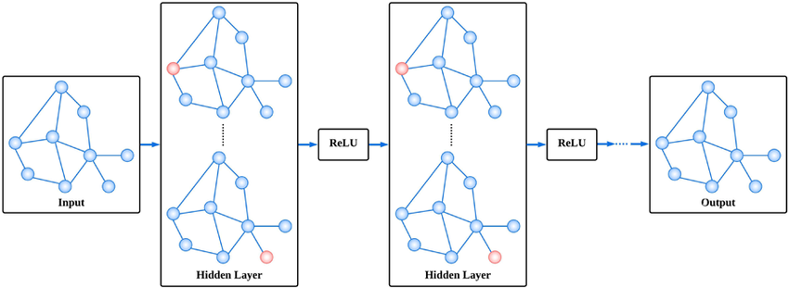
Introduction
Graph Neural Networks (GNNs)
Advanced machine learning models for graph-structured data.
Combine node features and graph topology to make predictions.
Figure 1: A simple GCN model

Slide 4




Introduction
Key Operations in GNNs
At each layer , GNNs perform three computations:
Message Passing:
For a node pair :
Where are the representations from the previous layer
captures the relationship
Aggregation:
Combines messages from a node's neighborhood:

Slide 5



Introduction
Key Operations in GNNs
Update:
Updates the node's representation:
Final Embedding
After layers, each node's embedding is:

Slide 6



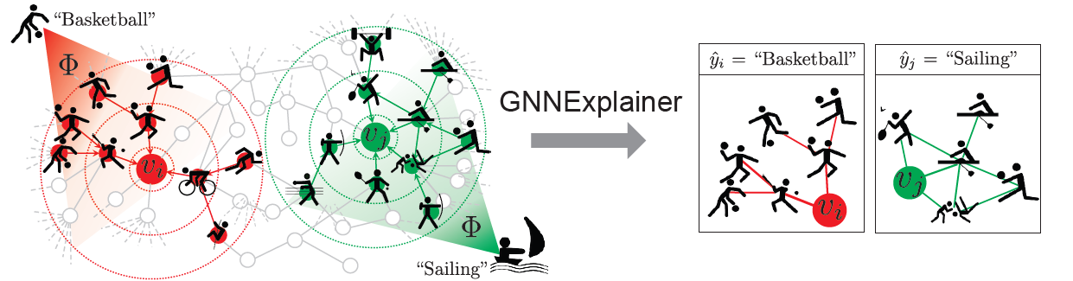
Introduction
Motivation
Subgraph ( ) critical to node level prediction ( )
Important features ( ) within the subgraph
Trained GNN and its predictions
Explaining GNN’s predictions
Figure 2: GNNExplainer highlights subgraphs and features influencing predictions, e.g., "Basketball" or "Sailing."

Slide 7
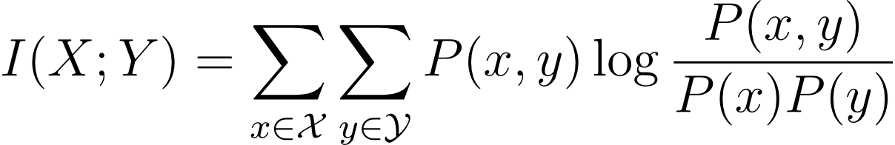




Method
Mathematical Foundations of Mutual Information
Mutual Information (MI) is a measure of the amount of information that one random variable contains about another.
Between two random variables:
: Joint probability , : marginal probabilities
In terms of entropy:
: individual entropies, : Joint entropy

Slide 8

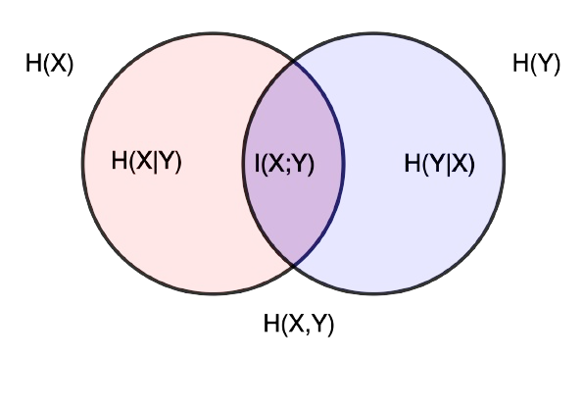
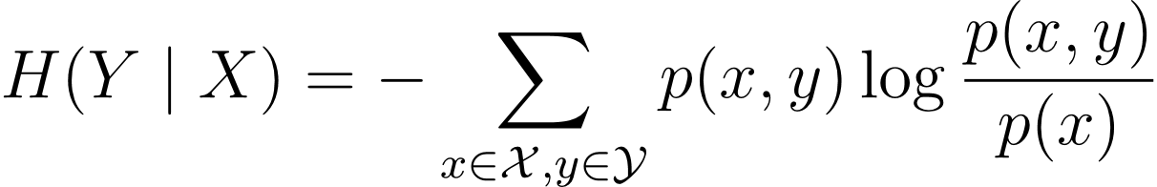
Method
Insights into Joint and Conditional Entropies
Joint Entropy can be expressed as:
: conditional entropies
Conditional entropy measures the uncertainty
in Y given X:
From Venn diagram, we can say:
Figure 3: Venn Diagram of Entropies and Mutual Information

Slide 9


Method
Identifying Important Subgraphs and Features
Objective Function:
Maximizes mutual information between the prediction ( ) and the explanation ( )
Mutual Information (MI):
Measures how the identified subgraph ( ) and features ( ) influence
the prediction ( ).
Conditional entropy of given and represents the uncertainty in after knowing and :

Slide 10




Method
Conditional Entropy and Compact Explanations
The mutual information objective simplifies to minimizing the conditional entropy
as H(Y) is constant for model .
: predicted probability of Y according to the GNN model when only
using and .
: Taking the logarithm penalizes lower probabilities, emphasizing
situations where the model is less confident in its predictions
: expectation (average) over the conditional distribution of Y,
given and .

Slide 11


Method
Conditional Entropy and Compact Explanations
Compact Explanations:
A constraint is imposed on subgraph to ensure the explanation is concise:
= max number of nodes or edges
Denoising computational graph using nodes that gives maximum mutual information

Slide 12
Method
Optimization Framework for GNNExplainer
Optimization Challenges:
Direct optimization is computationally intractable due to the exponential number of subgraphs .
Adjacency Matrix of Graph (Ac):
1
2
 | 1 | 2 | 3 | 4
1 | 1 | 1 | 1 | 0
2 | 1 | 1 | 0 | 1
3 | 1 | 0 | 1 | 1
4 | 0 | 1 | 1 | 1
3
4
Figure 4: Undirected graph (4 nodes)
Table 1: Adjacency Matrix of graph

Slide 13
Method
Optimization Framework for GNNExplainer
Fractional Adjacency matrix (As) that represents a soft selection of edges for the subgraph
Example layout:
 | 1 | 2 | 3 | 4
1 | 0.78 | 0.2 | 0.3 | 0
2 | 0.6 | 0.9 | 0 | 0.52
3 | 0.67 | 0 | 0.4 | 0.16
4 | 0 | 0.76 | 0.56 | 0.87
Table 2: Fractional Adjacency matrix

Slide 14


Method
Optimization Framework for GNNExplainer
Optimization Challenges:
Direct optimization is computationally intractable due to the exponential number of subgraphs .
Relaxation via Fractional Adjacency Matrix:
A fractional adjacency matrix represents the subgraph
Subgraph constraints:

Slide 15
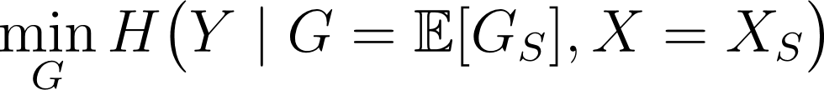
Method
Optimization Framework for GNNExplainer
Objective Function with relaxation:
Minimize the expected entropy over the subgraph distribution:
Assuming convexity, Jensen’s Inequality applies:
The surrogate avoids sampling the subgraph distribution, making computation more efficient

Slide 16
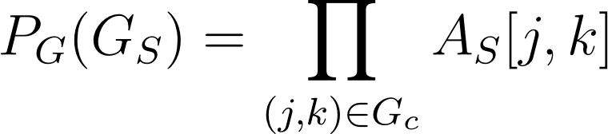


Method
Optimization Framework for GNNExplainer
Optimization Challenge:
Neural networks are non-convex, making direct optimization infeasible
Solution:
Use mean-field variational approximation to decompose G into a multivariate Bernoulli distribution:
represents soft probabilities for edges .
The method models whether an edge is included or excluded probabilistically.

Slide 17
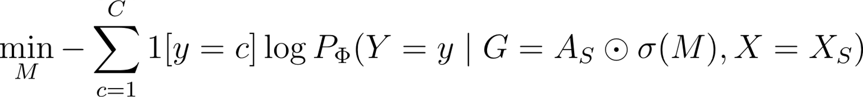



Method
Optimization Framework for GNNExplainer
Efficient Objective Function:
: The mask to be learned, representing edge importance
: Element-wise multiplication
: Sigmoid function that maps M values to probabilities between [0,1]
: The GNN's prediction probability for the true label y

Slide 18

Method
Joint Learning of Graph Structure and Node Features
Feature Selection:
A binary mask is learned to identify and retain key features while excluding non-essential ones.
This process ensures the inclusion of only the most relevant features, providing additional explanatory power on top of the graph structure .
Optimization:
The method combines graph structure ( ) and node features ( ) to maximize mutual information between the predictions and the data:

Slide 19
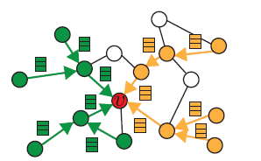
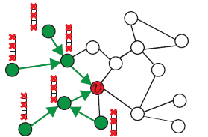

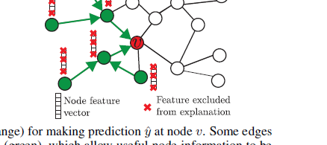
Method
Joint Learning of Graph Structure and Node Features
Figure 5a:Highlights key (green) and minor (orange) edges in GNN graphs
Figure 5b: Node feature mask identifies key dimensions

Slide 20
Method
GNNExplainer Model Extensions
Versatility:
Explains node classification by identifying key features and subgraphs.
Supports link prediction with feature masks for link endpoints.
Handles graph classification by explaining graph-level decisions.
Scalability:
Works across tasks without changes to the optimization algorithm.

Slide 21
Method
Experiment Setup and Datasets
Synthetic Datasets:
BA-SHAPES: BA graph with "house" motifs.
BA-COMMUNITY: Two BA-SHAPES graphs with community roles.
TREE-CYCLES: Binary tree with cycle motifs.
TREE-GRID: Binary tree with grid motifs.
Real-World Datasets:
MUTAG: Molecule graphs for mutagenicity prediction.
REDDIT-BINARY: Thread graphs for Question-Answer vs. Online-Discussion

Slide 22
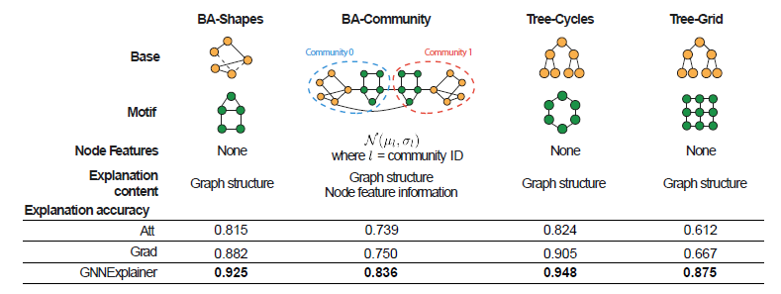
Results
Performance Evaluation of GNNExplainer on Synthetic Datasets
Figure 6: Synthetic datasets and GNNExplainer vs. baselines (GRAD, ATT)

Slide 23
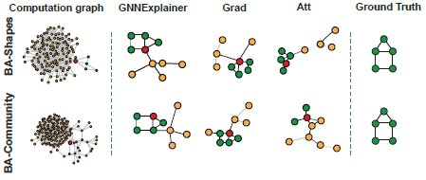
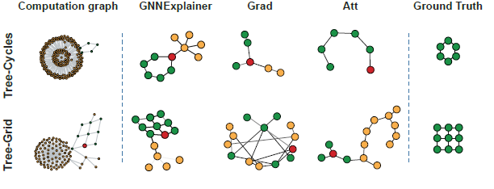
Results
Method Comparisons for Red Node Predictions
Figure 7a: Method comparisons for red node predictions
Figure 7b: Method comparisons for red node predictions

Slide 24
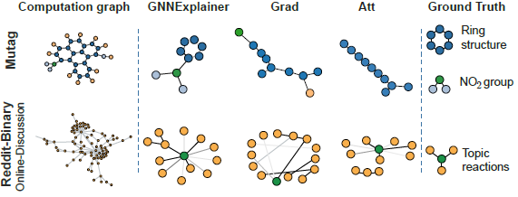
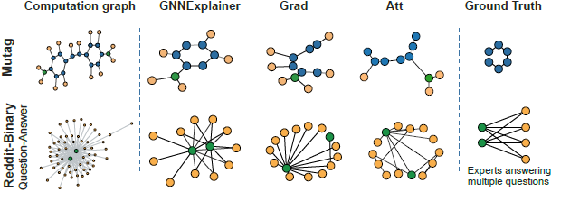
Results
Explanation Subgraphs for MUTAG and REDDIT-BINARY
Figure 8a: Explanation subgraphs for MUTAG and REDDIT-BINARY
Figure 8b: Explanation subgraphs for MUTAG and REDDIT-BINARY

Slide 25
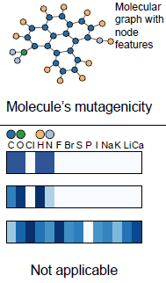
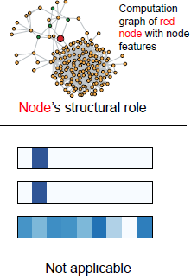
Results
Feature Importance Comparison
Graph Classification
Node Classification
Input to GNN
Input to GNN
GNN's
Prediction
GNN's
Prediction
Ground Truth Feature Importance
Ground Truth Feature Importance
GNNExplainer
GNNExplainer
Grad
Grad
Att
Att
Figure 9b: BA-COMMUNITY graph highlighting features for role prediction.
Figure 9a: MUTAG graph with key features (C, O, H, N).

Slide 26
Conclusion
GNNExplainer explains GNN predictions without modifying models or re-training.
Identifies key graph pathways and relevant node features.
Simplifies debugging and understanding of relational structures.

Slide 27
Limitations
Scalability:
High computational cost for large graphs due to iterative optimization.
Complexity:
Relies on non-convex optimization, which may lead to suboptimal solutions.
Task Dependency:
Performance depends on dataset structure and quality of node features.

Slide 28
Overview of Jupyter Notebook
Graph Neural Network Explanation Workflow
Generate Explanations (GCN)
Visualize Results (GCN)
Train GCN
Load Data
Preprocess Data
Generate Explanations (GAT)
Visualize Results (GAT)
Train GAT
Figure 10: Workflow of implementation

Slide 29
Overview of Jupyter Notebook
Loading Dataset
QM9 Dataset: Molecules as graphs with nodes, edges, and features tied to quantum chemistry properties.
Nodes: 5 atoms (1 carbon, 4 hydrogens).
Edges: 8 bonds (4 bidirectional C-H bonds).
Node Features (x): Atomic properties, Edge Features (edge_attr): Bond properties.
Target Properties (y): Quantum values, 3D Coordinates (pos): Atom positions.
Atomic Numbers (z): Atom types.

Slide 30
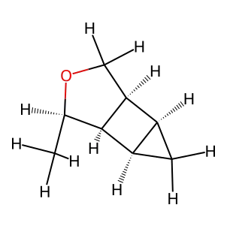
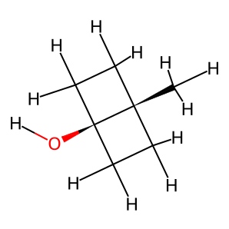
Overview of Jupyter Notebook
Preprocessing
Ring Classification: Classifies rings as homocyclic (0) or heterocyclic (1) from SMILES.
Dataset & Metrics: Adds ring type to the dataset.
Figure 11a: Molecule labelled as 1
Figure 11b: Molecule labelled as 0

Slide 31
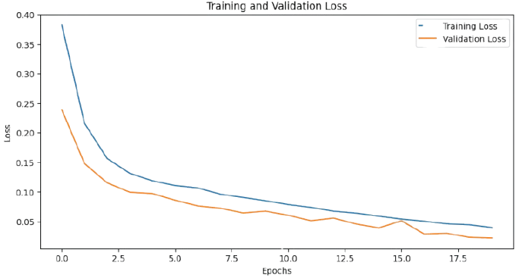
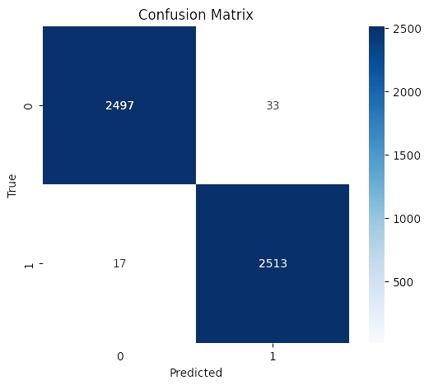
Overview of Jupyter Notebook
Training Progress and Confusion Matrix (GCN)
Figure 12a: Training and Validation Loss vs. Epochs
Figure 12b: Confusion Matrix of Model Predictions

Slide 32
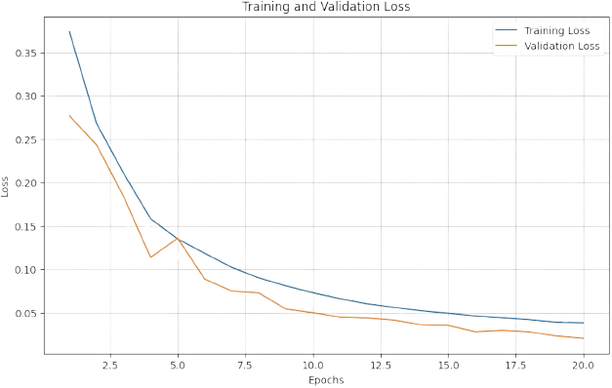
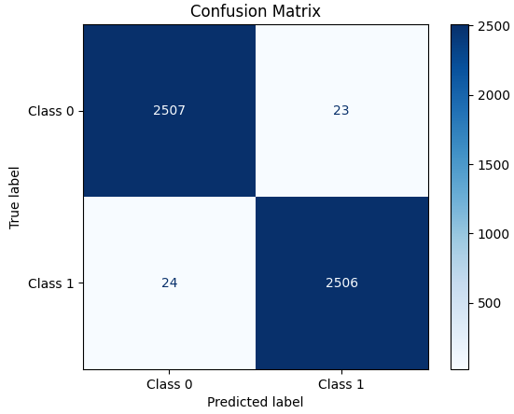
Overview of Jupyter Notebook
Training Progress and Confusion Matrix (GAT)​
Figure 13a: Training and Validation Loss vs. Epochs
Figure 13b: Confusion Matrix of Model Predictions

Slide 33
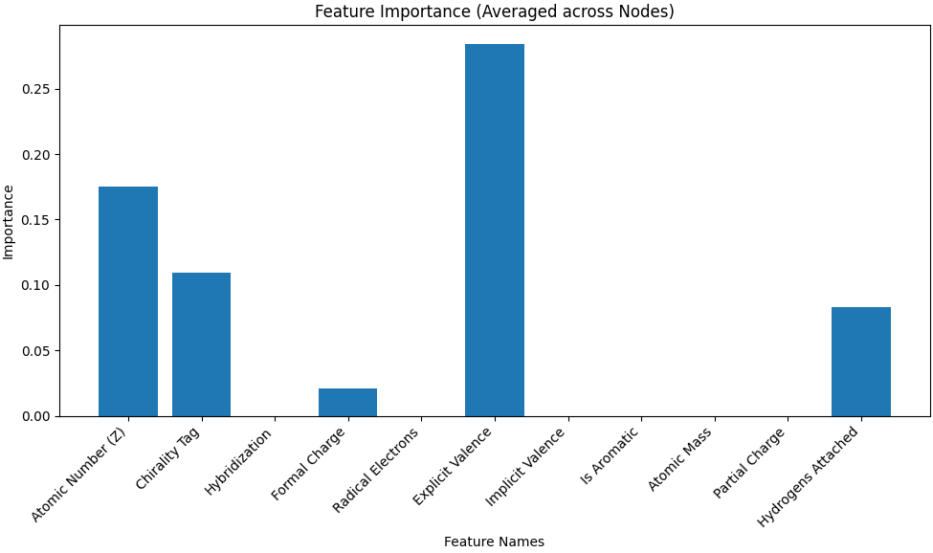
Overview of Jupyter Notebook
GNNExplainer: Generate Explanations (GCN)
Figure 14: Important node features

Slide 34
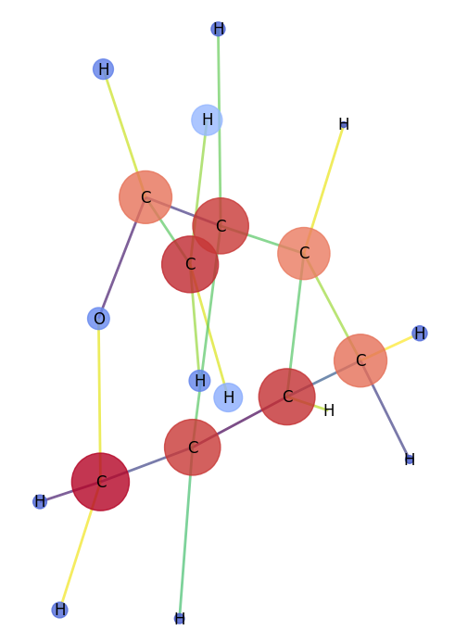
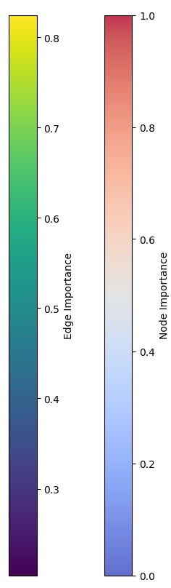
Overview of Jupyter Notebook
GNNExplainer: Visualize Results (GCN)
Figure 15a: Heterocyclic molecule
Figure 15b: Explanantion by GNNExplainer

Slide 35
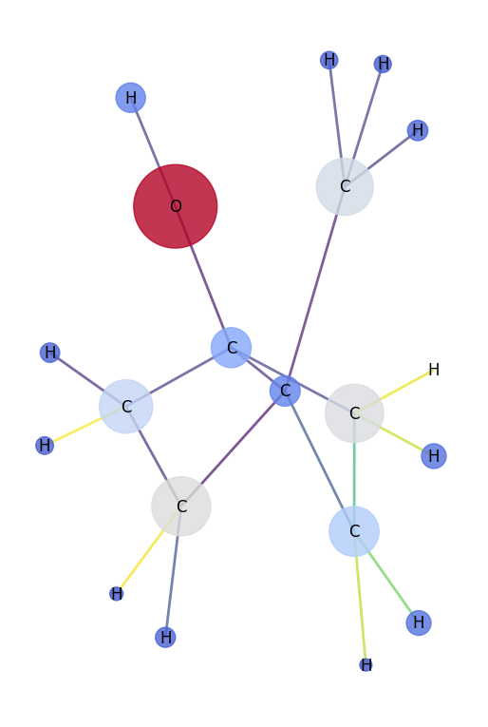
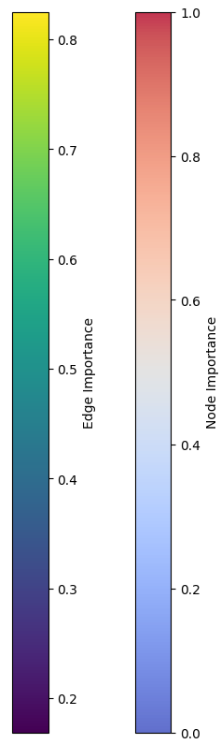
Overview of Jupyter Notebook
GNNExplainer: Visualize Results (GCN)
Figure 16a: Homocyclic molecule
Figure 16b: Explanation by GNNExplainer

Slide 36
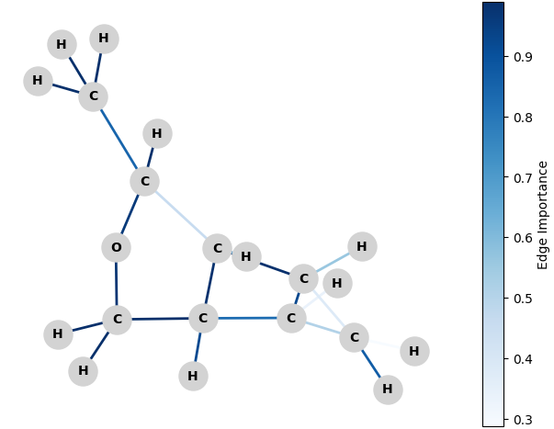
Overview of Jupyter Notebook
Attention Explainer: Visualize Results (GAT)
Figure 17a: Heterocyclic molecule
Figure 17b: Explanation by Attention Explainer

Slide 37
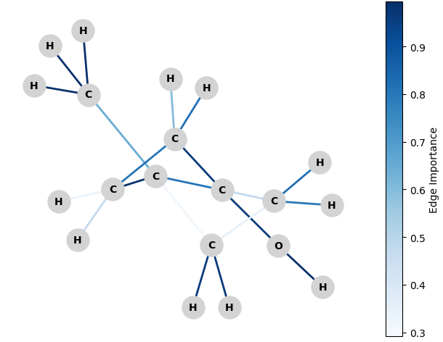
Overview of Jupyter Notebook
Attention Explainer: Visualize Results (GAT)
Figure 18a: Homocyclic molecule
Figure 18b: Explanation by Attention Explainer

Slide 38
References
Ying, R., Bourgeois, D., You, J., Zitnik, M., & Leskovec, J. (2019). GNNExplainer: Generating explanations for graph neural networks. Advances in Neural Information Processing Systems (NeurIPS), 32. Retrieved from https://arxiv.org/abs/1903.03894
Ramakrishnan, R., Dral, P. O., Rupp, M., & von Lilienfeld, O. A. (2014). Quantum chemistry structures and properties of 134 kilo molecules. Scientific Data, 1(1), 140022. https://doi.org/10.1038/sdata.2014.22
Landrum, G. A. (2006). RDKit: Open-source cheminformatics. Retrieved from http://www.rdkit.org
Longa, A., Azzolin, S., Santin, G., Cencetti, G., Liò, P., Lepri, B., & Passerini, A. (2024). Explaining the explainers in graph neural networks: A comparative study. ACM Computing Surveys, 57(5), Article 97. https://doi.org/10.1145/3696444
Sharma, A., Sharma, A., Tselykh, A., & Bozhenyuk, A. (2024). Image and video analysis using graph neural network for Internet of Medical Things and computer vision applications. CAAI Transactions on Intelligence Technology. https://doi.org/10.1049/cit2.12306
Yeung, R. W. A First Course in Information Theory. Norwell, MA/New York: Kluwer/Plenum, 2002.

