Slide 1
Protein Structure Prediction Using a
Maximum Likelihood Formulation of a
Recurrent Geometric Network
Authors: Guowei Qi, Mallory R. Tollefson, Rose A. Gogal, et al.
Presenter: Muhammad Usman
Seminar

Slide 2
Contents
Introduction
Dataset
Methods
Results
Discussion
Future Work
References

Slide 3
Introduction
Challenges in Protein Structure Prediction
Structural Coverage Gaps
60% of the human proteome is unresolved.
Importance of Protein Folding
Proper 3D structure is vital for protein function and drug interaction.
Limitations of Traditional Methods
High computational costs.
Cannot simulate folding at biological timescales.

Slide 4
Introduction
Advances in Deep Learning for Protein Structure Prediction
Revolutionizing Protein Folding: DL predicts structures faster using 3D data and MSAs, even without experimental data.
Major Breakthroughs:
AlphaFold2: 92.4 GDT at CASP14; 98.5% of the human proteome predicted.
RGN2: Single-sequence predictions; 10⁶x faster and excels with orphan proteins.

Slide 5
Introduction
Maximum Likelihood in Structural Prediction
Significance in Structural Biology:
Used in X-ray crystallography, molecular replacement, and NMR refinement.
Outperforms least-squares by addressing coordinate uncertainties.
Application in Likelihood-RGN:
Reformulated loss as maximum likelihood.
Integrated B-factors (X-ray) and NMR parameters.
Focused on high-certainty regions, reducing disordered noise.

Slide 6
Dataset
ProteinNet
Standardized Dataset:
Contains protein sequences, structures, and evolutionary data for ML methods.
Includes six datasets aligned with CASP7–12 competitions.
Training
Validation
Test
PDB structures pre-CASP; filtered for quality and redundancy
Clusters matching testing difficulty; sequence identity-based
Target sequences and structures from CASP7–12

Slide 7
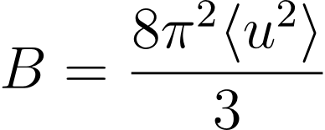

Dataset
Atomic Displacement Parameters and Dataset Augmentation
X-ray B-Factors:
Indicate atomic vibration and uncertainty in coordinates
Smaller B-factor: rigid regions
Larger B-factor: flexible regions
where is the mean squared displacement of the atom
Equation 1

Slide 8
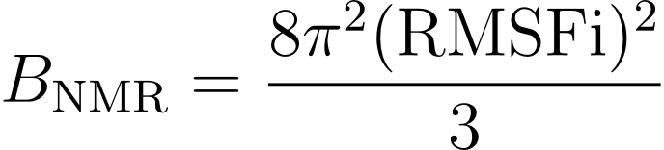
Dataset
Atomic Displacement Parameters and Dataset Augmentation
NMR Displacement Parameters:
Derived using RMSF from multi-model ensembles.
Flexible regions show higher RMSF values.
Converted to B-factor equivalents:
Equation 2

Slide 9
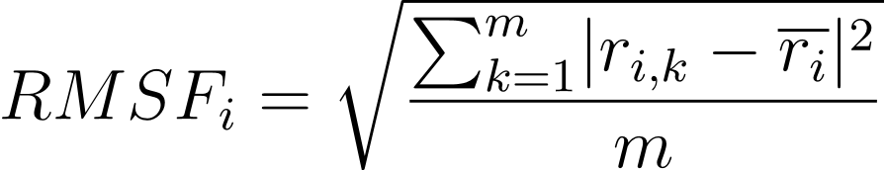

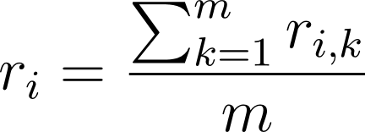
Dataset
Deriving Experimental Uncertainties for NMR Structures
RMSF Calculation:
Root Mean Square Fluctuation (RMSF) quantifies per-atom positional variability in multi-model NMR ensembles
: Position of atom i in the k-th model.
: Average position of atom i across m-models.
Lower RMSF: Found in defined secondary structures (e.g., helices, sheets).
Higher RMSF: Found in flexible, disordered regions (e.g., loops).
Equation 3

Slide 10
Dataset
ProteinNetX: Augmented Dataset
Used BioJava to extract structural data from RCSB PDB.
Added B-factors (X-ray) and NMR displacement parameters (multi-model NMR).
Created ProteinNetX by combining augmented data with CASP12 ProteinNet.

Slide 11
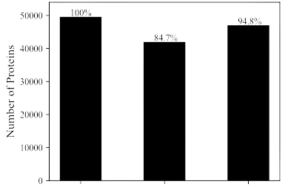
Dataset
ProteinNetX: Augmented Dataset
Composition:
Covers 94.8% of CASP12 ProteinNet
structures including:
X-ray crystallography (experimental B-factors)
Multi-model NMR (atomic displacement parameters)
Filtering:
Filtered at 90% sequence identity to ensure
non-redundancy.
ProteinNet
ProteinNetX (X-ray only)
ProteinNetX
(X-ray + NMR)
Figure 4a: Dataset: ProteinNet, ProteinNetX (X-ray), ProteinNetX (X-ray + NMR).

Slide 12
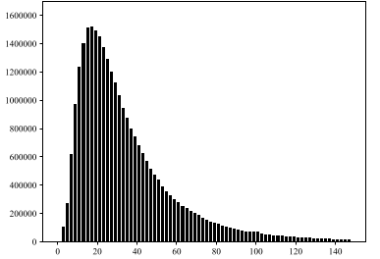
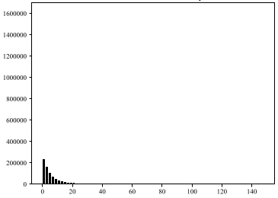
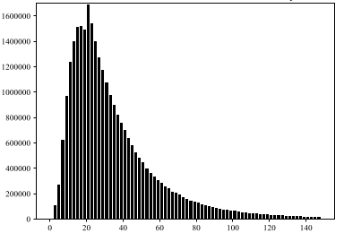
Dataset
ProteinNetX: Augmented Dataset
B-Factor (Å²)
B-Factor (Å²)
B-Factor (Å²)
Figure 4b: Distribution of crystallographic B-factors
Figure 4c: Distribution of NMR B-factors equivalents
Figure 4d: Distribution of all atomic displacement parameters (X-rays + NMR)

Slide 13
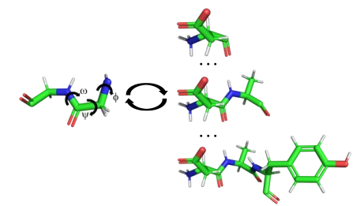
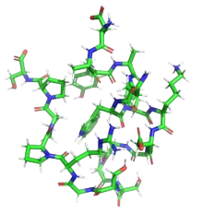
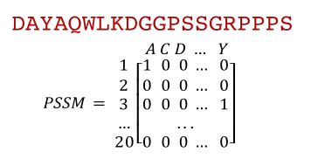
Methods
Stages of Protein Structure Prediction in RGN
Figure 1: Protein sequence converted into a Position Specific Scoring Matrix (PSSM)
Figure 2: Predicts torsion angles (ϕ, ψ, ω) to construct the backbone step-by-step
Figure 3: Generates the final 3D backbone structure and compares predicted vs. experimental structure

Slide 14
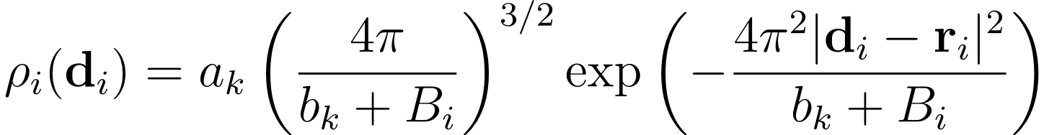




Methods
Maximum Likelihood Loss in Likelihood-RGN
Electron Density of an Atom
: Atomic center coordinates
: Isotropic crystallographic B-factor
, : Gaussian form factor parameters
Equation 4

Slide 15
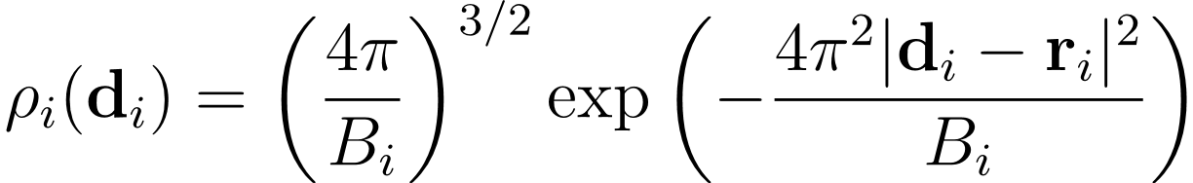
Methods
Maximum Likelihood Loss in Likelihood-RGN
Taking the limit as the Gaussian width approaches zero (i.e., all electron density is concentrated at the atomic center).
Setting amplitude =1, the electron density simplifies to a probability density
Equation 5

Slide 16

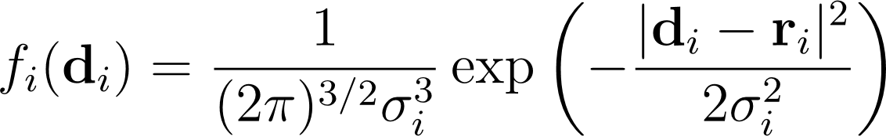
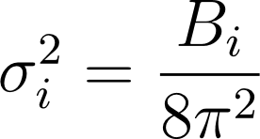
Methods
Maximum Likelihood Loss in Likelihood-RGN
3D Normal Distribution:
Modeled with equivalent standard deviations
Variance Relationship:
Comparing equation 5 and 6, the variance is:
Equation 6
Equation 7

Slide 17
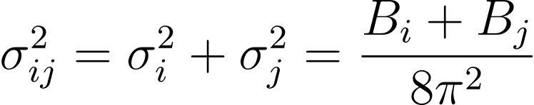
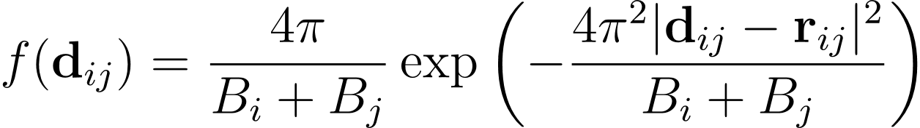
Methods
Maximum Likelihood Loss in Likelihood-RGN
To mirror the dRMSD target, consider an atom j with measured position and variance:
giving the probability density function:
Equation 8
Equation 9

Slide 18
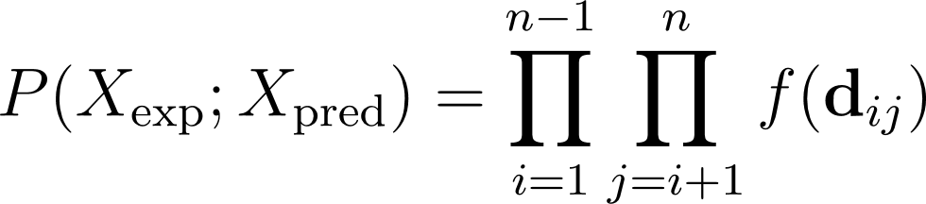

Methods
Maximum Likelihood Loss in Likelihood-RGN
Overall Likelihood:
Product of interatomic distance likelihoods for backbone coordinates:
where = Predicted atomic separation between Cα atoms of residues i and j,
and n= total residues
Equation 10

Slide 19
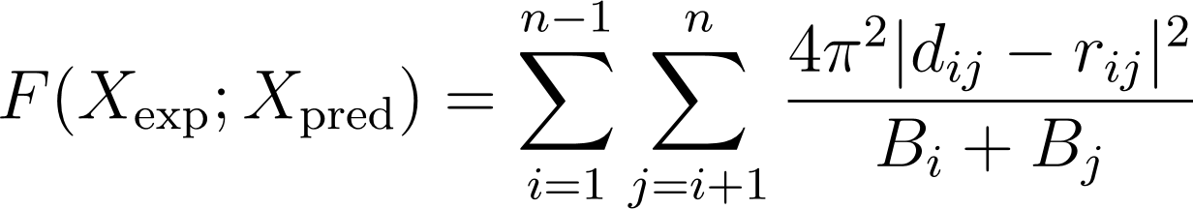
Methods
Maximum Likelihood Loss in Likelihood-RGN
Maximum Likelihood Loss:
Negative log-likelihood to minimize during training:
Equation 11

Slide 20
Methods
Evaluation Metrics:
Likelihood-RGN outperformed RGN in:
RMSD: Root Mean Square Deviation of backbone atoms.
GDT/GDT-HA: Global Distance Test.
TM-Score: Template Modeling Score.
Torsion Angles: Favored backbone torsions

Slide 21
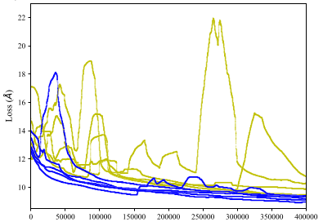
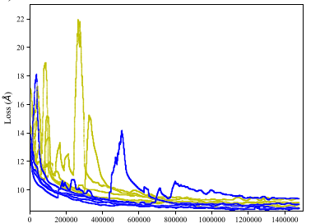
Methods
Model Training with ProteinNetX
Design: 5 model pairs; compared Least-Squares vs. Maximum Likelihood Loss.
Training: 1.5M iterations + 10K fine-tuning.
Iteration
Iteration
Figure 5a: 400K (X-ray) - Smoother with Maximum Likelihood (Blue)
Figure 5b: 1.5M (X-ray) - Lower loss, Maximum Likelihood (Blue)

Slide 22
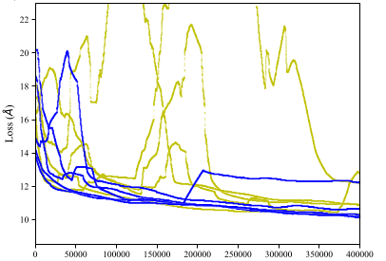
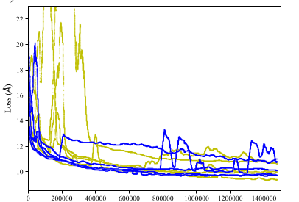
Methods
Model Training with ProteinNetX
Iteration
Iteration
Figure 5c: 400K (X-ray + NMR) - Stable with Maximum Likelihood (Blue)
Figure 5d: 1.5M (X-ray + NMR): Better convergence (Blue)

Slide 23
Results
Likelihood-RGN: Improved Protein Structure Prediction
Evaluation: Predicted 63 CASP12 structures.
Performance: Likelihood-RGN outperformed RGN.
Structure: Better helices, sheets, and downstream suitability.
Observation: NMR improved local but reduced global metrics; full ensembles may help.
Training Model | Model | dRMSD | RMSD | GDT | GDT-HA | TM-Score | Outlier Torsions | Favored Torsions
X-Ray | RGN | 8.87 | 14.14 | 0.19 | 0.09 | 0.32 | 52.7 | 23.9
 | L-RGN | 8.61 | 13.66 | 0.21 | 0.10 | 0.33 | 42.6 | 40.8
X-Ray + NMR | RGN | 9.24 | 16.53 | 0.14 | 0.06 | 0.24 | 23.3 | 48.1
 | L-RGN | 8.81 | 14.68 | 0.18 | 0.09 | 0.30 | 6.6 | 77.8
Table 1: Average scores: RGN vs. Likelihood-RGN on X-ray and full ProteinNetX

Slide 24
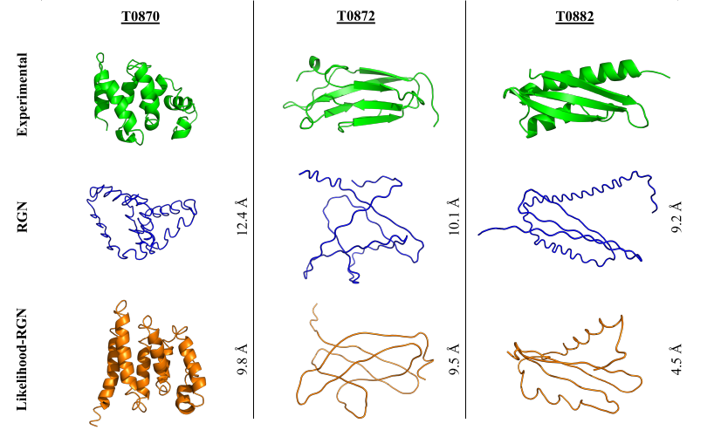
Results
CASP12 Target Structures: Likelihood-RGN vs. RGN Performance
Figure 6: CASP12 targets: Experimental (green), RGN (blue), and Likelihood-RGN (orange) structures with RMSD comparison

Slide 25
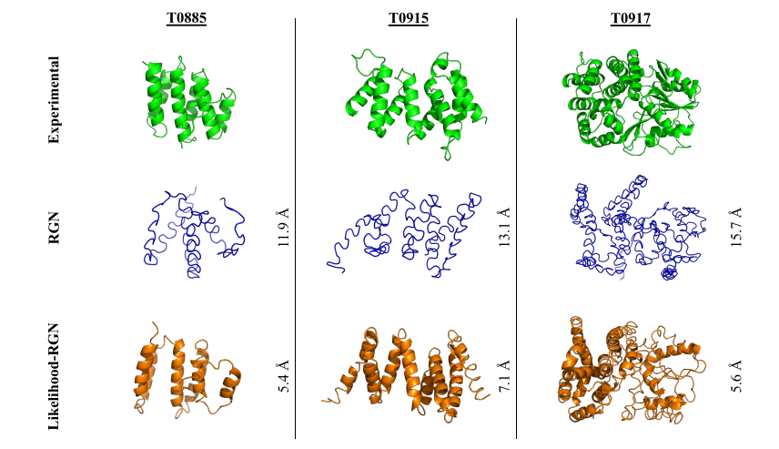
Results
CASP12 Target Structures: Likelihood-RGN vs. RGN Performance
Figure 7: CASP12 targets: Experimental (green), RGN (blue), and Likelihood-RGN (orange) structures with RMSD comparison

Slide 26
Results
Physics-Based Optimization of Predicted Backbones
Optimization Process:
Force Fields:
Amber: Initial minimization (fixed-charge).
AMOEBA: Refinement (polarizable).
Protocol:
Amber: RMS gradient 0.1 kcal/mol/A˚.
AMOEBA: Reduces steric clashes, refines torsions.
Purpose:
Relaxes backbones for simulations (e.g., dynamics, side-chain optimization).

Slide 27
Results
Impact: Slight RMSD increase; Likelihood-RGN outperforms RGN
Model | Optimization | RMSD | GDT | GDT-HA | TM-Score | Outlier Torsions | Favored Torsions
RGN | None | 16.53 | 0.14 | 0.06 | 0.24 | 23.3 | 48.1
 | Minimize | 17.45 | 0.12 | 0.06 | 0.22 | 20.5 | 49.3
L-RGN | None | 14.68 | 0.18 | 0.09 | 0.30 | 6.6 | 77.8
 | Minimize | 15.52 | 0.17 | 0.08 | 0.28 | 11.8 | 68.3
Table 2: Performance Metrics: RGN vs. Likelihood-RGN Before and After Optimization ​

Slide 28
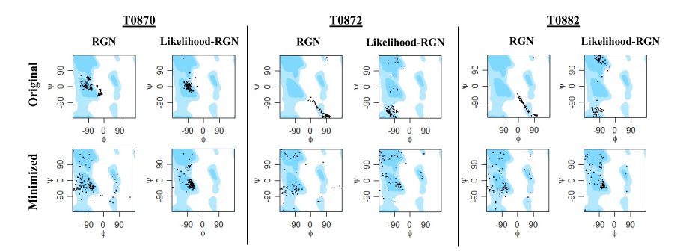
Results
Ramachandran Plots:
Likelihood-RGN: Fewer torsion outliers, realistic dispersion, and improved structural quality for analyses.
Figure 8: Ramachandran plots highlighting torsional improvements

Slide 29
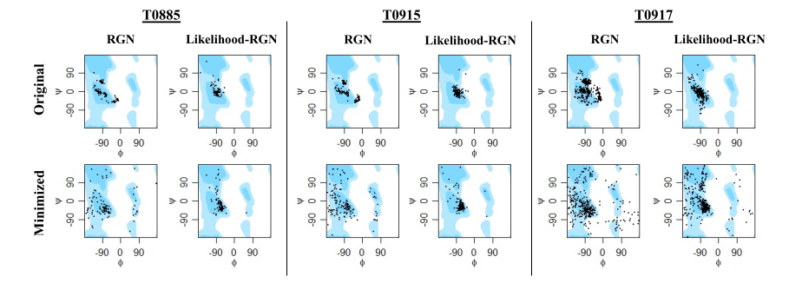
Results
Ramachandran Plots:
Figure 9: Ramachandran plots highlighting torsional improvements

Slide 30
Results
Side-Chain Optimization with Many-Body Algorithm
Optimization Process:
Algorithm: GPU-accelerated many-body optimization builds side-chain atoms.
Force Field: AMOEBA with generalized Kirkwood implicit solvent.
Evaluation metric:
MolProbity scores evaluate steric clashes and side-chain/backbone conformations.

Slide 31
Results
Side-Chain Optimization with Many-Body Algorithm
Model | Optimization | MolProbity Score | Clash Score | Favored Torsions | Rotamer Outliers | Torsion Outliers
RGN | Minimize | 4.1 | 158.1 | 49.3 | 16.7 | 20.5
 | Sidechains | 3.4 | 74.4 | 52.9 | 9.9 | 9.9
L-RGN | Minimize | 3.3 | 84.5 | 68.3 | 10.2 | 11.8
 | Sidechains | 2.9 | 38.1 | 69.9 | 6.6 | 10.6
Table 2: Performance Metrics: RGN vs. Likelihood-RGN Before and After Optimization

Slide 32
Discussion
Contributions:
Developed ProteinNetX with B-factors and NMR parameters.
Reformulated RGN loss to maximum likelihood, integrating experimental uncertainties.
Impact:
Improved Training: Better stability, convergence, and accuracy.
Optimizations: Likelihood-RGN structures retained folds better and enabled efficient simulations.

Slide 33
Future Works
Goals:
Enhance NMR uncertainty in ProteinNetX.
Compute atomic displacement for single-model NMR and cryo-EM.
Train networks to predict B-factors for uncertainty quantification.
Implications:
Extend to advanced DL models (e.g., RGN2, AlphaFold2).
Refine datasets, loss functions, and procedures for protein folding solutions.

Slide 34
References
Qi, G., Tollefson, M. R., Gogal, R. A., Smith, R. J. H., AlQuraishi, M., & Schnieders, M. J. (2021). Protein structure prediction using a maximum likelihood formulation of a recurrent geometric network. bioRxiv. https://doi.org/10.1101/2021.09.03.458873
AlQuraishi, M. (2019). End-to-end differentiable learning of protein structure. Cell Systems, 8(4), 292–301. https://doi.org/10.1016/j.cels.2019.03.006

Slide 35
Thanks

