Slide 1

Set-Theoretic IR Models
Assignment #5 - Presentation
Boolean Extended Information Retrieval (IR) Model
Presented By: 2021-CS-118

Slide 2
Agenda
Introduction
Objective
Steps in development
Data flow diagram
Understanding with example

Slide 3
Introduction
The Boolean Extended Information Retrieval (IR) Model represents an advanced approach to document retrieval that leverages Boolean algebra principles to process and match user queries against document collections.

Slide 4
Objective
The goal is
To choose a Set Theoretic model - Boolean Extended Model
Enable complex query processing through AND, OR, and NOT operations
Implement a scalable search mechanism without relying on external libraries

Slide 5
Steps in development
Step 1: Document Preprocessing
Step 2: Query Processing Architecture
Step 3: Mathematical Representation
Step 4: Boolean Algebraic Operations

Slide 6
Understanding With Example
Step 1: Documents:
Document 1: "algorithm optimization sorting",
Document 2: "algorithm dynamic graph theory",
Document 3: "optimization dynamic programming"
Preprocessing:
['algorithm', 'dynamic', 'graph', 'optimization', 'programming', 'sorting', 'theory']
Step 2: Binary Term-document Matrix
Document | algorithm | dynamic | graph | optimization | programming | sorting | theory
Document 1 | 1 | 0 | 0 | 1 | 0 | 1 | 0
Document 2 | 1 | 1 | 1 | 0 | 0 | 0 | 1
Document 3 | 0 | 1 | 0 | 1 | 1 | 0 | 0

Slide 7
Understanding With Example
Step 1: algorithm
Result vector: [1, 1, 0]
Document 1: Contains algorithm → 1
Document 2: Contains algorithm → 1
Document 3: Does not contain algorithm → 0
Step 2: optimization
Result vector: [1, 0, 1]
Document 1: Contains optimization → 1
Document 2: Does not contain optimization → 0
Document 3: Contains optimization → 1
Step 3: AND (algorithm AND optimization)
[1, 1, 0] AND [1, 0, 1] = [1, 0, 0]
Only Document 1 satisfies both conditions (algorithm AND optimization).

Slide 8
Understanding With Example
Step 4: NOT dynamic
Vector for dynamic: [0, 1, 1]
Document 1: Does not contain dynamic → 0
Document 2: Contains dynamic → 1
Document 3: Contains dynamic → 1
NOT [0, 1, 1] = [1, 0, 0]
Document 1: Does not contain dynamic → 1
Document 2: Contains dynamic → 0
Document 3: Contains dynamic → 0
Step 5: Final AND
Now combine:
Result of algorithm AND optimization: [1, 0, 0]
Result of NOT dynamic: [1, 0, 0]
Final AND ([1, 0, 0] AND [1, 0, 0]):
[1, 0, 0] AND [1, 0, 0] = [1, 0, 0]

Slide 9
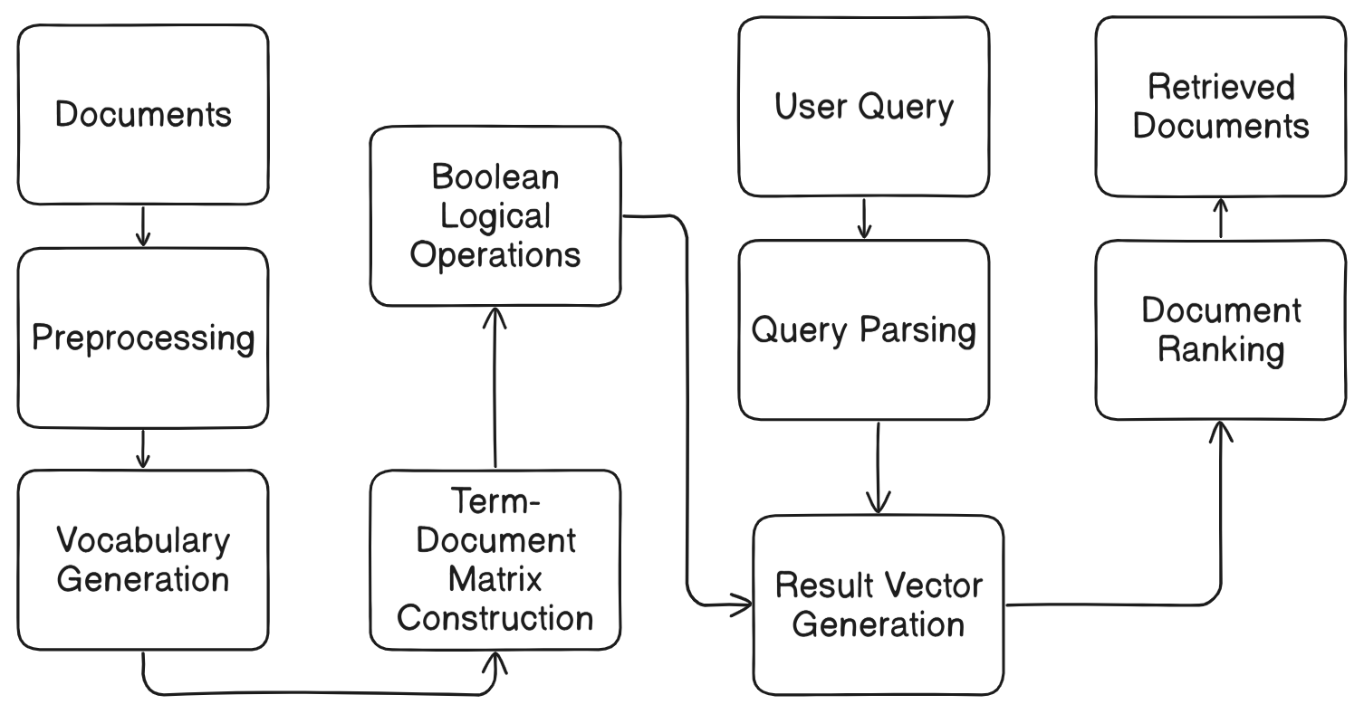
Data Flow Diagram

Slide 10
Thank You!

